Slide 1
MAT 2572 Probability w/Statistics, Halleck
Day 24 slides:
10.3 Goodness-of-Fit Tests: All Parameters Known
10.4 Goodness-of-Fit Tests: Parameters Unknown

Slide 2
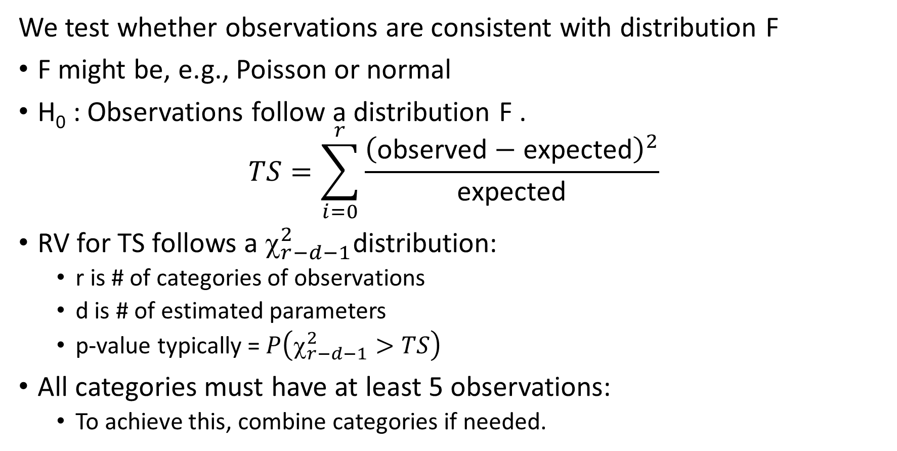
Goodness-of-Fit
We test whether observations are consistent with distribution F
F might be, e.g., Poisson or normal
H₀ : Observations follow a distribution F .
$$TS=\sum_{i=0}^{r}{\frac{{\left(\text{observed}−\text{expected}\right)}^{2}}{\text{expected}}}$$
RV for TS follows a $_{r−d−1}^{2}$distribution:
r is # of categories of observations
d is # of estimated parameters
p-value typically = $P\left(χ_{r−d−1}^{2}>TS\right)$
All categories must have at least 5 observations:
To achieve this, combine categories if needed.

Slide 3
Student laboratory data (observed)
A laboratory assignment with a Geiger counter is to measure the clicks during successive 20 second intervals. The student gets these 25 observations: 0, 3, 1, 0, 1, 1, 1, 3, 4, 3, 2, 0, 2, 0, 0, 0, 4, 2, 3, 4, 1, 6, 1, 4, 1. Can the student say that these observations do not come from a Poisson distribution? (H₀ : Observations consistent w/ Poisson)
The Poisson distribution has one parameter which we can estimate by finding the average: $=\frac{47}{25}=1.88$
Creating a frequency table, we get
Note how had only one observation of 6, so we folded it in to 4
x | 0 | 1 | 2 | 3 | 4 or more
observed | 6 | 7 | 3 | 4 | 5

Slide 4
Student laboratory data (expected, TS, p-value)
To get expected, we used estimated parameter and multiply chance of each outcome by # of observations (25).
For last category, we can use a cumulative function.
$TS=\sum_{i=0}^{r}{\frac{{\left(\text{observed}−\text{expected}\right)}^{2}}{\text{expected}}=}4.62$
$df=r−d−1=5−1−1=3$
P-value = $P\left(χ_{r−d−1}^{2}>TS\right)=P\left(χ_{3}^{2}>4.62\right)=20\%>5\%$
We do not reject H₀: observations seem to be consistent w/ Poisson
Oops! There is problem: expected dip below 5, so combine categories
x | 0 | 1 | 2 | 3 | 4 or more
observed | 6 | 7 | 3 | 4 | 5
expected | 3.81 | 7.17 | 6.74 | 4.22 | 3.05

Slide 5
Student laboratory data (expected, TS, p-value)
Combining categories to bring up expecteds above 5:
$TS=\sum_{i=0}^{r}{\frac{{\left(\text{observed}−\text{expected}\right)}^{2}}{\text{expected}}=}2.86$
$df=r−d−1=3−1−1=1$
P-value = $P\left(χ_{r−d−1}^{2}>TS\right)=P\left(χ_{1}^{2}>2.86\right)=9\%>5\%$
Again, we do not reject H₀; observations are consistent w/ Poisson.
x | 0 or 1 | 2 | 3 or more
observed | 13 | 3 | 9
expected | 10.98 | 6.74 | 7.27

Slide 6
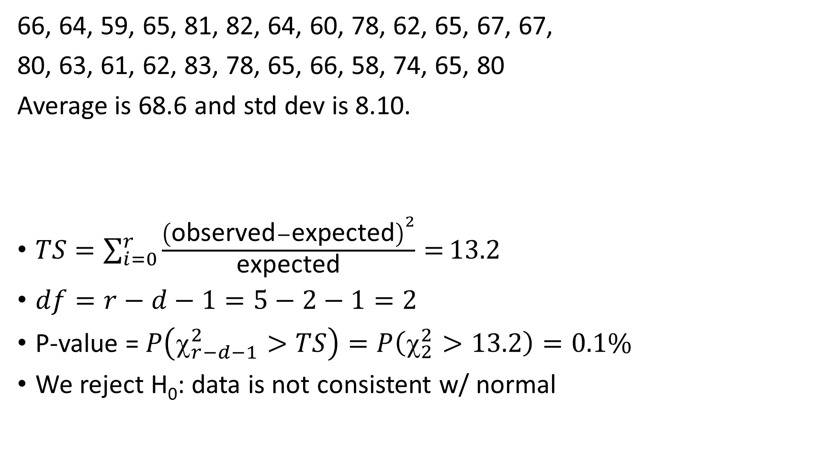
Are the exam scores normal?
66, 64, 59, 65, 81, 82, 64, 60, 78, 62, 65, 67, 67,
80, 63, 61, 62, 83, 78, 65, 66, 58, 74, 65, 80
Average is 68.6 and std dev is 8.10.
$TS=\sum_{i=0}^{r}{\frac{{\left(\text{observed}−\text{expected}\right)}^{2}}{\text{expected}}=}13.2$
$df=r−d−1=5−2−1=2$
P-value = $P\left(χ_{r−d−1}^{2}>TS\right)=P\left(χ_{2}^{2}>13.2\right)=0.1\%$
We reject H₀: data is not consistent w/ normal
x | (0,61.8] | (61.8,66.5] | (66.5,70.7] | (70.7,75.4] | (75.4,100]
observed | 4 | 11 | 2 | 1 | 7
expected | 5 | 5 | 5 | 5 | 5

