Slide 1
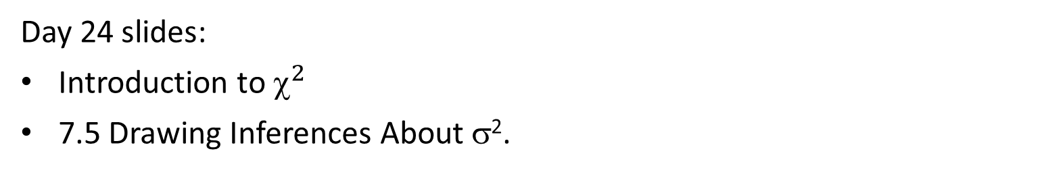
MAT 2572 Probability w/Statistics, Halleck
Day 24 slides:
Introduction to $^{2}$
7.5 Drawing Inferences About σ².

Slide 2
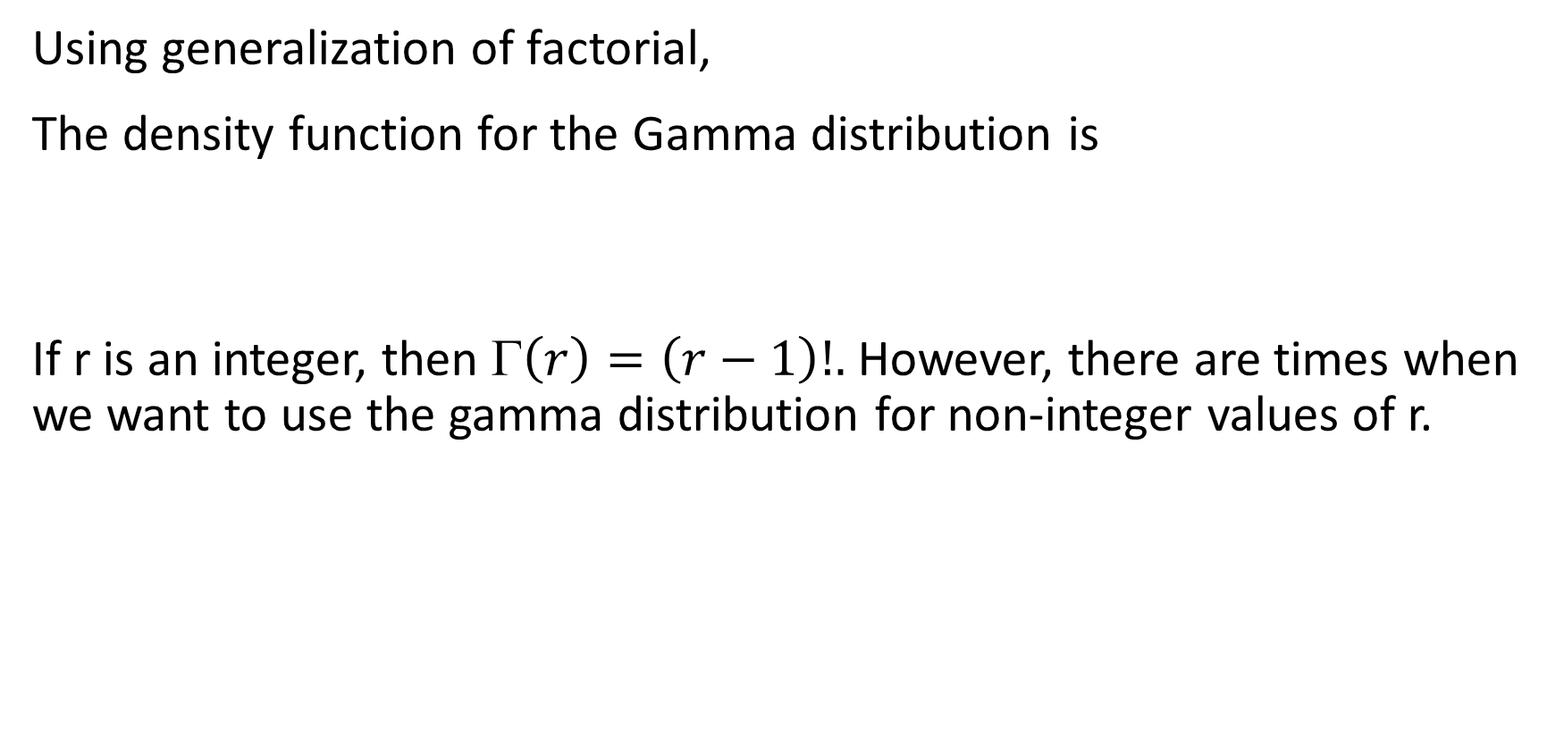
Recall Gamma distribution r > 0 real #’s.
Using generalization of factorial,
The density function for the Gamma distribution is
If r is an integer, then $\left(r\right)=\left(r−1\right)!.$ However, there are times when we want to use the gamma distribution for non-integer values of r.

Slide 3
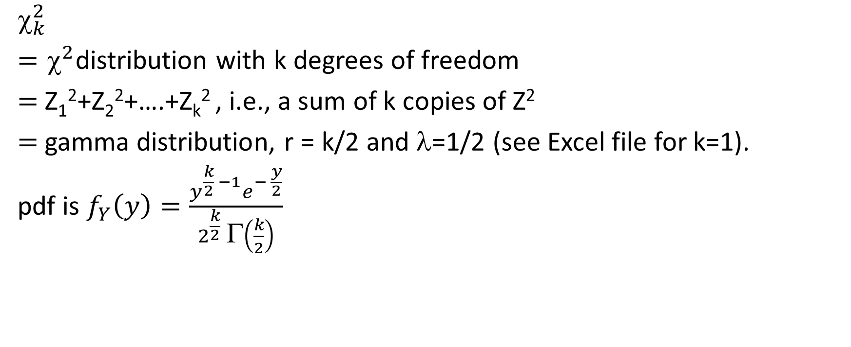
Definition: the chi square distribution
$$_{k}^{2}$$
${=}^{2}$distribution with k degrees of freedom
$=$Z₁²+Z₂²+….+Z_{k}² , i.e., a sum of k copies of Z²
$=$gamma distribution, r = k/2 and λ=1/2 (see Excel file for k=1).
pdf is $f_{Y}\left(y\right)=\frac{y^{\frac{k}{2} −1}e^{− \frac{y}{2}}}{2^{\frac{k}{2}} Γ\left(\frac{k}{2}\right)}$

Slide 4
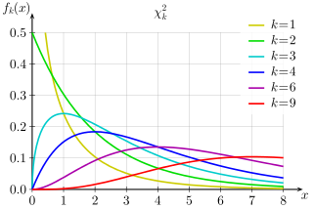

Graphs of pdf’s for $_{k}^{2}$

Slide 5
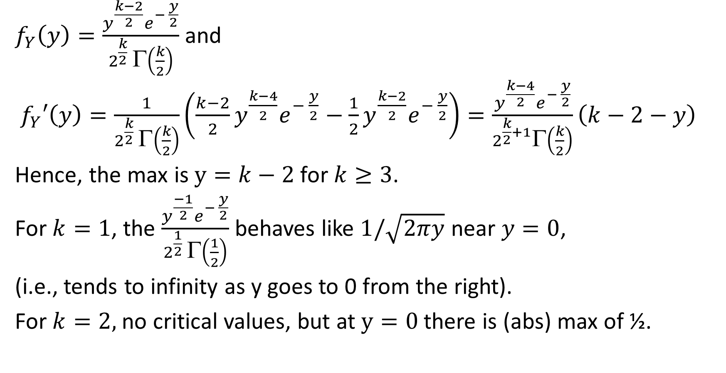

Finding the peak for $_{k}^{2}$
$f_{Y}\left(y\right)=\frac{y^{\frac{k−2}{2}}e^{− \frac{y}{2}}}{2^{\frac{k}{2}} Γ\left(\frac{k}{2}\right)}$ and
$f_{Y}′\left(y\right)=\frac{1}{2^{\frac{k}{2}} Γ\left(\frac{k}{2}\right)}\left(\frac{k−2}{2}y^{\frac{k−4}{2}}e^{− \frac{y}{2}}−\frac{1}{2}y^{\frac{k−2}{2}}e^{− \frac{y}{2}}\right)=\frac{y^{\frac{k−4}{2}}e^{− \frac{y}{2}}}{2^{\frac{k}{2}+1}Γ\left(\frac{k}{2}\right)}\left(k−2−y\right)$
Hence, the max is $y=k−2$ for $k≥3$.
For $k=1$, the $\frac{y^{\frac{−1}{2}}e^{− \frac{y}{2}}}{2^{\frac{1}{2}} Γ\left(\frac{1}{2}\right)}$ behaves like $1/\sqrt{2πy}$ near $y=0$,
(i.e., tends to infinity as y goes to 0 from the right).
For $k=2,$no critical values, but at $y=0$there is (abs) max of ½.

Slide 6
Drawing Inferences About σ².
Most often, the statistic of interest is the average (μ).
Sometimes, the variability (σ²) is of interest as well or solely.
Examples:
  Comparison of 2 machines for filling bags of chips whose mean can be adjusted.
  The risk of an investment rather than just its expected yield.
Exercises:
  Why would variability be of interest for the 2 examples above?
  Come up with your own example and explain why variability would be desirable or necessary to know.

Slide 7
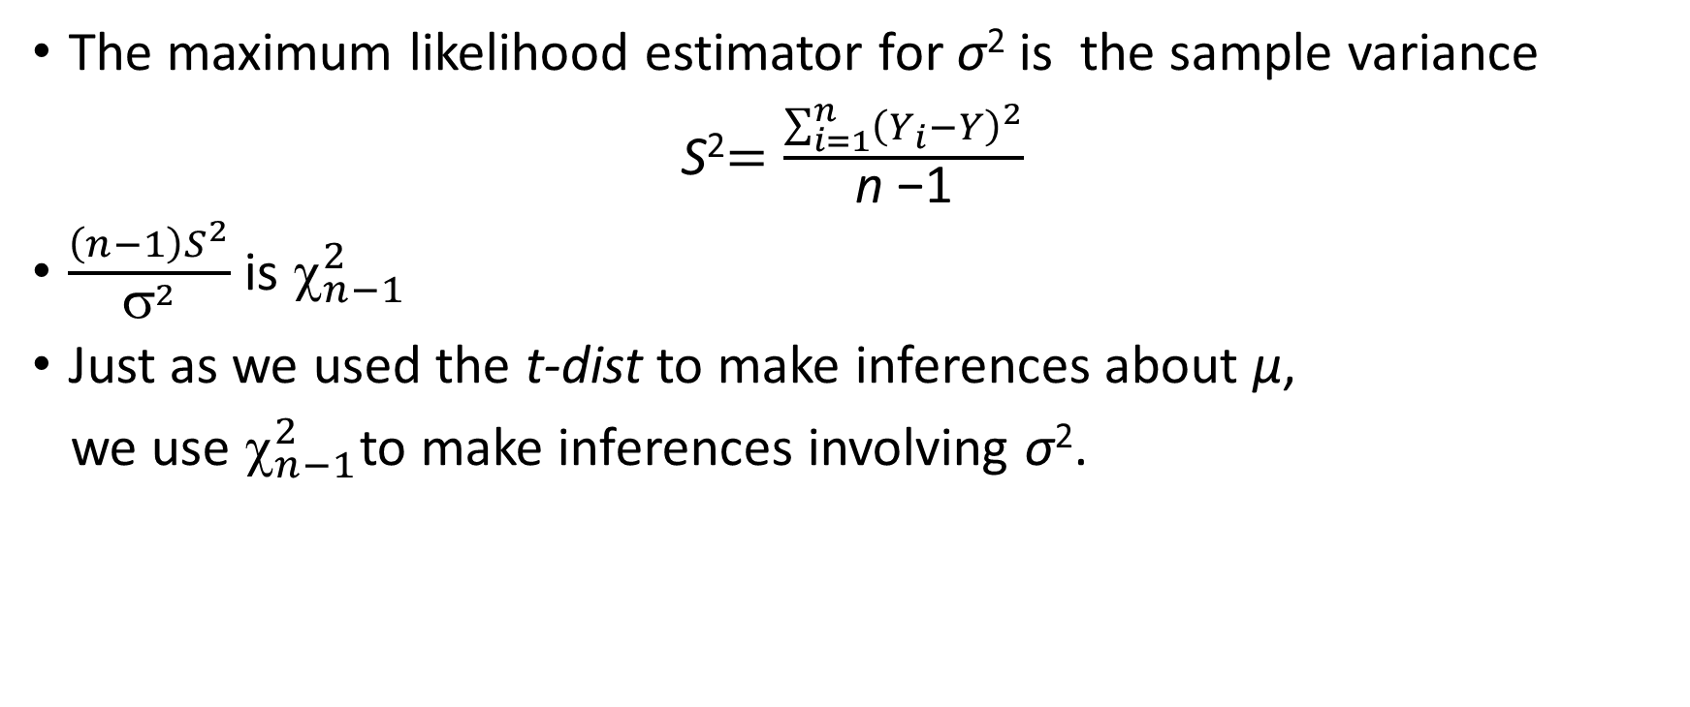
How to estimate the variability statistic
The maximum likelihood estimator for σ² is the sample variance
S²$=\frac{\sum_{i=1}^{n}{{\left(Y_{i}−Y\right)}^{2}}}{\text{n} \text{−1}}$
$\frac{\left(n−1\right)S^{2}}{σ^{2}}$ is $_{n−1}^{2}$
Just as we used the t-dist to make inferences about μ,
we use $_{n−1}^{2}$to make inferences involving σ².

Slide 8
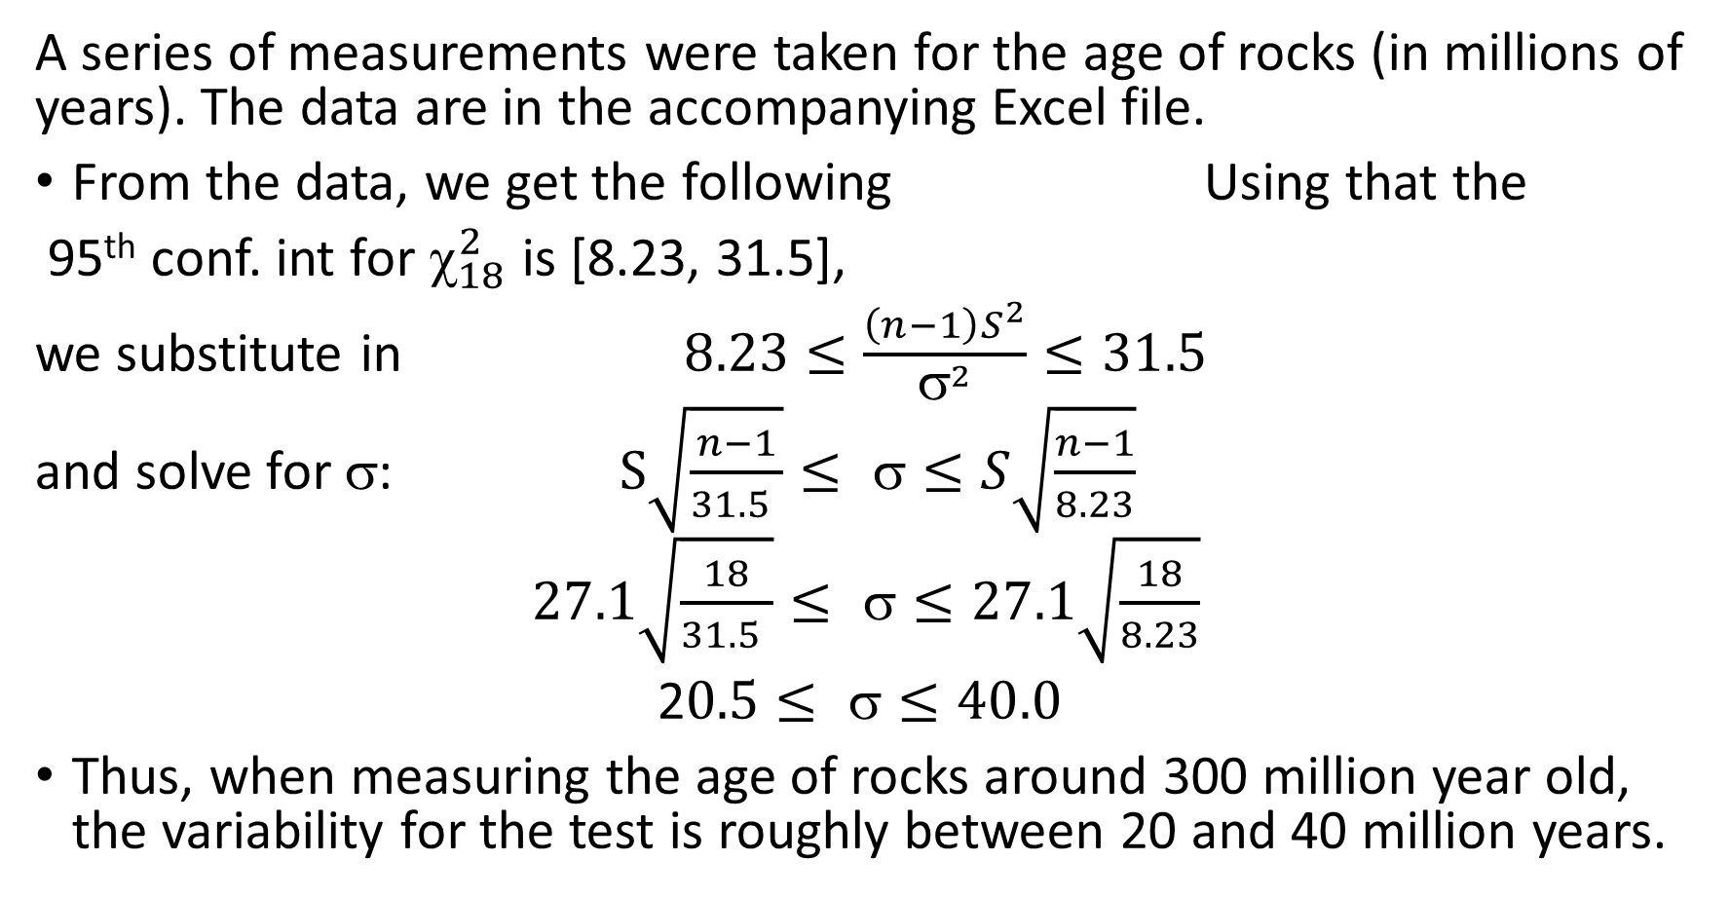
CS 7.5.1 variability in measuring rock ages
A series of measurements were taken for the age of rocks (in millions of years). The data are in the accompanying Excel file.
From the data, we get the following Using that the
95th conf. int for $_{18}^{2}$ is [8.23, 31.5],
we substitute in $8.23≤\frac{\left(n−1\right)S^{2}}{σ^{2}}≤31.5$
and solve for σ: $S\sqrt{\frac{n−1}{31.5 }}≤ σ≤S\sqrt{\frac{n−1}{8.23}}$
$27.1\sqrt{\frac{18}{31.5 }}≤ σ≤27.1\sqrt{\frac{18}{8.23}}$
2$0.5≤ ≤40.0$
Thus, when measuring the age of rocks around 300 million year old, the variability for the test is roughly between 20 and 40 million years.
mean | 277
std dev | 27.1
count | 19

Slide 9
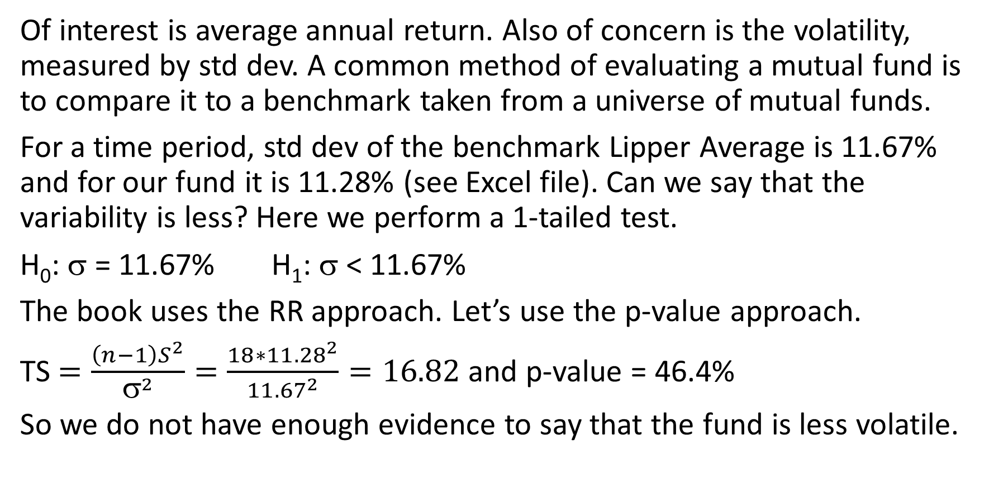
CS 7.5.2 Mutual fund volatility
Of interest is average annual return. Also of concern is the volatility, measured by std dev. A common method of evaluating a mutual fund is to compare it to a benchmark taken from a universe of mutual funds.
For a time period, std dev of the benchmark Lipper Average is 11.67% and for our fund it is 11.28% (see Excel file). Can we say that the variability is less? Here we perform a 1-tailed test.
H₀: σ = 11.67% H₁: σ < 11.67%
The book uses the RR approach. Let’s use the p-value approach.
TS $=\frac{\left(n−1\right)S^{2}}{σ^{2}}=\frac{18∗{11.28}^{2}}{{11.67}^{2}}=16.82$ and p-value = 46.4%
So we do not have enough evidence to say that the fund is less volatile.

