Slide 1
MAT 2572 Probability w/Statistics, Halleck
Day 20 slides:
5.3 Interval Estimation

Slide 2
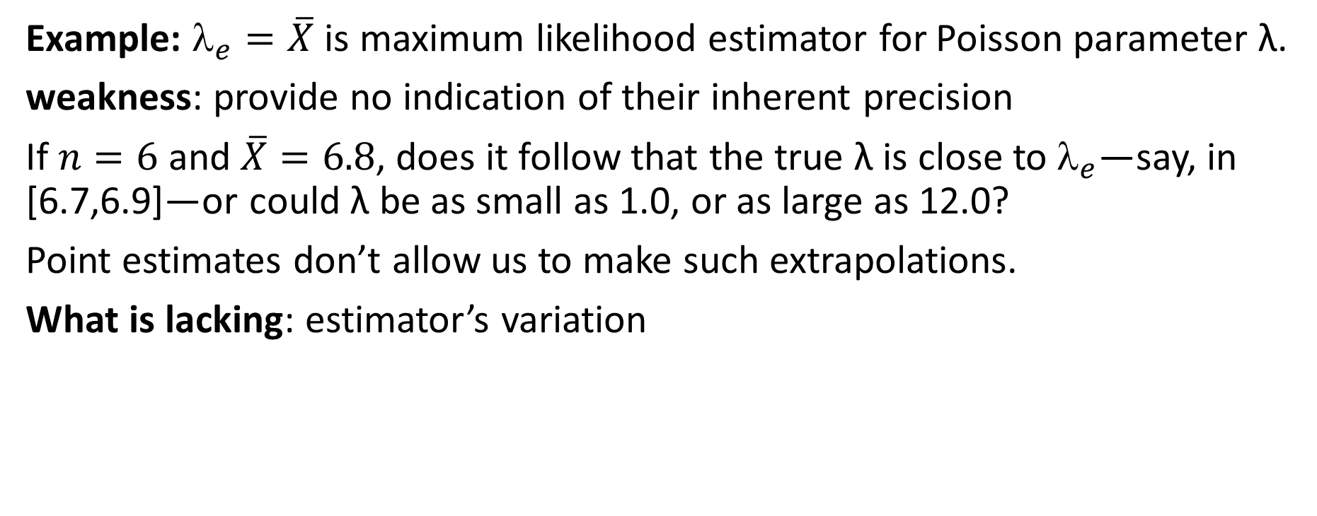
Point estimates
Example: $_{e}=\overline{X}$ is maximum likelihood estimator for Poisson parameter λ.
weakness: provide no indication of their inherent precision
If $n=6$ and $\overline{X}=6.8$, does it follow that the true λ is close to $_{e}$—say, in [6.7,6.9]—or could λ be as small as 1.0, or as large as 12.0?
Point estimates don’t allow us to make such extrapolations.
What is lacking: estimator’s variation

Slide 3
Confidence interval is
a range of numbers that have a high probability of “containing” the unknown parameter as an interior point.
By looking at width of confidence interval,
we get sense of estimator’s precision.
Typically, we like to have 95% certainty.

Slide 4
Normal distribution’s role
Recall CLT:
Normal distribution approximates the sampling from any distribution.
Larger the sample size n, better the approximation.
  Even for distributions that are highly non-normal (e.g., uniform), by n=30, the sampling distribution will be normal for most intents and purposes.
For the standard normal, the interval with radius 1.96 centered at 0, holds 95% of the outcomes:

Slide 5
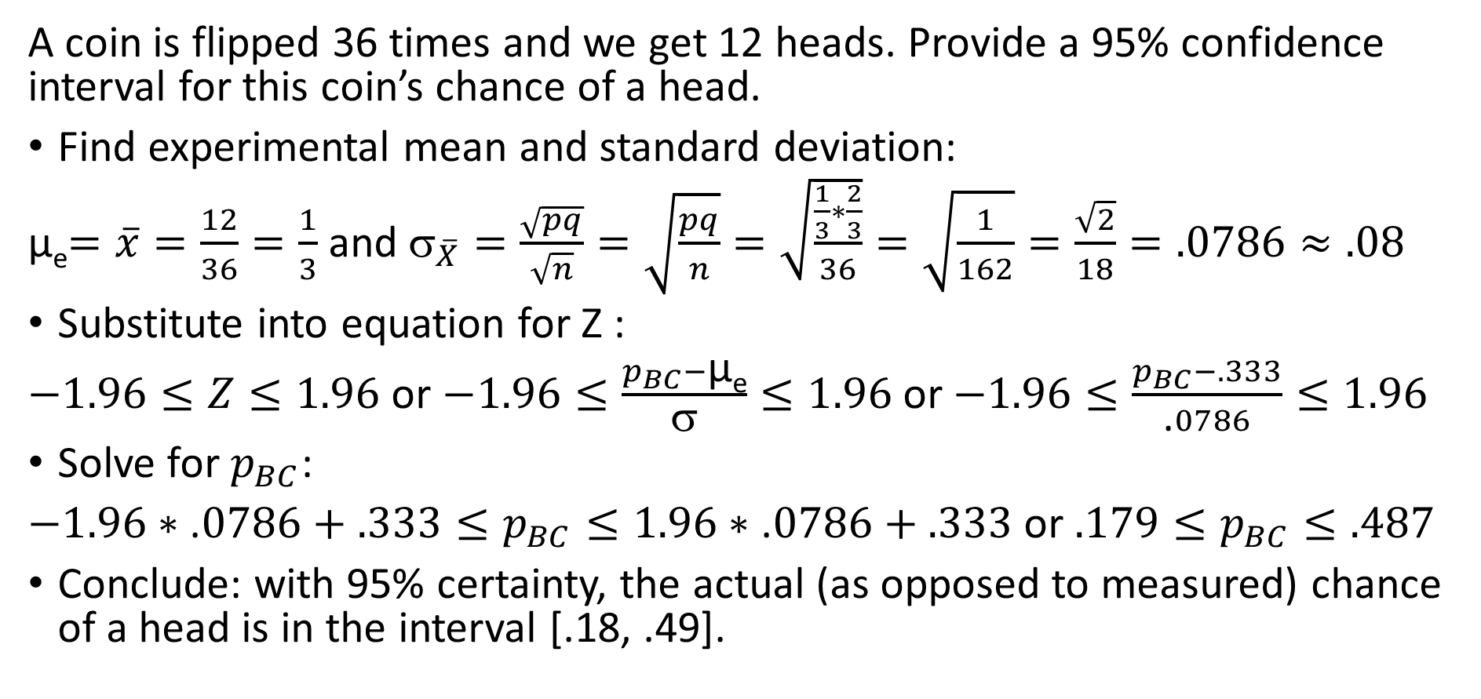
Bent coin flip example with n=36
A coin is flipped 36 times and we get 12 heads. Provide a 95% confidence interval for this coin’s chance of a head.
Find experimental mean and standard deviation:
µ_{e}$=\overline{x}=\frac{12}{36}=\frac{1}{3}$ and ${\text{}}_{\overline{X}}=\frac{\sqrt{pq}}{\sqrt{n}}=\sqrt{\frac{pq}{n}}=\sqrt{\frac{\frac{1}{3}∗\frac{2}{3}}{36}}=\sqrt{\frac{1}{162}}=\frac{\sqrt{2}}{18}=.0786≈.08$
Substitute into equation for Z :
$−1.96≤Z≤1.96$ or $−1.96≤\frac{p_{BC}−\text{µ}\text{e}}{\text{σ}}≤1.96$ or $−1.96≤\frac{p_{BC}−.333}{\text{.}0786}≤1.96$
Solve for $p_{BC}$:
$−1.96∗\text{.}0786+.333≤p_{BC}≤1.96∗\text{.}0786+.333$ or $.179≤p_{BC}≤.487$
Conclude: with 95% certainty, the actual (as opposed to measured) chance of a head is in the interval [.18, .49].

Slide 6
Bent coin flip example (cont.)
[.18 .33 .49] actual chance of head
measured chance of a head

Slide 7
Possible 95% confidence intervals for μ
We only went 6 for 8 or 75%, but unless our assumptions or measure-ments are wrong, we should in the long run bat at a 95% success rate.

Slide 8
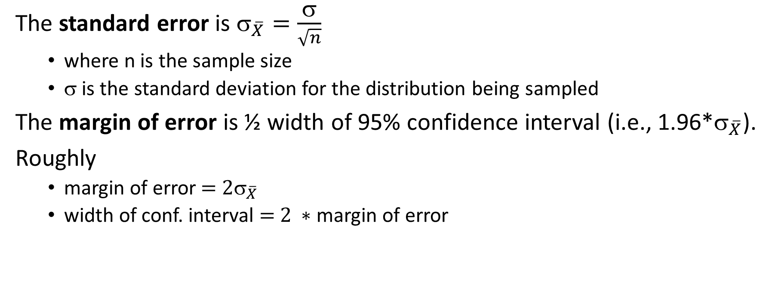
Standard error and margin of error
The standard error is ${\text{}}_{\overline{X}}=\frac{\text{σ}}{\sqrt{n}}$
  where n is the sample size
  $\text{}$ is the standard deviation for the distribution being sampled
The margin of error is ½ width of 95% confidence interval (i.e., 1.96*${\text{}}_{\overline{X}}$).
Roughly
  margin of error${ \text{= 2}\text{σ}}_{\overline{X}}$
  width of conf. interval $\text{= 2} ∗$margin of error

Slide 9
Bent coin flip example (revisited)
[.18 .33 .49]
Width of confidence interval is .49-.18=.31
Margin of error is ~.16
Standard error is ~.08.

Slide 10
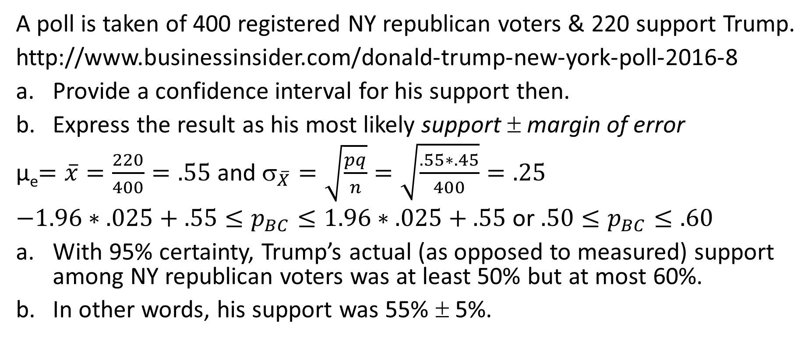
Trumps Poll #’s among NY republicans (Aug 2016)
A poll is taken of 400 registered NY republican voters & 220 support Trump.
http://www.businessinsider.com/donald-trump-new-york-poll-2016-8
Provide a confidence interval for his support then.
Express the result as his most likely support ± margin of error
µ_{e}$=\overline{x}=\frac{220}{400}=.55$ and ${\text{}}_{\overline{X}}=\sqrt{\frac{pq}{n}}=\sqrt{\frac{.55∗.45}{400}}=.25$
$−1.96∗.025+.55≤p_{BC}≤1.96∗.025+.55$ or $.50≤p_{BC}≤.60$
With 95% certainty, Trump’s actual (as opposed to measured) support among NY republican voters was at least 50% but at most 60%.
In other words, his support was 55% ± 5%.

Slide 11
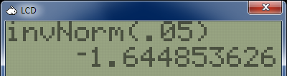
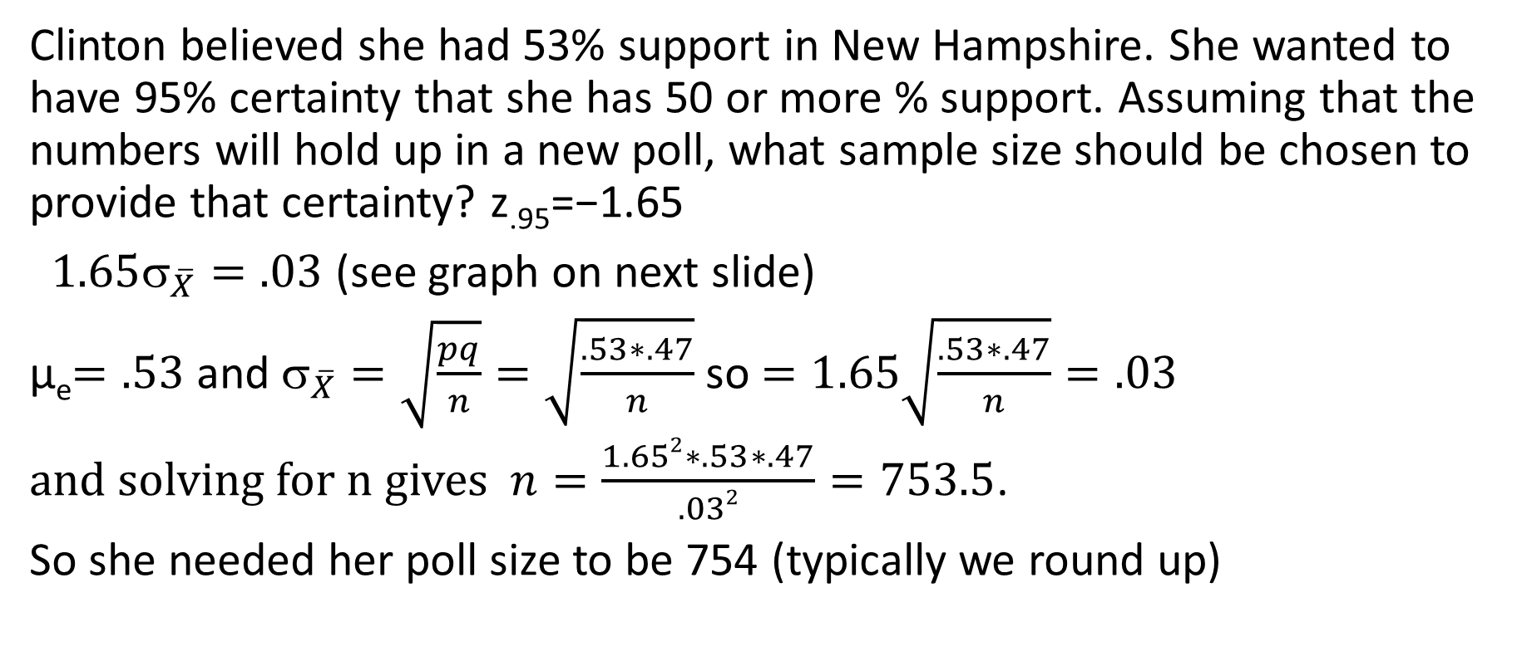
Clinton’s numbers in New Hampshire
Clinton believed she had 53% support in New Hampshire. She wanted to have 95% certainty that she has 50 or more % support. Assuming that the numbers will hold up in a new poll, what sample size should be chosen to provide that certainty? z_{.95}=−1.65
$1.65{\text{σ}}_{\overline{X}}=.03$ (see graph on next slide)
µ_{e}$=.53$ and ${\text{}}_{\overline{X}}=\sqrt{\frac{pq}{n}}=\sqrt{\frac{.53∗.47}{n}}$ so $=1.65\sqrt{\frac{.53∗.47}{n}}=.03$
and solving for n gives $n=\frac{1.652∗.53∗.47}{.032}=753.5$.
So she needed her poll size to be 754 (typically we round up)

Slide 12
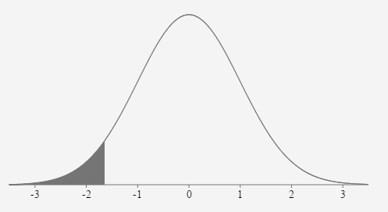
Clinton’s numbers(cont.): graph for her support
Chance that she is behind (want it to <5%)
Chance that she is ahead (want it to be >95%)
z_{.95}=−1.65
.50 1.65${\text{}}_{\overline{X}}$ .53

Slide 13
finite correction factor
Binomial Hypergeometric
Since (N−n)/(N−1) < 1, the Hypergeom var is smaller than binom var. The ratio (N−n)/(N−1) is the finite correction factor (fcf). If N is much larger than n, then the fcf will be close to 1 and hence a “binomial” assumption is more than adequate. Only when sample is a sizeable fraction of population do we need to include the fcf in any calculations.

Slide 14
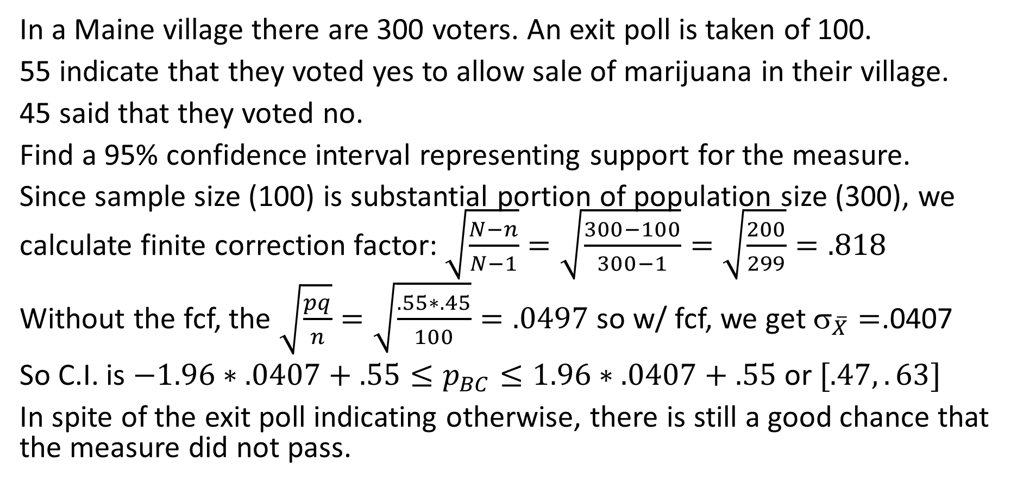
Finite correction factor example
In a Maine village there are 300 voters. An exit poll is taken of 100.
55 indicate that they voted yes to allow sale of marijuana in their village.
45 said that they voted no.
Find a 95% confidence interval representing support for the measure.
Since sample size (100) is substantial portion of population size (300), we calculate finite correction factor: $\sqrt{\frac{N−n}{N−1}}=\sqrt{\frac{300−100}{300−1}}=\sqrt{\frac{200}{299}}=.818$
Without the fcf, the $\sqrt{\frac{pq}{n}}=\sqrt{\frac{.55∗.45}{100}}=.0497$ so w/ fcf, we get ${\text{}}_{\overline{X}}=$.0407
So C.I. is $−1.96∗.0407+.55≤p_{BC}≤1.96∗.0407+.55$ or $[.47,.63]$
In spite of the exit poll indicating otherwise, there is still a good chance that the measure did not pass.

Slide 15
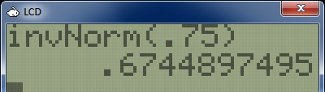
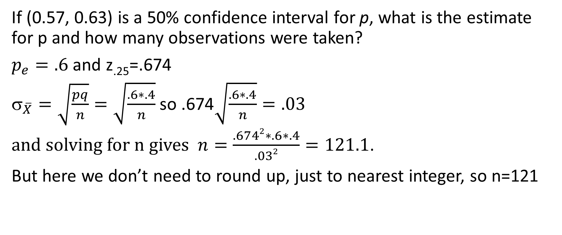
Exercise 5.3.14
If (0.57, 0.63) is a 50% confidence interval for p, what is the estimate for p and how many observations were taken?
$p_{e}=.6$ and z_{.25}=.674
${\text{}}_{\overline{X}}=\sqrt{\frac{pq}{n}}=\sqrt{\frac{.6∗.4}{n}}$ so $\text{.674}\sqrt{\frac{.6∗.4}{n}}=.03$
and solving for n gives $n=\frac{.6742∗.6∗.4}{.032}=121.1$.
But here we don’t need to round up, just to nearest integer, so n=121

