Slide 1
MAT 2572 Probability w/Statistics, Halleck
Day 13 slides:
3.12 Moment-Generating Functions

Slide 2
A clever way to get all moments into 1 expression
Recall k^{th} moment: $μ$_{k} = E[Y^{k}]$=\int_{−∞}^{∞}{\text{y}\text{k} \text{f}\text{Y}\text{(}\text{y}\text{)}dy}$ (in the continuous case)
Expectation is the 1st moment
Variance is 2nd moment around expectation
Shape statistics skewing & kurtosis are connected to 3rd and 4th moments
Take a sum of powers of Yt divided by factorials:
e^{tY}$=1+Yt+$ $\frac{\left(Yt\right)2}{2!}+\frac{\left(Yt\right)3}{3!}+…$
Take expectation to get the moment generating function:
M_{Y}(t) = E(e^{tY}) $=1+μ1t+$ $\frac{μ2t2}{2!}+\frac{μ3t3}{3!}+…$

Slide 4
3.12.1 Discrete example: geometric
Let’s redefine geometric distribution. Instead of counting number of trials to get 1st success, count just the number of failures
Then: p_{X} (k) = (1− p)^{k} p = q^{k} p, k =1, 2, . . .
$MX\left(t\right)=E\left(etX\right)=\sum_{k=0}^{∞}{etk}qkp=p\sum_{k=0}^{∞}{\left(qet\right)k}=\frac{p}{1−qe^{t}}$

Slide 5
How to get particular moment from MGF
To recover k^{th} moment, take k^{th} derivative w.r.t. “t” and set t=0:
$$μk=\frac{dkMX\left(t\right)}{dtk}\left|\begin{matrix} \\ t=0\end{matrix}\right.$$
Do you understand why this works?
Each time you take a derivative,
for each term, you eliminate a factor in the factorial;
present first term in the expansion gets killed.
Setting $t=0$ gets rid of all terms except the present first one.
Think of an MGF as a clothes line:
Each time you take derivative, you pull it in one item.

Slide 6
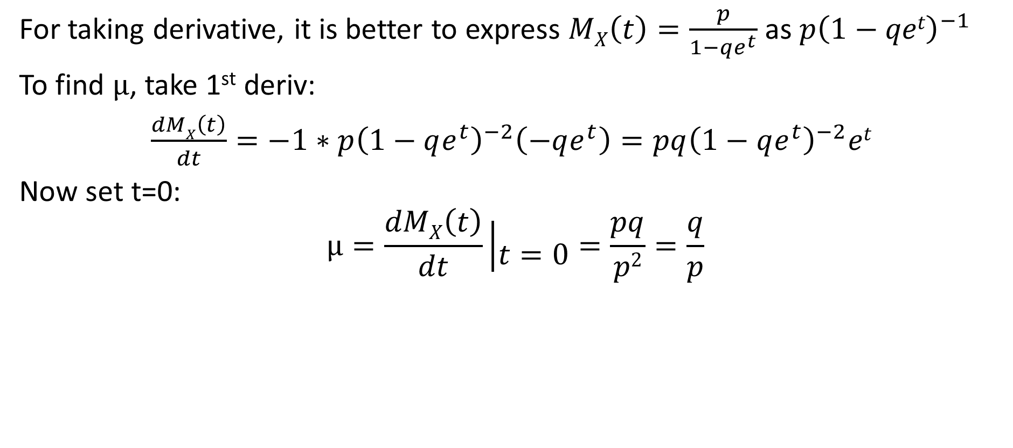
3.12.1 Discrete example: geometric (cont)
For taking derivative, it is better to express $MX\left(t\right)=\frac{p}{1−qe^{t}}$ as $p{\left(1−qet\right)}^{−1}$
To find $μ$, take 1st deriv:
$\frac{dMX\left(t\right)}{dt}=−1∗{p\left(1−qe^{t}\right)}^{−2}\left(−qe^{t}\right)={pq\left(1−qe^{t}\right)}^{−2}et$
Now set t=0:
$$μ=\frac{dMX\left(t\right)}{dt}\left|\begin{matrix} \\ t=0\end{matrix}\right.=\frac{pq}{p2}=\frac{q}{p}$$

Slide 7
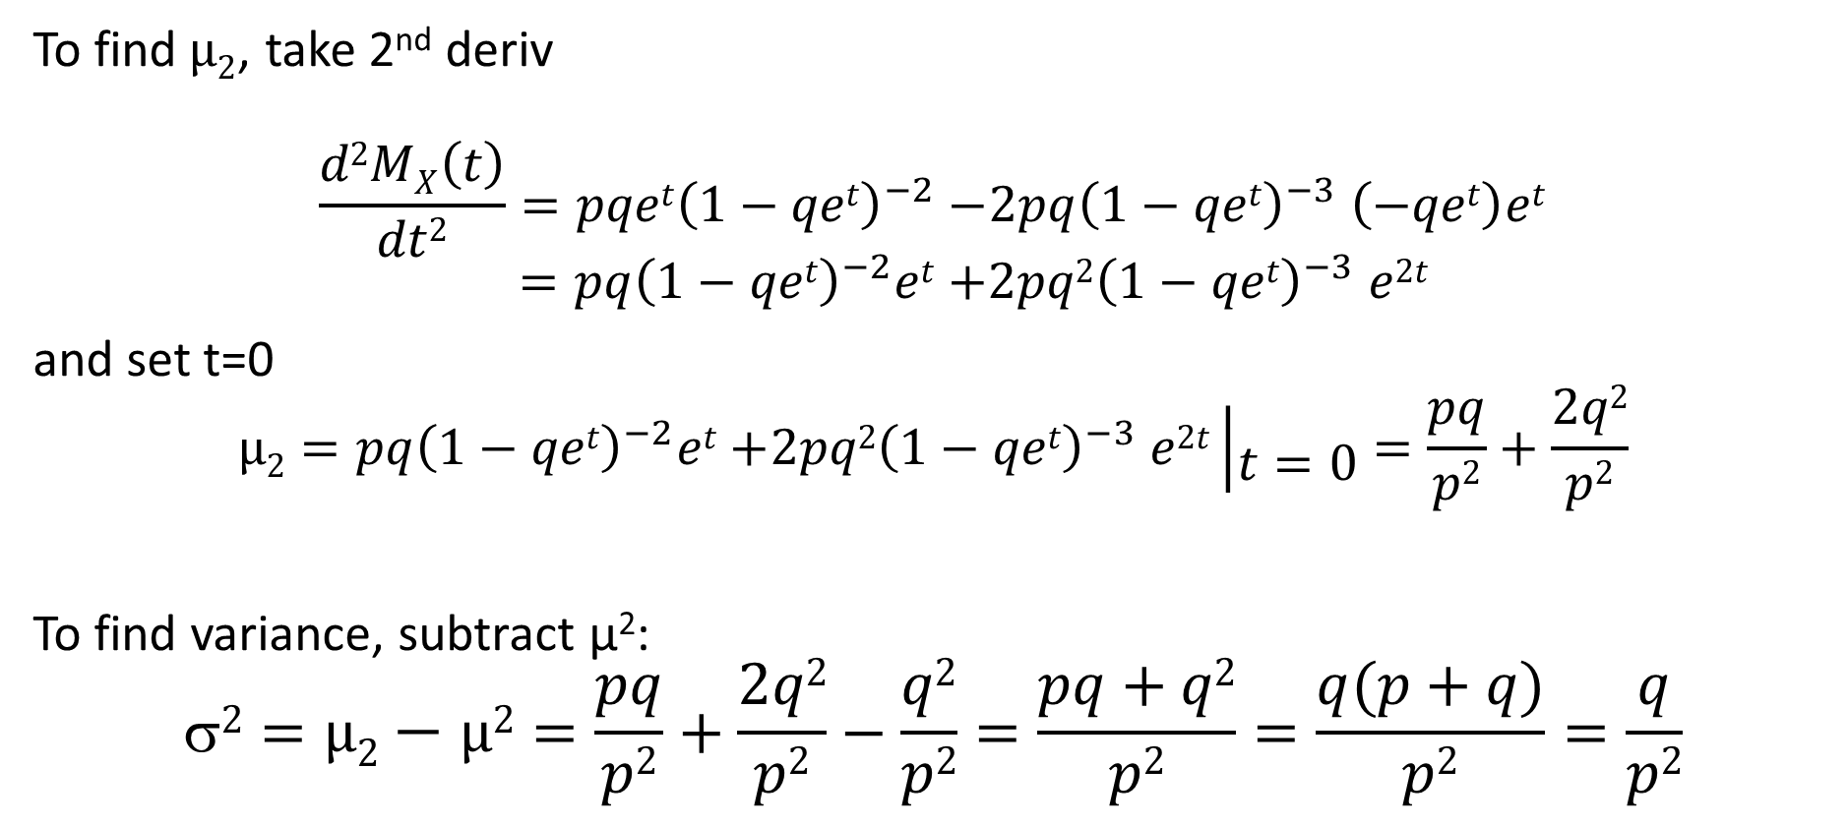
3.12.1 Discrete example: geometric (cont)
To find$μ2$, take 2nd deriv
$$\frac{d2MX\left(t\right)}{dt2}={pqet\left(1−qet\right)}^{−2}{−2pq\left(1−qet\right)}^{−3}\left(−qet\right)et$$
$$={pq\left(1−qet\right)}^{−2}et{+2pq2\left(1−qet\right)}^{−3}e2t$$
and set t=0
$$μ2={pq\left(1−qet\right)}^{−2}et{+2pq2\left(1−qet\right)}^{−3}e2t\left|\begin{matrix} \\ t=0\end{matrix}\right.=\frac{pq}{p2}+\frac{2q2}{p2}$$
To find variance, subtract μ²:
$$2=μ2−μ2=\frac{pq}{p2}+\frac{2q2}{p2}−\frac{q2}{p2}=\frac{pq+q2}{p2}=\frac{q(p+q)}{p2}=\frac{q}{p2}$$

Slide 8
3.12.2 Discrete example: binomial
Recall: p_{X} (k)=$\left({n \atop k}\right)$p^{k}(1− p)^{n−k} , k =0, 1, . . . , n
From the binomial theorem, this last expression can be written as:
$${(pe^{t}+\left(1−p\right))}^{n}={(1−p+pe^{t})}^{n}{=(q+pe^{t})}^{n}$$

Slide 9
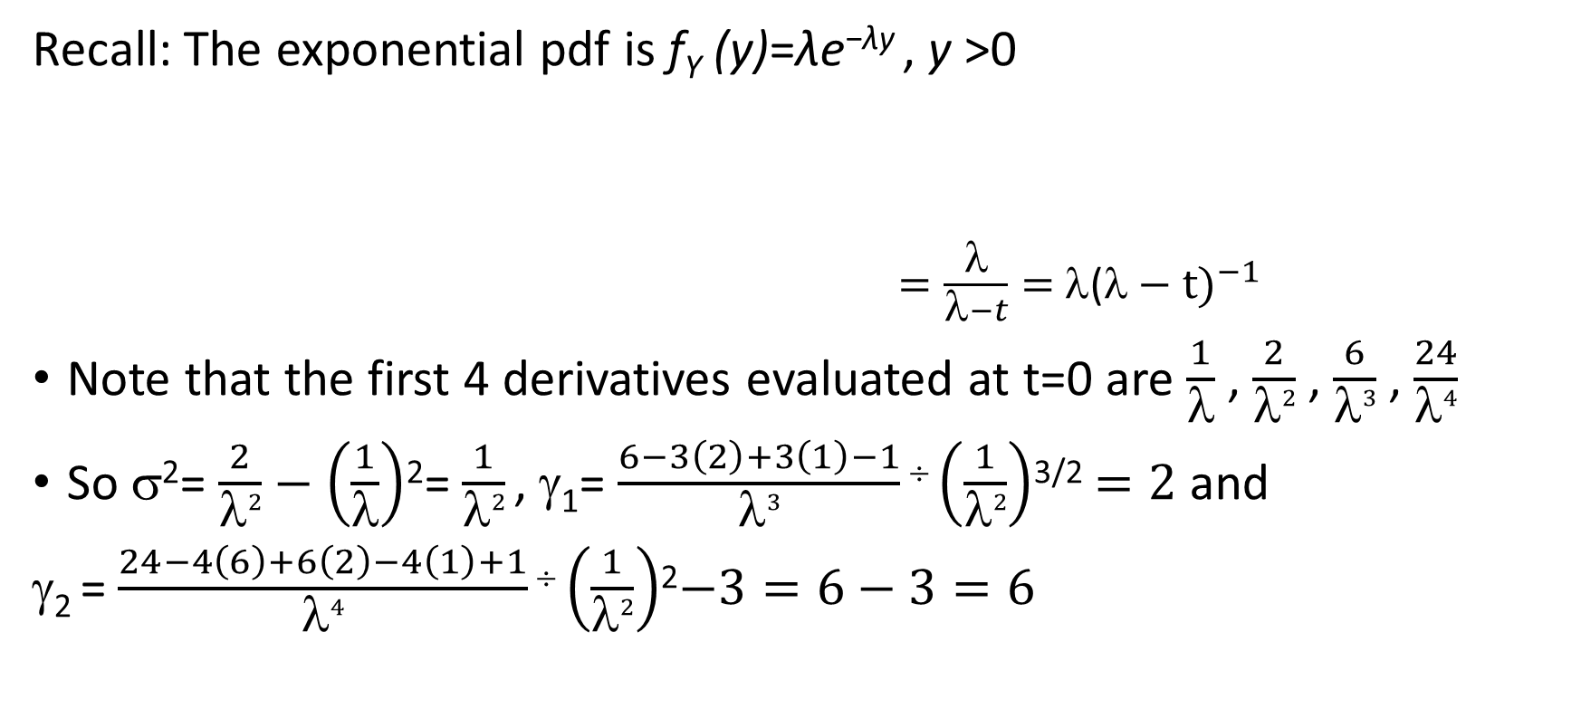
3.12.3 Continuous example: exponential
Recall: The exponential pdf is f_{Y} (y)=λe^{−λy} , y >0
$=\frac{λ}{λ−t}=$ ${\text{(}λ−t)}^{−1}$
Note that the first 4 derivatives evaluated at t=0 are $\frac{1}{λ}$ , $\frac{2}{λ2}$ , $\frac{6}{λ3}$ , $\frac{24}{λ4}$
So σ²= $\frac{2}{λ2}−\left(\frac{1}{λ}\right)$²= $\frac{1}{λ2}$, γ₁= $\frac{6−3\left(2\right)+3\left(1\right)−1}{λ3}÷\left(\frac{1}{λ2}\right)$^{3/2} $=2$and
γ₂ = $\frac{24−4\left(6\right)+6\left(2\right)−4\left(1\right)+1}{λ4}÷\left(\frac{1}{λ2}\right)$²$−3=6−3=6$

Slide 10
Theorem 3.12.2
Moment generating function is unique to a distribution:
if two MGF’s are same, then so are the defining density functions.

Slide 11
Theorem 3.12.3

Slide 12
Example 3.12.4: MGF for normal distribution
Derivation of the MGF for Y = N(μ,σ²) is quite lengthy in the text.
We derive it by finding MGF for standard normal distribution Z = N(1,0) and then use Theorem 3.12.3 to extend to Y = N(μ,σ²).
$$MZ\left(t\right)=E\left(etZ\right)=\int_{−∞}^{∞}{etz\frac{1}{\sqrt{2\text{p}}}e^{−z^{2}/2} dz}=\frac{1}{\sqrt{2\text{p}}}\int_{−∞}^{∞}{e^{tz−z^{2}/2} dz}$$
Completing square $−\frac{1}{2}(z^{2}−$ 2$tz+___)=−\frac{1}{2}(z^{2}−$ 2$tz+t2)+\frac{t2}{2}$, so
$$MZ\left(t\right)=\frac{1}{\sqrt{2\text{p}}}\int_{−∞}^{∞}{e^{−\frac{1}{2}(z^{2}−\text{ 2}tz+t2)+\frac{t2}{2}} dz}=e^{\frac{t2}{2}}\frac{1}{\sqrt{2\text{p}}}\int_{−∞}^{∞}{e^{−\frac{1}{2}(z− t)2}dz}=e^{\frac{t2}{2}}$$
Note: the last integral is 1 because the integrand is the PDF for Z.

Slide 13
Example 3.12.4: MGF for normal distr. (cont.)
From last slide, we know $MZ\left(t\right)=e^{\frac{t2}{2}}$
Use Theorem 3.12.3 a. to extend to Y = N(μ,σ²):
Y = σ Z + μ
So $MY\left(t\right)=e^{\text{μ}t}MZ\left(\text{σ}t\right){=e^{\text{μ}t}e}^{\frac{(\text{σ}t)2}{2}}=e^{\text{μ}t+\frac{\text{σ}2t2}{2}}$

Slide 14
Summary: PDF and MGF for normal distribution
PDF:
MGF:
In the next slide, we introduce a library of many such pairs.

Slide 15
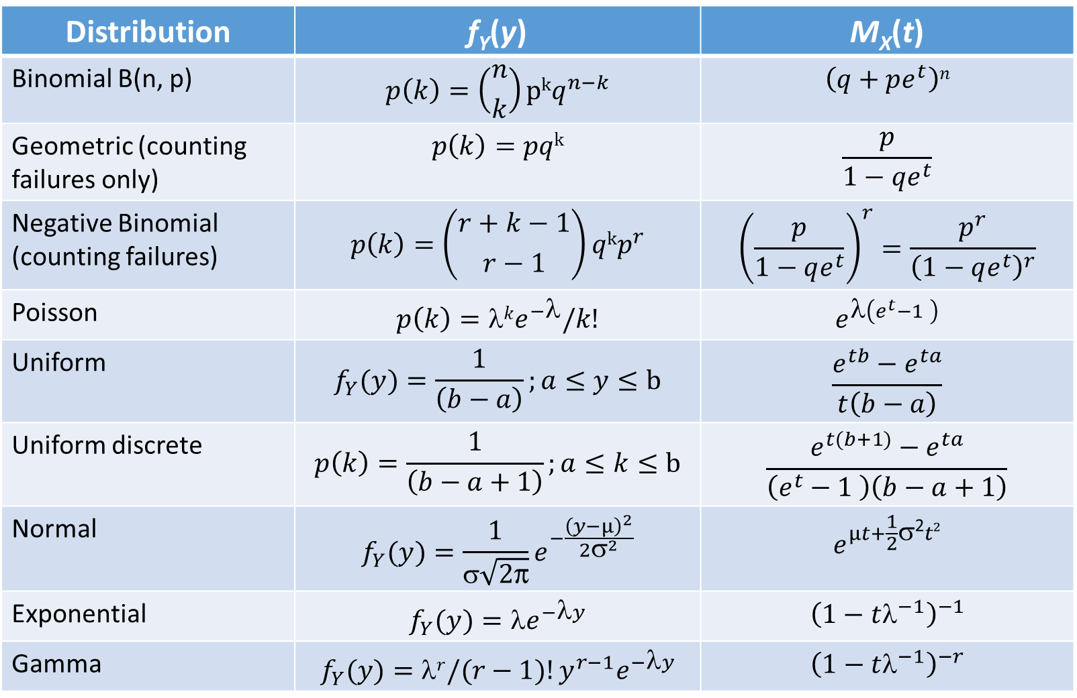
Library
Distribution | f_{Y}(y) | M_{X}(t)
Binomial B(n, p) | $$p\left(k\right)=\left({n \atop k}\right)pkq^{n−k}$$ | $$\left(q+pe^{t}\right)n$$
Geometric (counting failures only) | $$p\left(k\right)=pqk$$ | $$\frac{p}{1−qe^{t}}$$
Negative Binomial (counting failures) | $$p\left(k\right)=\left({r+k−1 \atop r−1}\right)qkp^{r}$$ | $${\left(\frac{p}{1−qe^{t}}\right)}^{r}=\frac{p^{r}}{{\left(1−qe^{t}\right)}^{r}}$$
Poisson | $$p\left(k\right)=λke^{−λ}/k!$$ | $$e^{λ\left(e^{t}−1 \right)}$$
Uniform | $$f_{Y}(y)=\frac{1}{\left(b−a\right)};a≤y≤b$$ | $$\frac{e^{tb}−e^{ta}}{t\left(b−a\right)}$$
Uniform discrete | $$p\left(k\right)=\frac{1}{\left(b−a+1\right)};a≤k≤b$$ | $$\frac{e^{t(b+1)}−e^{ta}}{\left(e^{t}−1 \right)\left(b−a+1\right)}$$
Normal | $$f_{Y}(y)=\frac{1}{σ\sqrt{2\text{p}}}e^{−\frac{{\left(y−μ\right)}^{2}}{2σ^{2}}}$$ | $$e^{μt+\frac{1}{2}\text{σ}\text{2}t2}$$
Exponential | $$f_{Y}(y)=e^{−y}$$ | $${\left(1−tλ^{−1}\right)}^{−1}$$
Gamma | $$f_{Y}(y)={r{/(r−1)!y}^{r−1}e}^{−y}$$ | $${\left(1−tλ^{−1}\right)}^{−r}$$

Slide 16
Example 3.12.11: standardizing normal dist
(given an arbitrary normal random variable Y with parameters μ and σ)

