Slide 1
MAT 2572 Probability w/Statistics, Halleck
Day 11 slides:
3.5 Expected Values

Slide 2
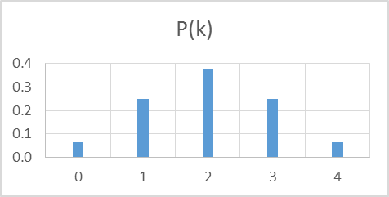
Review: Discrete random variable
Can be presented as a two row matrix:
Row 1: “outcomes”, arbitrary real numbers (can be countably ∞)
Row 2: probabilities, positive real numbers which sum to 1
(can be zero, but then the corresponding outcome never occurs)
Binomial example: fair coin flipped 4 times & # of heads counted

Slide 3
Measures of central location
Given a distribution, often we want to know
1. mean (average) 2. median (half-way pt.) or 3. mode (most likely outcome)
Expected value, average or mean is sum of all outcomes weighted by likelihoods: 0*(1/16)+1*(1/4)+2*(3/8)+3*(1/4)+4*(1/16)=4/16+12/16+12/16+4/16=32/16=2
2. Median: Sum up probabilities left to right and stop at 50%:
Partial sums (1/16, 5/16, 11/16,…) reach (& overtake) 1/2 at k = 2, so 2 is median.
3. The outcome that is most likely to occur is 2, so that is the mode.
For symmetric distributions, mean and median always coincide.

Slide 4
Mean as dot product of 2 vectors
Best way to describe mean is as dot product of vector of
outcomes with corresponding vector of probabilities:
X⋅P(X)
For our running example:
<0, 1, 2, 3, 4>⋅<1/16, 1/4, 3/8, 1/4, 1/16>
= <0, 1, 2, 3, 4>⋅<1, 4, 6, 4, 1>/16
=(0*1+1*4+2*6+3*4+4*1)/16 = 32/16 = 2

Slide 5
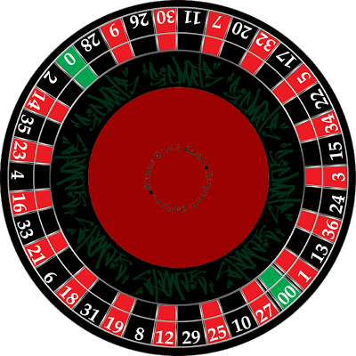
Roulette betting on red or black
Suppose that you bet $1 on red. On average, how much will you win or lose?
In terms of colors, there are 3 outcomes, green (house), red or black. However, we want to think of the outcomes in terms of earnings. If it is red, you earn $1. If it is either black or green, you lose the $1 you bet. There are 18 red, 18 black and 2 green, so since each slot is equally likely, the RV is:
Taking dot product gives -1/19, a loss of ~ 5.3 cents.
So the expected value is −0.053.

Slide 6
Roulette (cont.)
Suppose that you bet $1 on red. On average, how much will you win or lose?
Physically, an expected value can be thought of as a center of gravity.
Imagine 2 bars of ht. 10/19 and 9/19 positioned at pts −1 and +1, respectively. If a fulcrum were placed at −0.053, the system would be in balance:

Slide 7
Recap & notation: Expected value for discrete RV’s
Let X be a discrete random variable with probability function p_{X} (k).
The expected value of X, denoted E(X) (or sometimes or μ_{X} ) is
μ is the Greek letter “mu” [pronounced (quickly) me-you]

Slide 8
Testing a mix of blood samples
In test for rare disease, lab takes samples & mixes parts of them together. Most of time, test is −. If test is +, then sample w/ disease must be found. All samples in batch are then tested individually.
If batch consists of 50 samples, at what frequency of disease does it make sense to just test each individually from start?
If p is frequency of disease, then chance of having at least one sample with disease is 1− (1−p)⁵⁰, in which case a total of 51 samples have to be tested. Otherwise, just the initial test had to be made:
k | 1 | 51
P(k) | (1-p)⁵⁰ | 1-(1-p)⁵⁰

Slide 9
Testing a mix of blood samples (cont.)
If a batch consists of 50 samples, at what frequency does it make sense to just test each individually from start?
With table: E(X)= (1-p)⁵⁰ +51(1-(1-p)⁵⁰)
Evaluating expectation for various values of p, we get:
There is no savings if disease is at 10% level.
At 1% prevalence level, ave #tests needed is significantly reduced
(50 → 21)
Note: if there is +,
a divide and conquer approach would lower the expectation
But we will leave the accompanying analysis for a more advanced course
k | 1 | 51
P(k) | (1-p)⁵⁰ | 1-(1-p)⁵⁰

Slide 10
Example: Suppose that you roll a die (E(X)=3.5), then double the value and subtract 1. On average, what will you get?
2(3.5)-1=6

Slide 12
Example: Expectation for rolling 2 dice & summing
On average, each die is 3.5, therefore, on average the sum will be:
E(X+Y)=E(X)+E(Y)=3.5+3.5=7
For n dice, the average sum will be n*3.5.

Slide 13
Expectation for binomial
Flip fair coin, give 0 tail, 1 head then μ = ½
Flip n fair coins & count heads, then μ = n* ½
If coin is not fair,
for one flip, μ = p
for n flips, μ = np
Example, suppose coin has 60% chance of head:
If coin is flipped 40 times, on average, you will see 40* 0.6 = 24 heads.

Slide 14
Expectation for hypergeometric
An urn contains r red chips and w white chips, where r + w = N.
Draw n chips from the urn one at a time without replacing any of the chips selected.
Count #red chips among the n removed.
If n=1, then this is binomial situation w/ p=r/N, so expectation is r/N.
For arbitrary n, the RV is a sum of RV’s, one corresponding to each chip removal. Using the addition rule, we get
E(W)=E(X₁ + X₂ +…+ X_{n})= E(X₁)+ E(X₂) +…+ E(X_{n})=n*r/N=nr/(r+w)
Example: suppose r=4,w=6 and n=5, then E(W)=5*4/(4+6)=2

Slide 15
Expansion to the continuous
Continuous RV is given by a density function f(y).
The probability of any particular outcome is 0.
The probability of interval is area above interval and underneath f(y):
We have expectation (and median) for discrete RV’s,
Goal: explore notions in continuous.

Slide 16
For symmetric distributions, the idea of the middle should be pretty obvious, but how can we find it computationally?
Main idea from discrete: take outcomes, multiply by probs & sum.
Can we do something analogous with continuous?

Slide 17
Expectation for Continuous RV’s
Take outcomes---y---multiply by “probs”---f(y)--- and “sum”
Sum for continuous means integrate!
E.g., uniform: $\int_{a}^{b}{\text{y} ⋅\frac{1}{\left(b−a\right)}\text{dy}}$ $=$ $\frac{y^{2}}{2\left(b−a\right)} \left|\begin{matrix}b \\ a\end{matrix}= \frac{b^{2}−a^{2}}{2\left(b−a\right)}\right.=$ $\frac{a+b}{2}$
last expression is midpoint of endpoints a & b of our interval
Exactly what we expect! (pardon the pun)

Slide 18
Revisit 2nd cont. example:
f (t)=3t², 0 ≤t ≤1
Remember fulcrum tool for
understanding what expectation is:
At what point along t-axis would fulcrum balance an object of this shape (say a steel plate)?

Slide 19

2nd cont. example (cont.):
f (t)=3t², 0≤t ≤1
$μ=\int_{0}^{1}{\text{t} ⋅\text{3}\text{t}\text{2}}$dt
= ¾$\text{t}\text{4}$ $\left|\begin{matrix}1 \\ 0\end{matrix}\right.$ = ¾
Did this coincide with where you thought the fulcrum should be?
(perhaps somewhere to the right of 2/3)

Slide 20
2nd cont. example (cont.):
f (t)=3t², 0≤t ≤1
$μ= \int_{0}^{1}{\text{t} ⋅\text{3}\text{t}\text{2}}$dt = ¾$\text{t}\text{4}$ $\left|\begin{matrix}1 \\ 0\end{matrix}\right.$ = ¾
Note: distribution is not symmetric, hence median may not be same as μ.
Recall: median is point where half the probability is on either side.
To find it, let’s review the cumulative distribution F_{Y}(t).

Slide 21
Cumulative distribution function (CDF):
Cumulative distribution function F_{Y}(y) measures area under curve (probability) to the left of the inputted point.

Slide 22
2nd cont. example (cont.):
f (t)=3t², 0≤t ≤1
First, we find an expr for CDF
F_{Y}(y)=$\int_{0}^{y}{\text{3}}\text{t}\text{2}$dt = $\text{t}\text{3}$ $\left|\begin{matrix}y \\ 0\end{matrix}\right.$ = $\text{y}\text{3}$
Now set CDF to ½ and solve for y:
$\text{y}\text{3}$=½ so $y=\sqrt[3]{\text{½}}=0.794$
The distribution is skewed to the left (where the tail is).
Note: μ ( .75 for this situation) is to the left of the median
Its position relative to median can be used to find direction of skewing.
The reasons is that μ is more sensitive to skewing:
Start with symmetric distribution. Pull on one side, both the mean and median will be pulled as well, but the mean will be pulled further.

Slide 23
3.5.6 Exponential distribution and gas travel
Distance Y that a molecule in a gas travels before colliding with another molecule can be modeled by the exponential pdf:
f_{Y} (y)= (1/μ)e^{−y/μ}, y ≥0
Using integration by parts, we find that
E(Y )=$\int_{0}^{\text{∞}}{\text{w} ⋅\left(\text{1/}\text{μ}\right)\text{e}\text{−}\text{w}\text{/}\text{μ}}$dy = μ[−we^{−w} −e^{−w}] $\left|\begin{matrix}\text{∞ } \\ 0\end{matrix}\right.$ = μ
Hence, parameter μ represents average distance that a molecule travels between collisions.
At room temp and sea level, μ ≈ 0.5 micrometer (μm) for N₂.
(1 μm=10⁻³ mm, diameter of human hair ranges from 17 to 181 μm)

Slide 24
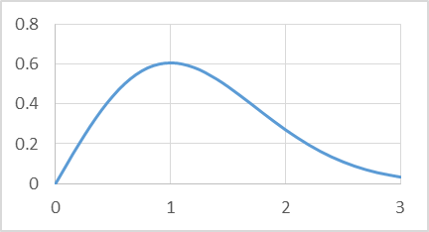
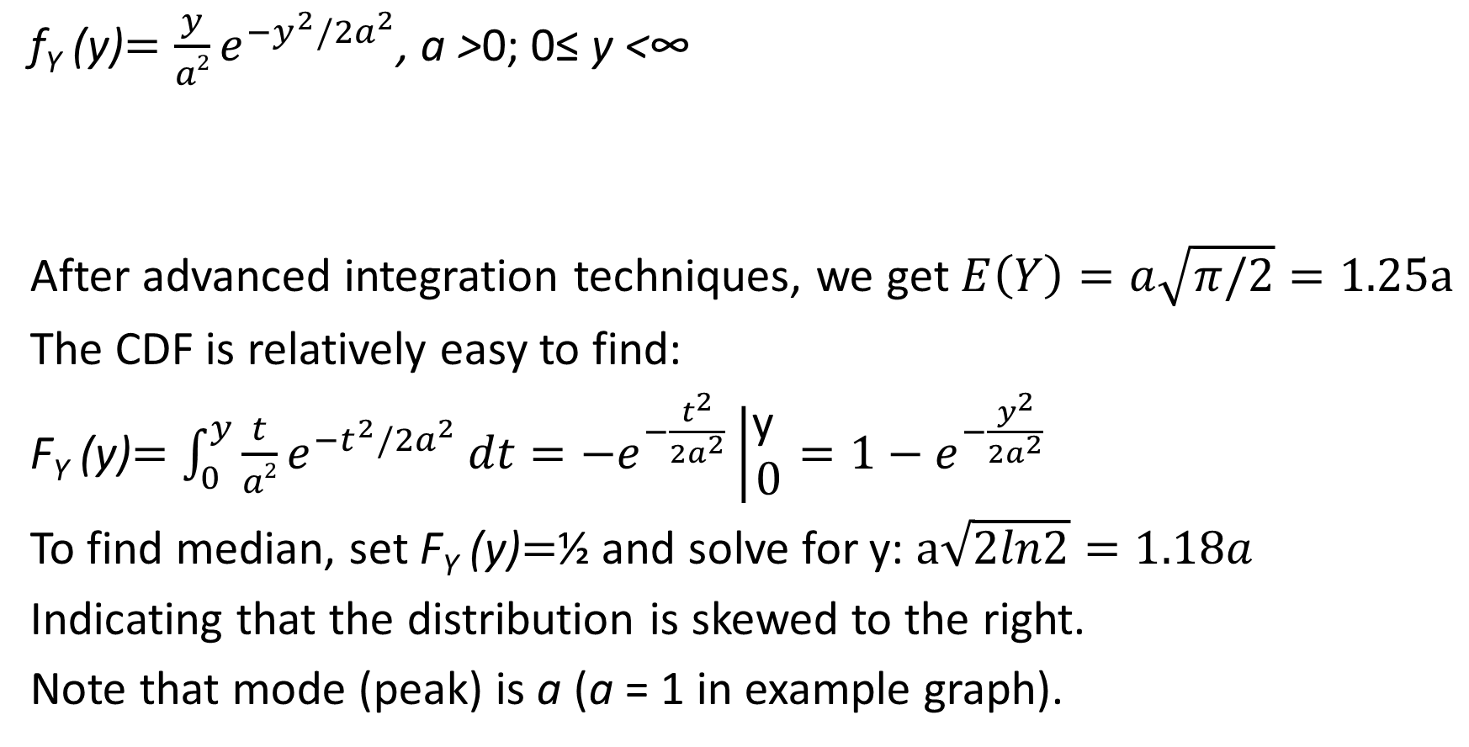
Example 3.5.7 Rayleigh distribution
pdf for Raleigh distribution with a=1
f_{Y} (y)$=\frac{y}{a2}e^{−y^{2}/2a^{2}}$, a >0; 0≤ y <∞
After advanced integration techniques, we get $E\left(Y\right)=a\sqrt{π/2}=1.25a$
The CDF is relatively easy to find:
F_{Y} (y)$=\int_{0}^{y}{\frac{t}{a2}e^{−t^{2}/2a^{2}}}dt=−e^{−\frac{t^{2}}{2a^{2}}}\left|\begin{matrix}\text{y} \\ 0\end{matrix}\right.=1−e^{−\frac{y^{2}}{2a^{2}}}$
To find median, set F_{Y} (y)$=$½ and solve for y: $a\sqrt{2ln2}=1.18a$
Indicating that the distribution is skewed to the right.
Note that mode (peak) is a (a = 1 in example graph).

Slide 25
The Expected Value of a Function of a Random Variable
Discrete:
Continuous:

Slide 26
Discrete Example
A fair coin is tossed twice & # of heads is counted: what is E(X²)?
X: X²:
So E(X²) = 0 * ¼ + 1* ½ + 4 * ¼ = 1 ½ = 3/2
(note that X is symmetric, so E(X)=1)
What is median of X²? Is their skewing? What is the direction?
k | 0 | 1 | 2
P(k) | 1/4 | 1/2 | 1/4
k | 0 | 1 | 4
P(k) | 1/4 | 1/2 | 1/4

Slide 27
Continuous example: 3.5.14
A point y is selected at random from interval [0, 1], dividing line into two segments.
What is expected value for ratio of shorter segment to longer segment?
w.l.o.g., y is in LHS of interval as in the picture (we use symmetry).
Ratio of shorter segment to longer segment is y/(1-y) so
$$E\left(\frac{y}{1−y}\right)=\int_{0}^{\frac{1}{2}}{\frac{y}{1−y}∗2dy\text{ =} 2}\int_{0}^{\frac{1}{2}}{\left(\frac{1}{1−y} −1\right)dy}$$
$$=2\left(−\ln\left(1−y\right)−y\right)\left|\begin{matrix}\text{1/2 } \\ 0\end{matrix}\right.=2 ln2−1=0.39≈0.4=\frac{2}{5}$$
so on average, longer piece is ~ 2 ½ times shorter piece.

