Slide 1
MAT 2572 Probability w/Statistics, Halleck
Day 19 slides:
4.6 The Gamma Distributions

Slide 2
RV Y is Gamma w/ parameters r > 0 & λ > 0 if
This distribution arises in same situation as exponential, but instead of measuring time it takes to reach one success. We measure time it takes to reach r^{th} success:

Slide 3
Example 4.6.1: space shuttle fuel pump
Engineers designing space shuttle plan 2 fuel pumps—one active, other in reserve (so r=2). If primary pump malfunctions, reserve is automatically brought on line. A mission requires fuel for 50 hrs. Pumps fail on average once every 100 hrs (so λ=0.01). What are chances system would not remain functioning for full 50 hrs?
Using integration by parts, we get .09 or 9%, clearly unacceptable.
Exercise: how reliable should pumps be to bring risk down to 1%?

Slide 4
Generalizing gamma to r > 0 non-integers.
There is a generalization of factorial namely:
The improper integral converges for all r > 0 & an easy induction
shows that
For the time being, we will just use formula where r is an integer.

Slide 5
MGF, expectation and variance
The same theorems used to go from Binomial to NB allow us to go from the exponential results and conclude:

Slide 6
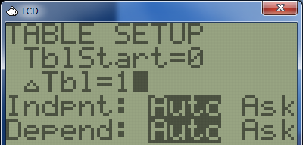
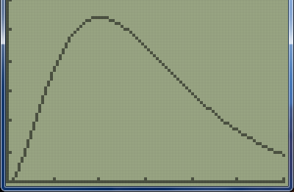
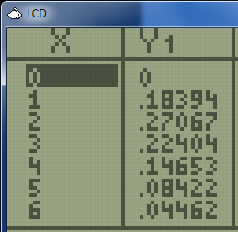
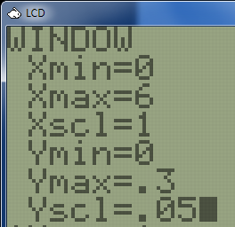
Exercise: Graph density function for Γ(r=3, λ=1)
$f_{Γ}\left(y\right)=\frac{1}{2}y^{2}e^{−y}$

Slide 7
Exercise: Find mean, median and mode for Γ(r=3, λ=1) and label on graph.
Mean is $µ=\frac{r}{λ}=3$
For median, let’s first find cdf: $F_{Γ}\left(y\right)=\frac{1}{2}\int_{0}^{y}{t^{2}e^{−t}dt}$
$=\frac{{−e}^{−t}}{2}\left(t^{2}+2t+2\right)\left|\begin{matrix}y \\ \\ t=0\end{matrix}\right.=1−\frac{e^{−y}}{2}\left(y^{2}+2y+2\right)$ .
Setting $F_{Γ}\left(y\right)=\frac{1}{2}$, we get ${y^{2}+2y+2−e}^{y}=0$ or $y≈2.67$
In particular, we note that since (median) 2.67 -> 3 (mean) is a movement from left to the right, this confirms the right skewing evident from the graph.

Slide 8

Exercise: Find mean, median and mode for Γ(r=3, λ=1) and label on graph (cont.)
To find the mode, we need to find
the max of the density function.
$f_{Γ}^{′\left(y\right)}=\left(y−\frac{1}{2}y^{2}\right)e^{−y}$
$=\frac{1}{2}y\left(2−y\right)e^{−y}$ so $y=2$
(In general, the mode is
$y=(r−1)/\text{λ}$.)
mode
2
median
2.67
mean
3

Slide 9
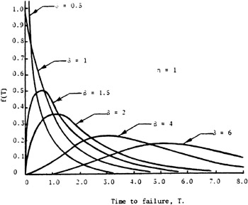
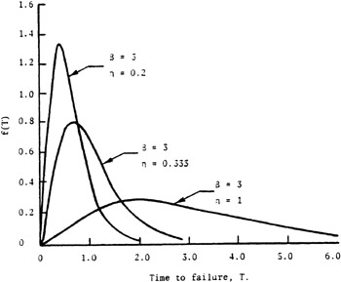
Graphs of various gamma distributions
Fixing r=3 (labeled B in graphs) and varying λ (=1/n in graphs)
Fixing λ=1 and varying r (labeled B in graphs)

Slide 10
Exercise 4.6.1 Weather station
An Arctic weather station has three electronic wind gauges. Only one is used at any given time. The lifetime of each gauge is exponentially distributed with a mean of 1000 hrs. On average, how long will it be until the last gauge wears out?
This is gamma with $=\frac{1}{1000}$ and r=3. $E\left(X\right)=\frac{r}{λ}=\frac{3}{1/1000}=3000$

Slide 11
Exercise 4.6.3: some hints on how to proceed
A set of measurements Y₁, Y₂, . . . , Y₁₀₀ is taken from gamma dist. with µ = 1.5 & σ²= 0.75. How many Y_{i} ’s would you expect to find in the interval [1.0, 2.5]?
Tricky, multistep problem.
Overarching distribution is binomial
100 trials with a fixed but unknown p
p corresponds to chance that gamma outcome for a trial is between 1 & 2.5.
To do this we need parameters r and λ. To get these parameters, use
and the given to get 2 equations. This system is easily solved.

