Slide 1
Number Theory and Cryptography
Chapter 4
With Question/Answer Animations
Copyright © McGraw-Hill Education. All rights reserved. No reproduction or distribution without the prior written consent of McGraw-Hill Education.

Slide 2
Chapter Summary
4.1 Divisibility and Modular Arithmetic
4.2 Integer Representations and Algorithms
4.3 Primes and Greatest Common Divisors
4.4 Solving Congruences
4.5 Applications of Congruences
4.6 Cryptography

Slide 3
Cryptography
Section 4.6

Slide 4
Section Summary
Classical Cryptography
Cryptosystems
Public Key Cryptography
RSA Cryptosystem
Crytographic Protocols

Slide 5
Caesar Cipher
The process of making a message secret is encryption.
Julius Caesar created secret messages by shifting each letter three letters forward (sending the last three letters to the first three letters.)
For example,
  B is replaced by E
  X is replaced by A.
Here is how the encryption process works:
Replace each letter by an integer from Z₂₆, that is an integer from 0 to 25
  representing 1 less than its position in alphabet (better yet, index using 0 to 25)
The encryption function is f(p) = (p + 3) mod 26.
  It replaces each integer p in the set {0,1,2,…,25} by f(p) in the set {0,1,2,…,25} .
Replace f(p) by the letter in position p in the alphabet.
Example: Encrypt “MEET YOU IN THE PARK” using the Caesar cipher.
Solution: 12 4 4 19 24 14 20 8 13 19 7 4 15 0 17 10.
Now replace each of these numbers p by f(p) = (p + 3) mod 26.
15 7 7 22 1 17 23 11 16 22 10 7 18 3 20 13.
Translating the numbers back to letters produces the encrypted message
“PHHW BRX LQ WKH SDUN.”

Slide 6
Caesar Cipher
The process of recovering the original message is decryption.
To recover the original message, use f⁻¹(p) = (p−3) mod 26.
  So, each letter in the coded message is shifted back three letters (with the first three letters sent to the last three letters)
The Caesar cipher is one of a family of shift ciphers.
Letters are shifted by an integer k, with 3 just one possibility.
The encryption function is f(p) = (p + k) mod 26
The decryption function is f⁻¹(p) = (p−k) mod 26
k is the key.

Slide 7
Shift Cipher
Example 1: Encrypt “STOP GLOBAL WARMING” using the shift cipher with k = 11.
Solution: Replace each letter with an element of Z₂₆.
18 19 14 15 6 11 14 1 0 11 22 0 17 12 8 13 6.
Apply the shift f(p) = (p + 11) mod 26, yielding
3 4 25 0 17 22 25 12 11 22 7 11 2 23 19 24 17.
Translating #s back to letters produces the ciphertext
“DEZA RWZMLW HLCXTYR.”

Slide 8
Cryptanalysis on a shift cipher
Example 2: If ciphertext is “LEWLYPLUJL PZ H NYLHA ALHJOLY” was encrypted using a shift cipher, find the message.
Solution: There are an awful lot of L's (7) in this ciphertext and the letter used most frequently in English is E.
To go from E to L is a shift of 7, so we suspect that k = 7.
Replacing each letter with an element of Z₂₆:
11 4 22 11 24 15 11 20 9 11 15 25 7 13 24 11 7 0 0 11 7 9 14 11 24.
Shift each of #s by −k = −7 modulo 26, yielding
4 23 15 4 17 8 4 13 2 4 8 18 0 6 17 4 0 19 19 4 0 2 7 4 17
Translating the #s back to letters produces
“EXPERIENCE IS A GREAT TEACHER.”
So our guess of k = 7 paid off. If it had still been gobbledygook, then look at another letter that occurs frequently, such as Y or H (3 each).
More sophisticated approaches using multiple letters are also available.

Slide 9
Affine Ciphers
Shift ciphers are special case of affine ciphers, whose encryption function is
f(p) = (ap + b) mod 26,
where a and b are integers chosen so that f is a bijection
(i.e., gcd(a, 26) = 1)
Example: If f(p) = (7p + 3) mod 26 is used for encryption
what letter replaces the letter K?
Soltn: (i) 10 represents K & f(10) = (7∙10 + 3) mod 26 =21, which is then replaced by V.

Slide 10
Affine Ciphers
To decrypt, solve c ≡ ap + b (mod 26) for p.
  Subtract b from both sides to obtain c− b ≡ ap (mod 26).
  Multiply both sides by inverse of a mod 26 (exists since gcd(a,26)= 1)
  ā(c− b) ≡ āap (mod 26), which simplifies p ≡ ā(c− b) (mod 26)
Example (cont.): If f(p) = (7p + 3) mod 26 is the encryption.
(ii) What letter does X stand for? (X corresponds to c=23)
Solution: (ii) To find inverse of 7, perform Euclidean algorithm with 26=3*7+5, 7=1*5+2, 5=2*2+1 or 26-3*7=5, 7-1*5=2, 5-2*2=1
  Hence 5-2*(7-1*5)=1 or 3*5-2*7=1 or 3*(26-3*7)-2*7=1 or 3*26-11*7=1
  Thus the inverse of a= 7 is -11 ≡15. b is 7 and c=23
  So p ≡ ā(c− b) ≡ 15(23 − 3) ≡ 15*20 ≡ 300 ≡ 14 so original letter is O.
  (Verify that f(14) does indeed give you 23!)

Slide 11
Cryptanalysis of Affine Ciphers
The process of recovering plaintext from ciphertext is cryptanalysis
An important tool for cryptanalyzing ciphertext produced with any bijection of letters is relative frequencies of letters.
The 9 most common letters in the English texts are
E 13%, T 9%, A 8%, O 8%, I 7%, N 7%, S 7%, H 6%, and R 6%.
To analyze ciphertext where a shift cipher is suspected
  Find the frequency of the letters in the ciphertext.
  Hypothesize that the most frequent letter is produced by encrypting E.
  If the value of the shift from E to the most frequent letter is k, shift the ciphertext by −k and see if it makes sense.
  If not, try T as a hypothesis or look at the 2nd most common letter as a candidate for E as we discussed earlier.

Slide 12
Cryptanalysis of Affine Ciphers
E 13%, T 9%, A 8%, O 8%, I 7%, N 7%, S 7%, H 6%, and R 6%.
Example: intercepted message “ZNK KGXRE HOXJ MKZY ZNK CUXS”. Let’s cryptanalyze.
Solution: The most common letter in the ciphertext is K. So perhaps the letters were shifted by 6 since this would then map E to K. Shifting the entire message by −6 gives us “THE EARLY BIRD GETS THE WORM.”
If no shift works then try an affine cipher.
Look at the 2 highest frequency letters and assign to E and T respectively. This should provide you with the a and c of the encryption function.
If not, try assigning them to E and A, etc.

Slide 13
Block Ciphers
Ciphers that replace each letter of the alphabet by another letter are character or monoalphabetic ciphers.
They are vulnerable to cryptanalysis based on letter frequency.
Block ciphers avoid this problem, by replacing blocks of letters with other blocks of letters.
A simple block cipher is the transposition cipher.
  The key is a permutation σ of the set {1,2,…,m}, m ∈ Z
  (that is a one-to-one function from {1,2,…,m} to itself)
To encrypt a message, split the letters into blocks of size m, adding additional letters to fill out the final block.
We encrypt p₁, p₂,…, p_{m} as c₁, c₂,…, c_{m} = p_{σ(1)}, p_{σ(2)},…, p_{σ(m)}.
To decrypt c₁, c₂,…, c_{m} apply the inverse permutation σ⁻¹.

Slide 14
Block Ciphers
Example: Using the permutation σ of {1,2,3,4} with
σ(1) = 3, σ(2) = 1, σ(3) = 4, σ(4) = 2,
  Encrypt the plaintext PIRATE ATTACK
  Decrypt the ciphertext message SWUE TRAEOEHS.
Solution:
  Split into four blocks PIRA TEAT TACK.
Apply the permutation σ giving IAPR ETTA AKTC.
  σ⁻¹ : σ ⁻¹(1) = 2, σ ⁻¹(2) = 4, σ ⁻¹(3) = 1, σ ⁻¹(4) = 3.
  Apply the permutation σ⁻¹ giving USEW ATER HOSE.
  Split into words to obtain USE WATER HOSE.

Slide 15
Cryptosystems
Definition: A cryptosystem is a 5-tuple (P,C,K,E,D), where
  P is the set of plaintext strings,
  C is the set of ciphertext strings,
  K is the keyspace (set of all possible keys),
  E is the set of encryption functions, and
  D is the set of decryption functions.
The encryption function in E corresponding to the key k is denoted by E_{k} and the decryption function in D that decrypts cipher text encrypted using E_{k} is denoted by D_{k}. Therefore:
D_{k}(E_{k}(p)) = p, for all plaintext strings p.

Slide 16
Cryptosystems
Example: Describe shift ciphers as a cryptosystem.
Solution:
  P is the set of strings of elements in Z₂₆,
  C is the set of strings of elements in Z₂₆,
  K = Z₂₆,
  E consists of functions E_{k} (p) = (p + k) mod 26,
  D is the same as E where D_{k} (p) = (p − k) mod 26 .

Slide 17
Public Key Cryptography
All classical ciphers are private key cryptosystems.
  Knowing encryption key allows one to quickly determine decryption key.
All parties who wish to communicate using private key cryptosystem must share the key and keep it a secret.
In public key cryptosystems, invented in the 1970s, knowing how to encrypt does not help one to decrypt.
Therefore, everyone can have a publicly known encryption key.
Only the decryption key needs to be kept secret.

Slide 18


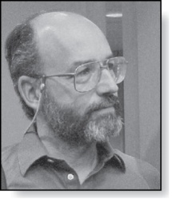
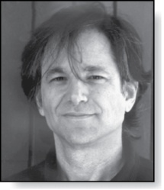
The RSA Cryptosystem
Clifford Cocks (Born 1950)
A public key cryptosystem, now known as the RSA system was introduced in 1976 by three researchers at MIT.
It is now known that the method was discovered earlier by Clifford Cocks, working secretly for the UK government.
The public encryption key is (n, e):
n = pq (the modulus) is the product of two large (~200 digit) primes p, q,
e is an exponent that is relatively prime to (p−1)(q −1).
The two large primes can be found using probabilistic primality tests.
But n = pq, with approximately 400 digits, cannot be factored in a reasonable length of time.
Leonard
Adelman
(Born 1945)
Ronald Rivest
(Born 1948)
Adi Shamir
(Born 1952)

Slide 19
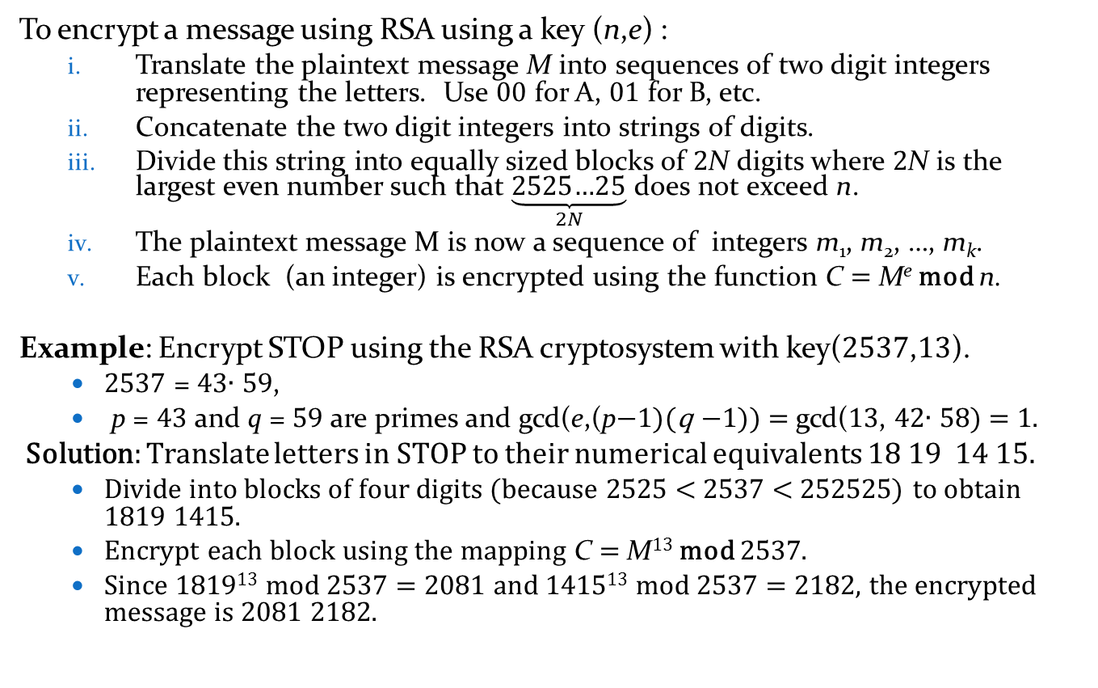
RSA Encryption
To encrypt a message using RSA using a key (n,e) :
  Translate the plaintext message M into sequences of two digit integers representing the letters. Use 00 for A, 01 for B, etc.
  Concatenate the two digit integers into strings of digits.
  Divide this string into equally sized blocks of 2N digits where 2N is the largest even number such that $\underset{2N}{\underbrace{\text{2525…25}}}$ does not exceed n.
  The plaintext message M is now a sequence of integers m₁, m₂, …, m_{k}.
  Each block (an integer) is encrypted using the function C = Me mod n.
Example: Encrypt STOP using the RSA cryptosystem with key(2537,13).
  2537 = 43∙ 59,
  p = 43 and q = 59 are primes and gcd(e,(p−1)(q −1)) = gcd(13, 42∙ 58) = 1.
Solution: Translate letters in STOP to their numerical equivalents 18 19 14 15.
  Divide into blocks of four digits (because 2525 < 2537 < 252525) to obtain 1819 1415.
  Encrypt each block using the mapping C = M¹³ mod 2537.
  Since 1819¹³ mod 2537 = 2081 and 1415¹³ mod 2537 = 2182, the encrypted message is 2081 2182.

Slide 20
RSA Decryption
To decrypt a RSA ciphertext, the decryption key d, an inverse of e mod (p−1)(q −1) is needed. The inverse exists since gcd(e,(p−1)(q −1)) = gcd(13, 42∙ 58) = 1.
With the decryption key d, we can decrypt each block with the computation
M = C^{d} mod p∙q. (see text for full derivation)
RSA works as a public key system since the only known method of finding d is based on a factorization of n into primes.
There is currently no known feasible method for factoring large #s into primes.
Example: The message 0981 0461 is received. What is the decrypted message if it was encrypted using the RSA cipher from the previous example.
Solution: The message was encrypted with n = 43∙ 59 and exponent 13. An inverse of 13 modulo 42∙ 58 = 2436 (exercise 2 in Section 4.4) is d = 937.
  To decrypt a block C, M = C⁹³⁷ mod 2537.
  Since 0981⁹³⁷ mod 2537 = 0704 and 0461⁹³⁷ mod 2537 = 1115, the decrypted message is 0704 1115.
  Translating back to English letters, the message is HELP.

Slide 21
Cryptographic Protocols: Key Exchange
Cryptographic protocols are exchanges of messages carried out by two or more parties to achieve a particular security goal.
Key exchange is a protocol by which two parties can exchange a secret key over an insecure channel without having any past shared secret information. Here the Diffie-Hellman key agreement protocol is described by example.
  Suppose that Alice and Bob want to share a common key.
  Alice and Bob agree to use a prime p and a primitive root a of p.
  Alice chooses a secret integer k₁ and sends a^{k1} mod p to Bob.
  Bob chooses a secret integer k₂ and sends a^{k2} mod p to Alice.
  Alice computes (a^{k2})^{k1} mod p.
  Bob computes (a^{k1})^{k2} mod p.
At the end of the protocol, Alice and Bob have their shared key
(a^{k2})^{k1} mod p = (a^{k1})^{k2} mod p.
To find the secret information from the public information would require the adversary to find k₁ and k₂ from a^{k1} mod p and a^{k2} mod p respectively.
This is an instance of the discrete logarithm problem, considered to be computationally infeasible when p and a are sufficiently large.

Slide 22
Cryptographic Protocols: Digital Signatures
Adding a digital signature to a message is a way of ensuring the recipient that the message came from the purported sender.
Suppose that Alice’s RSA public key is (n,e) and her private key is d. Alice encrypts a plain text message x using E_{(n,e)} (x)= x^{d} mod n. She decrypts a ciphertext message y using D_{(n,e)} (y)= y^{d} mod n.
Alice wants to send a message M so that everyone who receives the message knows that it came from her.
  She translates the message to numerical equivalents and splits into blocks, just as in RSA encryption.
  She then applies her decryption function D_{(n,e)} to the blocks and sends the results to all intended recipients.
  The recipients apply Alice’s encryption function and the result is the original plain text since E_{(n,e)} (D_{(n,e)} (x))= x.
Everyone who receives the message can then be certain that it came from Alice.

Slide 23
Cryptographic Protocols: Digital Signatures
Example: Suppose Alice’s RSA cryptosystem is same as in earlier example with key(2537,13), 2537 = 43∙ 59, p = 43, q = 59 and
gcd(e,(p−1)(q −1)) = gcd(13, 42∙ 58) = 1.
Her decryption key is d = 937. She wants to send “MEET AT NOON” to her friends so that they can be certain that the message is from her.
Solution: Alice translates the message into blocks of digits
1204 0419 0019 1314 1413.
  She then applies her decryption transformation D_{(2537,13)} (x)= x⁹³⁷ mod 2537 to each block.
  She finds (using her laptop, programming skills, and knowledge of discrete mathematics) that 1204⁹³⁷ mod 2537 = 817, 419⁹³⁷ mod 2537 = 555 , 19⁹³⁷ mod 2537 = 1310, 1314⁹³⁷ mod 2537 = 2173, and 1413⁹³⁷ mod 2537 = 1026.
  She sends 0817 0555 1310 2173 1026.
When one of her friends receive the message, they apply Alice’s encryption transformation E_{(2537,13)} to each block. They then obtain the original message which they translate back to English letters.

