Slide 1
Induction and recursion
Chapter 5
With Question/Answer Animations
Copyright © McGraw-Hill Education. All rights reserved. No reproduction or distribution without the prior written consent of McGraw-Hill Education.

Slide 2
Chapter Summary
Mathematical Induction
Strong Induction
Well-Ordering
Recursive Definitions
Structural Induction
Recursive Algorithms
Program Correctness

Slide 3
Mathematical Induction
Section 5.1

Slide 4
Section Summary
Mathematical Induction
Examples of Proof by Mathematical Induction
Mistaken Proofs by Mathematical Induction
Guidelines for Proofs by Mathematical Induction

Slide 5
Climbing an Infinite Ladder
Suppose we have an infinite ladder:
We can reach the first rung of the ladder.
If we can reach a particular rung of the ladder,
then we can reach the next rung.
From (1), we can reach the 1st rung.
Then by applying (2), we can reach the 2nd rung.
Applying (2) again, the third rung.
And so on.
We can apply (2) any number of times to reach any particular rung, no matter how high up.
This example motivates proof by mathematical induction.

Slide 6
Principle of Mathematical Induction (M.I.)
To prove that P(n) is true ∀n ∈ Z⁺, we complete these steps:
Basis Step: Show that P(1) is true.
Inductive Step: Show that P(k) → P(k + 1) is true ∀k ∈Z⁺.
To complete inductive step, we assume the inductive hypothesis that P(k) holds for arbitrary k ∈Z⁺ & show that P(k + 1) is true.
Climbing an Infinite Ladder Example:
BASIS STEP: By (1), we can reach rung 1.
INDUCTIVE STEP: We assume the inductive hypothesis that we can reach rung k. Then by (2), we can reach rung k + 1.
Hence, P(k) → P(k + 1) is true ∀k ∈Z⁺.
And we conclude that we can reach every rung on the ladder.

Slide 7
Important Points About Using M.I.
Mathematical induction can be expressed as the rule of inference
where the domain is Z⁺.
We don’t assume that P(k) is true ∀k ∈Z⁺!
We show that if P(k) is true,
then P(k + 1) must also be true.
Proofs by mathematical induction do not always start at 1. The starting point b can be any integer.
We will see examples of this soon.
(P(1) ∧ ∀k (P(k) → P(k + 1))) → ∀n P(n),

Slide 8
Validity of Mathematical Induction
Mathematical induction is valid because of the well ordering property, which states that every nonempty set of positive integers has a least element (see Section 5.2 & Appendix 1).
Suppose that P(1) holds and P(k) → P(k + 1) is true ∀k ∈Z⁺.
Assume that ∃n ∈Z⁺ for which P(n) is false.
Then the set S ⊆ Z⁺ for which P(n) is false is nonempty.
By the well-ordering property, S has a least element, say m.
We know that m can not be 1 since P(1) holds.
Since m > 1, m – 1 > 0 and m – 1 ÏS, P(m − 1) must be true.
But then, P(k) → P(k + 1), means P(m) must also be true.
This contradicts P(m) being false.
Hence, P(n) must be true ∀n ∈Z⁺.

Slide 9
How Mathematical Induction Works
Consider an infinite sequence of dominoes, labeled 1,2,3, …, where each domino is standing.
We know that the 1st domino is knocked down, i.e., P(1) is true .
We also know that if whenever the k^{th} domino is knocked over,
it knocks over the (k + 1)^{st} domino, i.e, P(k) → P(k + 1) ∀k ∈Z⁺.
Let P(n) be the proposition that the nth domino is knocked over.
\ all dominos are knocked over,
i.e., P(n) is true ∀n ∈Z⁺.

Slide 10
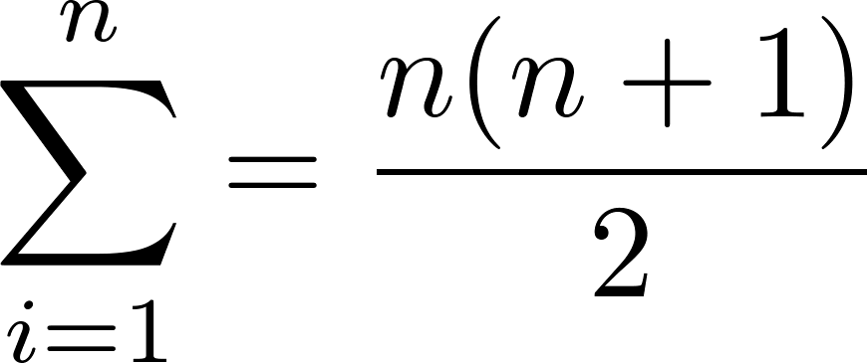
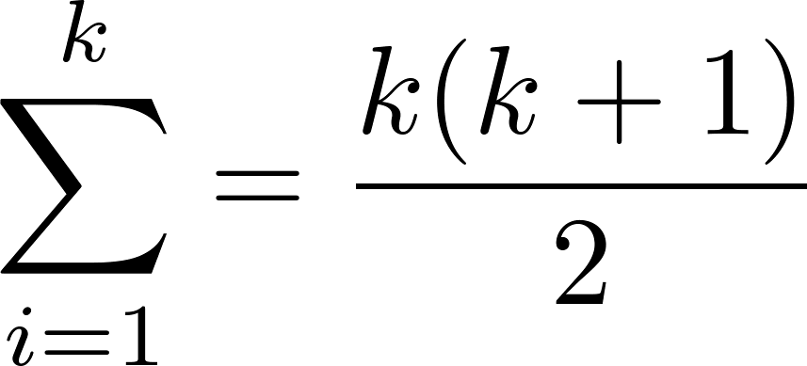
Proving a Summation Formula by Mathematical Induction
Note: Once we have this conjecture, mathematical induction can be used to prove it correct.
Example: Show that:
Solution:
BASIS STEP: P(1) is true since 1(1 + 1)/2 = 1.
INDUCTIVE STEP: Assume true for P(k).
The inductive hypothesis is
Under this assumption,
This is precisely the formula if you replace n with k+1.

Slide 11
Conjecturing and Proving
Example: Conjecture a formula for the sum of the first n positive odd integers. Then prove your conjecture.
Conjecture: We have: 1= 1, 1 + 3 = 4, 1 + 3 + 5 = 9,
1 + 3 + 5 + 7 = 16, 1 + 3 + 5 + 7 + 9 = 25.
We conjecture that the sum of the first n positive odd integers is n², i.e.,
1 + 3 + 5 + ∙∙∙+ (2n − 1) + (2n + 1) =n² .

Slide 12
Conjecturing and Proving (cont.)
Example: Conjecture and prove correct a formula for the sum of the first n positive odd integers.
Proof: We use mathematical induction to prove conjecture
BASIS STEP: P(1) is true since 1² = 1.
INDUCTIVE STEP:
Assume inductive hypothesis P(k) holds and show P(k + 1).
Hence, we have shown that P(k + 1) follows from P(k).
\sum of the first n positive odd integers is n².
1 + 3 + 5 + ∙∙∙+ (2n − 1) + (2n + 1) =n² .
Inductive Hypothesis: 1 + 3 + 5 + ∙∙∙+ (2k − 1) = k²
1 + 3 + 5 + ∙∙∙+ (2k − 1) + (2k + 1) =[1 + 3 + 5 + ∙∙∙+ (2k − 1)] + (2k + 1)
= k² + (2k + 1) (by inductive hypothesis)
= k² + 2k + 1 = (k + 1) ²

Slide 13
Inequalities
Example 1: Use mathematical induction to prove that
n < 2^{n} ∀n ∈ N.
Solution: Let P(n) be the proposition that n < 2^{n}.
BASIS STEP: P(0) is true since 0 < 2⁰ = 1.
INDUCTIVE STEP:
Assume P(k) holds, i.e., k < 2^{k}, for an arbitrary k ∈ N.
We show that P(k + 1) holds.
k + 1 < 2^{k} + 1 ≤ 2^{k} + 2^{k} = 2 ∙ 2^{k} = 2^{k+1} (0 ≤ k so 1 ≤ 2^{k})
\n < 2^{n} holds ∀n.

Slide 14
Inequalities
Example 2: Prove that 2^{n} < n!, ∀n ∈ Z, n ≥ 4.
Solution: Let P(n) be the proposition that 2^{n} < n!.
BASIS STEP: P(4) is true since 2⁴ = 16 < 4! = 24.
INDUCTIVE STEP: Assume P(k) holds, i.e., 2^{k} < k! for an arbitrary integer k ≥ 4. We show that P(k + 1) holds:
2^{k+1} = 2∙2^{k}
< 2∙ k! (by the inductive hypothesis)
< (k + 1)k! = (k + 1)! (1<3<k so 2<k+1)
\ 2^{n} < n! holds ∀n ∈ Z, n ≥ 4.
Note that here the basis step is P(4), since P(0), P(1), P(2), and P(3) are all false.

Slide 15
Divisibility Results
Example: Show that 3 | n³ − n ∀n ∈ Z⁺.
Solution: Let P(n) be the proposition that 3 | n³ − n.
BASIS STEP: P(1) is true since 1³ − 1 = 0, which is divisible by 3.
INDUCTIVE STEP: Assume P(k): 3 | k³ − k, for an arbitrary k ∈ Z⁺.
We show P(k + 1):
(k + 1)³ − (k + 1) = (k³ + 3k² + 3k + 1) − (k + 1)
= (k³ − k) + 3(k² + k)
By inductive hypothesis, 1st term (k³ − k) is divisible by 3 and 2nd term is divisible by 3 since it is an integer multiplied by 3.
So by Thm 1 in Section 4.1 , (k + 1)³ − (k + 1) is divisible by 3.
\ 3 | n³ − n ∀n ∈ Z⁺.

Slide 16
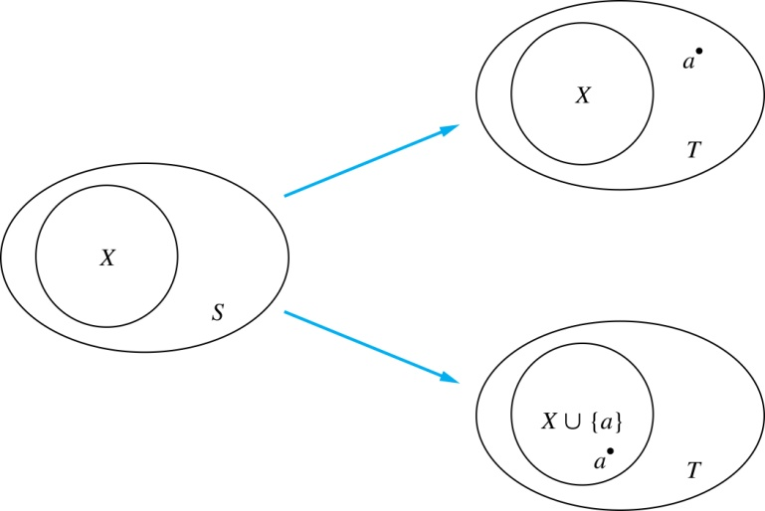
Number of Subsets of a Finite Set
Example: Use M.I. to show that if S is a finite set and $\left|S\right|=n$, n ∈ N, then # of subsets of S is 2^{n}.
Solution: Let P(n) be proposition that S has 2^{n} subsets.
Basis Step: P(0) is true (Æ has only itself as a subset & 2⁰ = 1).
Inductive Step: Assume P(k) is true for k ∈ N, arbitrary.
Given T, $\left|T\right|=k$+1, remove first element “a”: $S=T−\left\{a\right\}$.
$\left|S\right|=k$and so has 2^{k} subsets.
For each subset X of S, there are exactly
two subsets of T: X and X ∪ {a}.
\#subsets of T is 2*2^{k} = 2^{k+1}
Inductive Hypothesis: For arbitrary k ∈ N, S with $\left|S\right|=$k, then S has 2^{k} subsets.

Slide 17
Tiling Checkerboards
Example: Show that every 2^{n} ×2^{n}
checkerboard with one square removed
can be tiled using right triominoes (->):
Solution: Let P(n) be the proposition that every 2^{n} ×2^{n} checkerboard with one square removed can be tiled using right triominoes. Use M.I.
BASIS STEP: P(1) is true, because each of the four 2 ×2 boards with a square removed can be tiled using a single right triomino (as pictured above).
INDUCTIVE STEP: Assume P(k) is true for every 2^{k} ×2^{k} checkerboard, for some k ∈ Z⁺.
continued →

Slide 18
Tiling Checkerboards
Inductive Hypothesis: For some k ∈ Z⁺, every 2^{k} ×2^{k} checkerboard with one square removed can be tiled using right triominoes.
Consider a 2^{k+1} ×2^{k+1} checkerboard with one square removed. Split this checkerboard into 4 checkerboards of size 2^{k} × 2^{k}, by dividing it in ½ in both directions.
Also by the inductive hypothesis, the other three boards can be tiled with the square from the corner of the center of the original board removed. We can then cover the 3 adjacent squares with a triominoe.
Hence, the entire 2^{k+1} ×2^{k+1} checkerboard with one square removed can be tiled using right triominoes.
Remove a square from one of the
four 2^{k} ×2^{k} checkerboards.
By the inductive hypothesis,
this board can be tiled.

Slide 19
An Incorrect “Proof” by Mathematical Induction
Example: Let P(n) be the statement that every set of n lines in the plane, no two of which are parallel, meet in a common point. Here is a “proof” that P(n) is true for all positive integers n ≥ 2.
BASIS STEP: The statement P(2) is true because any two lines in the plane that are not parallel meet in a common point.
INDUCTIVE STEP: The inductive hypothesis is the statement that P(k) is true for k ∈Z, k ≥ 2, i.e., every set of k lines in the plane, no two of which are parallel, meet in a common point.
We must show that if P(k) holds, then P(k + 1) holds, i.e., if every set of k lines in the plane, no 2 of which are parallel, meet in a common point, then every set of k + 1 lines in the plane, no two of which are parallel, meet in a common point.
continued →

Slide 20
An Incorrect “Proof” by Mathematical Induction
Inductive Hypothesis: Every set of k lines in the plane, where k ≥ 2, no two of which are parallel, meet in a common point.
Consider a set of k + 1 distinct lines in the plane, no two parallel.
By the inductive hypothesis,
the first k of these lines must meet in a common point p₁
and the last k of these lines meet in a common point p₂.
If p₁, p₂ are different pts, all lines containing both of them must be the same line since two pts determine a line.
This contradicts assumption that the lines are distinct.
Hence, p₁ = p₂ lies on all k + 1 distinct lines, and therefore P(k + 1) holds.
Assuming that k ≥2, distinct lines meet in a common point,
then every k + 1 lines meet in a common pt.
There must be an error in this proof since the conclusion is absurd.
But where is the error?

Slide 21
An Incorrect “Proof” by Mathematical Induction
Inductive Hypothesis: Every set of k lines in the plane, where k ≥ 2, no two of which are parallel, meet in a common point.
Consider a set of k + 1 distinct lines in the plane, no two parallel.By the inductive hypothesis, the first k of these lines must meet in a common point p₁ and the last k of these lines meet in a common point p₂.
If p₁, p₂ are different pts, all lines containing both of them must be the same line since two pts determine a line. This contradicts assumption that the lines are distinct. Hence, p₁ = p₂ lies on all k + 1 distinct lines, and therefore P(k + 1) holds. Assuming that k ≥2, distinct lines meet in a common point, then every k + 1 lines meet in a common pt.
Where is the error?
Answer: P(k)→ P(k + 1) only holds for k ≥3. It is not the case that P(2) implies P(3). The 1st two lines must meet in a common point p₁ and the 2nd two must meet in a common point p₂.
They do not have to be the same point since only the 2nd line is common to both sets of lines.

Slide 22
Guidelines for Mathematical Induction
Express the statement that is to be proved in the form “for all n ≥ b, P(n)” for a fixed integer b.
Write out the words “Basis Step.” Then show that P(b) is true, taking care that the correct value of b is used. This completes the first part of the proof.
Write out the words “Inductive Step.”
State, and clearly identify, the inductive hypothesis, in the form “assume that P(k) is true for an arbitrary fixed integer k ≥ b.”
State what needs to be proved under the assumption that the inductive hypothesis is true. That is, write out what P(k + 1) says.
Prove the statement P(k + 1) making use the assumption P(k). Be sure that your proof is valid for all integers k with k ≥ b, taking care that the proof works for small values of k, including k = b.
Clearly identify the conclusion of the inductive step, such as by saying “this completes the inductive step.”
After completing the basis step and the inductive step, state the conclusion, namely that by mathematical induction, P(n) is true for all integers n with n ≥ b.

