Slide 1
Number Theory and Cryptography
Chapter 4
With Question/Answer Animations
Copyright © McGraw-Hill Education. All rights reserved. No reproduction or distribution without the prior written consent of McGraw-Hill Education.

Slide 2
Chapter Overview
Number theory is the study of integers & their properties.
Key ideas include divisibility and primality.
Representations of integers, including binary and hexadecimal, may be considered part of number theory.
Due to its beauty, accessibility, and wealth of open questions, number theory has attracted many mathematicians.
In our exploration of number theory, we’ll develop many of the proof methods and strategies introduced in chapter 1.
Mathematicians consider number theory to be pure mathematics, but it has important applications to computer science and cryptography (Sections 4.5 and 4.6).

Slide 3
Chapter Summary
4.1 Divisibility and Modular Arithmetic
4.2 Integer Representations and Algorithms
4.3 Primes and Greatest Common Divisors
4.4 Solving Congruences
4.5 Applications of Congruences
4.6 Cryptography

Slide 4
Divisibility and Modular Arithmetic
Section 4.1

Slide 5
Section Summary
Division
Division Algorithm
Modular Arithmetic

Slide 6
Definition of Divisibility
If a and b are integers with a ≠ 0, then a divides b if ∃c∈ Z such that b = ac, i.e., if b/a∈ Z .
  When a divides b we say that a is a factor or divisor of b and that b is a multiple of a.
  The notation a | b denotes that a divides b.
  If a does not divide b, we write a ∤ b.
Exercise: Determine if 3 | 7 and if 3 | 12.
3 ∤ 7 (7/3 is not an integer)
but 3 | 12 (12/3 = 4)

Slide 7
Properties of Divisibility
Theorem 1: Let a ≠0, b, c ∈ Z.
  If a | b and a | c, then a | (b + c);
  If a | b, then a | bc ∀c ∈ Z;
  If a | b and b | c, then a | c.
  Proof: (i) If a | b and a | c, then ∃s, t ∈ Z with b = as and c = at. Hence,
  b + c = as + at = a(s + t). \a | (b + c).
(Exercises 3 and 4 ask for proofs of parts (ii) and (iii).)
Corollary: If a ≠0, b, c ∈ Z, such that a | b and a | c, then
a | mb + nc if m, n ∈ Z.
Show how it follows easily from (ii) and (i) of Theorem 1.

Slide 8
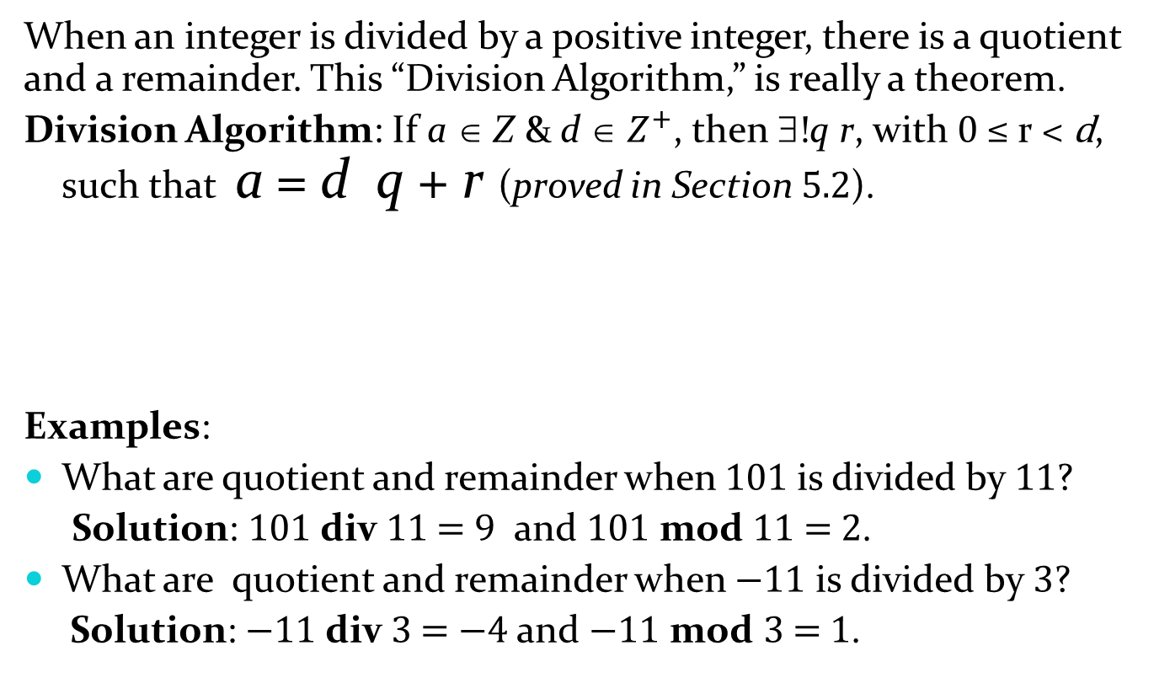
Division Algorithm
When an integer is divided by a positive integer, there is a quotient and a remainder. This “Division Algorithm,” is really a theorem.
Division Algorithm: If a ∈ Z & d ∈ $Z^{+}$, then ∃!q r, with 0 ≤ r < d, such that a = d q + r (proved in Section 5.2).
Examples:
What are quotient and remainder when 101 is divided by 11?
Solution: 101 div 11 = 9 and 101 mod 11 = 2.
What are quotient and remainder when −11 is divided by 3?
Solution: −11 div 3 = −4 and −11 mod 3 = 1.
Definitions of Functions div and mod
  q = a div d
  r = a mod d

Slide 9
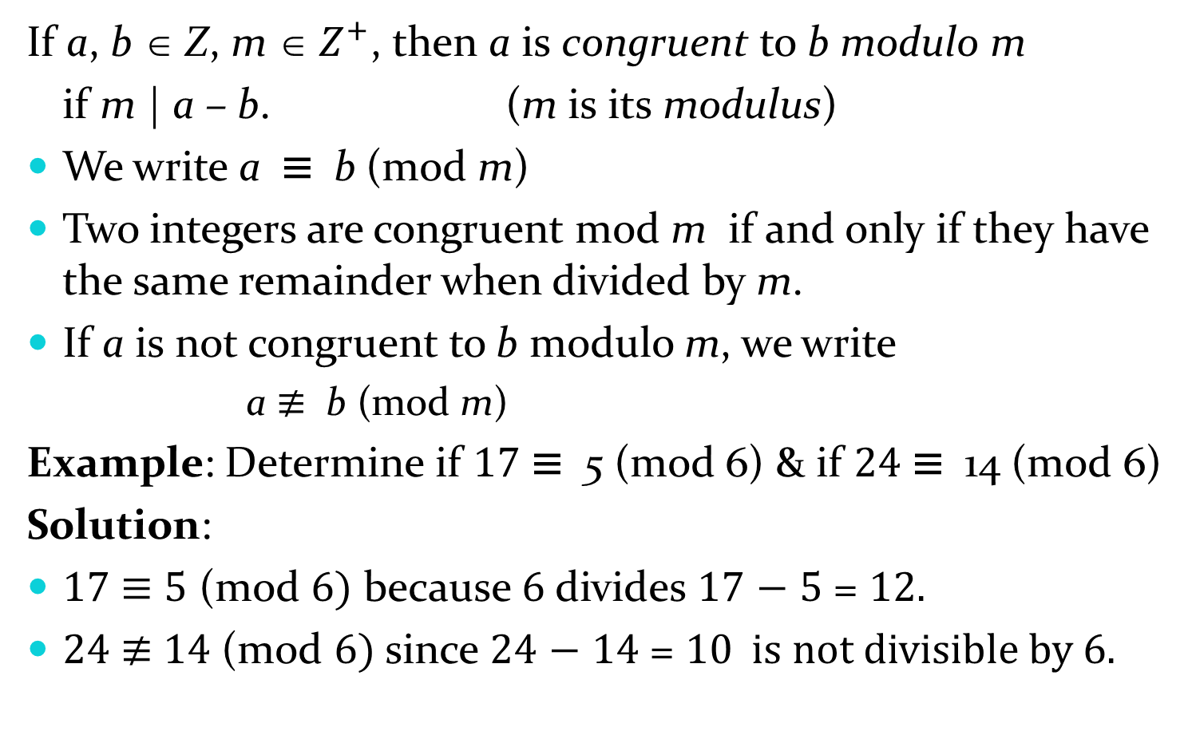
Definition of Congruence Relation
If a, b ∈ Z, m ∈ $Z^{+}$, then a is congruent to b modulo m
if m | a – b. (m is its modulus)
We write a ≡ b (mod m)
Two integers are congruent mod m if and only if they have the same remainder when divided by m.
If a is not congruent to b modulo m, we write
  a ≢ b (mod m)
Example: Determine if 17 ≡ 5 (mod 6) & if 24 ≡ 14 (mod 6)
Solution:
17 ≡ 5 (mod 6) because 6 divides 17 − 5 = 12.
24 ≢ 14 (mod 6) since 24 − 14 = 10 is not divisible by 6.

Slide 10
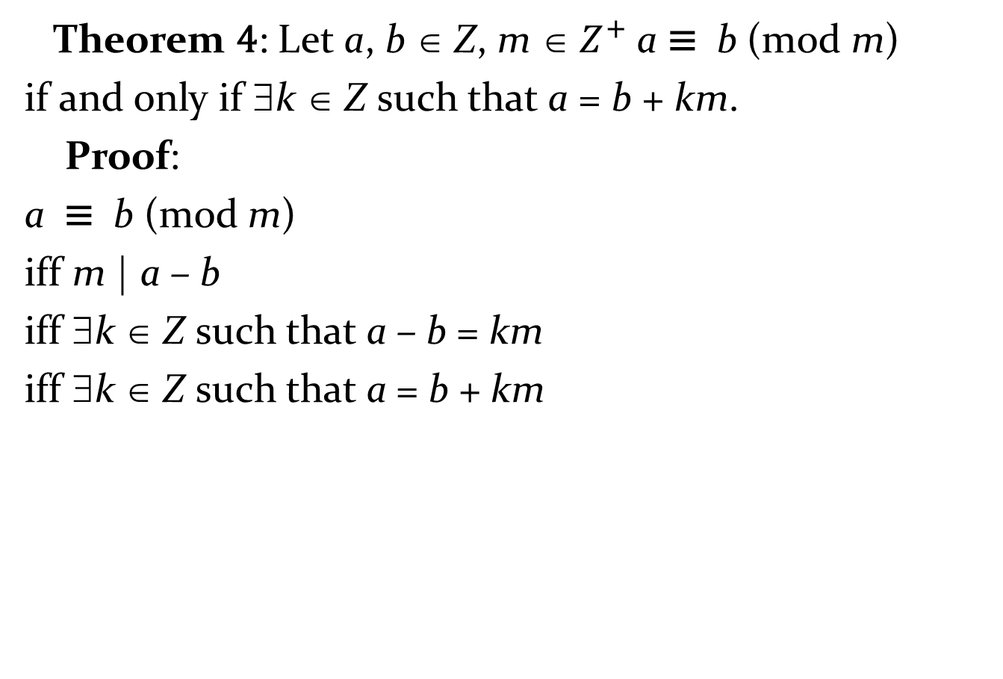
More on Congruences
Theorem 4: Let a, b ∈ Z, m ∈ $Z^{+}$a ≡ b (mod m)
if and only if ∃k ∈ Z such that a = b + km.
Proof:
a ≡ b (mod m)
iff m | a – b
iff ∃k ∈ Z such that a – b = km
iff ∃k ∈ Z such that a = b + km

Slide 11
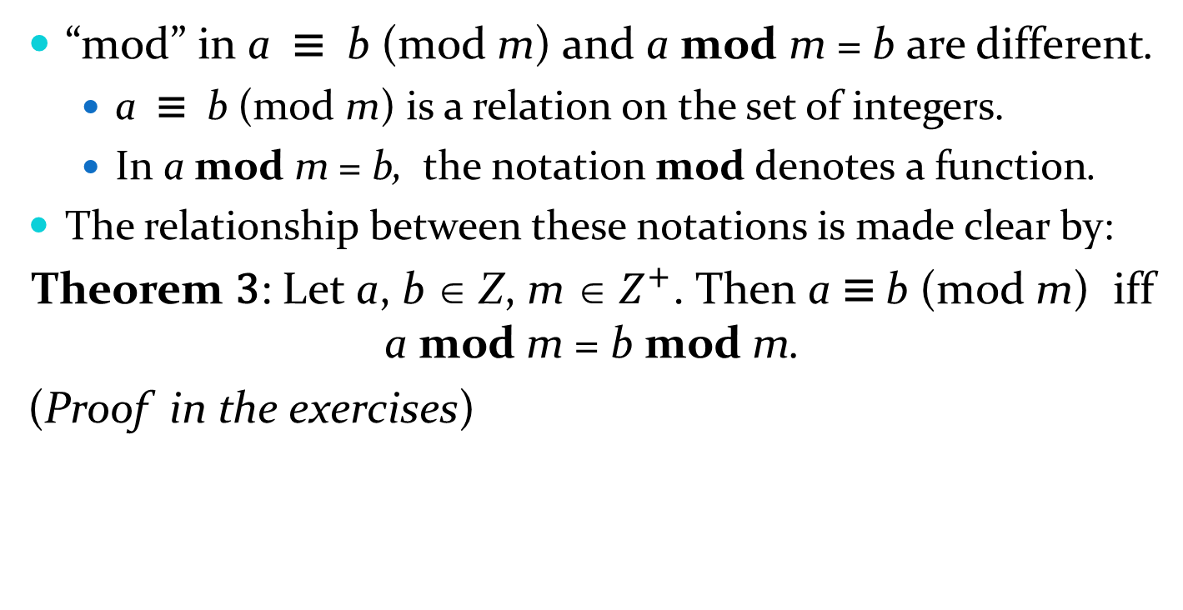
The Relationship between (mod m) and mod m Notations
“mod” in a ≡ b (mod m) and a mod m = b are different.
  a ≡ b (mod m) is a relation on the set of integers.
  In a mod m = b, the notation mod denotes a function.
The relationship between these notations is made clear by:
Theorem 3: Let a, b ∈ Z, m ∈ $Z^{+}$. Then a ≡ b (mod m) iff a mod m = b mod m.
(Proof in the exercises)

Slide 12
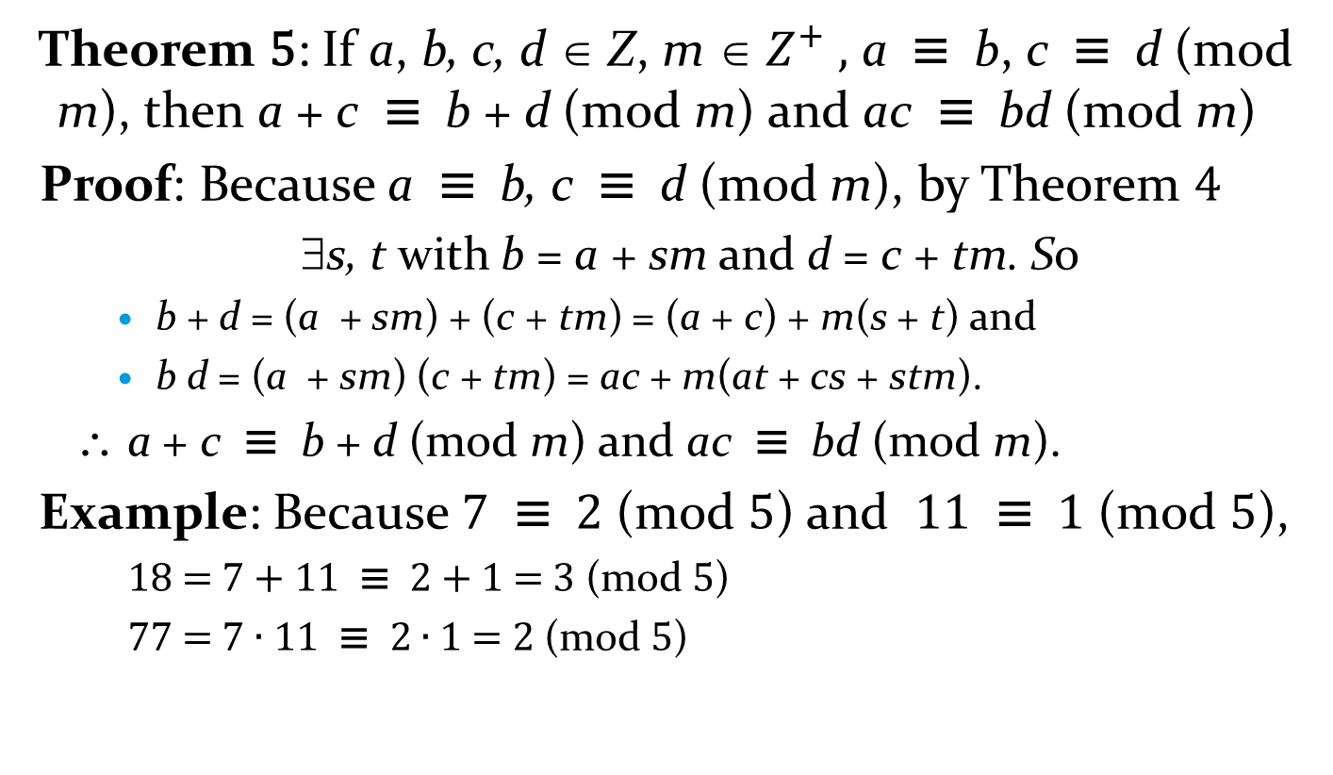
Congruences of Sums and Products
Theorem 5: If a, b, c, d ∈ Z, m ∈ $Z^{+} ,$ a ≡ b, c ≡ d (mod m), then a + c ≡ b + d (mod m) and ac ≡ bd (mod m)
Proof: Because a ≡ b, c ≡ d (mod m), by Theorem 4
  ∃s, t with b = a + sm and d = c + tm. So
    b + d = (a + sm) + (c + tm) = (a + c) + m(s + t) and
    b d = (a + sm) (c + tm) = ac + m(at + cs + stm).
  \ a + c ≡ b + d (mod m) and ac ≡ bd (mod m).
Example: Because 7 ≡ 2 (mod 5) and 11 ≡ 1 (mod 5),
    18 = 7 + 11 ≡ 2 + 1 = 3 (mod 5)
    77 = 7 ∙ 11 ≡ 2 ∙ 1 = 2 (mod 5)

Slide 13
Algebraic Manipulation of Congruences
Multiplying or adding to both sides preserves validity:
  If a ≡ b (mod m) holds and c ∈ Z then
  c∙a ≡ c∙b (mod m) and c + a ≡ c + b (mod m)
  hold by Theorem 5 with d = c.
Dividing does not always produce a valid congruence.
Example: The congruence 14≡ 8 (mod 6) holds. But dividing both sides by 2 does not produce a valid congruence since 14/2 = 7 and 8/2 = 4, but 7≢4 (mod 6).
See Section 4.3 for conditions when division is ok.

Slide 14
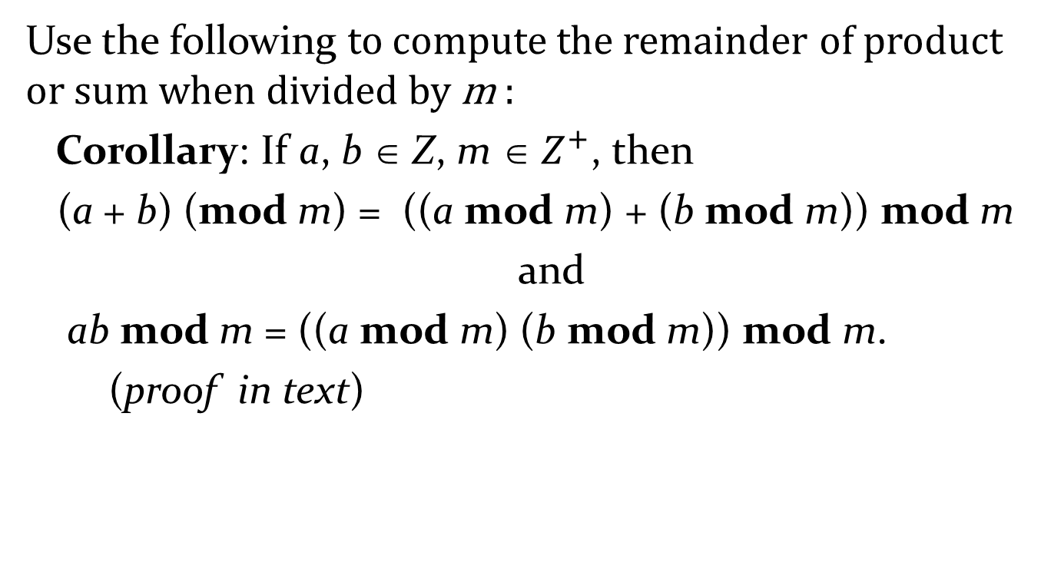
Computing mod m for ∙ and +
Use the following to compute the remainder of product or sum when divided by m :
Corollary: If a, b ∈ Z, m ∈ $Z^{+}$, then
(a + b) (mod m) = ((a mod m) + (b mod m)) mod m
and
ab mod m = ((a mod m) (b mod m)) mod m.
(proof in text)

Slide 15
Definitions: Arithmetic Modulo m
Let Z_{m} be the set of nonnegative integers less than m:
{0,1, …., m−1}
addition modulo m +_{m} is a +_{m} b = (a + b) mod m.
multiplication modulo m ∙_{m} is a ∙_{m} b = (a ∙ b) mod m.
Using these operations is doing arithmetic modulo m.
Example: Find 7 +₁₁ 9 and 7 ∙₁₁ 9.
Solution: Using the definitions above:
  7 +₁₁ 9 = (7 + 9) mod 11 = 16 mod 11 = 5
  7 ∙₁₁ 9 = (7 ∙ 9) mod 11 = 63 mod 11 = 8

Slide 16
Arithmetic Modulo m
+_{m} and ∙_{m} satisfy many of same props as ordinary + and ∙.
Closure: If a, b ∈ Z_{m} , then a +_{m} b ∈ Z_{m} and a ∙_{m} b ∈ Z_{m} as well.
Associativity: If a, b, c ∈ Z_{m} , then (a +_{m} b) +_{m} c = a +_{m} (b +_{m} c) and (a ∙_{m} b) ∙_{m} c = a ∙_{m} (b ∙_{m} c).
Commutativity: If a, b ∈ Z_{m}, then
a +_{m} b = b +_{m} a and a ∙_{m} b = b ∙_{m} a.
Identity: 0 and 1 are identity elements for + and * mod m:
  If a ∈ Z_{m} , then a +_{m} 0 = a and a ∙_{m} 1 = a.
a≠ 0 ∈ Z_{m} Þ m− a is the additive inverse of a mod m.
  a +_{m} (m− a) = 0 and 0 +_{m} 0 = 0 (0 is its own add inv.)
Distributivity: If a, b, and c belong to Z_{m} , then
  a ∙_{m} (b +_{m} c) = (a ∙_{m} b) +_{m} (a ∙_{m} c)
  (a +_{m} b) ∙_{m} c = (a ∙_{m} c) +_{m} (b ∙_{m} c)

Slide 17
Arithmetic Modulo m (cont.)
Exercises 42-44 ask for proofs of these properties.
Multiplicative inverses have not been included since they do not always exist.
  For example, there is no multiplicative inverse of 2 mod 6.
  Existence of an inverse is closely tied to existence of division already mentioned, as we will see in section 4.4.

