Slide 1
Algorithms
Chapter 3
With Question/Answer Animations
Copyright © McGraw-Hill Education. All rights reserved. No reproduction or distribution without the prior written consent of McGraw-Hill Education.

Slide 2
Chapter Summary
Algorithms
  Example Algorithms
  Algorithmic Paradigms
Growth of Functions
  Big-O and other Notation
Complexity of Algorithms

Slide 3
Complexity of Algorithms
Section 3.3

Slide 4
Section Summary
Time Complexity
Worst-Case Complexity
Algorithmic Paradigms
Understanding the Complexity of Algorithms

Slide 5
The Complexity of Algorithms
Given problem, algorithm and input of a particular size, how efficient is algorithm for solving problem?
In particular
  how much time does algorithm use?
  how much computer memory?
When we analyze
  time, we are finding time complexity;
  computer memory, we find its space complexity.

Slide 6
Our focus is Time Complexity
In both 2440 and 2540, we focus on time complexity.
(You may find space complexity treated in other courses.)
We measure time complexity as #operations needed & use big-O, big-Q notation.
We may use this analysis to
  to see how practical it is to use algorithm with input of a particular size.
  compare efficiency of different algorithms for solving same problem.
We ignore implementation details, e.g.,
  data structures
  hardware and software platforms

Slide 7
Time Complexity
To analyze time complexity, we determine #operations, e.g.,
  comparisons;
  arithmetic operations (addition, multiplication, etc.).
We ignore “house keeping” aspects.
If we determine
  #operations needed
  time needed for basic operations
then we could estimate actual time a computer needs.
We focus on worst-case time complexity of an algorithm which provides an upper bound on #operations needed.
On occasion we find average-case complexity:
  average #operations used over all inputs of particular size.

Slide 8
Example: analysis of “max”
Describe time complexity of “max”, which finds the maximum element in a finite sequence.
procedure max(a₁, a₂, …., a_{n}: integers)
max := a₁
for i := 2 to n
if max < a_{i} then max := a_{i}
return max{max is the largest element}
Solution: Count #comparisons.
  The max < a_{i} comparison is made n − 1 times.
  Each time i is incremented, a test is made to see if i ≤ n.
  One last comparison determines that i > n.
  Exactly 2(n − 1) + 1 = 2n − 1 comparisons are made.
Hence, the time complexity of the algorithm is Θ(n).

Slide 9
Example: Linear Search
Determine worst-case complexity of linear search.
procedure linear search(x:integer, a₁, a₂, …,a_{n}: distinct integers)
i := 1
while (i ≤ n and x ≠ a_{i})
i := i + 1
if i ≤ n then location := i
else location := 0
return location{location is the subscript of the term that equals x, or is 0 if x is not found}
Solution: Count #comparisons.
  If x is in list, then loop will exit early Þ ∃fewer comparisons
  Thus, we assume that x is not in the list.
  For each pass of loop, 2 comparisons are made; i ≤ n and x ≠ a_{i} .
  To exit loop, comparison n + 1 ≤ n is made.
  After the loop, one more n + 1 ≤ n comparison is made.
So in worst case, 2n + 2 comparisons are made.
\complexity is Θ(n).

Slide 10
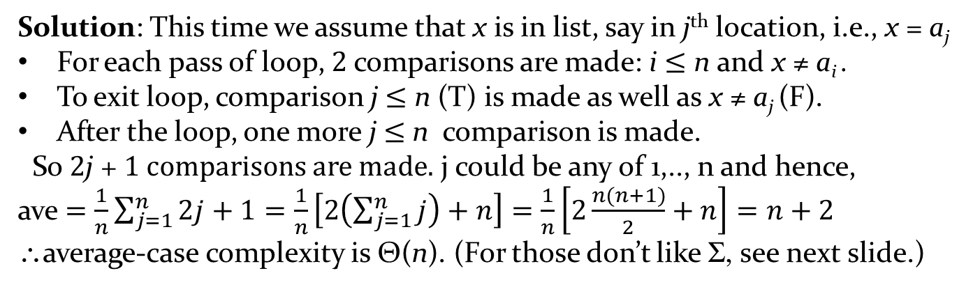
Example: Linear Search (cont.)
Determine average-case complexity of linear search.
procedure linear search(x:integer, a₁, a₂, …,a_{n}: distinct integers)
i := 1
while (i ≤ n and x ≠ a_{i})
i := i + 1
if i ≤ n then location := i
else location := 0
return location{location is the subscript of the term that equals x, or is 0 if x is not found}
Solution: This time we assume that x is in list, say in j^{th} location, i.e., x = a_{j}
For each pass of loop, 2 comparisons are made: i ≤ n and x ≠ a_{i} .
To exit loop, comparison j ≤ n (T) is made as well as x ≠ a_{j} (F).
After the loop, one more j ≤ n comparison is made.
So 2j + 1 comparisons are made. j could be any of 1,.., n and hence,
ave $=\frac{1}{n}\sum_{j=1}^{n}{2j+1}=\frac{1}{n}\left[2\left(\sum_{j=1}^{n}{j}\right)+n\right]=\frac{1}{n}\left[2\frac{n(n+1)}{2}+n\right]=n+2$
\average-case complexity is Θ(n). (For those don’t like S, see next slide.)

Slide 11
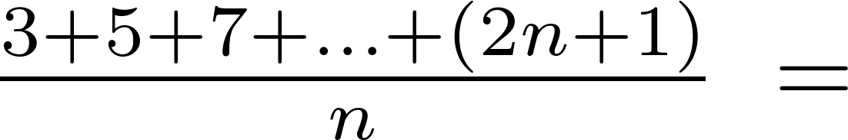
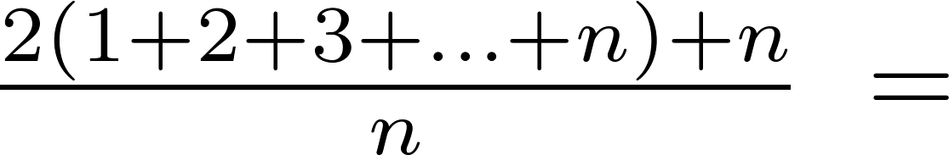
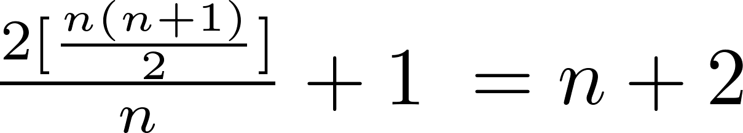
Example: Linear Search (cont.)
For those who do not like to work with S:
From now on, “complexity” will mean
“worst-case time complexity”
unless otherwise stated.

Slide 12
Example: Binary Search
Find complexity of binary search in terms of #comparisons.
procedure binary search(x: integer, a₁,a₂,…, a_{n}: increasing integers)
i := 1 {i is the left endpoint of interval}
j := n {j is right endpoint of interval}
while i < j
m := ⌊(i + j)/2⌋
if x > a_{m} then i := m + 1
else j := m
if x = a_{i} then location := i
else location := 0
return location{location is the subscript i of the term a_{i} equal to x, or 0 if x is not found}
Solution: Assume for moment that n = 2^{k} elements. Note that k = log n.
Two comparisons are made for each pass: i < j, and x > a_{m} .
Before 1st iteration, size of list is 2^{k}, then 2^{k-1} , 2^{k-2} & so on until size of list is 2¹ = 2.
Loop exits when |list| is 2⁰ = 1 & then x is compared with single remaining element.
Hence, 2k + 2 = 2 log n + 2 comparisons are made.
For non-powers of 2, #comparisons is 2 élog nù + 2
\complexity is Θ (log n), which is better than linear search.

Slide 13
Example: Bubble Sort
Find complexity of bubble sort in terms of #comparisons
procedure bubblesort(a₁,…,a_{n}: real numbers
with n ≥ 2)
for i := 1 to n− 1
for j := 1 to n − i
if a_{j} >a_{j+1} then interchange a_{j} and a_{j+1}
{a₁,…, a_{n} is now in increasing order}
Solution: A sequence of n −1 passes is made through list.
On i^{th} pass n − i comparisons are made.
Hence #comparisons is
\complexity of bubble sort is Θ(n²).

Slide 14
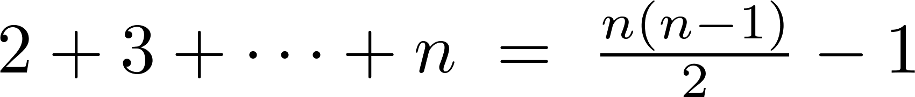
Example: Insertion Sort
Find complexity of insertion sort in terms of #comparisons
Solution: If we study # passes for 2 serially constructed while and for-loops inside the outer for-loop, we see that #comparisons is exactly j, the index of the outer loop.
Hence #comparisons in total is:
\complexity is Θ(n²).
procedure insertion sort(a₁,…,a_{n}:
real numbers with n ≥ 2)
for j := 2 to n
i := 1
while a_{j} > a_{i}
i := i + 1
m := a_{j}
for k := 0 to j − i − 1
a_{j-k} := a_{j-k-1}
a_{i} := m

Slide 15

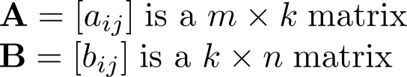
Matrix Multiplication Algorithm
The definition for matrix multiplication can be expressed as an algorithm; C = A B where C is an m n matrix that is the product of the m k matrix A and the k n matrix B.
This algorithm carries out matrix multiplication based on its definition.
procedure matrix multiplication(A,B: matrices)
for i := 1 to m
for j := 1 to n
c_{ij} := 0
for q := 1 to k
c_{ij} := c_{ij} + a_{iq} b_{qj}
return C{C = [c_{ij}] is the product of A and B}

Slide 16
Example: Matrix Multiplication
Find complexity in terms of #arithmetic operations
Solution: Product of 2 n ´ n matrices is itself an n ´ n matrix and so has n² entries.
Finding an entry requires n mults & n − 1 additions.
[(i,j)^{th} entry is the dot product of i ^{th} row and j ^{th} column.]
Hence, n³ multiplications & n²(n − 1) additions are used.
\complexity is O(n³).

Slide 17
Algorithmic Paradigms
An algorithmic paradigm is general approach based on particular concept for constructing algorithms to solve variety of problems.
Greedy algorithms were introduced in Section 3.1.
We discuss brute-force algorithms in this section.
Elsewhere in text you can find:
  probabilistic algorithms (Chapter 7)
  divide-and-conquer algorithms (Chapter 8)
  dynamic programming (Chapter 8)
  backtracking (Chapter 11)
∃many other paradigms that you may see in other courses.

Slide 18
Brute-Force Paradigm
A brute-force algorithm is solved in the most straightforward manner, without taking advantage of any ideas that can make the algorithm more efficient.
Brute-force algorithms we have previously seen:
  sequential search
  bubble and insertion sort

Slide 19
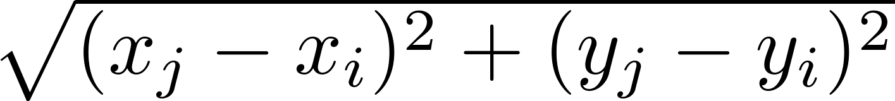
Example: Closest Pair of Points
Construct algorithm for finding closest pair of points in a set of n points & find complexity in terms of # operations.
Solution: Recall that distance betwn pts (x_{i},y_{i}) & (x_{j}, y_{j}) is
Our brute-force algorithm computes distance between all pairs of points & picks pair with smallest distance.
Note: In our procedure, we do not compute the square root, since the square of the distance between two points is smallest when the distance is smallest.
Procedure and estimate →

Slide 20
Closest Pair of Points (cont.)
Algorithm for finding the closest pair in a set of n points.
The algorithm loops through n(n −1)/2 pairs of points, computes the value (x_{j} − x_{i})² + (y_{j} − y_{i})² and compares it with the minimum, etc.
So our algorithm uses Θ(n²) arithmetic and comparison operations.
For algorithm with O(log n) worst-case complexity, see Section 8.3.
procedure closest pair((x₁, y₁), (x₂, y₂), … ,(x_{n}, y_{n}): x_{i}, y_{i} real numbers)
min = ∞
for i := 1 to n
for j := 1 to i
if (x_{j} − x_{i})² + (y_{j} − y_{i})² < min
then min := (x_{j} − x_{i})² + (y_{j} − y_{i})²
closest pair := (x_{i}, y_{i}), (x_{j}, y_{j})
return closest pair

Slide 21
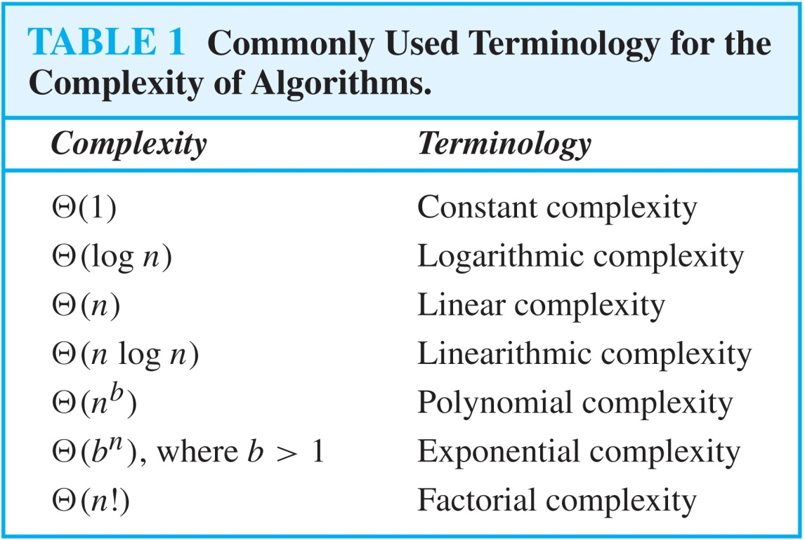
Terminology for Complexity

Slide 22
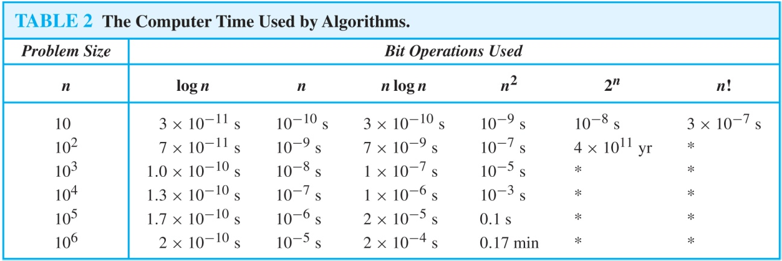
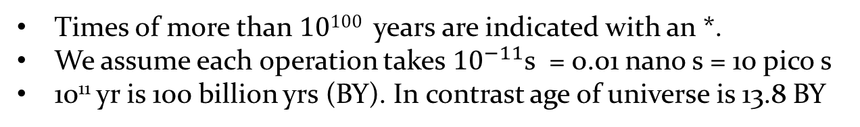
Comparison table for Complexity
Problem
Size
Times of more than 10¹⁰⁰ years are indicated with an *.
We assume each operation takes ${10}^{−11}$s = 0.01 nano s = 10 pico s
10¹¹ yr is 100 billion yrs (BY). In contrast age of universe is 13.8 BY

Slide 23
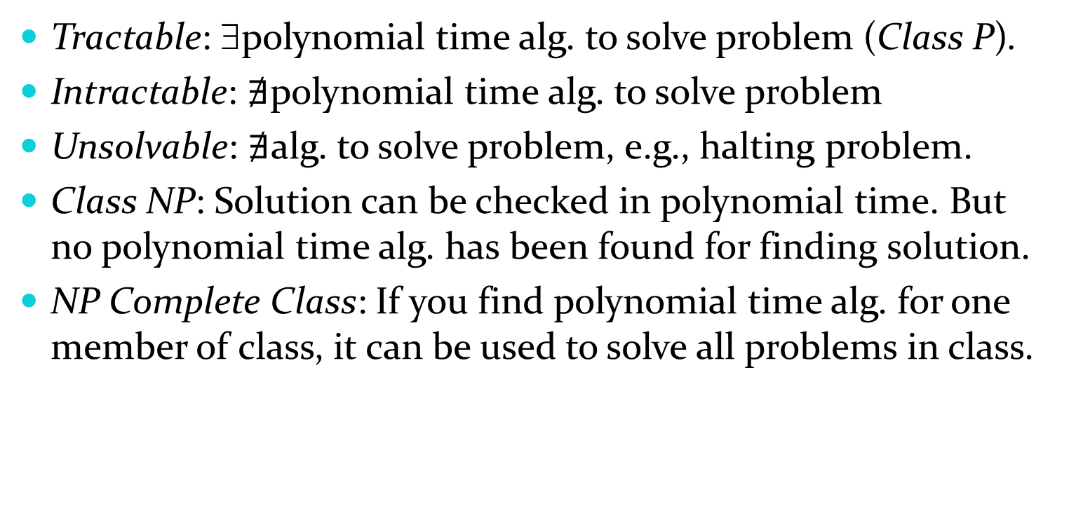
Complexity of Problems
Tractable: ∃polynomial time alg. to solve problem (Class P).
Intractable: $∄$polynomial time alg. to solve problem
Unsolvable: $∄$alg. to solve problem, e.g., halting problem.
Class NP: Solution can be checked in polynomial time. But no polynomial time alg. has been found for finding solution.
NP Complete Class: If you find polynomial time alg. for one member of class, it can be used to solve all problems in class.

Slide 24

P Versus NP Problem
Stephen Cook
(Born 1939)
P versus NP problem asks whether class P ≠ NP?
I.e., do ∃problems whose solutions can be checked in poly. time, but can not be solved in poly. time?
If polynomial time algorithm for any problem in the NP complete class were found, then that algorithm could be used to obtain a polynomial time algorithm for every problem in the NP complete class.
  Satisfiability (in Section 1.3) is an NP complete problem.
It is generally believed that P≠NP since no one has been able to find a polynomial time algorithm for any problem in the NP complete class.
P versus NP is the most famous unsolved problems in theoretical CS.
The Clay Math Institute has $1,000,000 prize for solution!

