Slide 1
Algorithms
Chapter 3
With Question/Answer Animations
Copyright © McGraw-Hill Education. All rights reserved. No reproduction or distribution without the prior written consent of McGraw-Hill Education.

Slide 2
Chapter Summary
Algorithms
Example Algorithms
Algorithmic Paradigms
Growth of Functions
Big-O and other Notation
Complexity of Algorithms

Slide 3
The Growth of Functions
Section 3.2

Slide 4
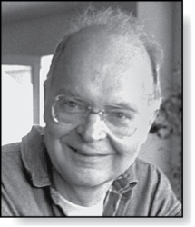
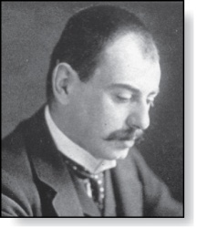
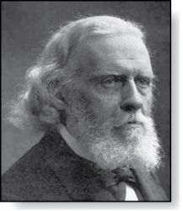
Section Summary
Donald E. Knuth
(Born 1938)
Big-O Notation
Big-O Estimates for Important Functions
Big-Omega and Big-Theta Notation
Edmund Landau
(1877-1938)
Paul Gustav Heinrich Bachmann
(1837-1920)

Slide 5
The Growth of Functions
In both CS and math:
There are times when we care about how fast a function grows.
In CS, the issue is known as complexity (section 3.3). Here are some questions that may arise:
How quickly does an algorithm solve a problem as input grows?
How does the efficiency of two different algorithms for solving the same problem compare?
Is it practical to use a particular algorithm as the input grows?
In math, growth of functions are studied in
number theory (Chapter 4)
combinatorics (Chapters 6 and 8)

Slide 6
Big-O Notation
Definition: Let f and g be functions from Z or R to R. f(x) is O(g(x)) if ∃constants C and k such that
whenever x > k. (illustration on next slide)
This is read
“f(x) is big-O of g(x)” or
“f is asymptotically dominated by g.”
C and k are witnesses to relationship f(x) is O(g(x)).
Only one pair of witnesses is needed.

Slide 7
Illustration of Big-O Notation
f(x) is O(g(x)

Slide 8
Important Points re Big-O Notation
If ∃one pair of witnesses, then ∃infinitely many pairs.
We can always make k or C larger and still maintain inequality .
i.e., any pair C ̍ and k̍ where C < C̍ and k < k ̍ is also a pair of witnesses since whenever x > k̍ > k.
You may see “ f(x) = O(g(x))” instead of “ f(x) is O(g(x)).”
But this is abuse since there is no equality just inequality.

Slide 9
More Important Points re Big-O
It is ok to write f(x) ∊ O(g(x)), because O(g(x)) represents the set of functions that are O(g(x)).
When functions take on positive values only
we drop the absolute value sign:
f(x) is O(g(x)) if $∃C,k>0$ such that $∀x>k, f\left(x\right)≤Cg(x)$

Slide 10
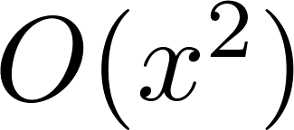
Using the Definition of Big-O Notation
Example: Show that is .
Solution: Since when x ≥ 1, x ≤ x² and 1 ≤ x²
So can take C = 4 and k = 1 as witnesses
(see graph on next slide)
Alternatively, when x ≥ 2, we have 2x ≤ x² and 1 ≤ x²
So can take C = 3 and k = 2 as witnesses instead.

Slide 11
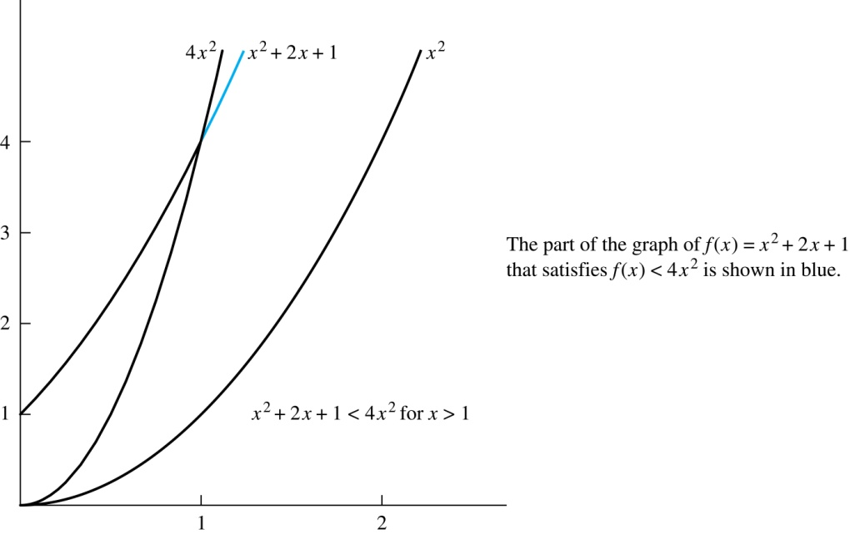
Illustration of Big-O Notation
is

Slide 12
Big-O Notation continued
Since both and
are such that and (why?).
We say that the two functions are of the same order.
(More on this later)
If and $∀x>r$, h(x) ≥ g(x), then .
[for the witness pair, choose the same C and let $k^{′}=max⁡(k,r)]$
For many applications, the goal is to select the function g(x) in O(g(x)) as small as possible (up to multiplication by a constant, of course).

Slide 13
Using the Definition of Big-O Notation
Example: Show that 7x² is O(x³).
Solution: When x > 7, 7x² < x³. Take C =1 and k = 7 as witnesses to establish that 7x² is O(x³).
(Would C = 7 and k = 1 work?)
Example: Show that n² is not O(n).
Solution: Suppose ∃C, k for which n² ≤ Cn, whenever n > k. Then (by dividing both sides of n² ≤ Cn) by n, then n ≤ C must hold for all n > k. A contradiction!

Slide 14
Big-O Estimates for Polynomials
Let
where are real numbers with a_{n} ≠0.
Then f(x) is O(x^{n}).
Proof: |f(x)| = |a_{n}x^{n} + a_{n-1} x^{n-1} + ∙∙∙ + a₁x¹ + a₀|
≤ |a_{n}|x^{n} + |a_{n-1}| x^{n-1} + ∙∙∙ + |a₁|x¹ + |a₀|
= x^{n} (|a_{n}| + |a_{n-1}| /x + ∙∙∙ + |a₁|/x^{n-1} + |a₀|/ x^{n})
≤ x^{n} (|a_{n}| + |a_{n-1}| + ∙∙∙ + |a₁|+ |a₀|)
Take C = |a_{n}| + |a_{n-1}| + ∙∙∙ + |a₀| and k = 1. QED
Leading term a_{n}x^{n} of polynomial dominates its growth.
Use triangle inequality, exercise, Section 1.8.
Assuming x > 1

Slide 15
More Big-O Estimates
Example: Use big-O notation to estimate the sum of the first n positive integers.
Solution:
Hence

Slide 16
More Big-O Estimates (cont)
Example: Use big-O notation to estimate n! and log n!
Solution:
*
Hence
Now apply log to * and use a property of logarithms
.
Hence, log(n!) is O(n∙log(n)) taking C = 1 and k = 1.

Slide 17
Display of Growth of Functions
Note the difference in behavior of functions as n gets larger

Slide 18
Who dominates who among logarithms, powers, and exponents?
If d > c > 1, then n^{c} is O(n^{d}), but n^{d} is not O(n^{c}).
If c > b > 1, then b^{n} is O(c^{n}), but c^{n} is not O(b^{n}).
[exponentials and powers strictly dominate within their classes as expected]
If b > 1 and c and d are positive, then
(log_{b} n)^{c} is O(n^{d}), but n^{d} is not O((log_{b} n)^{c})
[any power strictly dominates a log power]
If b > 1 & d > 0, then n^{d} is O(b^{n}), but b^{n} is not O(n^{d}).
[any exponential strictly dominates a power]

Slide 19
Combinations of Functions
If f₁ (x) is O(g₁(x)) and f₂ (x) is O(g₂(x)) then
( f₁ + f₂ )(x) is O(max(|g₁(x) |,|g₂(x) |)).
(See next slide for proof)
If f₁ (x) and f₂ (x) are both O(g(x)) then
( f₁ + f₂ )(x) is O(g(x)).
(See text for argument)
If f₁ (x) is O(g₁(x)) and f₂ (x) is O(g₂(x)) then
( f₁ f₂ )(x) is O(g₁(x)g₂(x)).
(See text for argument)

Slide 20
Combinations of Functions
If f₁ (x) is O(g₁(x)) and f₂ (x) is O(g₂(x)) then
( f₁ + f₂ )(x) is O(max(|g₁(x) |,|g₂(x) |)).
Proof:
By the definition of big-O notation, ∃C₁,C₂ ,k₁,k₂ such that | f₁ (x)| ≤ C₁|g₁(x)| when x > k₁ and |f₂ (x)| ≤ C₂|g₂(x)| when x > k₂ .
|( f₁ + f₂ )(x)| = |f₁(x) + f₂(x)|
≤ |f₁ (x)| + |f₂ (x)| by the triangle inequality |a + b| ≤ |a| + |b|
≤ C₁|g₁(x)| + C₂|g₂(x)|
≤ C₁ g(x) + C₂ g(x) where g(x) = max(|g₁(x)|,|g₂(x)|)
= (C₁ + C₂) g(x)
= C g(x) where C = C₁ + C₂
Therefore |( f₁ + f₂ )(x)| ≤ C g(x) whenever x > k, where k = max(k₁,k₂)

Slide 21
Ordering Functions by Order of Growth
Put in order so that each function is big-O of next function:
f₁(n) = (1.5)^{n}
f₂(n) = 8n³+17n² +111
f₃(n) = (log n )²
f₄(n) = 2^{n}
f₅(n) = log (log n)
Start by finding the dominant term in the 2 functions that have multiple terms.
Use hierarchy--constant, log of log, powers of log, powers, exponential, factorial (n^{n})--to put into categories.
Follow the usually clear hierarchy within each category.
f₆(n) = n² (log n)³
f₇(n) = 2^{n} (n² +1)
f₈(n) = n³+ n(log n)²
f₉(n) = 10000
f₁₀(n) = n!

Slide 22
Ordering Functions by Order Solution
f₉(n) = 10000 (constant, does not increase with n)
f₅(n) = log (log n) (grows slowest of all the others)
f₃(n) = (log n )² (grows next slowest)
f₆(n) = n² (log n)³ (next largest, (log n)³ factor smaller than any power of n)
f₂(n) = 8n³+17n² +111 (tied with the one below)
f₈(n) = n³+ n(log n)²
f₁(n) = (1.5)^{n} (next largest, an exponential function)
f₄(n) = 2^{n} (grows faster than one above since 2 > 1.5)
f₇(n) = 2^{n} (n² +1) (grows faster than above because of the n² +1 factor)
f₁₀(n) = n! ( n! grows faster than c^{n} for every c)

Slide 23
Big-Omega Notation
Definition: Let f and g be functions from Z or R to R. if ∃C and k such that
when x > k.
“f(x) is big-Omega of g(x)” or “f asymptotically dominates g.”
Big-O gives an upper bound on the growth of a function, while Big-Omega gives a lower bound.
Big-Omega tells us that a function grows at least as fast as another.
Ω is the upper case version of the lower case Greek letter ω.

Slide 24
Big-Omega Notation
Example: Show that is
where .
Solution: ∀x ∈ R.
\ (Take C = 8 and k = 1)
Is it also the case that is ?
What can you take for C and k?
Can we generalize this observation?
f(x) is Ω(g(x)) if and only if g(x) is O(f(x)).
This follows from the definitions. (See text for details.)
If pair for LHS is C, k, we can take as pair for RHS 1/C, k.

Slide 25
Big-Theta Notation
Θ is the upper case version of the lower case Greek letter θ.
Definition: Let f and g be functions from Z or R to R.
if and .
We say that
“f(x) is big-Theta of g(x)”
“f(x) is of order g(x)”
“f(x) and g(x) are of the same order.”
if and only if ∃constants C₁ , C₂ and k such that C₁g(x) < f(x) < C₂ g(x) ∀ x > k.
(This follows from the definitions of big-O and big-Omega.)

Slide 26
Big Theta Notation example 1
Example: Show that sum of first n positive integers is Θ(n²).
Solution: Let f(n) = 1 + 2 + ∙∙∙ + n.
We have already shown that f(n) is O(n²).
To show that f(n) is Ω(n²), we need a positive constant C such that f(n) > Cn² for sufficiently large n. Summing only the terms ≥ n/2 we obtain the inequality. To ease calculations, we assume n even. We leave n odd case as exercise.
1 + 2 + ∙∙∙ + n ≥ n/2 + ( n/2 + 1) + ∙∙∙ + n
≥ n/2 + n/2 + ∙∙∙ + n/2
= (n/2 +1)(n/2) ≥ n²/4
Taking C = ¼, f(n) > Cn²∀ n ∈ Z⁺. Hence, f(n) is Ω(n²).
\ f(n) is Θ(n²).

Slide 27
Big-Theta Notation example 2
Example: Sh0w that f(x) = 3x² + 8x log x is Θ(x²).
Solution:
3x² + 8x log x ≤ 11x² for x > 1, since 0 ≤ 8x log x ≤ 8x² .
Hence, 3x² + 8x log x is O(x²).
(Why? What pair C, k have we shown to work?)
3x² + 8x log x is clearly Ω(x² ).
(Why? What pair C, k works?)
Hence, 3x² + 8x log x is Θ(x²).

Slide 28
Miscellaneous Q facts/confusion
If then as well.
Also note that if and only if
and
partially accounting for why you see big-Omega infrequently.
Writers are often careless and use big-O when they really mean big-Teta.

Slide 29
Big-Theta Estimates for Polynomials
Theorem: Let
where are real numbers with a_{n} ≠0.
Then f(x) is Θ(x^{n}) (or of order x^{n}).
(The proof is an exercise.)
Examples:
is Θ(x⁵).
is Θ(x¹⁹⁹) .

Slide 30
Classifying Functions by their Order
f₉(n) = 10000 is Θ(1 )
f₅(n) = log (log n) is Θ(log (log n))
f₃(n) = is Θ((log n )² )
f₆(n) = n² (log n)³ is Θ(n² (log n)³ )
f₂(n) = 8n³+17n² +111 n² is Θ(n³ )
f₈(n) = n³+ n(log n)²is Θ(n³ )
f₁(n) = (1.5)^{n} is Θ((1.5)^{n})
f₄(n) = 2^{n} is Θ(2^{n})
f₇(n) = 2^{n} (n² +1) is Θ(n² 2^{n})
f₁₀(n) = n! is Θ(n^{n})

