Slide 1
Algorithms
Chapter 3
With Question/Answer Animations
Copyright © McGraw-Hill Education. All rights reserved. No reproduction or distribution without the prior written consent of McGraw-Hill Education.

Slide 2
Chapter Summary
Algorithms (3 class days)
  Example Algorithms
  Algorithmic Paradigms
Growth of Functions (2 class days)
  Big-O and other Notation
Complexity of Algorithms (1 class day)

Slide 3
Algorithms
Section 3.1

Slide 4
Algorithm Section Summary
Day 1
  Properties (Slides 5-10)
  Searching (Slides 11-15)
Day 2/3
  Sorting (Slides 16-25)
Day 3
  Greedy (Slides 26-34)
  Halting Problem (Slide 35-37)
    Be able to state what it is (proof optional)

Slide 5
Problems and Algorithms
In many domains ∃problems that ask for output with specific properties when given valid input.
In computer programming, an algorithm is a procedure or set of steps which
  takes valid input
  produces desired output.
More generally, an algorithm is a finite set of precise instructions for calculations or for solving a problem.

Slide 6

Algorithms
Abu Ja’far Mohammed Ibin Musa Al-Khowarizmi
(780-850), spent most of life in present-day Iraq
Example: Describe algorithm for finding maximum value or max in finite sequence of integers {a₁, a₂, …, a_{n}}
Solution:
  Set maximum: max = a₁
  Compare next integer in sequence to max
    If it is larger than max, set max equal to this integer.
  Repeat previous step if ∃more integers. If not, stop.
  Upon termination, max is largest integer in sequence.
An actual implementation would depend on the computer programming language, although clearly there is need for a loop, which could either be “while” or “for”.

Slide 7
Pseudocode
Algorithms can be described in English or in a particular programming language such as Java or Python.
Pseudocode is an intermediate between an English language description & the coding using a programming language.
The form of pseudocode we use is specified in Appendix 3. It uses some of the structures found in C++ and Java.
Programmers can easily take the description of an algorithm in pseudocode & construct a program in a particular language.
Pseudocode allows us to analyze the number and type of steps required, independent of any particular implementation.
Compilers often have optimizing algorithms which may greatly improve the user-inputted code, but that is another story.

Slide 8
Properties of Algorithms
Input: An algorithm has input values from a specified set.
Output: The algorithm produces the output values from a specified set. The output values are the solution.
Correctness: An algorithm should produce the correct output values for each set of input values.
Finiteness, Effectiveness, Generality: An algorithm should produce the output after a finite # of steps for any input.

Slide 9
Finding Maximum Element
The algorithm in pseudocode:
Does this algorithm have all the properties listed on the previous slide?
(Input, Output, Correctness, Finiteness, Effectiveness, Generality)
procedure max(a₁, a₂, …., a_{n}: integers)
max := a₁
for i := 2 to n
if max < a_{i} then max := a_{i}
return max{max is the largest element}

Slide 10
Our Algorithm Problems
Three classes of problems will be studied in this section:
  Searching: finding position of particular element in list.
  Sorting: putting elements of list into increasing order.
  Optimization: determining optimal value (max or min) of a particular quantity ∀inputs.

Slide 11
Searching
The searching problem is to locate an element x in the list of a₁,a₂,...,a_{n}, or determine that it is not in the list.
  The solution is (first) location of term in list that equals x (i is the solution if x = a_{i}) or 0 if x is not in the list.
  For example, before boarding a plane, airlines must check to see if a customer is on the no-fly list.
  We study two different algorithms:
    linear
    binary

Slide 12
Linear Search Algorithm
(for non-sorted sets)
The linear search algorithm locates an item in a list by examining elements in the sequence one at a time, starting at the beginning:
  First compare x with a₁. If they are equal, return 1.
  If not, try a₂. If x = a₂, return 2.
  Keep going, & if no match found when entire list is scanned, return 0.
procedure linear search(x: integer; a₁, a₂, …,a_{n}: integers)
i := 1
while (i ≤ n and x ≠ a_{i})
i := i + 1
if i ≤ n then location := i
else location := 0
return location{location is the subscript of 1st term that equals x, or is 0 if x is not found}

Slide 13
Binary Search (for sorted sets)
Assume input is list of items in increasing order.
Algorithm begins by comparing element to be found with middle element.
  If middle element is lower, search proceeds with upper half of list.
  If not, search proceeds with lower half of list.
Repeat this process until we have a list of size 1.
  If element looked for is equal to this element, position is returned.
  Otherwise, 0 is returned to indicate that element was not found.
In Section 3.3, we show that binary search algorithm is efficient.

Slide 14
Binary Search pseudocode
procedure binary search(x: integer, a₁, a₂,…, a_{n}: increasing integers)
i := 1 {i is the left endpoint of interval}
j := n {j is right endpoint of interval}
while i < j
m := ⌊(i + j)/2⌋
if x > a_{m} then i := m + 1
else j := m
if x = a_{i} then location := i
else location := 0
return location{location is the subscript i of the term a_{i} equal to x,
or 0 if x is not found}

Slide 15
Binary Search example input
Example: The steps taken by a binary search for 19 in the list:
1 2 3 5 6 7 8 10 12 13 15 16 18 19 20 22
List has 16 elements, so midpoint is 8. The value in the 8th position is 10. Since 19 > 10, further search is restricted to positions 9 through 16.
1 2 3 5 6 7 8 10 12 13 15 16 18 19 20 22
Midpoint of list (positions 9 through 16) is now 12th position with value of 16. Since 19 > 16, further search is restricted to the 13th position and above.
1 2 3 5 6 7 8 10 12 13 15 16 18 19 20 22
Midpoint of current list is now 14th position with a value of 19. Since 19 ≯ 19, further search is restricted to the portion from 13th through the 14th positions .
1 2 3 5 6 7 8 10 12 13 15 16 18 19 20 22
Midpoint of the current list is now 13th position with value of 18. Since 19 > 18, search is restricted to the portion from the 14th position through the 14th.
1 2 3 5 6 7 8 10 12 13 15 16 18 19 20 22
Now list has single element and loop ends. Since 19=19, location 14 is returned.

Slide 16
Sorting
To sort elements of a list is to put them in increasing order.
Example is files in directory, sorted using any one of several categories (name, size, type, date created, date modified)
Substantial computing resources are devoted to sorting
Many algorithms have been invented for sorting:
  binary, insertion, bubble, selection, merge, quick, tournament
In Section 3.3, we discuss the efficiency of these algorithms.

Slide 17
Bubble Sort on a₁,…,a_{n}
Bubble sort in n− 1 passes through a list, interchanges every pair of elements found to be out of order.
After the i^{th} pass, the last i elements are in order, so the passes decrement in length for each new pass.
procedure bubblesort(a₁,…,a_{n}: real numbers with n ≥ 2)
for i := 1 to n− 1
for j := 1 to n − i
if a_{j} > a_{j+1} then interchange a_{j} and a_{j+1}
{a₁,…, a_{n} is now in increasing order}

Slide 18
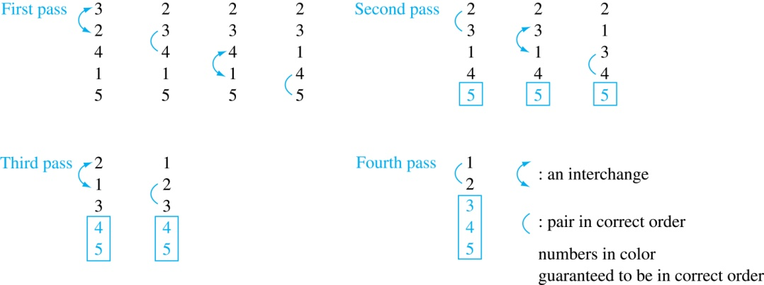
Bubble Sort on 3 2 4 1 5

Slide 19
Bubble Sort on 3 2 4 1 5

Slide 20
Bubble Sort on 3 2 4 1 5

Slide 21
Bubble Sort on 3 2 4 1 5

Slide 22
Insertion Sort
Insertion sort begins with 2nd element. It compares 2nd element with 1st and puts it before the 1st if it is not larger.
Next the 3rd element is put into the correct position among the first 3 elements.
In each subsequent pass, the n+1st element is put into its correct position among the first n+1 elements.
Linear search is used to find the correct position.

Slide 23
Insertion Sort
procedure insertion sort(a₁,…,a_{n}: real numbers with n ≥ 2)
for j := 2 to n
i := 1
while a_{j} > a_{i}
i := i + 1
m := a_{j}
for k := 0 to j − i − 1
a_{j-k} := a_{j-k-1}
a_{i} := m
{Now a₁,…,a_{n} is in increasing order}

Slide 24
Insertion Sort on 3 2 4 1 5
3 2 4 1 5 1st two positions are interchanged
2 3 4 1 5 3rd element remains in its position
2 3 4 1 5 4th element is placed at beginning
1 2 3 4 5 5th element remains in its position
1 2 3 4 5

Slide 25
Optimization
Optimization problems minimize or maximize some parameter over all possible inputs.
Examples we will study are:
  Finding a route between two cities with smallest total mileage.
  Determining how to encode messages using fewest possible bits.
  Finding links between network nodes using least amount of fiber.
Optimization problems often solved using a greedy algorithm, which makes the “best” choice at each step.

Slide 26
Greedy Algorithms
Making “best choice” at each step does not necessarily give optimal solution, but in many instances it does.
After specifying “best choice” at each step
  we show an optimal solution always produced;
  or find counterexample to show that it does not.
Greedy approach is an example of algorithmic paradigm, a general approach for designing an algorithm.
We return to algorithmic paradigms in Section 3.3.

Slide 27
Example: Making Change
Make change of n = 67 cents with quarters, dimes, nickels, and pennies, using least total number of coins.
Idea: At each step choose coin with the largest possible value that does not exceed the amount of change left.
  First choose quarter leaving 67−25 = 42 & another quarter leaving 42 −25 = 17.
  Then choose dime, leaving 17 − 10 = 7.
  Choose nickel, leaving 7 – 5 = 2.
  Choose penny, leaving 1 & another penny leaving 0.

Slide 28
Greedy Change-Making Algorithm: coin denominations c₁, c₂, …,c_{r}
procedure change(c₁, c₂, …, c_{r}: values of coins,
where c₁> c₂> … > c_{r} ; n: a positive integer)
for i := 1 to r
d_{i} := 0 {d_{i} counts coins of denomination c_{i}}
while n ≥ c_{i}
d_{i} := d_{i} + 1 {add a coin of denomination c_{i}}
n := n − c_{i}
{the sequence d₁, d₂, …, d_{r} provides # of each coin needed}
  For example of U.S. currency, we have quarters, dimes, nickels and pennies, with c₁ = 25, c₂ = 10, c₃ = 5, and c₄ = 1.

Slide 29
Proving Optimality
If n Î Z⁺, then n cents in change using quarters, dimes, nickels, and pennies, using fewest coins possible has:
Lemma 1: at most 2 dimes, 1 nickel, 4 pennies, and cannot have 2 dimes and a nickel.
Proof: By contradiction
  If we had 3 dimes, we replace them with a quarter and a nickel.
  If we had 2 nickels, we replace them with 1 dime.
  If we had 5 pennies, we replace them with a nickel.
  If we had 2 dimes & 1 nickel, we replace them with a quarter.
Lemma 2: total amount of change not in quarters £ 24 cents.
Proof: The allowable combinations, have a maximum value of 24 cents: 2 dimes and 4 pennies.

Slide 30
Proving Optimality for U.S. Coins
Theorem: The greedy change-making algorithm for U.S. coins produces change using the fewest coins possible.
Proof: By contradiction.
  Assume ∃n Î Z⁺ such that change can be made for n cents using quarters, dimes, nickels, and pennies, with a fewer total number of coins than given by the algorithm.
  Suppose q̍ < q where q̍ = #quarters used in this optimal way and q = #quarters in the greedy algorithm’s solution. But this is not possible by Lemma 2, since value of the coins other than quarters can not be greater than 24 cents.
  Similarly, by Lemma 1, the two algorithms must have the same number of dimes, nickels, and pennies (exercise).

Slide 31
Greedy Change-Making Algorithm
Optimality depends on the denominations available.
For U.S. coins, optimality still holds if we add half dollar coins (50 cents) and dollar coins (100 cents).
But if we allow only quarters (25 cents), dimes (10 cents), and pennies (1 cent), the algorithm no longer produces the minimum number of coins.
  Consider the example of 31 cents. The optimal number of coins is 4, i.e., 3 dimes and 1 penny. What does the algorithm output?

Slide 32
Greedy Scheduling
Example: We have a group of proposed talks with start and end times. Construct a greedy algorithm to schedule as many as possible in a lecture hall, under the following assumptions:
  When a talk starts, it continues till the end.
  No two talks can occur at the same time.
  A talk can begin at the same time that another ends.
  Once we have selected some of the talks, we cannot add a talk which is incompatible with those already selected because it overlaps at least one of these previously selected talks.
  How should we make the “best choice” at each step of the algorithm? That is, which talk do we pick ?
  The talk that starts earliest among those compatible with already chosen talks?
  The talk that is shortest among those already compatible?
  The talk that ends earliest among those compatible with already chosen talks?

Slide 33
Greedy Scheduling
Picking the shortest talk doesn’t work.
Can you find a counterexample here?
But picking the one that ends soonest does work. The algorithm is specified on the next page.
Start: 8:00 AM
Talk 1
Start: 9:00 AM
Talk 2
Start: 9:45 AM
End :9:45 AM
Talk 3
End: 10:00 AM
End: 11:00 AM

Slide 34
Greedy Scheduling algorithm
Solution: At each step, choose talks with the earliest ending time among talks compatible with those selected.
Will be proven correct by induction in Chapter 5.
procedure schedule(s₁ , s₂ , … , s_{n} : start times; e₁ , e₂ , … , e_{n} : end times)
sort talks by finish time {reorder so that e₁ ≤ e₂ ≤ … ≤ e_{n} }
S := ∅
for j := 1 to n
if talk j is compatible with S then
S := S ∪ {talk j}
return S { S is the set of talks scheduled}

Slide 35
Halting Problem
Develop a procedure that takes as input a computer program along with its input and determines whether the program will eventually halt with that input.
Solution: Proof by contradiction.
Assume that there is such a procedure and call it H(P,I).
Procedure H(P,I) takes as input program P & input I.
  H outputs “halt” if it is the case that P will stop when run with input I.
  Otherwise, H outputs “loops forever.”

Slide 36
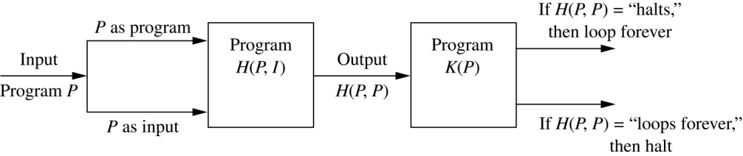
Halting Problem (cont.)
Since a program is a string of characters, we call H(P,P). Construct a procedure K(P), which works as follows.
  If H(P,P) outputs “loops forever” then K(P) halts.
  If H(P,P) outputs “halt” then K(P) goes into an infinite loop printing “ha” on each iteration.

Slide 37
Halting Problem (cont.)
Now we call K with K as input, i.e. K(K).
  If the output of H(K,K) is “loops forever” then K(K) halts. A Contradiction.
  If the output of H(K,K) is “halts” then K(K) loops forever. A Contradiction.
Hence, ∄ procedure that can decide whether or not an arbitrary program halts.
\ The halting problem is unsolvable.

