Slide 1
Basic Structures: Sets, Functions, Sequences, Sums, and Matrices
Chapter 2
With Question/Answer Animations
Copyright © McGraw-Hill Education. All rights reserved. No reproduction or distribution without the prior written consent of McGraw-Hill Education.

Slide 2
Chapter Summary
Sets
The Language of Sets
Set Operations
Set Identities
Functions
Types of Functions
Operations on Functions
Computability
Sequences and Summations
Types of Sequences
Summation Formulae
Set Cardinality
Countable Sets
Matrices
Matrix Arithmetic

Slide 3
Cardinality of Sets
Section 2.5

Slide 4
Section Summary
Cardinality
Countable Sets
Computability

Slide 5
Cardinality relationships
If ∃ 1-1 function (injection) from A to B, the cardinality of A is less than or the same as the cardinality of B
|A| ≤ |B|
If ∃ 1-1 correspondence (bijection) from A to B, the cardinality of a set A is equal that of B
|A| = |B|
If |A| ≤ |B| and A & B have different cardinalities, the cardinality of A is less than the cardinality of B
|A| < |B|

Slide 6
Countable
A set that is either finite or has the same cardinality as Z⁺ is countable.
A set that is not countable is uncountable.
The set of real numbers R is an uncountable set.
When a set is countably infinite its cardinality is ℵ₀ .
ℵ is aleph (the 1st letter of the Hebrew alphabet).
The zero subscript is pronounced “naught” or “null”.

Slide 7
Showing that a Set is Countable
A 1-1 correspondence f from Z⁺ to a set S can be expressed in terms of a sequence a₁ , a₂ , …, a_{n} ,… where
a₁ = f (1), a₂ = f (2),…, a_{n} = f (n),…
So can list the elements of S in a sequence indexed by Z⁺.
Example: Z is countable:
0, 1, −1, 2, −2, …
It is a good exercise but not necessary to create an explicit formula for the sequence:
a_{n} = (−1)^{n} ⎣n/2⎦

Slide 8
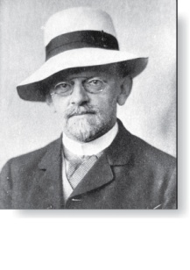
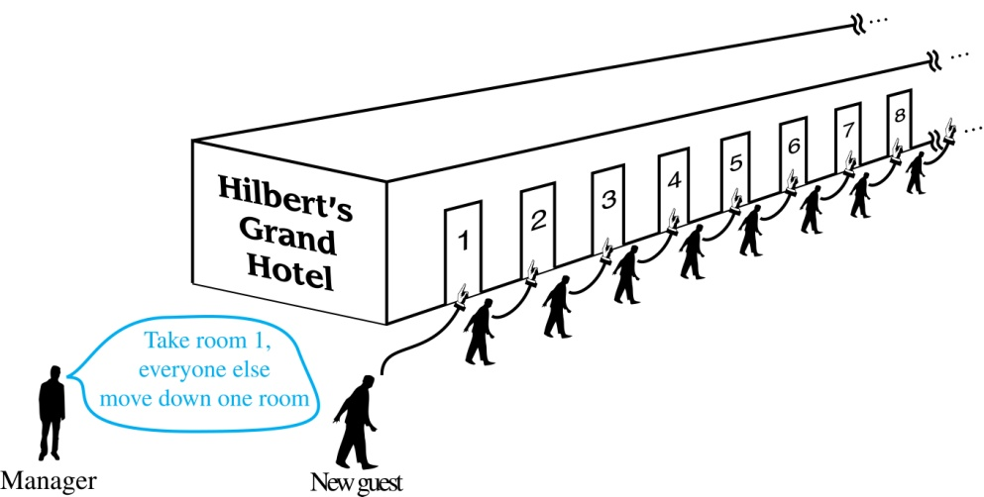
Hilbert’s Grand Hotel
David Hilbert
The Grand Hotel (example due to David Hilbert) has countably infinite number of rooms, each occupied by a guest. We can always accommodate a new guest at this hotel. How is this possible?
Explanation: Rooms are countable so we list them as R₁, R₂ , R₃, … . When a new guest arrives, we move guest in R₁ to R₂, guest in R₂ to R₃ and in general guest in R_{n} to R_{n+1} , ∀n ÎZ⁺. This frees up R₁, which we assign to the new guest, and all the current guests still have rooms.
The hotel can also accommodate a countable number of new guests, all the guests on a countable number of buses where each bus contains a countable number of guests (see exercises).

Slide 9
Countable example: even>0
Show that the set of positive even integers E⁺ is a countable set.
Solution: Let a_{n} = 2n. Or using function notation, f (n) = 2n
1 2 3 4 5 6 …..
2 4 6 8 10 12 ……
Then f is a bijection from N to E since f is both 1-1 and onto.
To show 1-1, if f(n) = f(m), then 2n = 2m, and so n = m.
To show onto, suppose that t is an even positive integer.
Then t = 2k for some positive integer k and f(k) = t.

Slide 10
Countable example: even Z
Show that the set of even integers E is a countable set.
Solution: Can list in a sequence:
0, 2, − 2, 4, − 4,………..
Or can define a bijection from Z⁺ to even Z:
a_{n} = (−1)^{n} 2 ⎣n/2⎦

Slide 11
Q⁺ is Countable
Recall: A rational number can be expressed as the ratio of two integers p and q such that q ≠ 0.
¾ is a rational number
√2 is not a rational number.
Example: Show Q⁺ is Countable.
Solution: Q⁺ can be arranged in a sequence:
r₁ , r₂ , r₃ ,…
The next slide shows how this is done. →

Slide 12
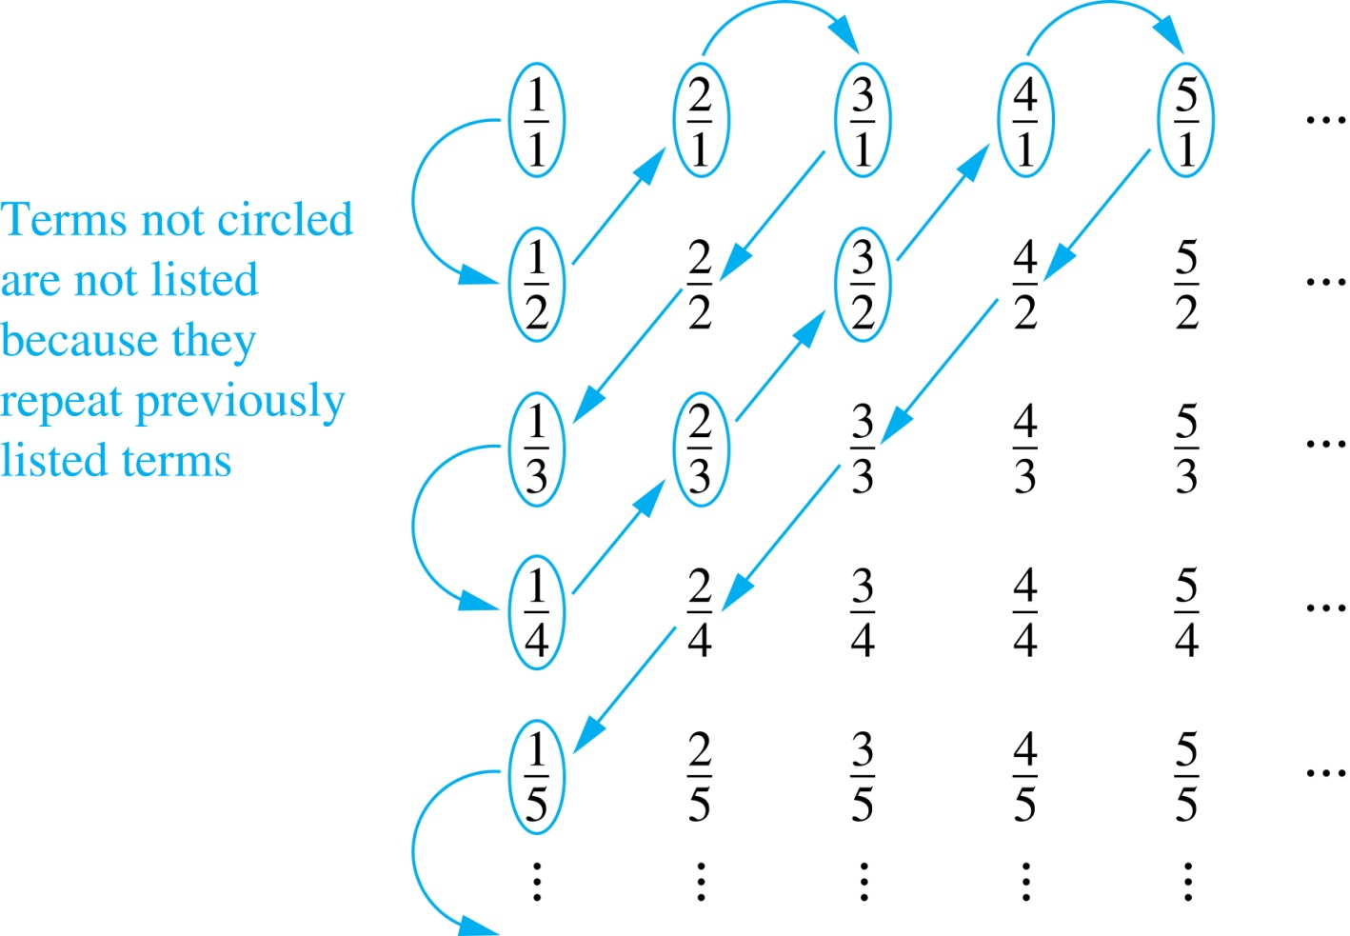
Q⁺ is Countable
Study table carefully.
What is common in each row?
What is common in each column?
Constructing List
First visit p/q with p + q = 2.
Next visit p/q with p + q = 3.
And so on.
1, ½, 2, 3, 1/3, ¼ , 2/3, 3/2, 4, 5, 1/5, 1/6, 2/5, ¾, 4/3, 5/2, 6, ….
Coming up with an explicit formula would not be advised.
Instead write a computer program!

Slide 13
Strings
Given finite alphabet A, show S = {finite strings} is countably infinite.
Solution: Assume alphabetical ordering of symbols in A
and list strings in a sequence:
string of length 0 (empty string l);
strings of length 1 in lexicographic (dictionary) order;
strings of length 2 in lexicographic order;
and so on.
This Þ ∃bijection from Z⁺ to S & hence S is countably ¥.

Slide 14
{all possible Java programs} is countably ¥.
Example: Show that the set of all Java programs is countable.
Solution: Let S = {strings} constructed from the characters which can appear in a Java program. Use ordering from previous example.
Take each string in turn and feed into a compiler.
Compiler will determine if input program is syntactically correct.
If compiler says YES, we add program to list.
We move on to the next string.
In this way we construct an implied bijection from N to the set of Java programs. Hence, the set of Java programs is countable.

Slide 15
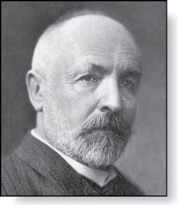
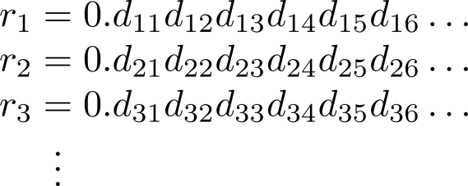
R is Uncountable!
Georg Cantor
(1845-1918)
Proof method is Cantor diagonalization and is by contradiction.
We focus on subset [0, 1] & assume that its elements are listable:
r₁ , r₂ , r₃ ,… .
Let decimal representation of this listing be
Form new real # where
r is not equal to any of the r₁ , r₂ , r₃ ,... because it differs from r_{i} in its
i^{th} position after the decimal point.
\ ∃ r Î [0, 1] that is not on list (every real # has ! decimal expansion). Hence, [0, 1] cannot be listed, & [0, 1] is uncountable.
Since a set with an uncountable subset is uncountable (exercise):
R is uncountable!

Slide 16
Computability
We say that a function is computable if ∃ a computer program in some programming language that finds the values of this function.
If a function is not computable we say it is uncomputable.
∃uncomputable functions.
We have shown that the set of Java programs is countable.
Exercise 38 in text shows that ∃uncountably many different functions from a particular countably infinite set to itself.
\by Exercise 39, ∃ uncomputable functions!

