Slide 1
Basic Structures: Sets, Functions, Sequences, Sums, and Matrices
Chapter 2
With Question/Answer Animations
Copyright © McGraw-Hill Education. All rights reserved. No reproduction or distribution without the prior written consent of McGraw-Hill Education.

Slide 2
Chapter Summary
Sets
The Language of Sets
Set Operations
Set Identities
Functions
Types of Functions
Operations on Functions
Computability
Sequences and Summations
Types of Sequences
Summation Formulae
Set Cardinality
Countable Sets
Matrices
Matrix Arithmetic

Slide 3
Sequences and Summations
Section 2.4

Slide 4
Section Summary
Sequences.
Examples: Geometric Progression, Arithmetic Progression
Recurrence Relations
Example: Fibonacci Sequence
Summations
Special Integer Sequences

Slide 5
List definition & introduction
Sequences are ordered lists of elements.
1, 2, 3, 5, 8
1, 3, 9, 27, 81, …….
Sequences arise in mathematics, computer science, and many other disciplines, e.g., botany & music.
We will introduce the terminology to represent sequences and sums of the terms in the sequences.

Slide 6
Function definition & notation
A sequence is a function from a subset of the integers (usually either {0, 1, 2, …..} or {1, 2, 3, ….} ) to a set S.
In place of a(n), use a_{n} to denote the image of n Î Z.
We call a_{n} a term of the sequence.

Slide 7
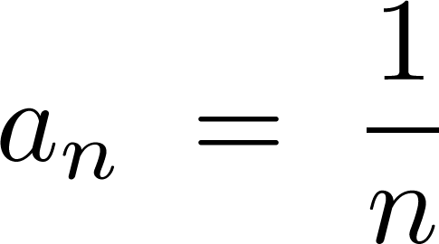
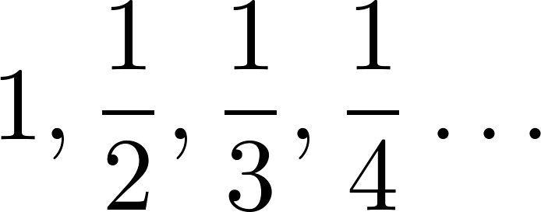
Notation options
Example: Consider the harmonic sequence
where

Slide 8
Geometric Progression
A geometric progression is a sequence of the form:
with initial term a and common ratio r, both real #’s.
Examples:
Let a = 1 and r = −1. Then:
Let a = 2 and r = 5. Then:
Let a = 6 and r = 1/3. Then:

Slide 9
Arithmetic Progression
An arithmetic progression is a sequence of the form:
with initial term a and common difference d, both real #’s.
Examples:
Let a = −1 and d = 4:
Let a = 7 and d = −3:
Let a = 1 and d = 2:

Slide 10
Strings
A string is a finite sequence of characters from a finite set (e.g., the alphabet).
Sequences of characters or bits are important in computer science.
The empty string is represented by λ.
The string abcde has length 5.

Slide 11
Recurrence Relations
A recurrence relation is an equation that expresses a_{n} in terms of one or more of a₀ , a₁ , …, a_{n-1}
The relation is valid for ∀ n ≥ n₀ where n₀ Î Z⁺.
Initial conditions specify the terms a_{n} for n < n₀.
A sequence is called a solution of a recurrence relation if its terms satisfy the recurrence relation.

Slide 12
Recurrence Relation Questions
Example 1: Given recurrence relation a_{n} = a_{n-1} + 3 for n₀ = 1 and a₀ = 2. What are a₁ , a₂ and a₃?
[Here a₀ = 2 is the single initial condition.]
Solution: We see from the recurrence relation that
a₁ = a₀ + 3 = 2 + 3 = 5
a₂ = 5 + 3 = 8
a₃ = 8 + 3 = 11 and so on
Does anyone recognize this sequence?

Slide 13
Recurrence Relations Questions
Example 2: Let a_{n} = a_{n-1} – a_{n-2} , n₀ = 2 and a₀ = 3, a₁ = 5. What are a₂ , a₃ , a₄ , a₅ and a₆?
[Here the initial conditions is the pair a₀ = 3, a₁ = 5. ]
Solution: We see from the recurrence relation that
a₂ = a₁ – a₀ = 5 – 3 = 2
a₃ = a₂ – a₁ = 2 – 5 = –3
a₄ = a₃ – a₂ = – 3 – 2 = –5
a₅ = a₄ – a₃ = – 5 –(–3) = –2
a₆ = a₅ – a₄ = – 2 –(–5) = 3
What is overall shape?
Quadratic (parabola)? Periodic (like a sin curve)?

Slide 14
Fibonacci Sequence
f_{n} = f_{n-1} + f_{n-2}, n₀ = 2 and f₀ = 0, f₁ = 1
Example: Find f₂ , f₃ , …, f₆ .
Answer:
f₂ = f₁ + f₀ = 1 + 0 = 1,
f₃ = f₂ + f₁ = 1 + 1 = 2,
f₄ = f₃ + f₂ = 2 + 1 = 3,
f₅ = f₄ + f₃ = 3 + 2 = 5,
f₆ = f₅ + f₄ = 5 + 3 = 8.
f_{n} is #pairs of rabbits after n months, where a new pair does not breed its 1st month but produces 1 new pair of offspring each month thereafter.

Slide 15
Solving Recurrence Relations
Often, we solve (find a closed formula) for the n^{th} term:
In this chapter, we use methods of iteration where we guess the formula.
The guess can be proved correct by induction (Chap 5).
Chapter 8 has various advanced methods for solving.

Slide 16
Forward Iterative Solution
a_{n} = a_{n-1} + 3, n₀ = 2, a₁ = 2.
a₂ = 2 + 3
a₃ = (2 + 3) + 3 = 2 + 2 ∙ 3
a₄ = (2 + 2 ∙ 3) + 3 = 2 + 3 ∙ 3
$$⋮$$
a_{n} = 2 + 3(n – 1)

Slide 17
Backward Iterative Solution
a_{n} = a_{n-1} + 3, n₀ = 2, a₁ = 2.
a_{n} = a_{n-1} + 3
= (a_{n-2} + 3) + 3 = a_{n-2} + 3 ∙ 2
= (a_{n-3} + 3 )+ 3 ∙ 2 = a_{n-3} + 3 ∙ 3
$$⋮$$
= a₂ + 3(n – 2)
= (a₁ + 3) + 3(n – 2)
= 2 + 3(n – 1)

Slide 18
Financial Application
Example: Suppose that a person deposits $10,000.00 in a savings account at a bank yielding 11% per year with interest compounded annually. How much will be in the account after 30 years?
Let P_{n} denote the amount in the account after 30 years. P_{n} satisfies the following recurrence relation:
P_{n} = P_{n-1} + 0.11P_{n-1} = (1.11) P_{n-1}
with the initial condition P₀ = 10,000
Continued on next slide →

Slide 19
Financial Application
P_{n} = P_{n-1} + 0.11P_{n-1} = (1.11) P_{n-1} , P₀ = 10,000
Solution: Forward Substitution
P₁ = (1.11)P₀
P₂ = (1.11)P₁ = (1.11)²P₀
P₃ = (1.11)P₂ = (1.11)³P₀
:
P_{n} = (1.11)P_{n-1} = (1.11)^{n}P₀
= (1.11)^{n} 10,000
P₃₀ = (1.11)³⁰ 10,000 = $228,992.97

Slide 20
Identifying Integer Sequences
Given a few terms of a sequence, try to identify sequence.
Conjecture formula, recurrence relation, or other rule.
Some questions to ask, tools to use:
Are there repeated terms of the same value?
Can you obtain term from previous term adding (arithmetic) or multiplying (geometric)by an amount?
Can you obtain a term by combining the previous terms?
Are their cycles among the terms?
(online encyclopedia of integer sequences)

Slide 21
Questions on Integer Sequences
Example 1: 1, ½, ¼, 1/8, 1/16,…
Solution: Denominators are powers of 2;
geometric progression with a = 1 and r = ½: a_{n} = 1/2^{n}
Example 2: 1,3,5,7,9,…
Solution: Term obtained by adding 2 to previous term;
arithmetic progression with a =1, d = 2: a_{n} = 2n + 1
Example 3: 1, -1, 1, -1,1, …
Solution: Terms alternate between 1 and -1;
geometric progression with a = 1, r = −1: a_{n} = (−1)^{n}

Slide 23
Finding Sequences
Example: Find simple formula for a_{n} if 1st 10 terms are 1, 7, 25, 79, 241, 727, 2185, 6559, 19681, 59047.
Solution: Ratio of each term to the previous » 3.
So now compare with the sequence 3^{n} .
We notice that the n^{th} term is 2 less than the corresponding power of 3 so
a_{n} = 3^{n} − 2.

Slide 24
Integer Sequence Puzzles
Identify these 3 sequences from the OEIS site:
2, 3, 3, 5, 10, 13, 39, 43, 172, 177, ... Think of alternatively adding & multiplying by successive #s.
0, 0, 0, 0, 4, 9, 5, 1, 1, 0, 55, ... one, two, three, four, five, six, seven, eight, nine, ten, eleven, ... and think like a Roman! (c,d,i,l,m,v,x)
2, 4, 6, 30, 32, 34, 36, 40, 42, 44, 46, ... Think of the English names for numbers, and whether or not they have the letter ‘e.’
The answers and many more can be found at
http://oeis.org/Spuzzle.html

Slide 25
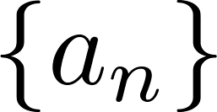
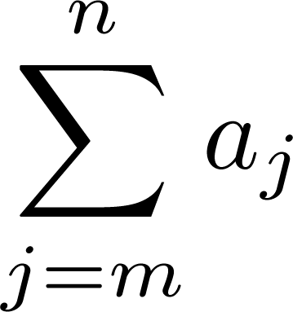
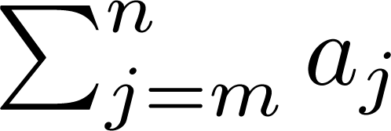
Summations
Sum of terms from sequence
is
Display Inline Subscript
Variable j is the index of summation.
It runs through all the integers starting with its lower limit m and ending with its upper limit n.

Slide 26
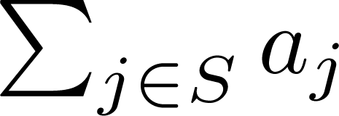
Summations
More generally, for set S, the sum of all its elements is:
Examples:
Sum of powers 0,1,…,n (special case of geometric)
Harmonic: it diverges (gets arbitrarily large)
Finite set:

Slide 27
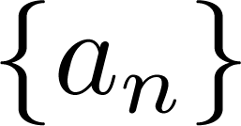
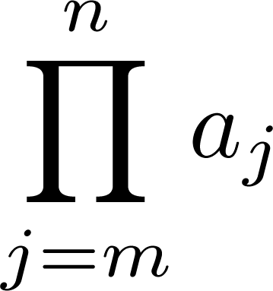
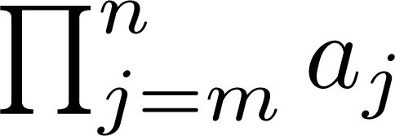
Product Notation
Product of the terms
from the sequence is
Some possible notations:
display inline subscript

Slide 28
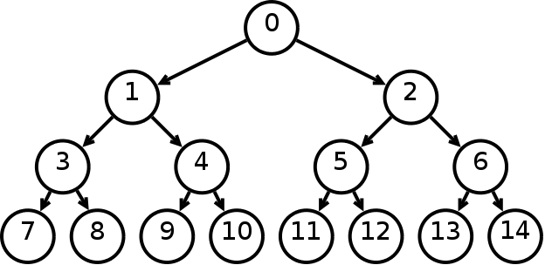
Geometric Series
Sums of terms of geometric progressions
Example: A full binary tree of depth 3 has
1+2+4+8 = $\frac{1∗16−1}{2−1}=15$ nodes (pictured on right)
and one of depth 10 has
1+2+…+1024 = $\frac{1∗2048−1}{2−1}$
= 2047 nodes

Slide 29
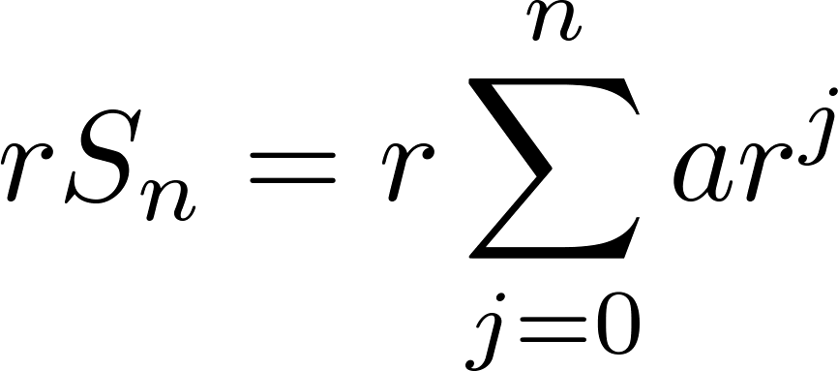
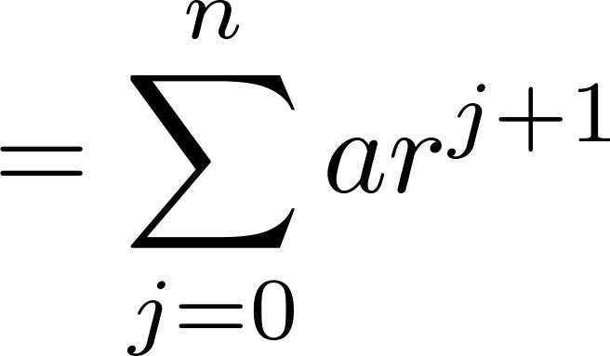
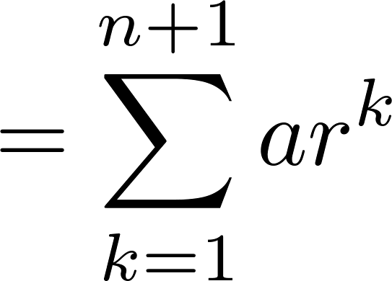
Geometric Series: proof (r ≠1)
First multiply both sides of the equality by r
Move factor of r into the summation
Shifting the index of summation with k = j + 1.
Removing k = n + 1 term and
adding k = 0 term.
Substituting S_{n} for summation formula
Solving for S_{n}

Slide 30
Some Useful Summation Formulae
Geometric Series: We just proved this.
Later we will prove some of these by induction.
Proof in text
(requires calculus)

