Slide 1
Basic Structures: Sets, Functions, Sequences, Sums, and Matrices
Chapter 2
With Question/Answer Animations
Copyright © McGraw-Hill Education. All rights reserved. No reproduction or distribution without the prior written consent of McGraw-Hill Education.

Slide 2
Chapter Summary
Sets
  The Language of Sets
  Set Operations
  Set Identities
Functions
  Types of Functions
  Operations on Functions
  Computability
Sequences and Summations
  Types of Sequences
  Summation Formulae
Set Cardinality
  Countable Sets
Matrices

Slide 3
Functions
Section 2.3

Slide 4
Section Summary
Definition of a Function.
  Domain, Codomain
  Image, Preimage
Injection, Surjection, Bijection
Inverse Function
Function Composition
Graphing Functions
Floor, Ceiling, Factorial
Partial Functions (not in syllabus)

Slide 5
Functions
Let A and B be nonempty sets.
A function or mapping f from A to B, denoted f : A → B, is an assignment of each a Î A to exactly one b ÎB .
We write f (a) = b or f : a ↦ b.
Each student is mapped
to a particular grade.
Students
Grades
A
Carlota Rodriguez
B
Sandeep Patel
C
Jalen Williams
D
F
Kathy Scott

Slide 6
Functions
A function f : A → B can also be defined as a relation (a subset of A×B) where no two elements of the relation have the same first element.
In other words, there is one and only one ordered pair (a, b) for every element a ∈ A:
!

Slide 7
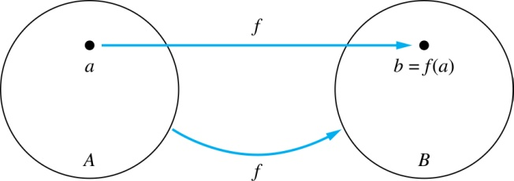
Functions
Given a function f : A → B
A is the domain.
B is the codomain.
If f (a) = b, then
  b is the image of a under f;
  a is the preimage of b.
f (A), the range of f, is the set of all images.
Two functions are equal when they
  have the same domain A and codomain B
  map each element of A to the same element of B.

Slide 8
Representing Functions
Functions may be specified in different ways, e.g.,
An explicit statement or diagram of the assignment.
  Students and grades example.
A formula.
  f(x) = x + 1
A computer program.
  A Java program that when given n Î Z, produces the n^{th} Fibonacci Number (sect 2.4 and also Chapter 5).

Slide 9
Questions
z
A
B
f(a) = ?
The image of d is ?
z
a
x
The domain of f is ?
A
b
y
The codomain of f is ?
B
c
d
z
The preimage of y is ?
b
f(A) = ?
{y,z}
The preimage(s) of z is (are) ?
{a,c,d}

Slide 10
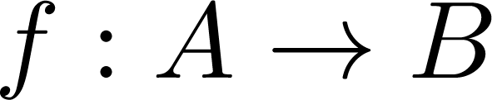
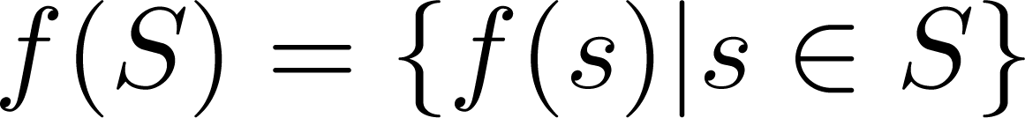
Question on Functions and Sets
If and S is a subset of A, then
A
B
f {a,b,c,} is ?
{y,z}
a
x
f {c,d} is ?
b
{z}
y
c
d
z

Slide 11
Injections
Definition: A function f is one-to-one, or injective:
if ∀a, b ÎA, f(a) = f(b) ® a = b.
A function is an injection if it is one-to-one.
A
B
a
x
v
b
y
c
z
d
w

Slide 12
Surjections
Definition: A function f from A to B is onto or surjective,
if ∀ b Î B, ∃ a Î A with f (a) = b.
Or equivalently:
  Is every b Î B an image?
  Do range and codomain coincide?
  Does f(A) = B?
A function f is a surjection if it is onto.
A
B
a
x
b
y
c
z
d

Slide 13
Bijections
Definition: A function f is a one-to-one correspondence, or a bijection,
if it is both one-to-one and onto
(surjective and injective).
A
B
a
x
b
y
c
d
z
w

Slide 14
Bijections: non-examples
A
B
A
B
a
x
v
a
x
b
y
b
c
y
z
c
d
z
d
w
Not onto. Why?
Not injective. Why?

Slide 15
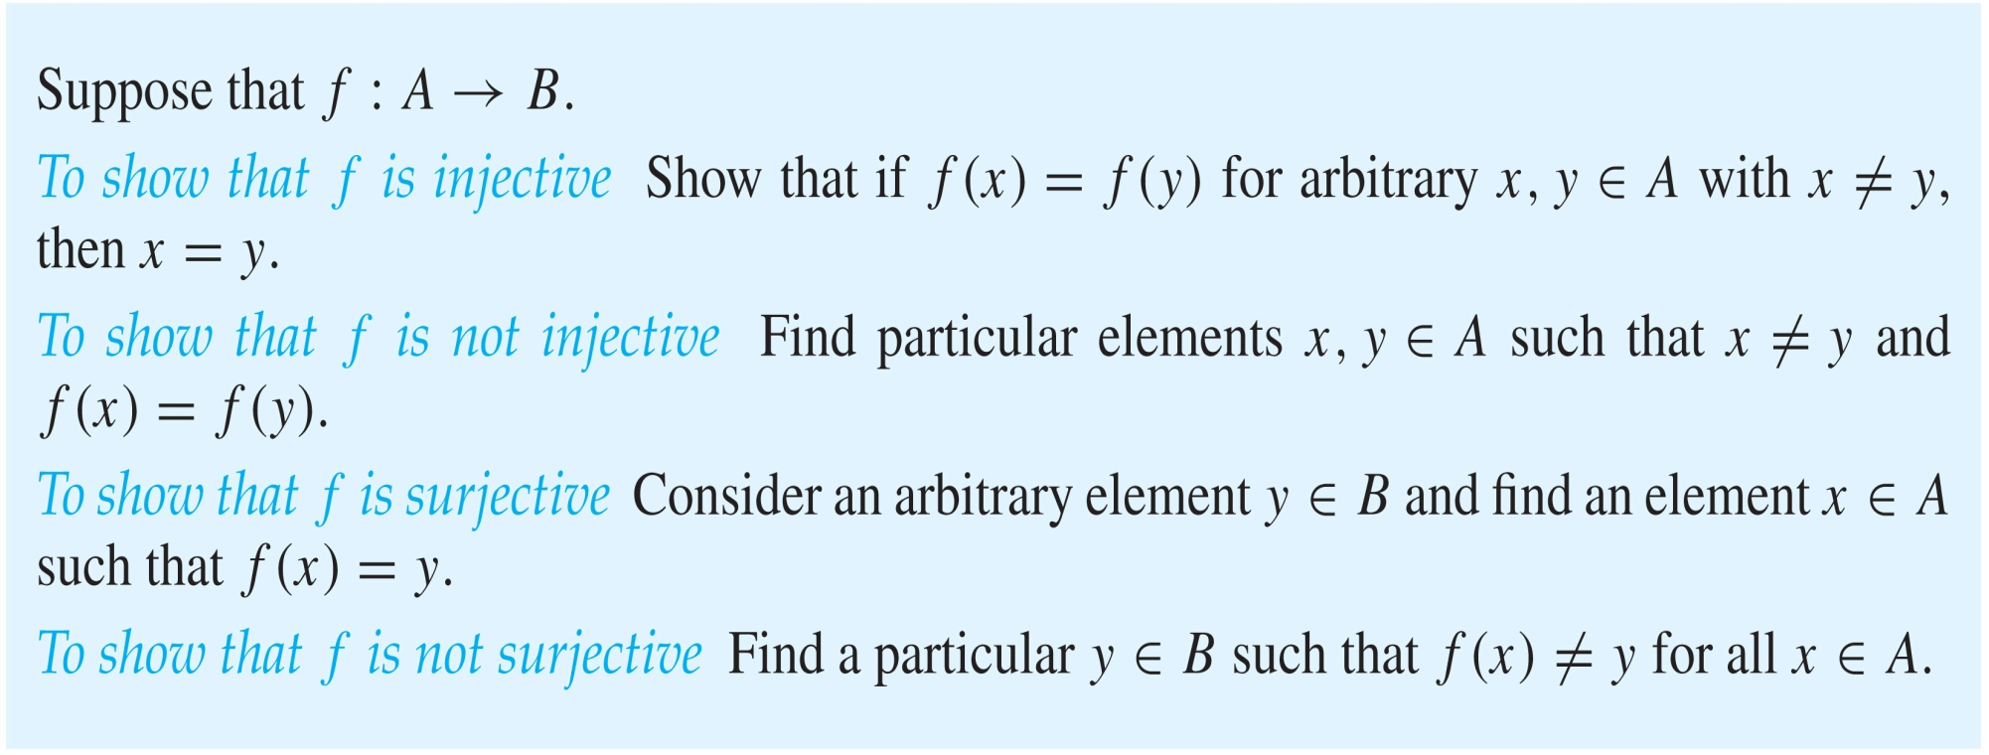
Showing that f is one-to-one or onto

Slide 16
Determining whether f is 1-1/onto
Let f : {a,b,c,d} ® {1,2,3} defined by
f(a) = 3, f(b) = 2, f(c) = 1, f(d) = 3
Is f 1-1?
Solution: No, f is not 1-1 since f(a) = f(d) = 3.
In fact, just noting cardinalities of domain & codomain, we know that the function is not 1-1. (why?)
This is an instance of the pigeonhole principle that we encountered earlier.

Slide 17
Determining whether f is 1-1/onto
Let f : {a,b,c,d} ® {1,2,3} defined by
f(a) = 3, f(b) = 2, f(c) = 1, f(d) = 3
Is f an onto function?
Solution: Yes, f is onto since all three elements of the codomain are images of elements in the domain.
If the codomain were changed to {1,2,3,4}, f would not be onto. (why?)

Slide 18
Determining whether f is 1-1/onto
Is f : R ® R, f : x ↦ x² onto?
Solution: No, f is not onto because there is no real number x with x² = −1, for example.
How can we restrict the codomain so that f is onto?
  Solution: (works in general) Restrict the codomain to be the image of the domain, i.e.,
  let codomain = R⁺ È {0}.

Slide 19
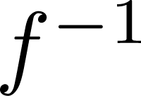
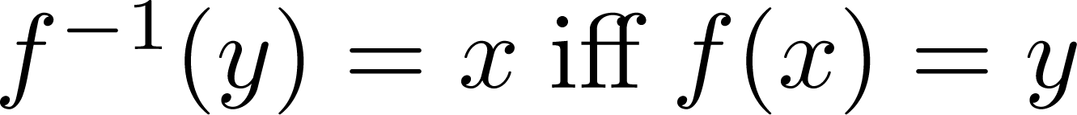
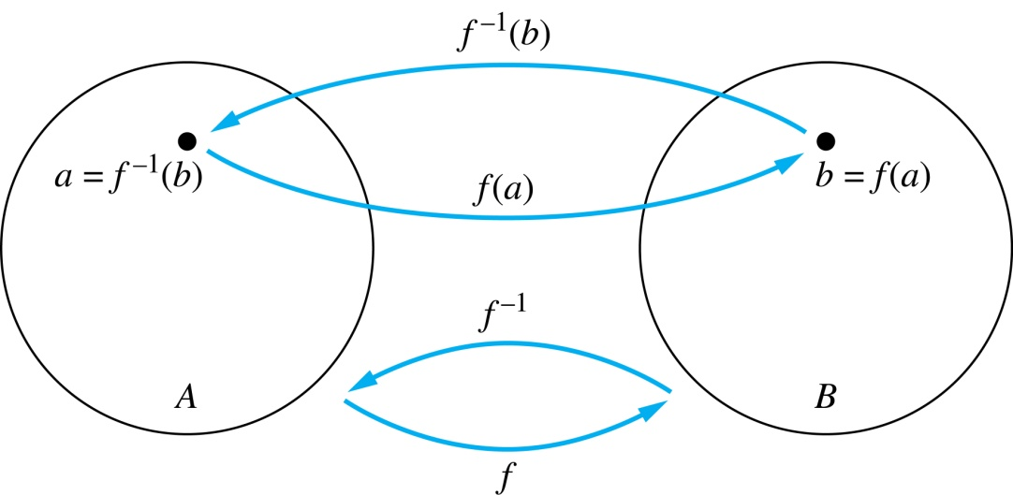
Inverse Functions
Definition: Let f be a bijection from A to B. Then the inverse of f, denoted , is the function from B to A defined as
No inverse exists unless f is a bijection. Exercise: Why?

Slide 20
Inverse Functions
A
B
A
B
f
a
V
V
a
b
b
W
W
c
c
d
X
X
d
Y
Y

Slide 21
Questions
Example 1: Let f be the function from {a,b,c} to {1,2,3} such that f(a) = 2, f(b) = 3, and f(c) = 1. Is f invertible and if so what is its inverse?
Solution: f is invertible because it is a bijection.
f⁻¹ reverses the correspondence given by f, so
f ⁻¹ (1) = c, f ⁻¹ (2) = a, f ⁻¹ (3) = b.

Slide 22
Questions
Example 2: Let f: Z → Z, f : x ↦ x + 1.
Is f invertible, and if so, what is its inverse?
Solution: f is invertible because it is a bijection.
The inverse function f ⁻¹ reverses the correspondence so
f ⁻¹ (y) = y – 1.

Slide 23
Questions
Example 3: Let f: R → R, f : x ↦x² Is f invertible, and if so, what is its inverse?
Solution: f is not invertible because it is not 1-1.
It is also not onto.
The lack of ontoness can be solved by restricting the codomain to the functions image: R⁺ È {0}.
To achieve 1-1 ness, we restrict the domain to
R⁺ È {0} or R⁻ È {0},
The resulting inverse functions are the positive and negative branches of the square root function, respectively.
Visually, the 2 branches each satisfy the
Vertical (for function) and horizontal (for 1-1) line tests.

Slide 24
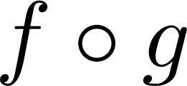
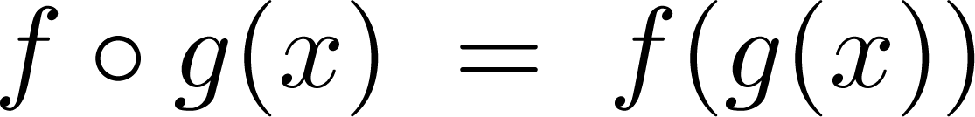
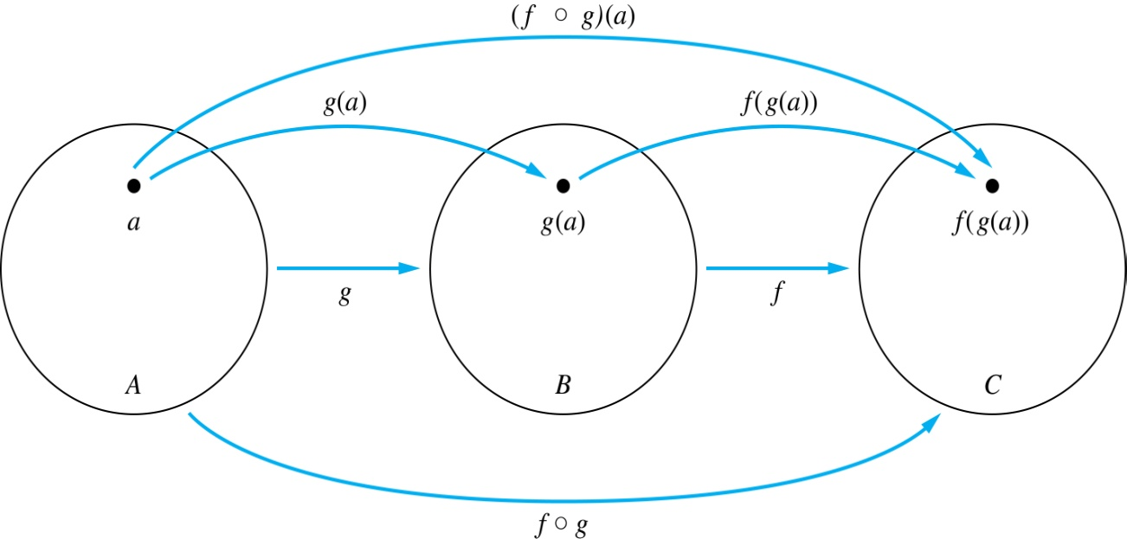
Composition
Definition: Let f: B → C, g: A → B. The composition of f with g, denoted is the function from A to C defined by

Slide 25
Composition
Note: range of g must be within the domain of f, i.e.,
G(A) Í B, where B is the domain of f.

Slide 26
Composition
A
g
B
f
C
A
C
V
a
a
h
h
b
i
b
W
i
c
c
X
j
d
d
j
Y

Slide 27
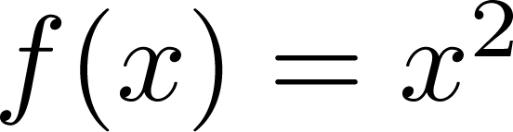
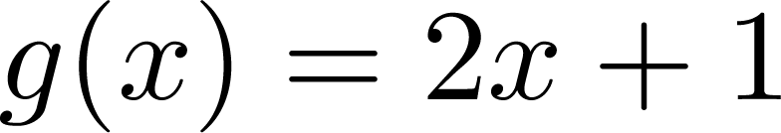
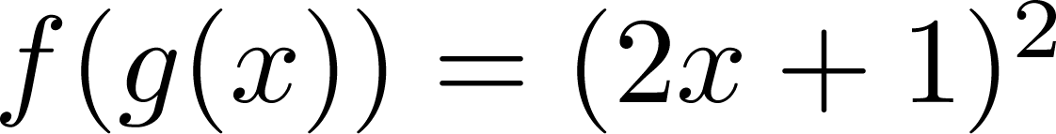
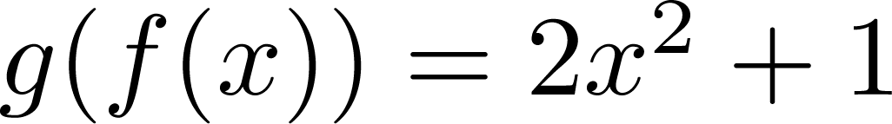
Composition
Example 1: If and , then
and
We can conclude that composition in general
is not commutative.

Slide 28
Composition Questions
Example 1: Let g: {a,b,c} ® {a,b,c} such that
g(a) = b, g(b) = c, and g(c) = a.
Let f : {a,b,c} ® {1,2,3} such that
f(a) = 3, f(b) = 2, and f(c) = 1.
What is f∘g and g∘f ?
Solution: The composition f∘g is defined by
  f∘g (a)= f(g(a)) = f(b) = 2.
  f∘g (b)= f(g(b)) = f(c) = 1.
  f∘g (c)= f(g(c)) = f(a) = 3.
  g∘f not defined (range f is not contained in domain g).

Slide 29
Composition Questions
Example 2: Let f, g: Z ® Z defined by f(x) = 2x + 3 and g(x) = 3x + 2.
What is f∘g and g∘f ?
Solution:
  f∘g (x)= f(g(x)) = f(3x + 2) = 2(3x + 2) + 3 = 6x + 7
  g∘f (x)= g(f (x)) = g(2x + 3) = 3(2x + 3) + 2 = 6x + 11
  Again, note how composition is non-commutative in general.

Slide 30
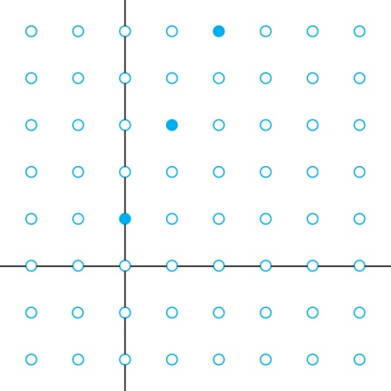
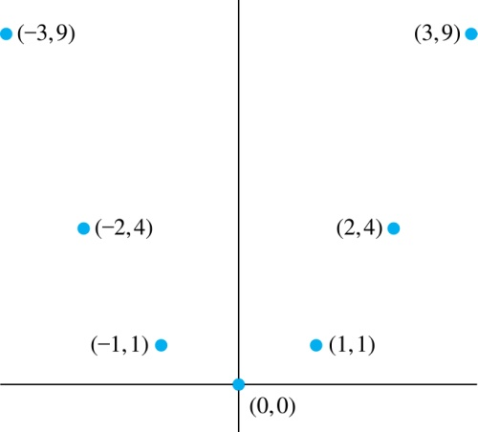
Graphs of Functions
Let f be a function from the set A to the set B. The graph of the function f is the set of ordered pairs {(a,b) | a ∈A and f(a) = b}.
Graph of f(n) = 2n + 1
from N to Z⁺
Graph of f(x) = x²
from Z to N

Slide 31
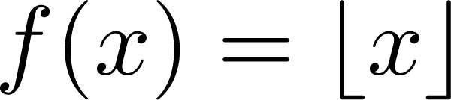
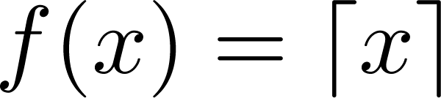
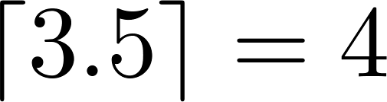
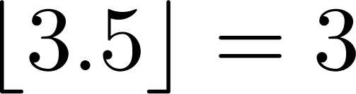
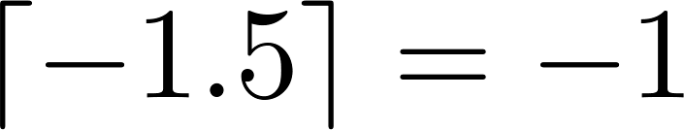
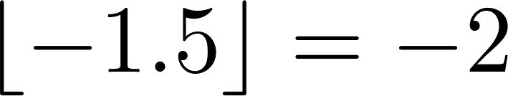
Some Important Functions
The floor function, denoted
is the largest integer less than or equal to x.
The ceiling function, denoted
is the smallest integer greater than or equal to x.
Examples:

Slide 32
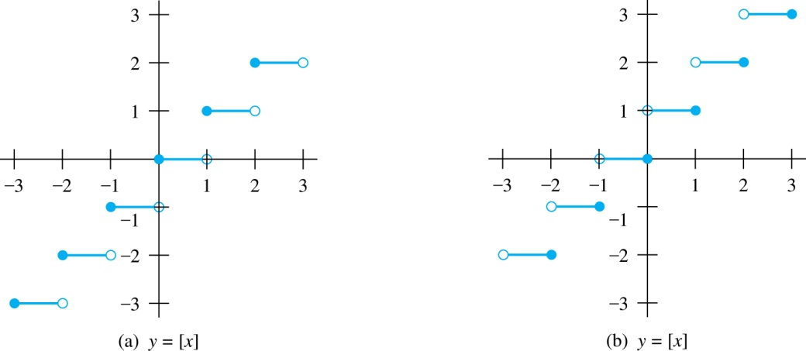
Floor and Ceiling Functions
Graph of (a) Floor and (b) Ceiling Functions

Slide 33
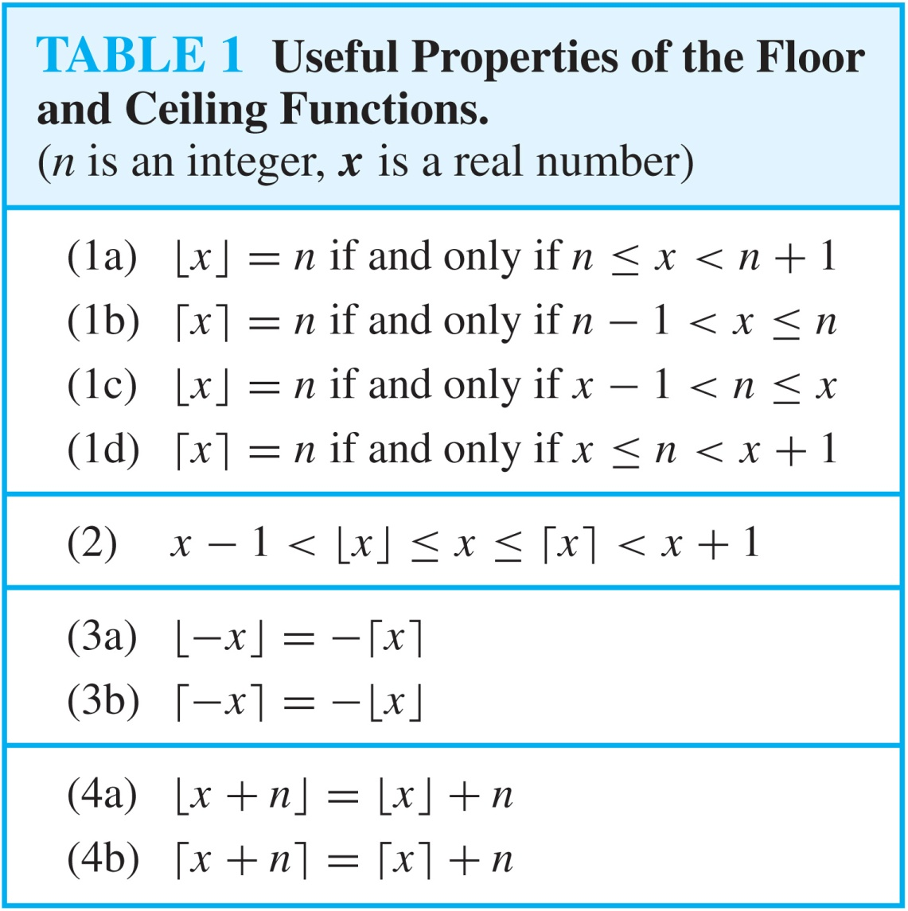
Floor and Ceiling Functions

Slide 34
Proving Properties of Functions
Example: Prove that x is a real number, then
⌊2x⌋= ⌊x⌋ + ⌊x + 1/2⌋
Solution: Let x = n + ε, where n is an integer and 0 ≤ ε< 1.
Case 1: ε < ½
  2x = 2n + 2ε and ⌊2x⌋ = 2n, since 0 ≤ 2ε< 1.
  ⌊x + 1/2⌋ = n, since x + ½ = n + (1/2 + ε ) and 0 ≤ ½ +ε < 1.
  Hence, ⌊2x⌋ = 2n and ⌊x⌋ + ⌊x + 1/2⌋ = n + n = 2n.
Case 2: ε ≥ ½
  2x = 2n + 2ε = (2n + 1) +(2ε − 1) and ⌊2x⌋ =2n + 1, since 0 ≤ 2 ε - 1< 1.
  ⌊x + 1/2⌋ = ⌊ n + (1/2 + ε)⌋ = ⌊ n + 1 + (ε – 1/2)⌋ = n + 1 since 0 ≤ ε – 1/2< 1.
  Hence, ⌊2x⌋ = 2n + 1 and ⌊x⌋ + ⌊x + 1/2⌋ = n + (n + 1) = 2n + 1.

Slide 35
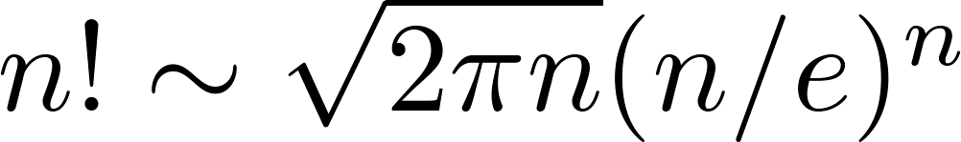
Factorial Function
Definition: f: N → Z⁺ , denoted by f(n) = n! is the product of the first n positive integers (or 1, if n = 0).
^{f(n) = 1 ∙ 2 ∙∙∙ (n – 1) ∙ n}
^{f(0) = 0! = 1}
Stirling’s Formula:
Examples:
^{f(1) = 1! = 1}
^{f(2) = 2! = 1 ∙ 2 = 2}
^{f(6) = 6! = 1 ∙ 2 ∙ 3∙ 4∙ 5} ^{∙ 6 = 720}
f(20) = 2,432,902,008,176,640,000.

