Slide 1
Basic Structures: Sets, Functions, Sequences, Sums, and Matrices
Chapter 2
With Question/Answer Animations
Copyright © McGraw-Hill Education. All rights reserved. No reproduction or distribution without the prior written consent of McGraw-Hill Education.

Slide 2
Chapter Summary
Sets
  The Language of Sets
  Set Operations
  Set Identities
Functions
  Types of Functions
  Operations on Functions
  Computability
Sequences and Summations
  Types of Sequences
  Summation Formulae
Set Cardinality
  Countable Sets
Matrices
  Matrix Arithmetic

Slide 3
Set Operations
Section 2.2

Slide 4
Section Summary
Set Operations
  Union
  Intersection
  Complementation
  Difference
More on Set Cardinality
Set Identities
Proving Identities
Membership Tables

Slide 5
Boolean Algebra
Propositional calculus and set theory are both instances of Boolean Algebra (discussed in Chapter 12, but NOT formally part of either MAT 2440 or 2540).
The operators in set theory are analogous to the corresponding operator in propositional calculus.
As always there must be a universal set U. All sets are assumed to be subsets of U.

Slide 6
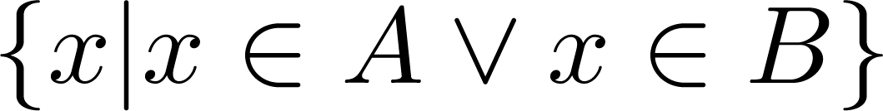
Union
Definition: Let A and B be sets. The union of the sets A and B, denoted by A ∪ B, is the set:
Example: What is {1,2,3} ∪ {3, 4, 5}?
Solution: {1,2,3,4,5}
Venn Diagram for A ∪ B
U
A
B

Slide 7
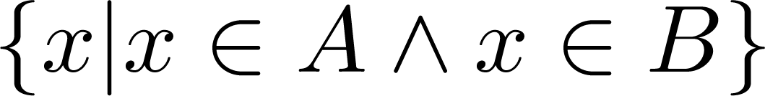
Intersection
Definition: The intersection of sets A and B, denoted by A ∩ B, is
If intersection is empty, then A and B are disjoint (also mutually exclusive).
Example: What is {1,2,3} ∩ {3,4,5} ?
Solution: {3}
Example: {1,2,3} ∩ {4,5,6} =?
Solution: ∅
Venn Diagram for A ∩B
U
A
B

Slide 8
Difference
Definition: Let A and B be sets. The difference of A and B, denoted by A – B, is the set containing the elements of A that are not in B.
A – B = {x | x ∈ A ∧ x ∉ B} = A ∩‾B
Example: What is {1, 2, 3} − {3, 4, 5} ?
Solution: {1, 2}
Venn Diagram for A − B
U
A
B

Slide 9
Complement
Definition: If A is a set, then the complement of A (with respect to U), denoted by Ā is the set U − A
Ā = {x ∈ U | x ∉ A}
(The complement of A is sometimes denoted by A^{c} .)
Example: If U = R, find complement of {x | x > 70}.
Solution: {x | x ≤ 70}
Venn Diagram for Complement
U
Ā
A

Slide 10


Symmetric Difference
Definition: The symmetric difference of A and B, denoted by is the set
Example:
  A = {1,2,3,4,5} B ={4,5,6,7,8}
  What is ?
  Solution: {1,2,3,6,7,8}
U
A
B
Venn Diagram

Slide 11
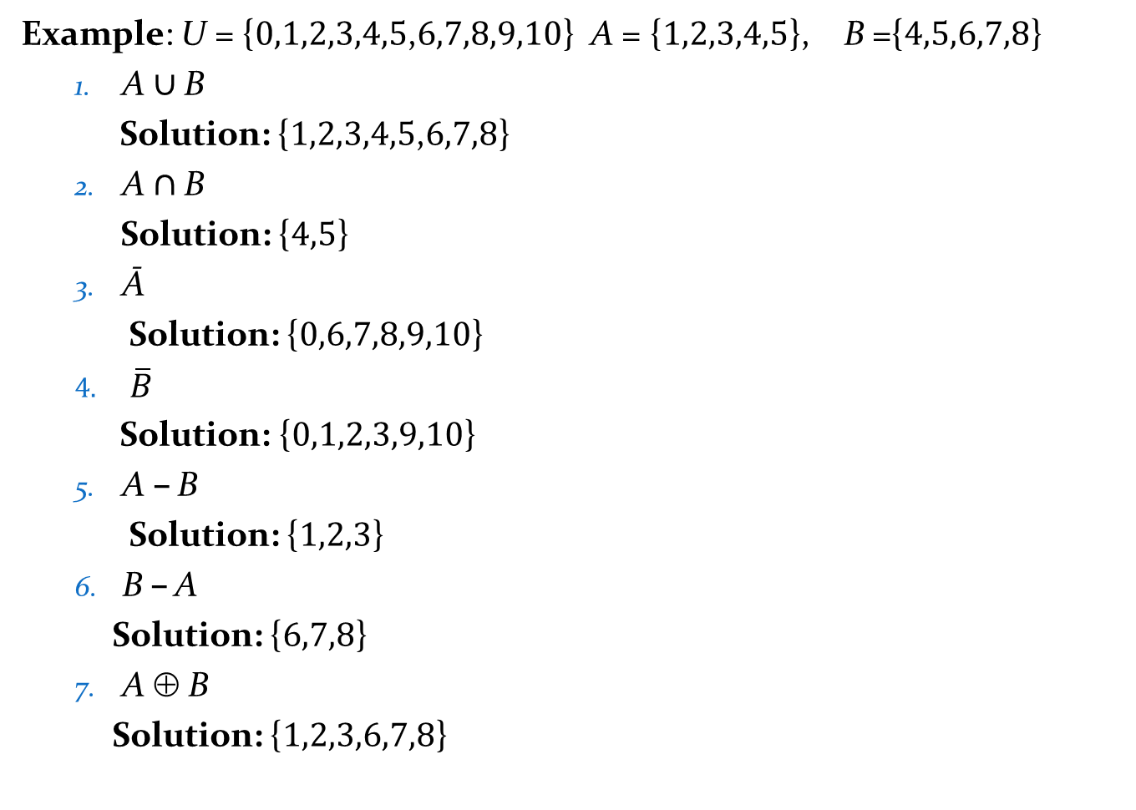
Example: U = {0,1,2,3,4,5,6,7,8,9,10} A = {1,2,3,4,5}, B ={4,5,6,7,8}
  A ∪ B
    Solution: {1,2,3,4,5,6,7,8}
  A ∩ B
    Solution: {4,5}
  Ā
    Solution: {0,6,7,8,9,10}
  $\overline{B}$
    Solution: {0,1,2,3,9,10}
  A – B
    Solution: {1,2,3}
  B – A
    Solution: {6,7,8}
  A ⊕ B
    Solution: {1,2,3,6,7,8}

Slide 12
Cardinality of the Union of Two Sets
U
Inclusion-Exclusion
|A ∪ B| = |A| + | B| − |A ∩ B|
Example:
Let A = math majors and B = CS majors.
To count #students who are either math or CS majors:
  add #math majors and #CS majors
  subtract #joint CS/math majors.
A
B
Venn Diagram for A, B, A ∩ B, A ∪ B

Slide 13
Inclusion-Exclusion for 3 sets
|A ∪ B ∪ C| = |A| + |B| + |C|
− |A ∩ B| − |A ∩ C| − |B ∩ C|
+ |A ∩ B ∩ C|

Slide 14



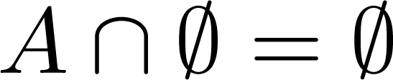


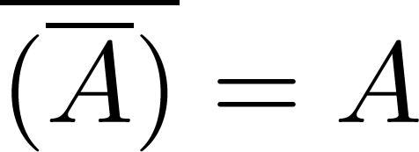
Set Identities (1 of 3)
Identity laws
Domination laws
Idempotent laws
Complementation law
Continued on next slide →

Slide 15


Set Identities (2 of 3)
Commutative laws
Associative laws
Distributive laws
Continued on next slide →

Slide 16


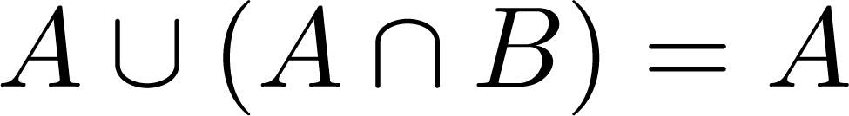
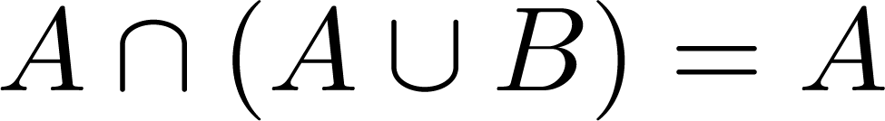

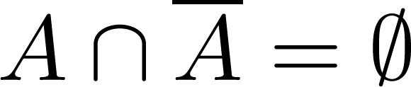
Set Identities (3 of 3)
De Morgan’s laws
Absorption law
Complement laws

Slide 17
Ways to Prove Set Identities
  Show each set (side of the identity) is subset of other.
  Use set builder notation and propositional logic.
  Membership Tables:
    Verify that elements in the same combination of sets always either belong or do not belong to the same side of the identity.
    Use 1 to indicate it is in the set and a 0 to indicate that it is not.

Slide 18


2nd De Morgan Law: containment
Example: Prove that
Solution: We prove this identity by showing that:
1) and
2)
Continued on next slide →

Slide 19
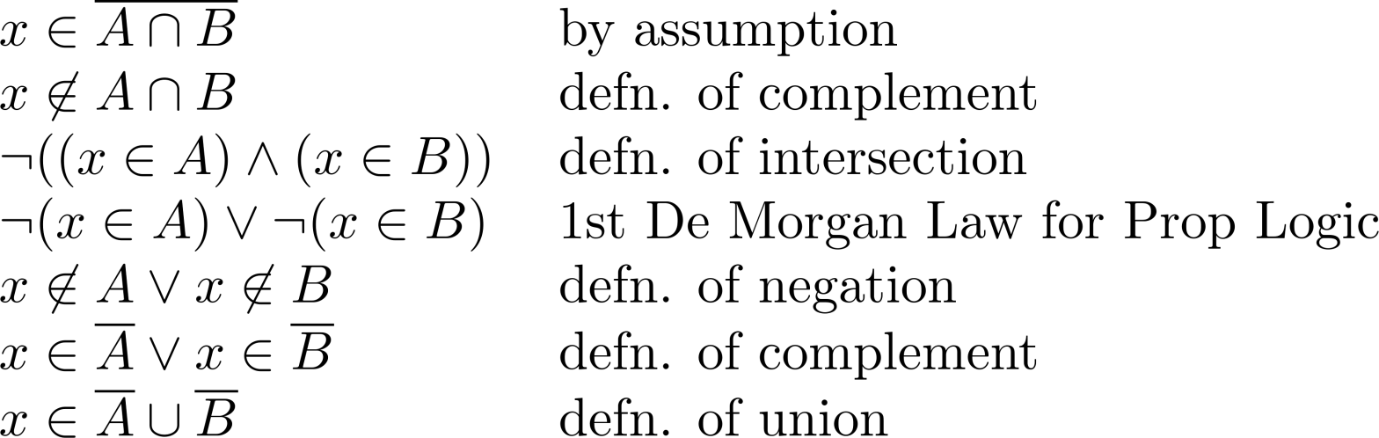
2nd De Morgan Law: containment
These steps show that:
Continued on next slide →

Slide 20
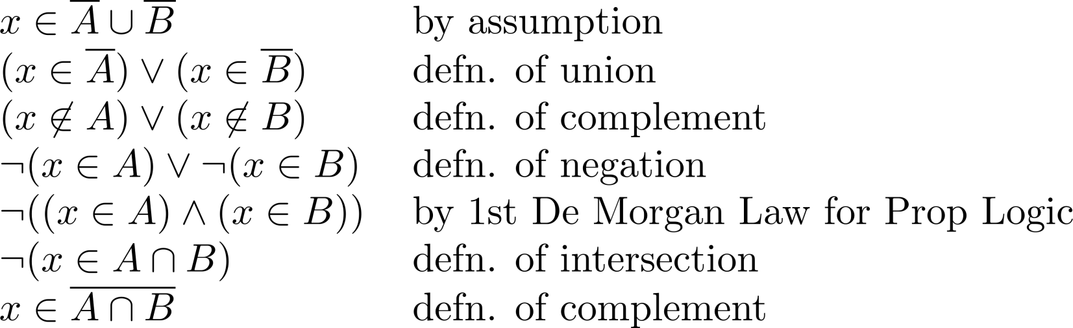
2nd De Morgan Law: containment
These steps show that:

Slide 21
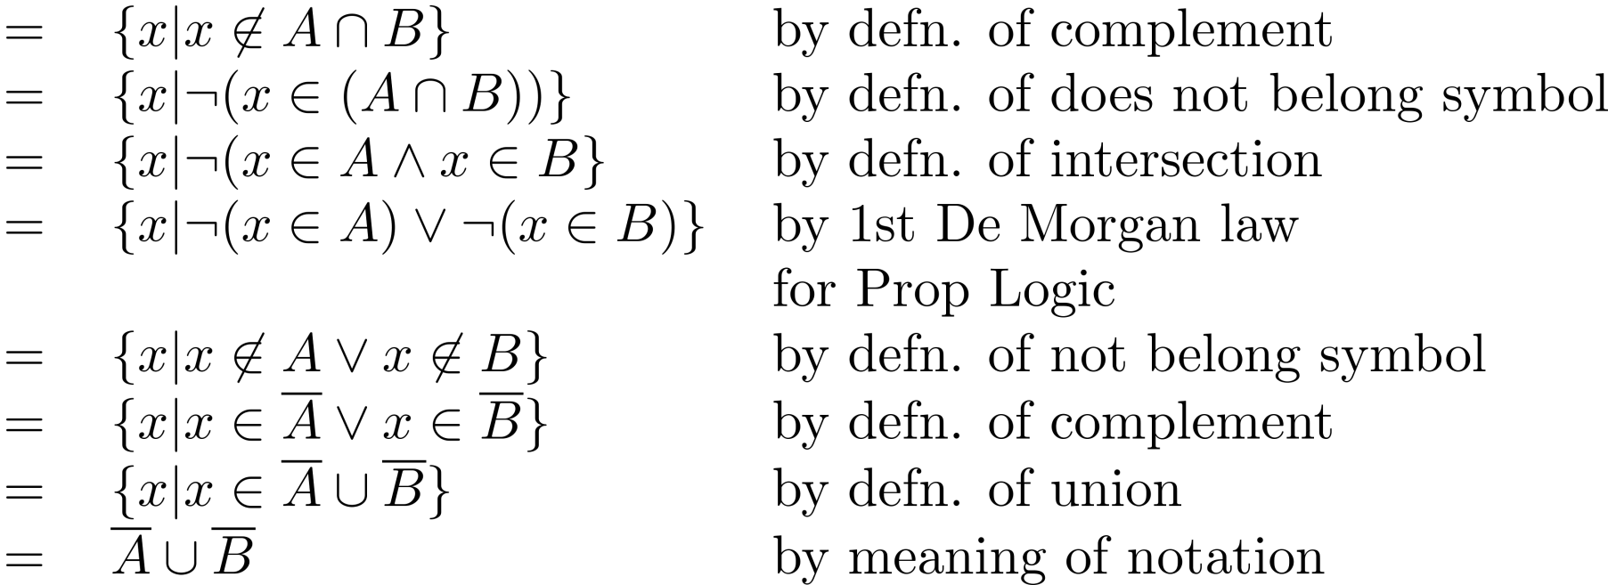
2nd De Morgan Law: Set-Builder Notation

Slide 22





distributive law: Membership Table
Solution:
A | B | C
1 | 1 | 1 | 1 | 1 | 1 | 1 | 1
1 | 1 | 0 | 0 | 1 | 1 | 1 | 1
1 | 0 | 1 | 0 | 1 | 1 | 1 | 1
1 | 0 | 0 | 0 | 1 | 1 | 1 | 1
0 | 1 | 1 | 1 | 1 | 1 | 1 | 1
0 | 1 | 0 | 0 | 0 | 1 | 0 | 0
0 | 0 | 1 | 0 | 0 | 0 | 1 | 0
0 | 0 | 0 | 0 | 0 | 0 | 0 | 0

Slide 23
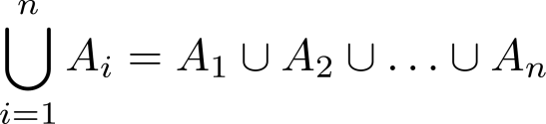
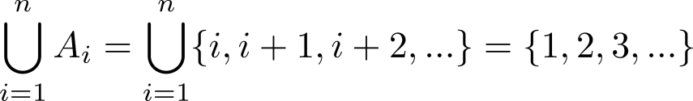
Generalized Unions
Let A₁, A₂ ,…, A_{n} be an indexed collection of sets.
We define:
This is well-defined, since union is associative.
For i = 1,2,…, let A_{i} = {i, i + 1, i + 2, ….}. Then

Slide 24
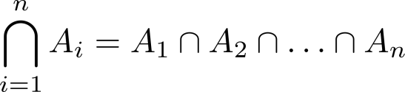
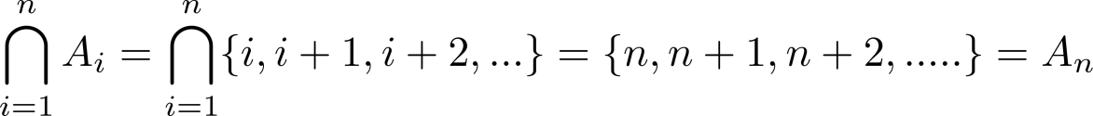
Generalized Intersections
Let A₁, A₂ ,…, A_{n} be an indexed collection of sets.
We define:
This is well-defined, since intersection is associative.
For i = 1,2,…, let A_{i} = {i, i + 1, i + 2, ….}. Then,

