Slide 1
The Foundations: Logic and Proofs
Chapter 1, Part I: Propositional Logic
With Question/Answer Animations
Copyright © McGraw-Hill Education. All rights reserved. No reproduction or distribution without the prior written consent of McGraw-Hill Education.

Slide 2
Chapter Summary
Propositional Logic
The Language of Propositions
Applications
Logical Equivalences
Predicate Logic
The Language of Quantifiers
Logical Equivalences
Nested Quantifiers
Proofs
Rules of Inference
Proof Methods
Proof Strategy

Slide 3
Propositional Logic Summary
The Language of Propositions
Connectives
Truth Values
Truth Tables
Applications
Translating English Sentences
System Specifications
Logic Puzzles
Logic Circuits
Logical Equivalences
Important Equivalences
Showing Equivalence
Satisfiability

Slide 4
Propositional Equivalences
Section 1.3

Slide 5
Section Summary
Tautologies, Contradictions, and Contingencies.
Logical Equivalence
Important Logical Equivalences
Showing Logical Equivalence
Normal Forms (optional, covered in exercises in text)
Disjunctive Normal Form
Conjunctive Normal Form
Propositional Satisfiability
Sudoku Example

Slide 6
Tautologies, Contradictions, and Contingencies
A tautology is a proposition which is always true.
Example: p ∨¬p
A contradiction is a proposition which is always false.
Example: p ∧¬p
A contingency is a proposition which is neither a tautology nor a contradiction, such as p
P | ¬p | p ∨¬p | p ∧¬p
T | F | T | F
F | T | T | F

Slide 7
Logically Equivalent
Two compound propositions p and q are logically equivalent if p↔q is a tautology.
We write this as p⇔q or as p≡q where p and q are compound propositions.
Two compound propositions p and q are equivalent if and only if the columns in a truth table giving their truth values agree.
This truth table shows that ¬p ∨ q is equivalent to p → q.
p | q | ¬p | ¬p ∨ q | p→ q
T | T | F | T | T
T | F | F | F | F
F | T | T | T | T
F | F | T | T | T

Slide 8
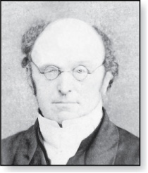
De Morgan’s Laws
Augustus De Morgan
1806-1871
This truth table shows that De Morgan’s Second Law holds.
p | q | ¬p | ¬q | (p∨q) | ¬(p∨q) | ¬p∧¬q
T | T | F | F | T | F | F
T | F | F | T | T | F | F
F | T | T | F | T | F | F
F | F | T | T | F | T | T

Slide 9
Key Logical Equivalences
Identity Laws: ,
Domination Laws: ,
Idempotent laws: ,
Double Negation Law:
Negation Laws: ,

Slide 10
Key Logical Equivalences (cont)
Commutative Laws: ,
Associative Laws:
Distributive Laws:
Absorption Laws:

Slide 11
More Logical Equivalences

Slide 12
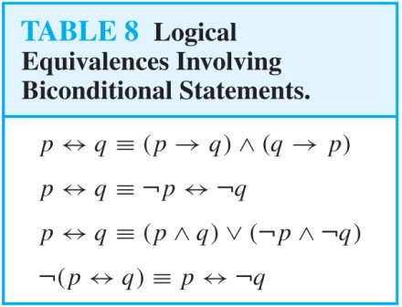
More Logical Equivalences (cont.)

Slide 13
Constructing New Logical Equivalences
We can show that two expressions are logically equivalent by developing a series of logically equivalent statements.
To prove that we produce a series of equivalences beginning with A and ending with B.
Keep in mind that whenever a proposition (represented by a propositional variable) occurs in the equivalences listed earlier, it may be replaced by an arbitrarily complex compound proposition.

Slide 14
Equivalence Proofs
Example: Show that
is logically equivalent to
Solution:

Slide 15
Equivalence Proofs
Example: Show that
is a tautology.
Solution:

Slide 16
Disjunctive Normal Form
A propositional formula is in disjunctive normal form if it consists of a disjunction of (1, … ,n) disjuncts where each disjunct consists of a conjunction of (1, …, m) atomic formulas or the negation of an atomic formula.
Yes
No
Disjunctive Normal Form is important for the circuit design methods discussed in Chapter 12.

Slide 17
Disjunctive Normal Form (DNF)
Every compound proposition has DNF.
Construct truth table for proposition.
Then an equivalent proposition is disjunction with n disjuncts, n = #rows for which the formula evaluates to T.
Each disjunct has m conjuncts, m = #variables.
Each conjunct includes
positive form of variable if variable is assigned T in that row and negated form if variable is assigned F in that row.

Slide 18
Disjunctive Normal Form
Example: Find the Disjunctive Normal Form (DNF) of
(p∨q)→¬r
Solution: This proposition is true when r is false or when both p and q are false.
(¬ p∧ ¬ q) ∨ ¬r

Slide 19
Conjunctive Normal Form
A compound proposition is in Conjunctive Normal Form (CNF) if it is a conjunction of disjunctions.
Every proposition can be put in an equivalent CNF.
Conjunctive Normal Form (CNF) can be obtained by eliminating implications, moving negation inwards and using the distributive and associative laws.
Important in resolution theorem proving used in artificial Intelligence (AI).
A compound proposition can be put in conjunctive normal form through repeated application of the logical equivalences covered earlier.

Slide 20
Conjunctive Normal Form (optional)
Example: Put the following into CNF:
Solution:
Eliminate implication signs:
Move negation inwards; eliminate double negation:
Convert to CNF using associative/distributive laws

Slide 21
Propositional Satisfiability
A compound proposition is satisfiable if there is an assignment of truth values to its variables that make it true. When no such assignments exist, the compound proposition is unsatisfiable.
A compound proposition is unsatisfiable if and only if its negation is a tautology.

Slide 22
Questions on Propositional Satisfiability
Example: Determine the satisfiability of the following compound propositions:
Solution: Satisfiable. Assign T to p, q, and r.
Solution: Satisfiable. Assign T to p and F to q.
Solution: Not satisfiable. Check each possible assignment of truth values to the propositional variables and none will make the proposition true.

Slide 23
Notation
Needed for the next example.

Slide 24
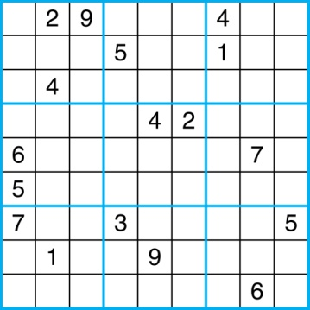
Sudoku
A Sudoku puzzle is represented by a 9×9 grid made up of nine 3×3 subgrids, known as blocks. Some of the 81 cells of the puzzle are assigned one of the numbers 1,2, …, 9.
The puzzle is solved by assigning numbers to each blank cell so that every row, column and block contains each of the nine possible numbers.

Slide 25
Encoding as a Satisfiability Problem
Let p(i,j,n) denote the proposition that is true when the number n is in the cell in the ith row and the jth column.
There are 9×9 × 9 = 729 such propositions.
In the sample puzzle p(5,1,6) is true, but p(5,j,6) is false for j = 2,3,…9

Slide 26
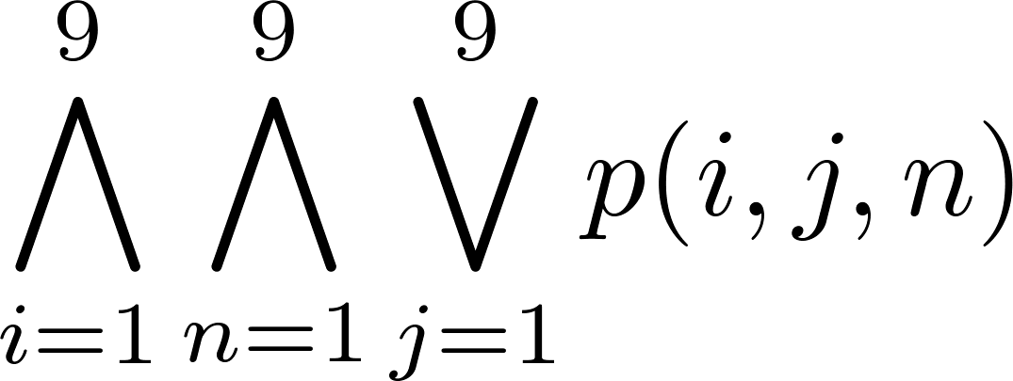
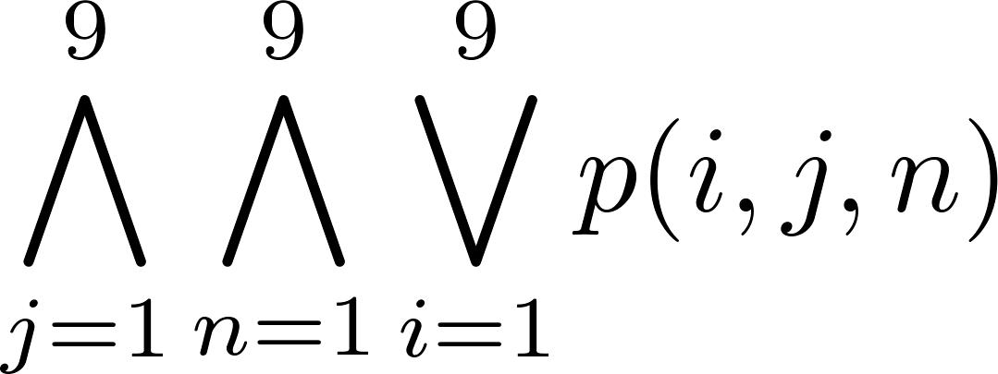
Encoding (cont)
For each cell with a given value, assert p(i,j,n), when the cell in row i and column j has the given value.
Assert that every row contains every number.
Assert that every column contains every number.

Slide 27
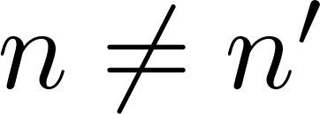
Encoding (cont)
Assert that each of the 3 x 3 blocks contain every number.
(this is tricky - ideas from chapter 4 help)
Assert that no cell contains more than one number. Take the conjunction over all values of n, n’, i, and j, where each variable ranges from 1 to 9 and ,
of

Slide 28
Solving Satisfiability Problems
To solve a Sudoku puzzle, we need to find an assignment of truth values to the 729 variables of the form p(i,j,n) that makes the conjunction of the assertions true. Those variables that are assigned T yield a solution to the puzzle.
A truth table can always be used to determine the satisfiability of a compound proposition. But this is too complex even for modern computers for large problems.
There has been much work on developing efficient methods for solving satisfiability problems as many practical problems can be translated into satisfiability problems.

