Slide 1
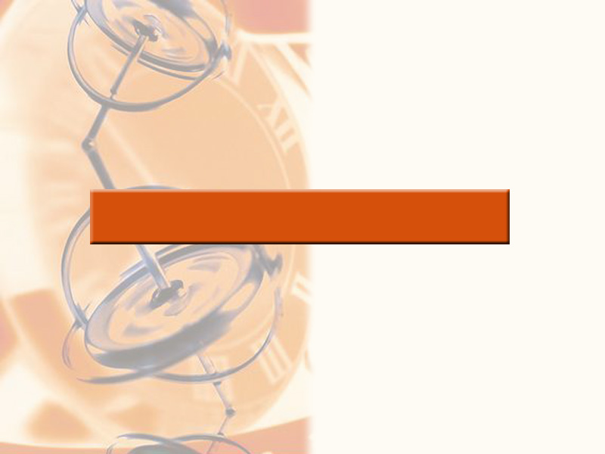
7
APPLICATIONS OF INTEGRATION

Slide 2
APPLICATIONS OF INTEGRATION
In 7.1-3, we looked at applications of integrals:
  Areas
  Volumes
In section 7.4, we focus on the 2 remaining topics for course:
  Arc length
  Surface area
  Some additional applications that might be taught:
  Work (physics)
  Average values (physics-center of mass) (probability/statistics-expectation)

Slide 3
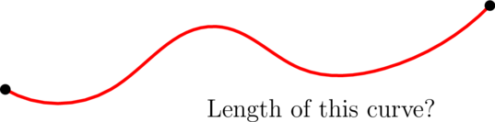
Arc Length
We could:
Fit a piece of string to curve;
Straighten string out;
Measure against a ruler.
However, if the curve is given by a formula,
we can find a formula for the arc length as well.

Slide 4

ARC LENGTH formula derivation
As we did with area & volume, we will
Use a Riemann sum with n pieces to approximate;
Take the limit as $n→∞$ to get an integral.

Slide 5
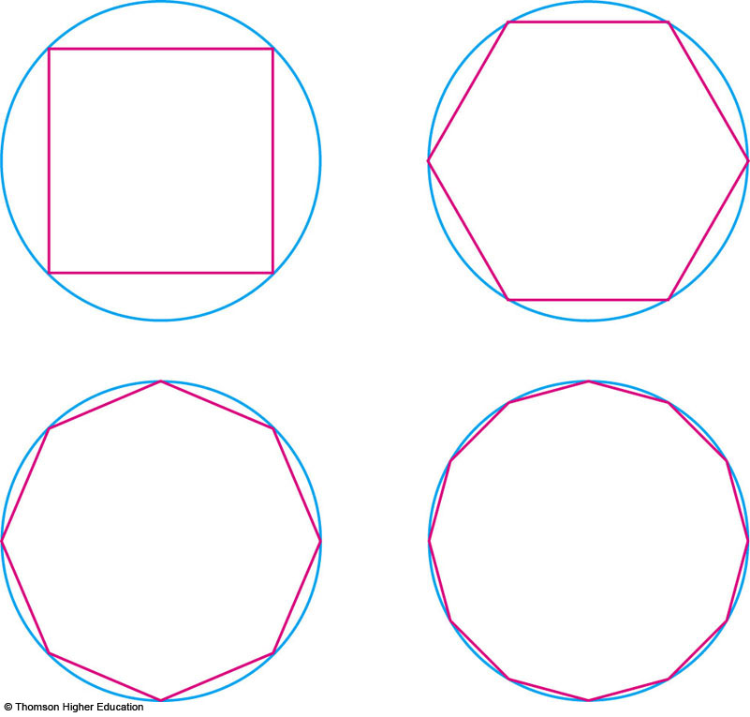
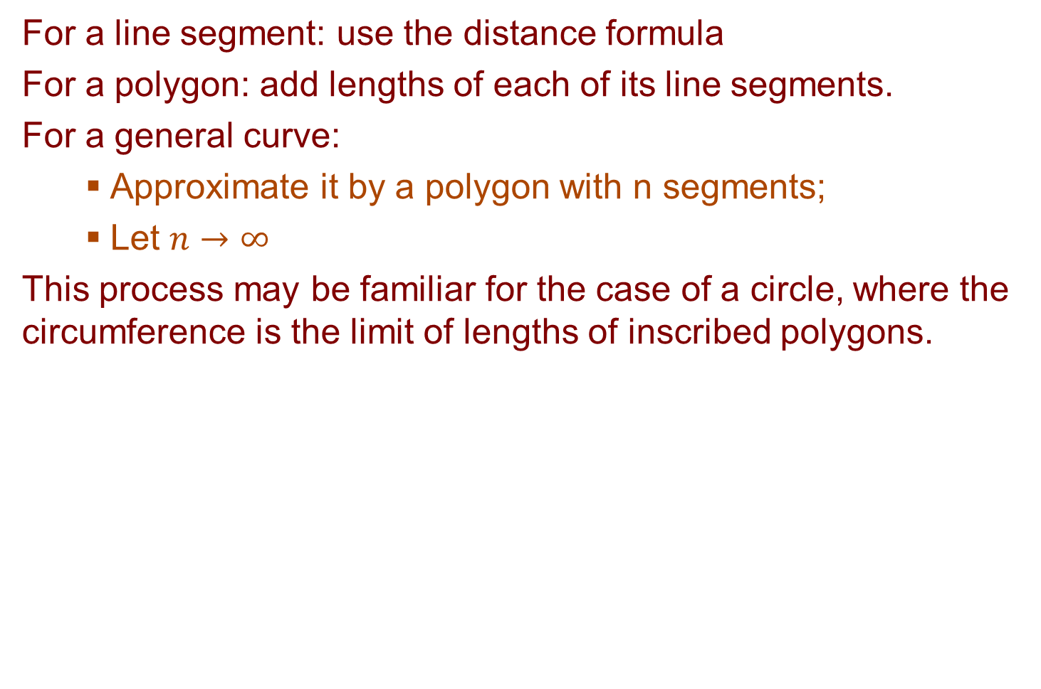
ARC LENGTH formula derivation: our approach
For a line segment: use the distance formula
For a polygon: add lengths of each of its line segments.
For a general curve:
  Approximate it by a polygon with n segments;
  Let $n→∞$
  This process may be familiar for the case of a circle, where the circumference is the limit of lengths of inscribed polygons.

Slide 6
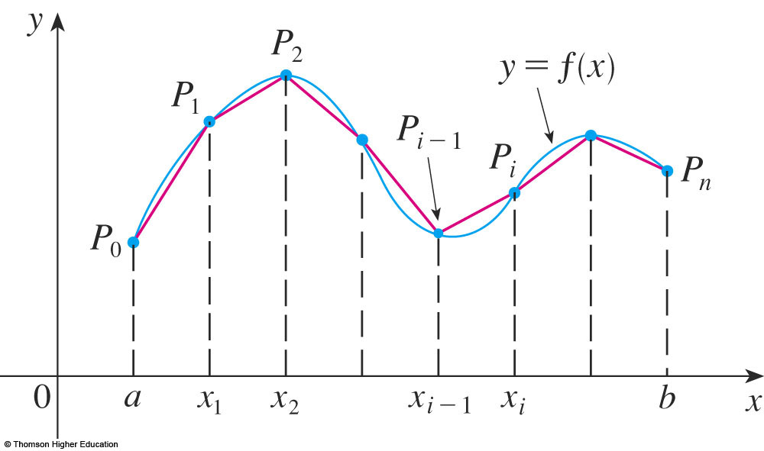
ARC LENGTH: for the graph of a function
If a curve C is defined by the equation y = f(x), where f(x) is continuous and a ≤ x ≤ b.
Obtain a polygonal approximation by dividing [a, b] into n subintervals with endpts x₀, x₁, … , x_{n} & width Δx
If y_{i} = f(x_{i}), then the pts P_{i} = (x_{i}, y_{i}) lie on C
and the polygon with vertices P_{o}, P₁, …, P_{n}, approximates C.

Slide 7

ARC LENGTH : for the graph of a function
The length L of C is approximately the length of this polygon & the approximation gets better as $n→∞$

Slide 8
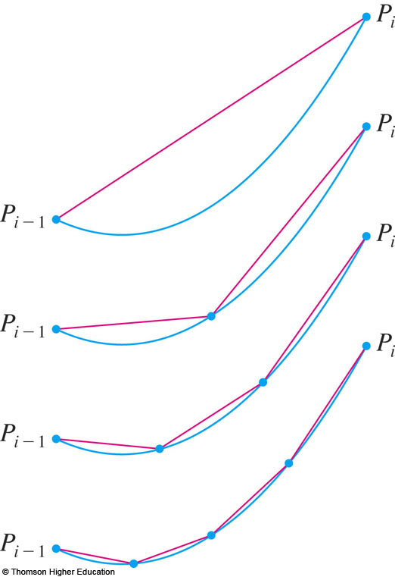
ARC LENGTH : for the graph of a function
Here, the arc of the curve between P_{i –1} and P_{i} has been magnified and approximations with successively smaller values of Δx are shown.

Slide 9
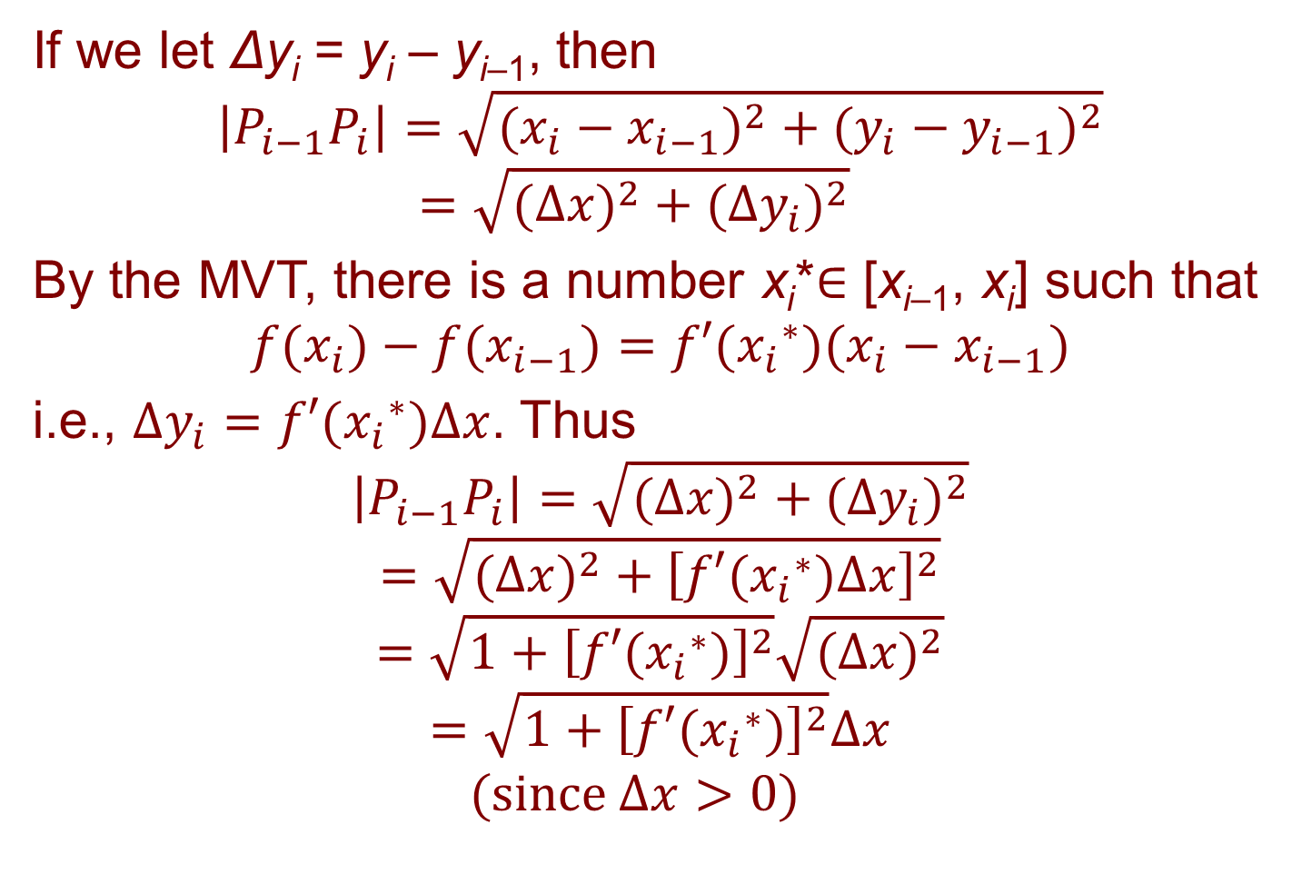
ARC LENGTH : for the graph of a SMOOTH function
If we let Δy_{i} = y_{i} – y_{i–1}, then
$$\left|P_{i−1}P_{i}\right|=\sqrt{(x_{i}−x_{i−1})^{2}+(y_{i}−y_{i−1})^{2}}$$
$$=\sqrt{(Δx)^{2}+(Δy_{i})^{2}}$$
By the MVT, there is a number x_{i}*$∈$ [x_{i–1}, x_{i}] such that
$$f(x_{i})−f(x_{i−1})=f′({x_{i}}^{∗})(x_{i}−x_{i−1})$$
i.e., $Δy_{i}=f′({x_{i}}^{∗})Δx$. Thus
$$\left|P_{i−1}P_{i}\right|=\sqrt{(Δx)^{2}+(Δy_{i})^{2}}$$
$$=\sqrt{(Δx)^{2}+{\left[f′({x_{i}}^{∗})Δx\right]}^{2}}$$
$$=\sqrt{1+{\left[f′({x_{i}}^{∗})\right]}^{2}}\sqrt{(Δx)^{2}}$$
$$=\sqrt{1+{\left[f′({x_{i}}^{∗})\right]}^{2}}Δx$$
$$(\text{since} Δx>0)$$

Slide 10
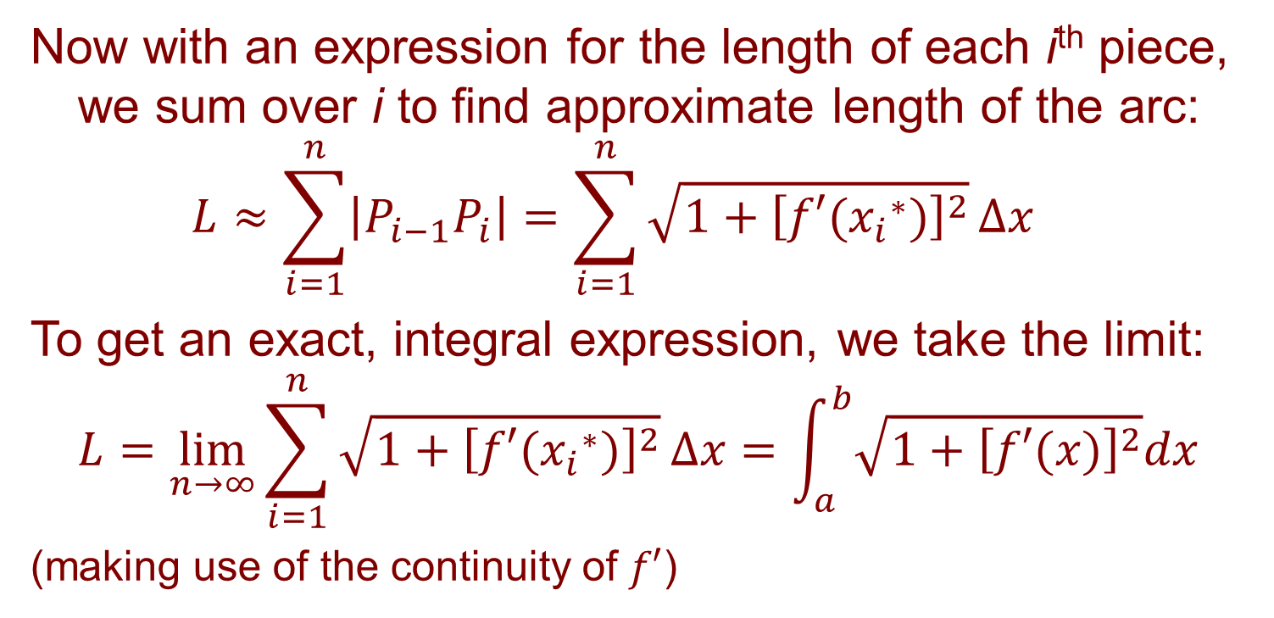
ARC LENGTH : for the graph of a SMOOTH function
Now with an expression for the length of each i^{th} piece, we sum over i to find approximate length of the arc:
$$L≈\sum_{i=1}^{n}{\left|P_{i−1}P_{i}\right|}=\sum_{i=1}^{n}{\sqrt{1+{\left[f′({x_{i}}^{∗})\right]}^{2}}}Δx$$
To get an exact, integral expression, we take the limit:
$$L=\lim_{n→∞}{\sum_{i=1}^{n}{\sqrt{1+{\left[f′({x_{i}}^{∗})\right]}^{2}}}}Δx=\int_{a}^{b}{\sqrt{1+{\left[f′(x)\right]}^{2}}dx}$$
(making use of the continuity of $f′$)

Slide 11
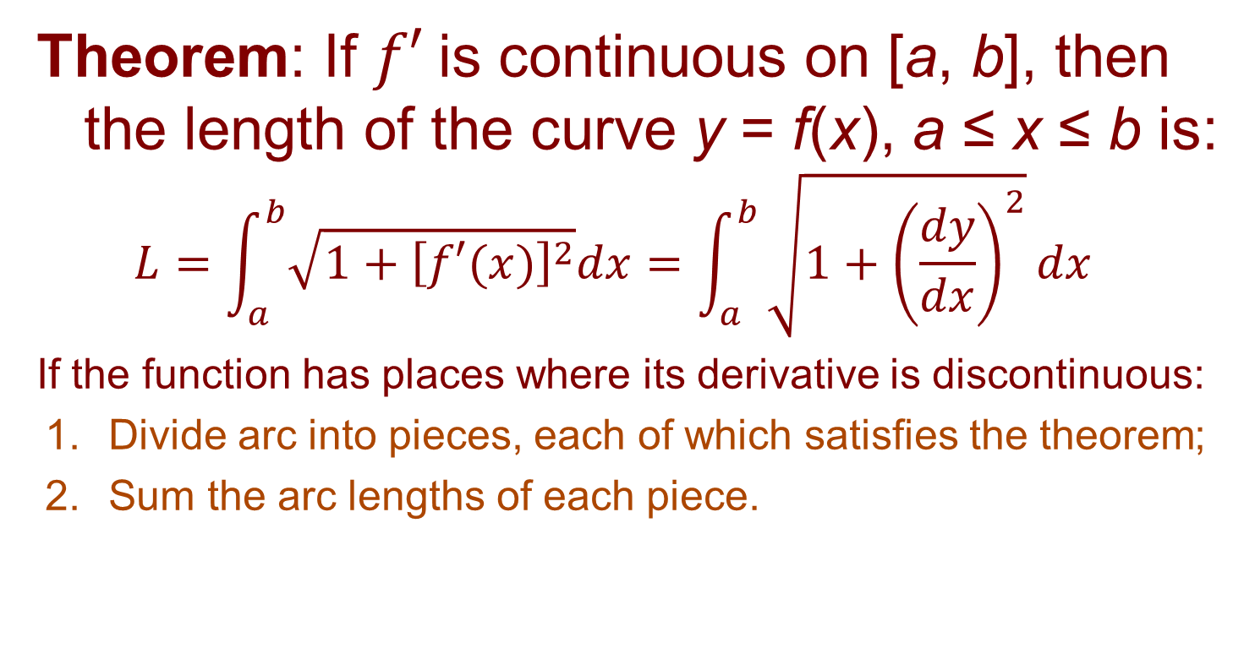
ARC LENGTH FORMULA
Formula 2
Theorem: If $f′$is continuous on [a, b], then the length of the curve y = f(x), a ≤ x ≤ b is:
$$L=\int_{a}^{b}{\sqrt{1+{\left[f′(x)\right]}^{2}}dx}=\int_{a}^{b}{\sqrt{1+{\left(\frac{dy}{dx}\right)}^{2}}dx}$$
If the function has places where its derivative is discontinuous:
  Divide arc into pieces, each of which satisfies the theorem;
  Sum the arc lengths of each piece.

Slide 12
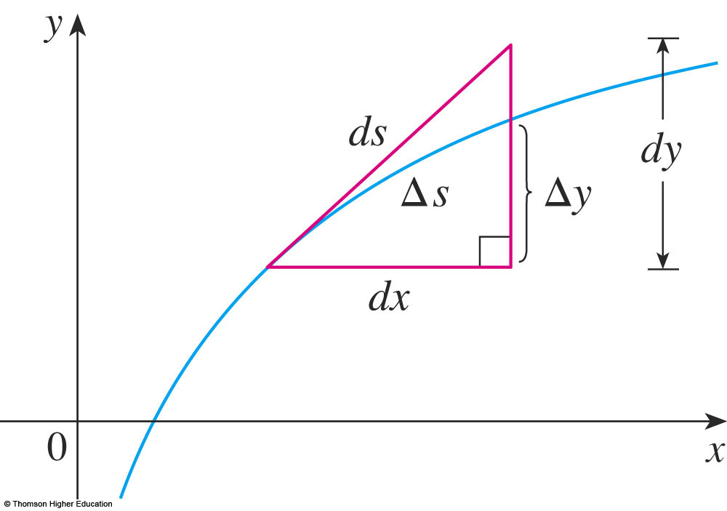
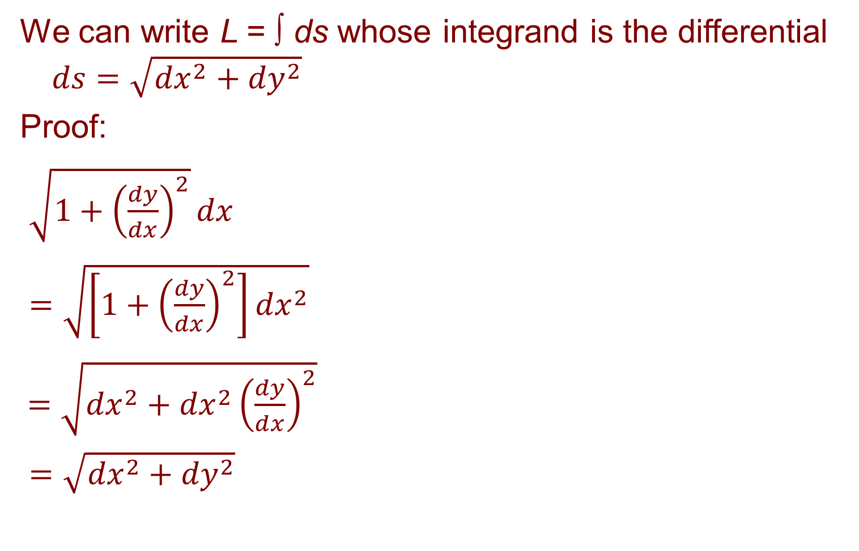
THE ARC-LENGTH DIFFERENTIAL ds
We can write L = ∫ ds whose integrand is the differential $ds=\sqrt{{dx}^{2}+{dy}^{2}}$
Proof:
$\sqrt{1+{\left(\frac{dy}{dx}\right)}^{2}}dx$
$=\sqrt{\left[1+{\left(\frac{dy}{dx}\right)}^{2}\right]{dx}^{2}}$
$=\sqrt{{dx}^{2}+{dx}^{2}{\left(\frac{dy}{dx}\right)}^{2}}$
$=\sqrt{{dx}^{2}+{dy}^{2}}$

Slide 13
Riemann sum approach to finding ARC LENGTH
We pause to remind you that the procedure for finding the formula for arc length, area and volume have all been similar:
  Divide the curve, the region or the solid into a large number of small parts.
  Find approximate lengths, areas or volumes of these smaller parts and sum.
  Take the limit as n → ∞ to get an integral.

Slide 14
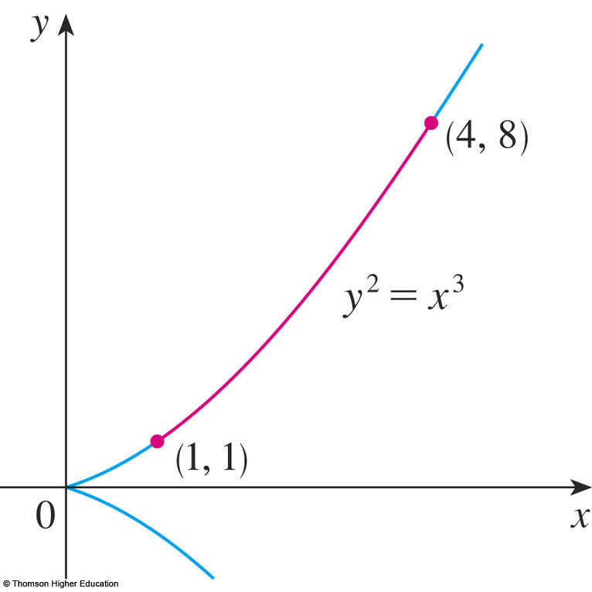
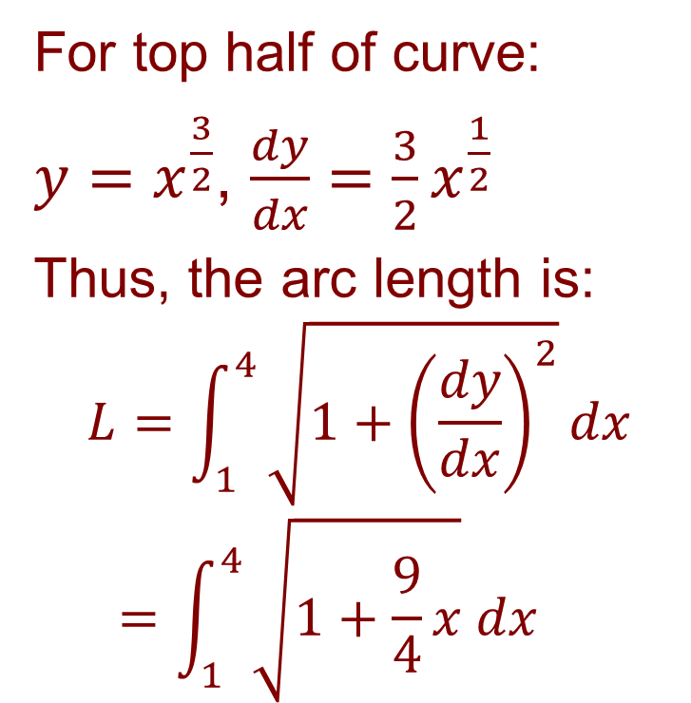
Find the arc length for y² = x³ between the points (1, 1) and (4, 8)
Example 1
For top half of curve:
$y=x^{\frac{3}{2}}$, $\frac{dy}{dx}=\frac{3}{2}x^{\frac{1}{2}}$
Thus, the arc length is:
$$L=\int_{1}^{4}{\sqrt{1+{\left(\frac{dy}{dx}\right)}^{2}}}dx$$
$$=\int_{1}^{4}{\sqrt{1+\frac{9}{4}x} dx}$$

Slide 15

Find the arc length for y² = x³ between the points (1, 1) and (4, 8)
Example 1
$u=1+\frac{9}{4}x$→ $du=\frac{9}{4}$; x = 1 → $u=\frac{13}{4}$; x = 4 → $u=10$.
$L=\int_{1}^{4}{\sqrt{1+\frac{9}{4}x} dx}=\frac{4}{9}\int_{\frac{13}{4}}^{10}{\sqrt{u}du}=\frac{4}{9}⋅{\left.\frac{2}{3}u^{\frac{3}{2}}\right]}_{\frac{13}{4}}^{10}$
$=\frac{8}{27}\left[10^{\frac{3}{2}}−{\left(\frac{13}{4}\right)}^{\frac{3}{2}}\right] =\frac{1}{27}\left(80\sqrt{10}−13\sqrt{13}\right)≈7.634$
In contrast, the length of
the straight line connecting
the 2 endpoints is:
$\sqrt{{\left(4−1\right)}^{2}+{\left(8−1\right)}^{2}}$
$=\sqrt{58}≈7.616$
($≈$0.2% difference)

Slide 16
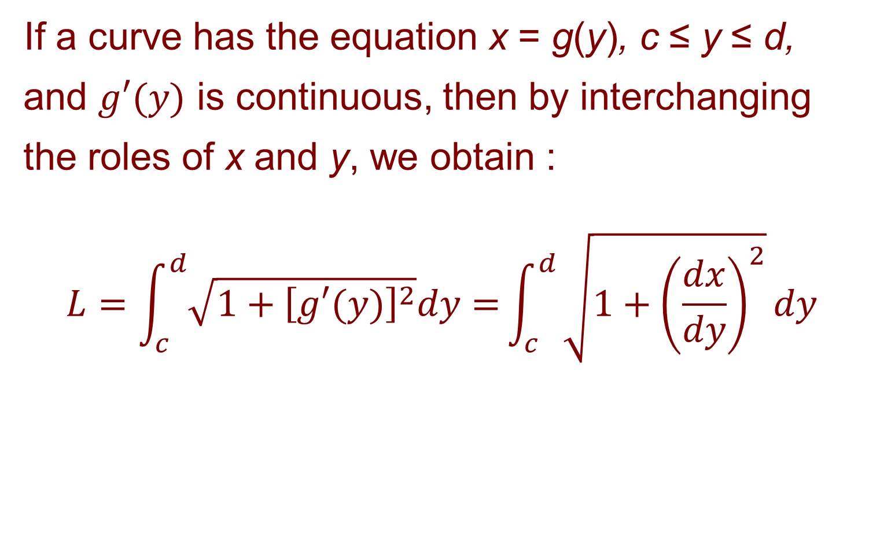
ARC LENGTH
Formula 4
If a curve has the equation x = g(y), c ≤ y ≤ d, and $g′(y)$ is continuous, then by interchanging the roles of x and y, we obtain :
$$L=\int_{c}^{d}{\sqrt{1+{\left[g′(y)\right]}^{2}}dy=}\int_{c}^{d}{\sqrt{1+{\left(\frac{dx}{dy}\right)}^{2}}}dy$$

Slide 17
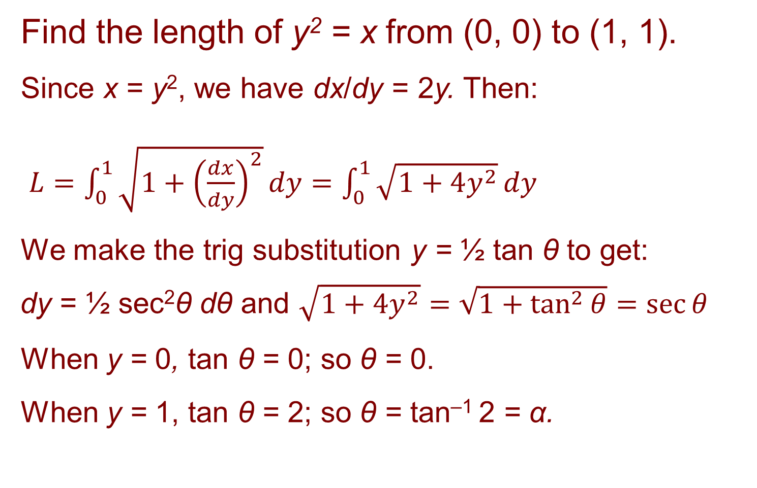
ARC LENGTH
Example 2
Find the length of y² = x from (0, 0) to (1, 1).
Since x = y², we have dx/dy = 2y. Then:
$L=\int_{0}^{1}{\sqrt{1+{\left(\frac{dx}{dy}\right)}^{2}}}dy=\int_{0}^{1}{\sqrt{1+4y^{2}}}dy$
We make the trig substitution y = ½ tan θ to get:
dy = ½ sec²θ dθ and $\sqrt{1+4y^{2}}=\sqrt{1+\tan^{2}{θ}}=\sec{θ}$
When y = 0, tan θ = 0; so θ = 0.
When y = 1, tan θ = 2; so θ = tan^{–1} 2 = α.

Slide 18
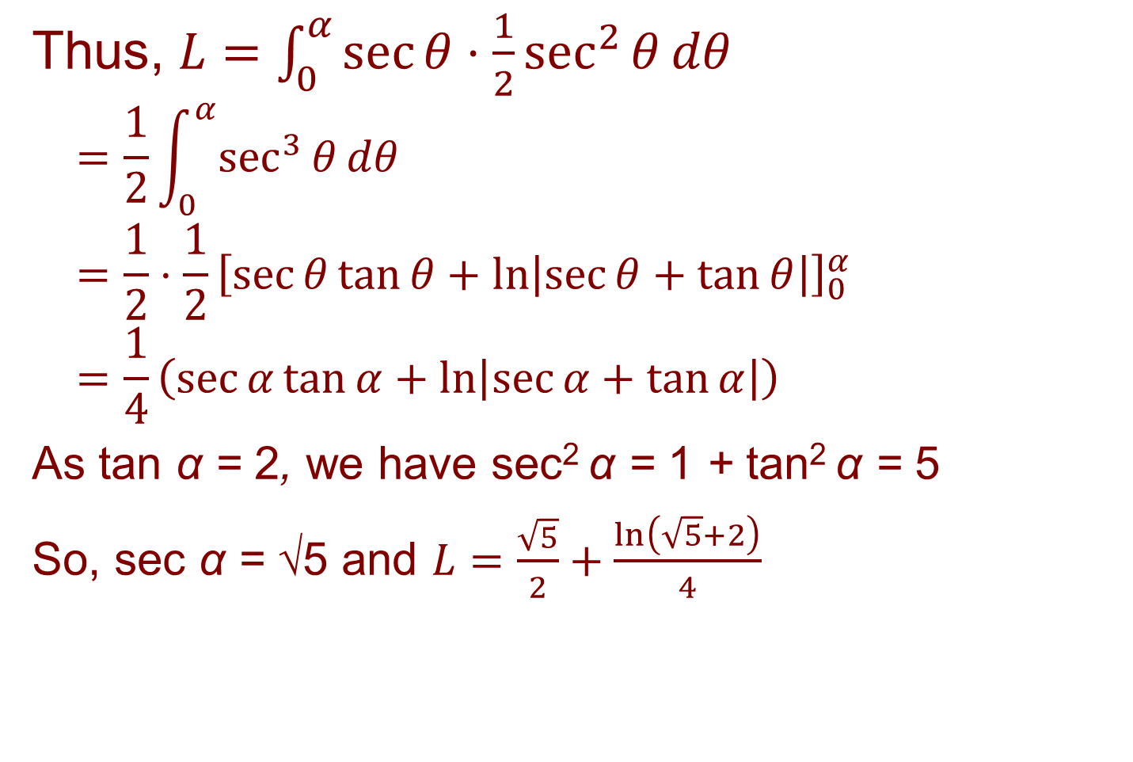
ARC LENGTH
Example 2
Thus, $L=\int_{0}^{α}{\sec{θ}⋅\frac{1}{2}\sec^{2}{θ}}dθ$
$$=\frac{1}{2}\int_{0}^{α}{\sec^{3}{θ}dθ}$$
$$=\frac{1}{2}⋅\frac{1}{2}{\left[\sec{θ}\tan{θ}+\ln\left|\sec{θ}+\tan{θ}\right|\right]}_{0}^{α}$$
$$=\frac{1}{4}\left(\sec{α}\tan{α}+\ln\left|\sec{α}+\tan{α}\right|\right)$$
As tan α = 2, we have sec² α = 1 + tan² α = 5
So, sec α = √5 and $L=\frac{\sqrt{5}}{2}+\frac{\ln\left(\sqrt{5}+2\right)}{4}$

Slide 19
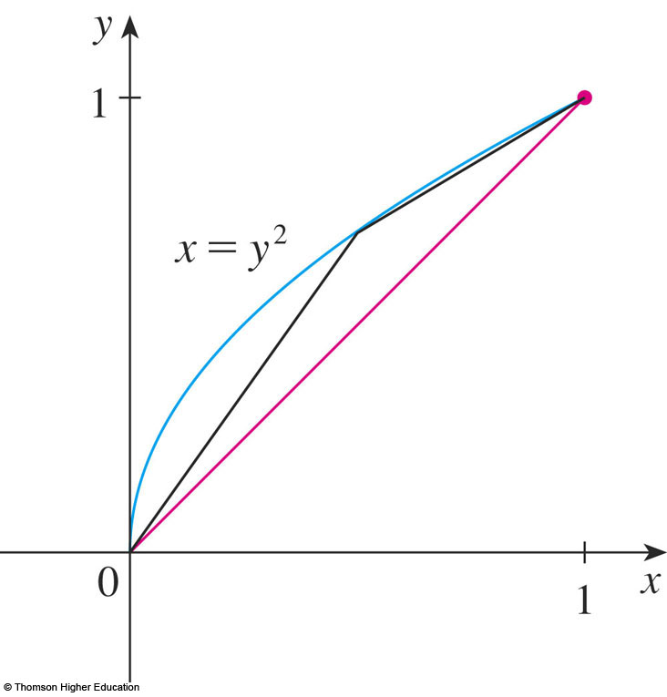
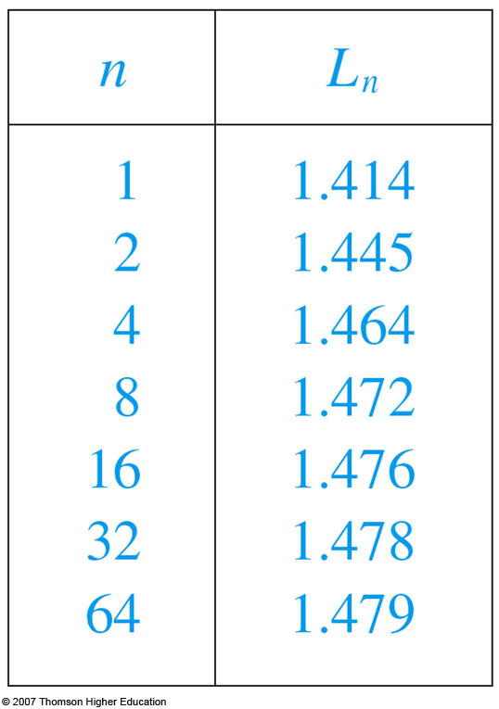
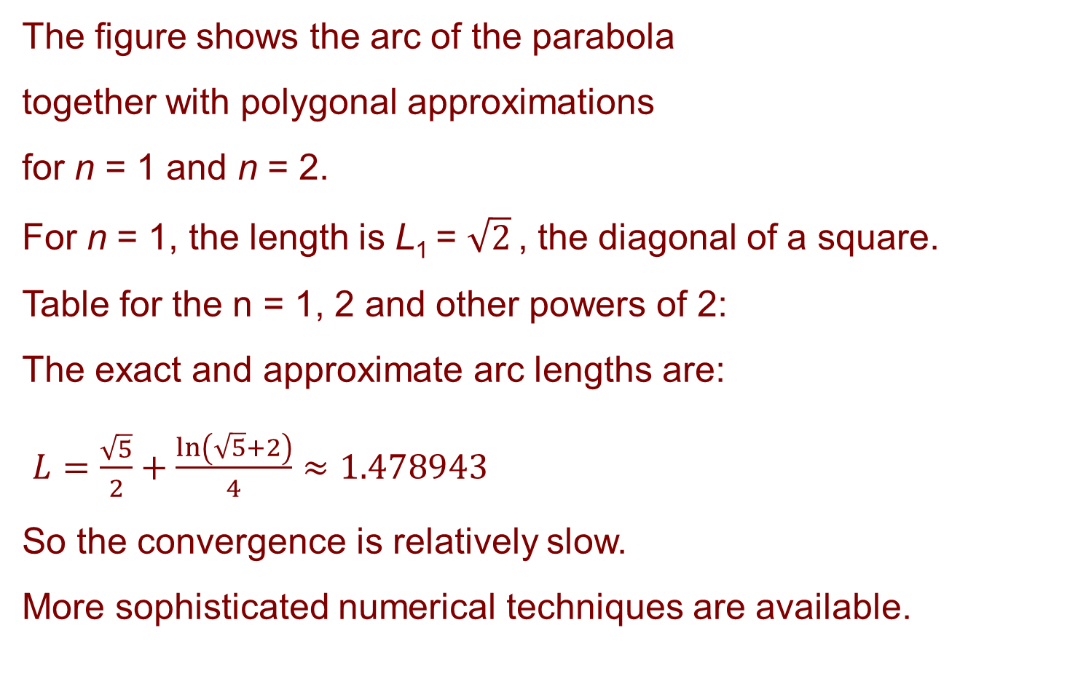
ARC LENGTH
Example 2 (cont.)
The figure shows the arc of the parabola
together with polygonal approximations
for n = 1 and n = 2.
For n = 1, the length is L₁ = $\sqrt{2}$ , the diagonal of a square.
Table for the n = 1, 2 and other powers of 2:
The exact and approximate arc lengths are:
$L=\frac{\sqrt{5}}{2}+\frac{\ln\left(\sqrt{5}+2\right)}{4}≈1.478943$
So the convergence is relatively slow.
More sophisticated numerical techniques are available.

Slide 20
ARC LENGTH
Due to the presence of the square root sign, the calculation of an arc length often leads to an integral that is difficult or even impossible to evaluate explicitly.
So, sometimes, we have to be content with finding an approximation.

Slide 21
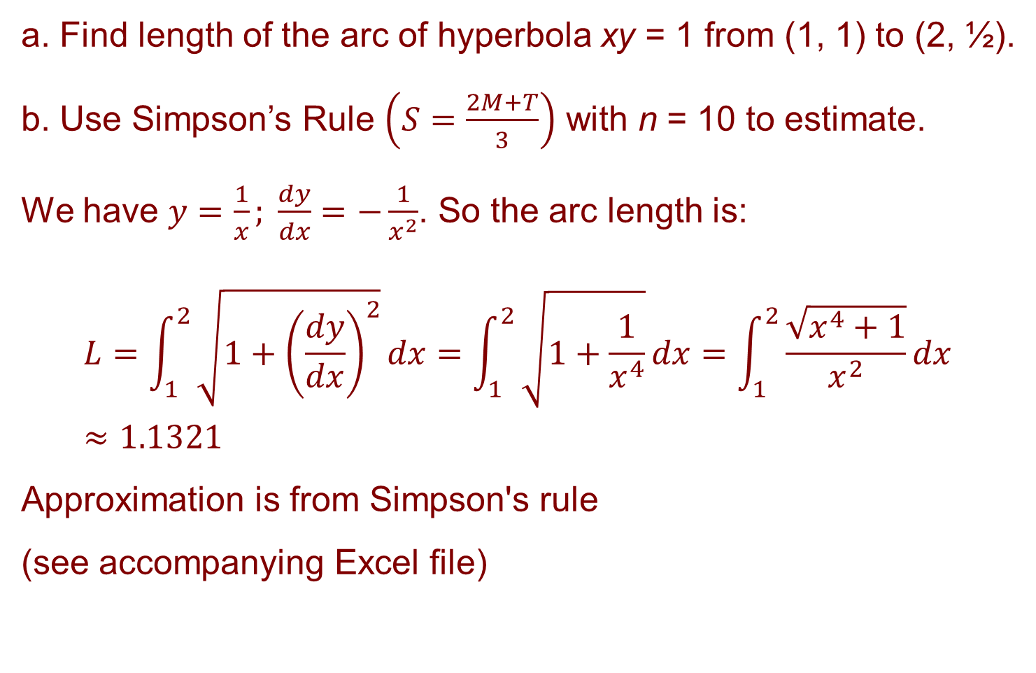
ARC LENGTH
Example 3
a. Find length of the arc of hyperbola xy = 1 from (1, 1) to (2, ½).
b. Use Simpson’s Rule $\left(S=\frac{2M+T}{3}\right)$ with n = 10 to estimate.
We have $y=\frac{1}{x}; \frac{dy}{dx}=−\frac{1}{x^{2}}$. So the arc length is:
$$L=\int_{1}^{2}{\sqrt{1+{\left(\frac{dy}{dx}\right)}^{2}}}dx=\int_{1}^{2}{\sqrt{1+\frac{1}{x^{4}}}}dx=\int_{1}^{2}{\frac{\sqrt{x^{4}+1}}{x^{2}}}dx≈1.1321$$
Approximation is from Simpson's rule
(see accompanying Excel file)

Slide 22
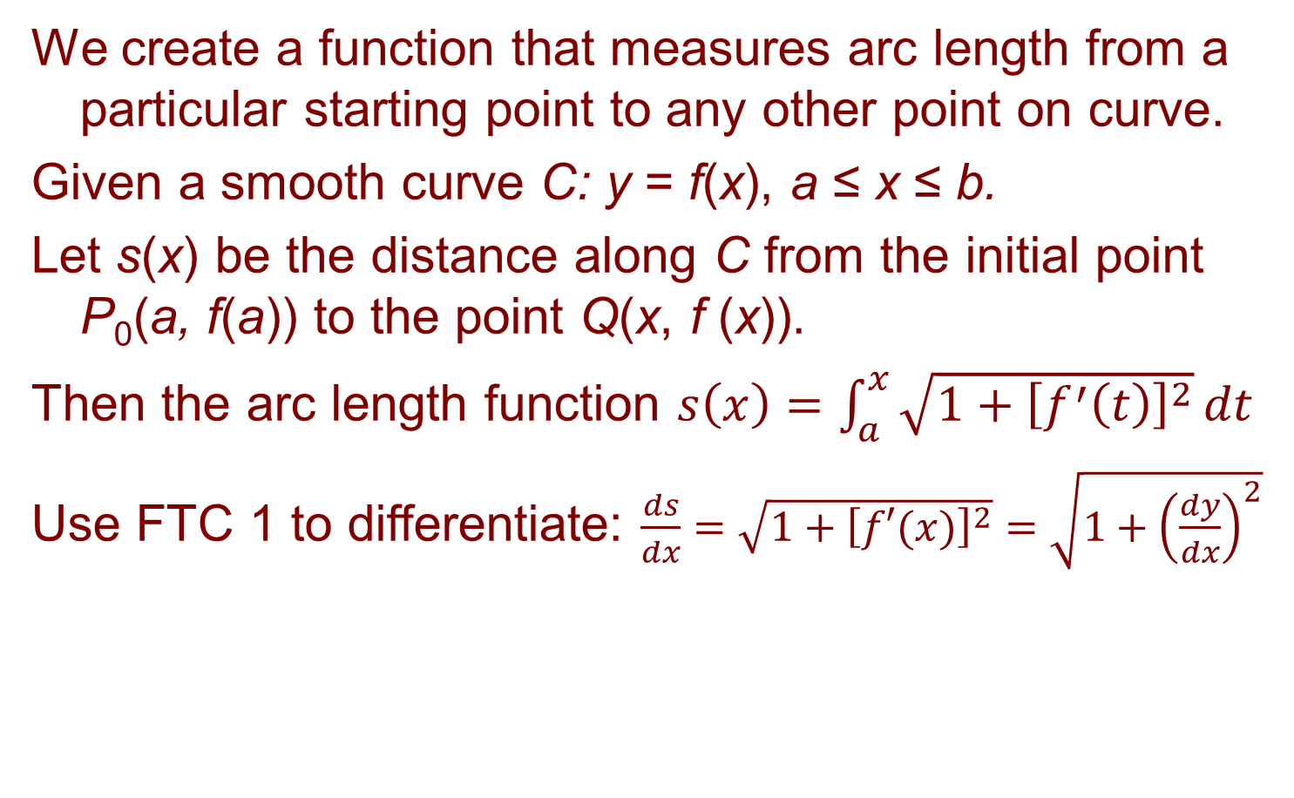
ARC LENGTH FUNCTION
We create a function that measures arc length from a particular starting point to any other point on curve.
Given a smooth curve C: y = f(x), a ≤ x ≤ b.
Let s(x) be the distance along C from the initial point P₀(a, f(a)) to the point Q(x, f (x)).
Then the arc length function $s\left(x\right)=\int_{a}^{x}{\sqrt{1+{\left[f^{′}\left(t\right)\right]}^{2}}}dt$
Use FTC 1 to differentiate: $\frac{ds}{dx}=\sqrt{1+{\left[f′(x)\right]}^{2}}=\sqrt{1+{\left(\frac{dy}{dx}\right)}^{2}}$

Slide 23
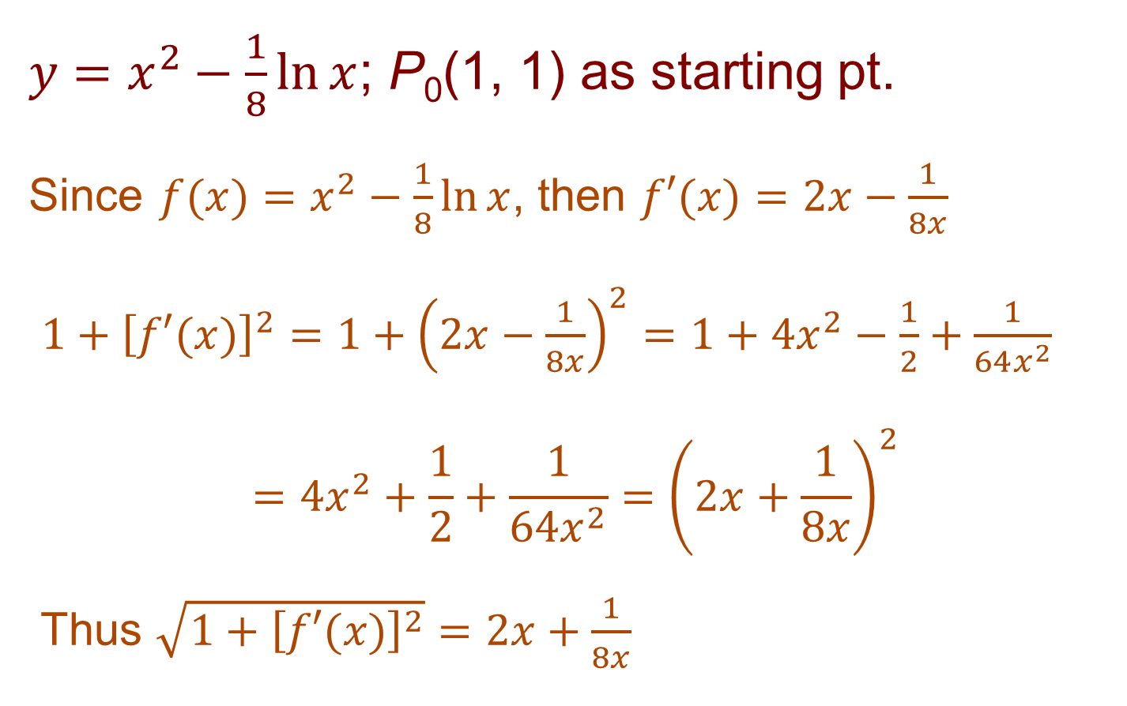
ARC LENGTH FUNCTION
Example 4
$y=x^{2}−\frac{1}{8}\ln{x}$; P₀(1, 1) as starting pt.
Since $f(x)=x^{2}−\frac{1}{8}\ln{x}$, then $f′(x)=2x−\frac{1}{8x}$
$1+{\left[f′(x)\right]}^{2}=1+{\left(2x−\frac{1}{8x}\right)}^{2}=1+4x^{2}−\frac{1}{2}+\frac{1}{64x^{2}}$
$$=4x^{2}+\frac{1}{2}+\frac{1}{64x^{2}}={\left(2x+\frac{1}{8x}\right)}^{2}$$
Thus $\sqrt{1+{\left[f′(x)\right]}^{2}}=2x+\frac{1}{8x}$

Slide 24
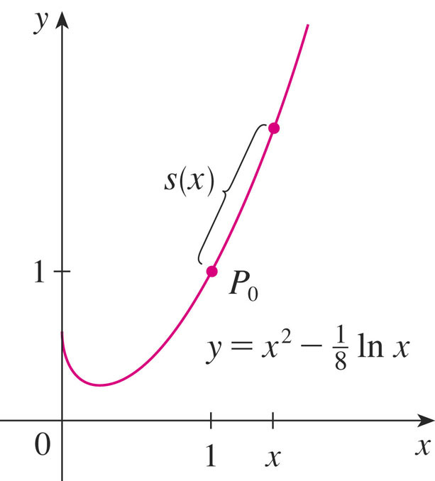
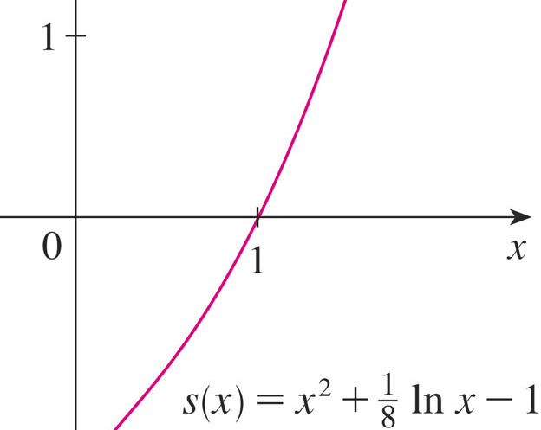
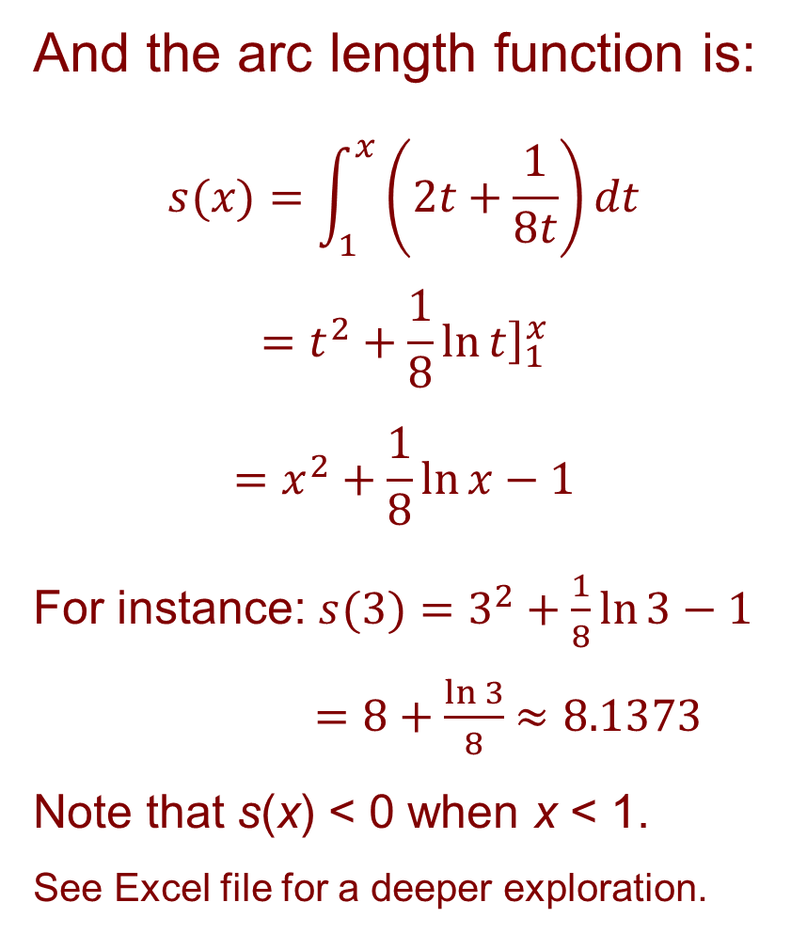
Example 4 cont.
And the arc length function is:
$$s(x)=\int_{1}^{x}{\left(2t+\frac{1}{8t}\right)}dt$$
$$=t^{2}+\frac{1}{8}{\left.\ln{t}\right]}_{1}^{x}$$
$$=x^{2}+\frac{1}{8}\ln{x}−1$$
For instance: $s(3)=3^{2}+\frac{1}{8}\ln{3}−1$
$=8+\frac{\ln{3}}{8}$ $≈8.1373$
Note that s(x) < 0 when x < 1.
See Excel file for a deeper exploration.

Slide 25
SURFACE OF REVOLUTION and Area
A surface of revolution is formed when a curve is rotated about a line.
  Such a surface could be the lateral boundary of a solid
  of revolution of the type discussed in Sections 7.2-3.
We want the area of a surface of revolution to correspond to our intuition.
  If the surface area is A, we can imagine that
  painting the surface would require the same
  amount of paint as does a flat region with area A .
  Let’s start with some simple surfaces.

Slide 26
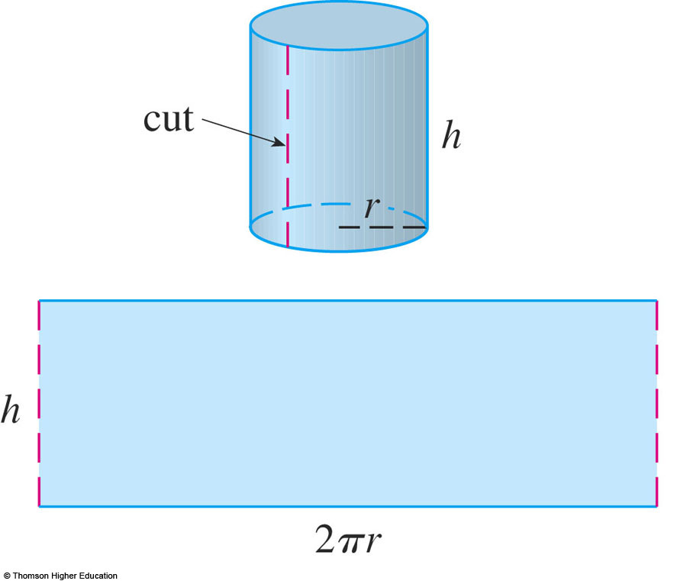
CIRCULAR CYLINDERS
The lateral surface area of a circular cylinder
with radius r and height h is taken to be: A = 2πrh
  We can imagine
  cutting the cylinder
  and unrolling it to
  obtain a rectangle
  with dimensions of
  2πr and h.

Slide 27
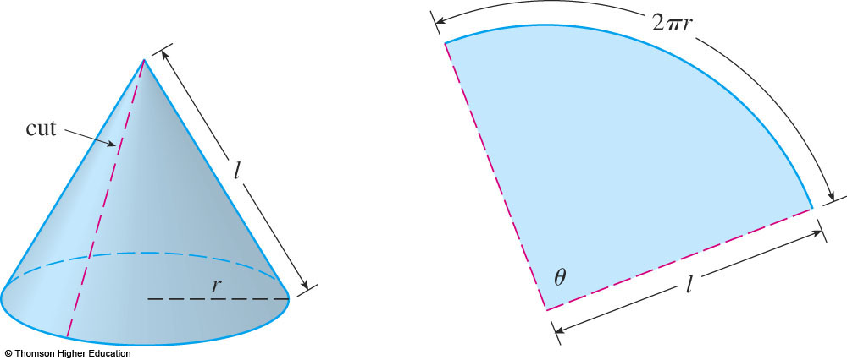
CIRCULAR CONES
We can take a circular cone with base radius r and slant height l, cut it along the dashed line as shown, and flatten it to form a sector of a circle with radius l and central angle θ = 2πr/l.

Slide 28

CIRCULAR CONES
Area of a sector with radius l, angle θ is ½ l² θ
(if θ = 2 π, we recover formula for area of circle)
  Thus, the lateral surface area of a cone is
  $$A=\frac{1}{2}l^{2}θ=\frac{1}{2}l^{2}\left(\frac{2πr}{l}\right)=πrl$$
What about more complicated surfaces of revolution?

Slide 29
AREA OF A SURFACE OF REVOLUTION
If we follow the strategy we used with arc length, we can approximate the original curve by a polygon.
  When this is rotated about an axis, it creates a simpler surface whose surface area approximates the actual surface area.
  By taking a limit, we can determine the exact surface area.
Then, the approximating surface consists of a number of bands
each formed by rotating a line segment about an axis.

Slide 30
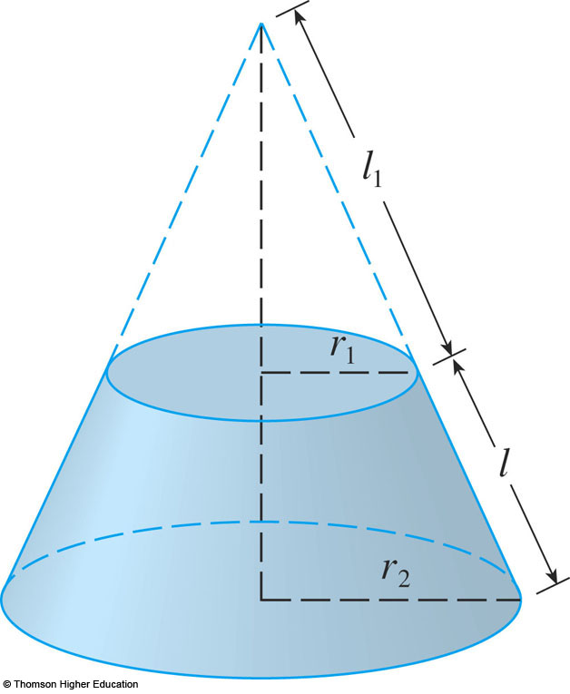
BANDS
To find the surface area, each of these bands can be considered a portion of a circular cone.
The band (or frustum) has:
slant height l
upper r₁ and lower r₂ radii

Slide 31
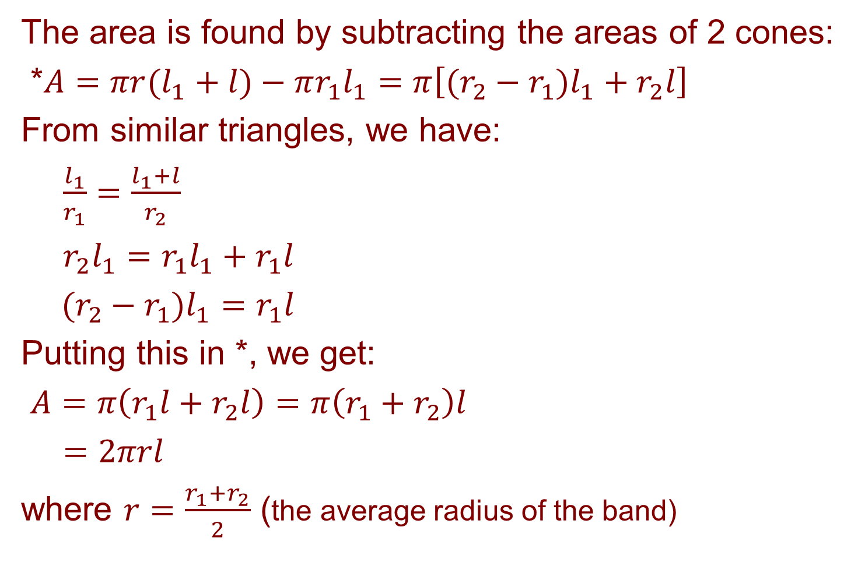
BANDS
Equation 1
The area is found by subtracting the areas of 2 cones:
*$A=πr(l_{1}+l)−πr_{1}l_{1}=π\left[(r_{2}−r_{1})l_{1}+r_{2}l\right]$
From similar triangles, we have:
$\frac{l_{1}}{r_{1}}=\frac{l_{1}+l}{r_{2}}$
$r_{2}l_{1}=r_{1}l_{1}+r_{1}l$
$(r_{2}−r_{1})l_{1}=r_{1}l$
Putting this in *, we get:
$A=π\left(r_{1}l+r_{2}l\right)=π\left(r_{1}+r_{2}\right)l$
$=2πrl$
where $r=\frac{r_{1}+r_{2}}{2}$ (the average radius of the band)

Slide 32
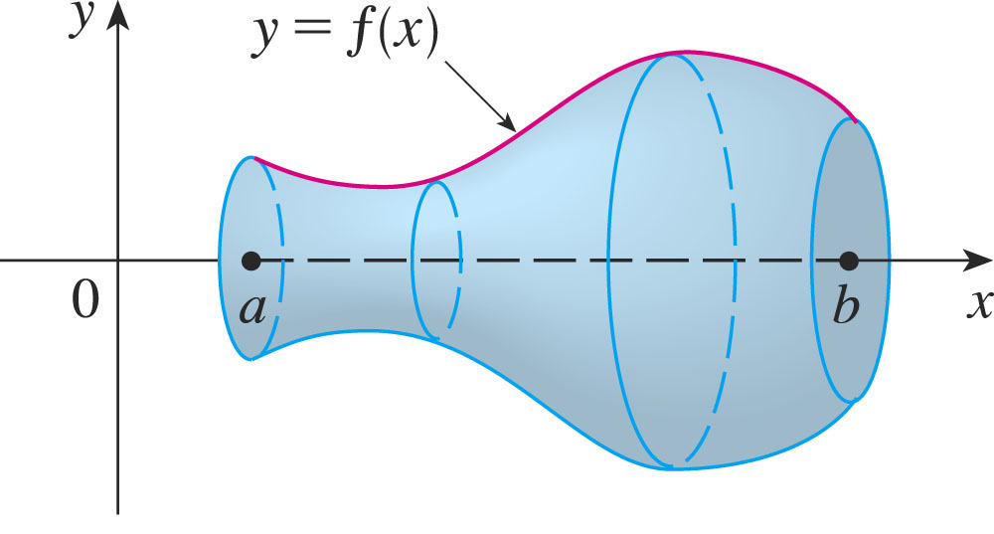
SURFACE of REVOLUTION
Consider the surface obtained by rotating the curve y = f(x), a ≤ x ≤ b, about the x-axis, where f is positive & has a continuous derivative.

Slide 33
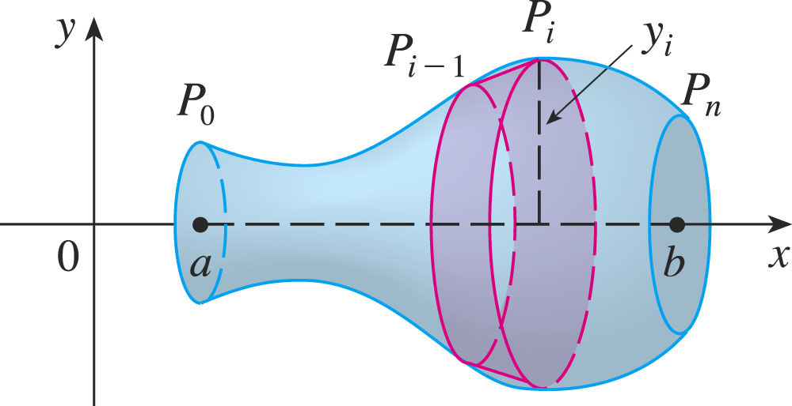

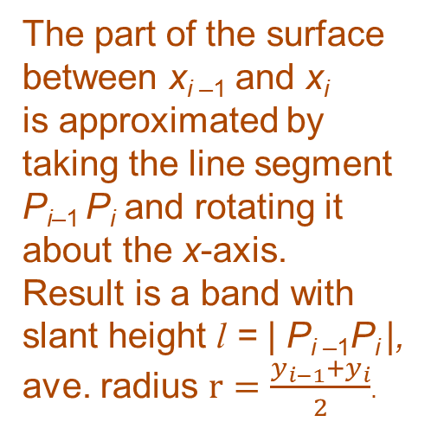
SURFACE AREA
Divide [a, b] into n subintervals with endpts x₀, x₁,…, x_{n} & equal width Δx, as we did in determining arc length.
If y_{i} = f(x_{i}), then point P_{i}(x_{i}, y_{i}) lies on the curve.
The part of the surface between x_{i –1} and x_{i}
is approximated by taking the line segment P_{i–1} P_{i} and rotating it about the x-axis.
Result is a band with slant height l = | P_{i –1}P_{i} |,
ave. radius $r=\frac{y_{i−1}+y_{i}}{2}$.
  So its surface area is $2π\frac{y_{i−1}+y_{i}}{2}|P_{i−1}P_{i}|$

Slide 34
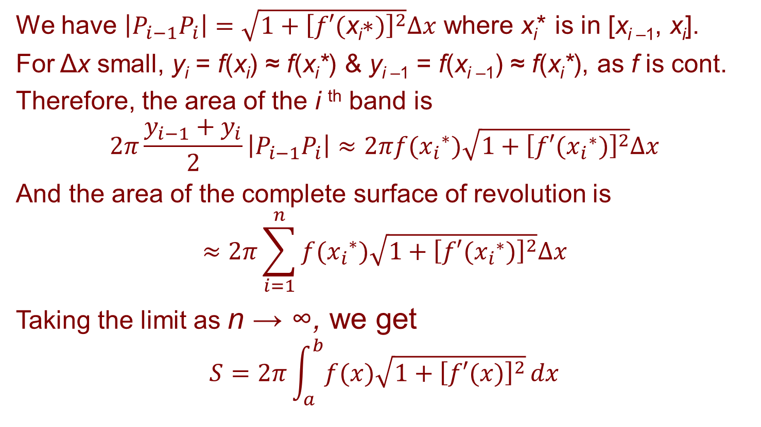
SURFACE AREA
We have $\left|P_{i−1}P_{i}\right|=\sqrt{1+{\left[f′(\text{x}\text{i}\text{∗})\right]}^{2}}Δx$ where x_{i}* is in [x_{i –1}, x_{i}].
For Δx small, y_{i} = f(x_{i}) ≈ f(x_{i}*) & y_{i –1} = f(x_{i –1}) ≈ f(x_{i}*), as f is cont.
Therefore, the area of the i ^{th} band is
$$2π\frac{y_{i−1}+y_{i}}{2}\left|P_{i−1}P_{i}\right|≈2πf({x_{i}}^{∗})\sqrt{1+{\left[f′({x_{i}}^{∗})\right]}^{2}}Δx$$
And the area of the complete surface of revolution is
$$≈2π\sum_{i=1}^{n}{f({x_{i}}^{∗})\sqrt{1+{\left[f′({x_{i}}^{∗})\right]}^{2}}Δx}$$
Taking the limit as n → ∞, we get
$$S=2π\int_{a}^{b}{f(x)\sqrt{1+{\left[f′(x)\right]}^{2}}}dx$$

Slide 35
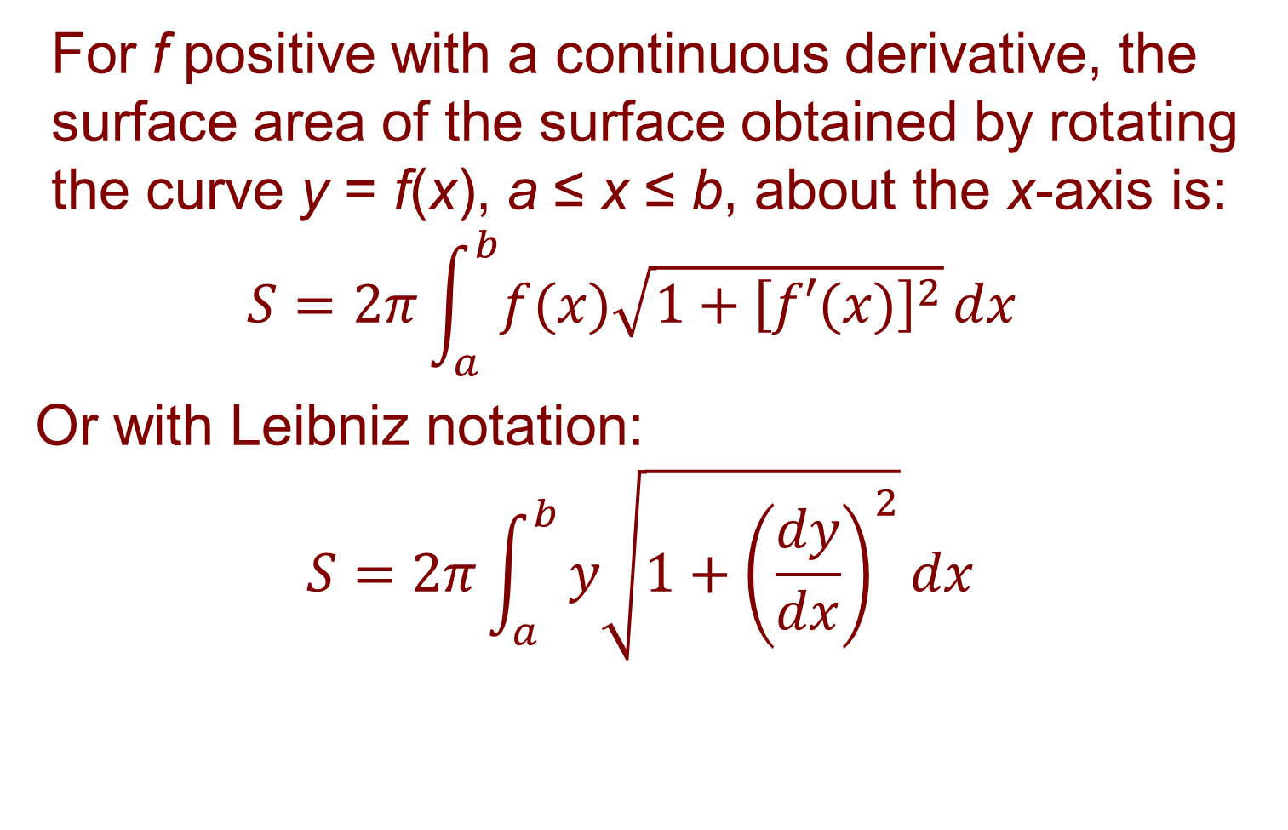
SURFACE AREA
Formula 4
For f positive with a continuous derivative, the surface area of the surface obtained by rotating the curve y = f(x), a ≤ x ≤ b, about the x-axis is:
$$S=2π\int_{a}^{b}{f(x)\sqrt{1+{\left[f′(x)\right]}^{2}}}dx$$
Or with Leibniz notation:
$$S=2π\int_{a}^{b}{y\sqrt{1+{\left(\frac{dy}{dx}\right)}^{2}}}dx$$

Slide 36
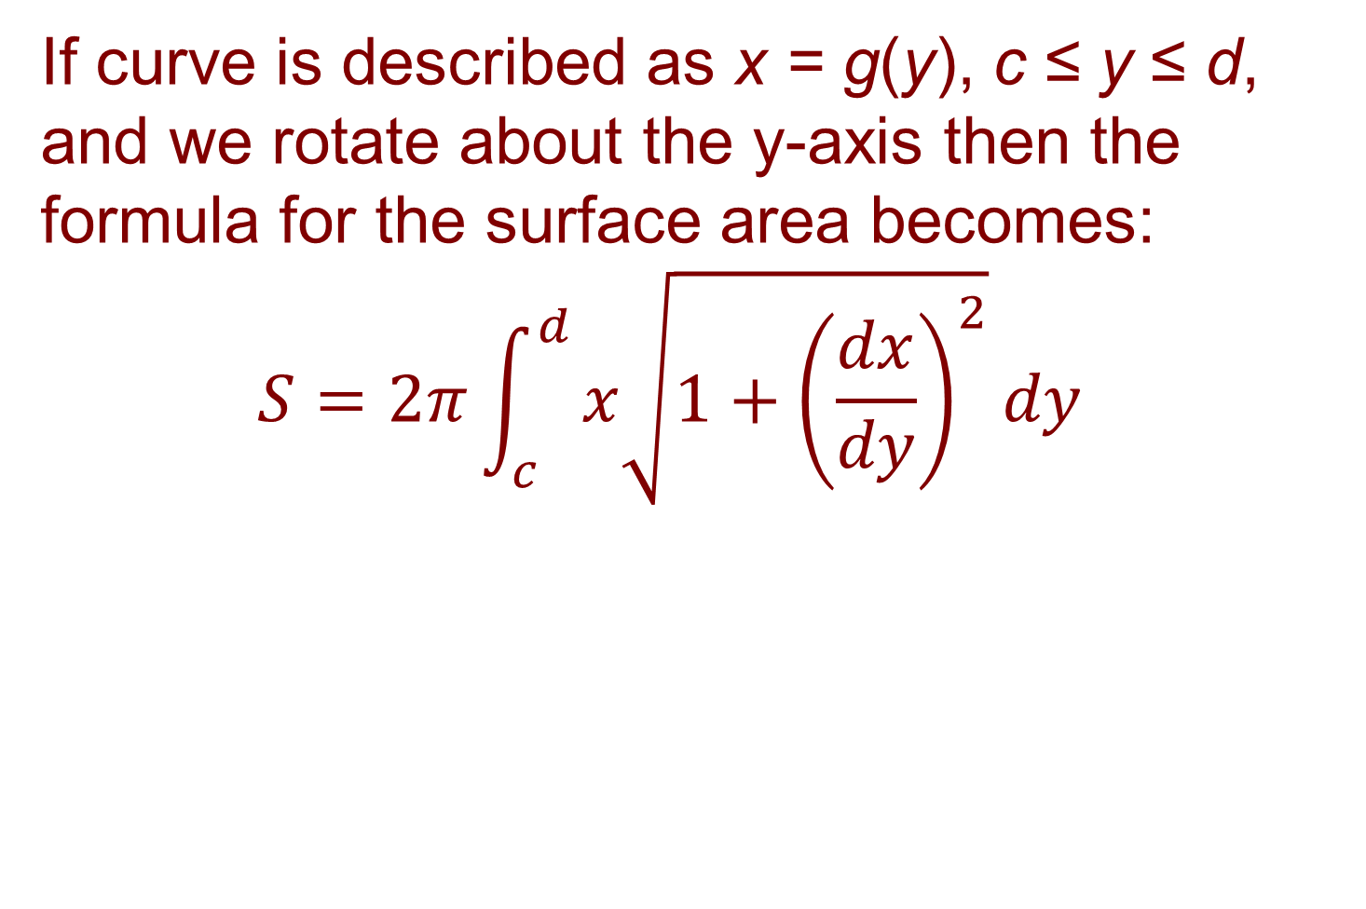
SURFACE AREA
Formula 5
If curve is described as x = g(y), c ≤ y ≤ d, and we rotate about the y-axis then the formula for the surface area becomes:
$$S=2π\int_{c}^{d}{x\sqrt{1+{\left(\frac{dx}{dy}\right)}^{2}}}dy$$

Slide 37
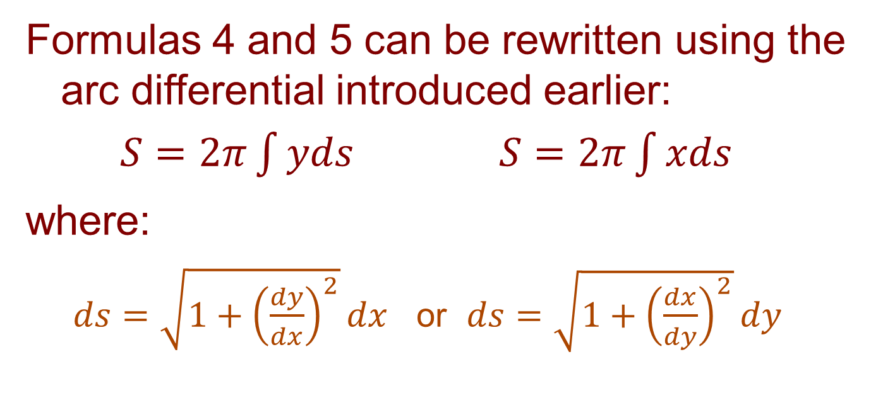
SURFACE AREA
Formulas 4 and 5 can be rewritten using the arc differential introduced earlier:
$S=2π\int{yds}$ $S=2π\int{xds}$
where:
  $ds=\sqrt{1+{\left(\frac{dy}{dx}\right)}^{2}}dx$ or $ds=\sqrt{1+{\left(\frac{dx}{dy}\right)}^{2}}dy$

Slide 38
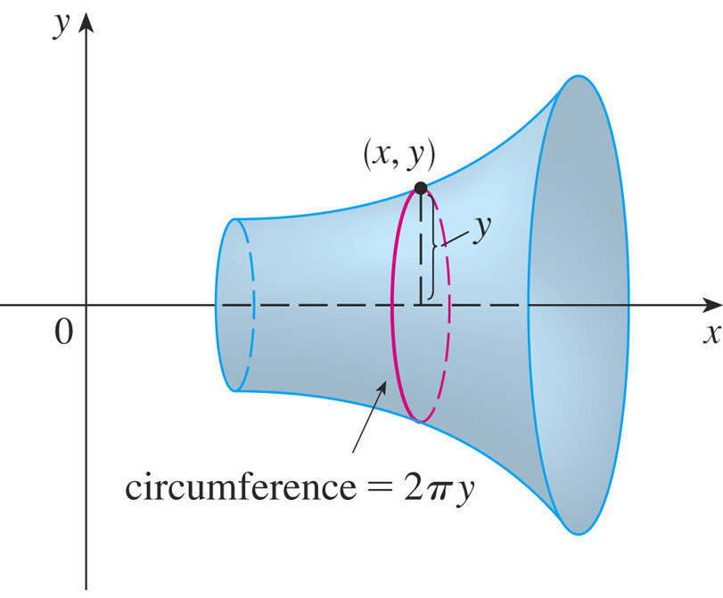
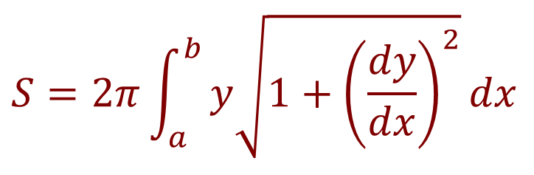
SURFACE AREA—FORMULA 4
Think of 2πy as the circumference of a circle traced out by the point (x, y) on the curve as it is rotated about the x-axis.
$$S=2π\int_{a}^{b}{y\sqrt{1+{\left(\frac{dy}{dx}\right)}^{2}}}dx$$

Slide 39
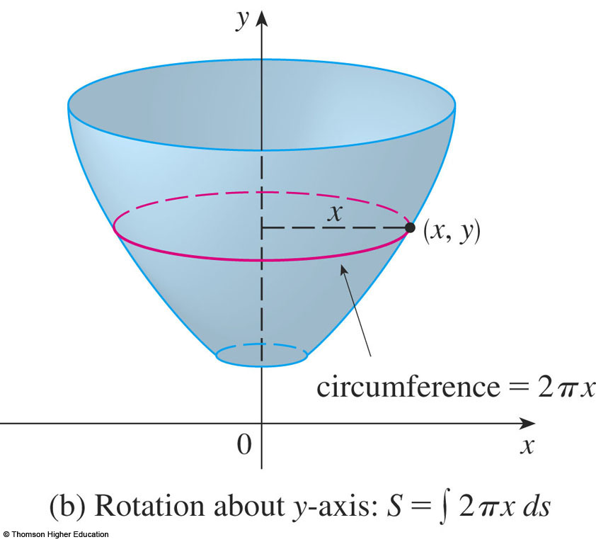
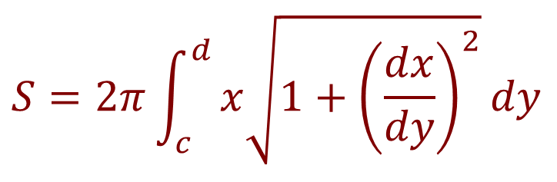
SURFACE AREA—FORMULA 5
Think of 2πx as the circumference of a circle traced out by the point (x, y) on the curve as it is rotated about the y-axis.
$$S=2π\int_{c}^{d}{x\sqrt{1+{\left(\frac{dx}{dy}\right)}^{2}}}dy$$

Slide 40
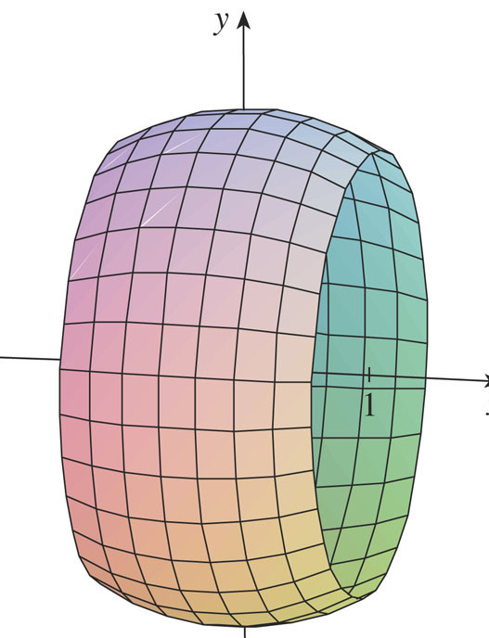
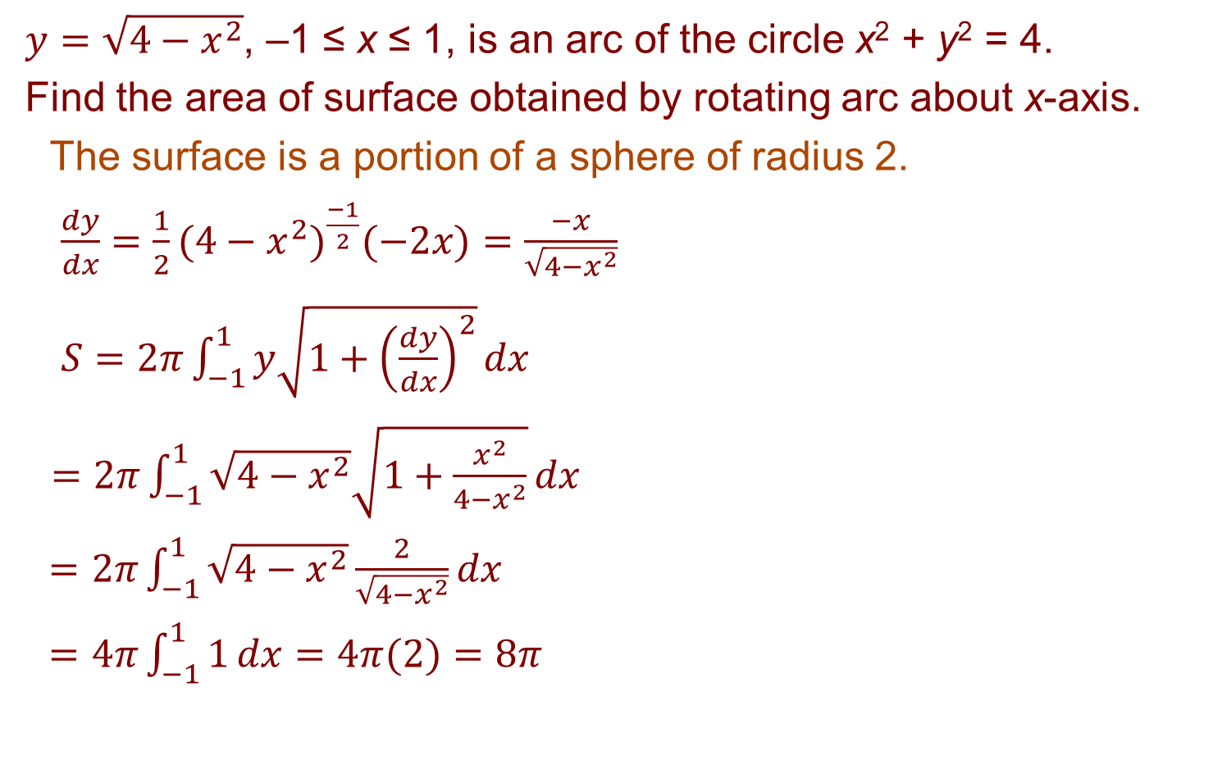
SURFACE AREA
Example 5
$y=\sqrt{4−x^{2}}$, –1 ≤ x ≤ 1, is an arc of the circle x² + y² = 4.
Find the area of surface obtained by rotating arc about x-axis.
  The surface is a portion of a sphere of radius 2.
  $\frac{dy}{dx}=\frac{1}{2}(4−x^{2})^{\frac{−1}{2}}(−2x)=\frac{−x}{\sqrt{4−x^{2}}}$
  $S=2π\int_{−1}^{1}{y\sqrt{1+{\left(\frac{dy}{dx}\right)}^{2}}}dx$
  $=2π\int_{−1}^{1}{\sqrt{4−x^{2}}\sqrt{1+\frac{x^{2}}{4−x^{2}}}}dx$
  $=2π\int_{−1}^{1}{\sqrt{4−x^{2}}\frac{2}{\sqrt{4−x^{2}}}}dx$
  $=4π\int_{−1}^{1}{1}dx=4π(2)=8π$

Slide 41
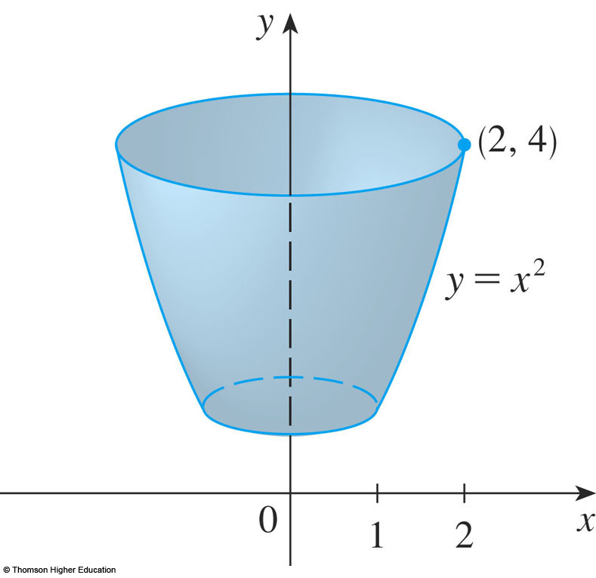
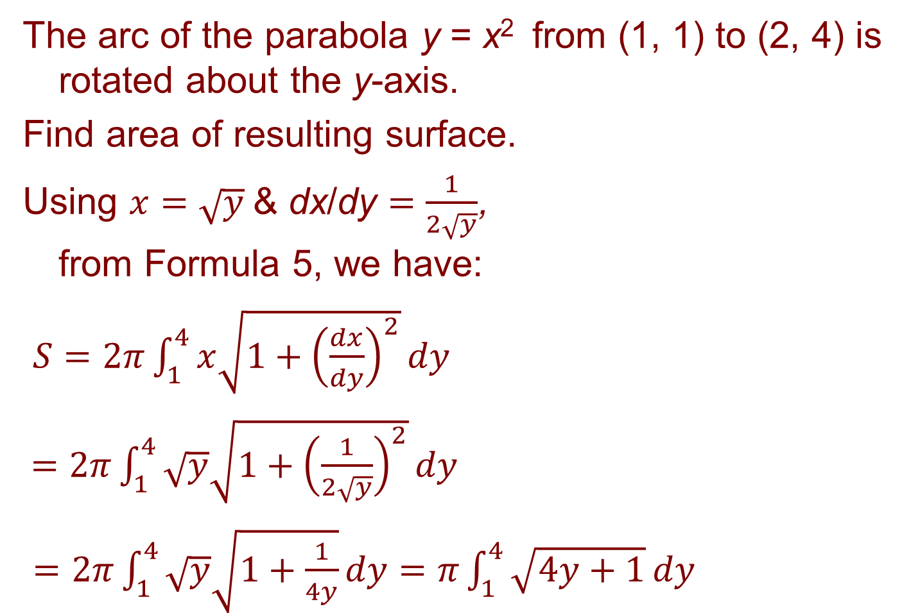
SURFACE AREA
Example 6
The arc of the parabola y = x² from (1, 1) to (2, 4) is rotated about the y-axis.
Find area of resulting surface.
Using $x=\sqrt{y}$& dx/dy $=\frac{1}{2\sqrt{y}}$,
from Formula 5, we have:
$S=2π\int_{1}^{4}{x\sqrt{1+{\left(\frac{dx}{dy}\right)}^{2}}}dy$
$=2π\int_{1}^{4}{\sqrt{y}\sqrt{1+{\left(\frac{1}{2\sqrt{y}}\right)}^{2}}}dy$
$=2π\int_{1}^{4}{\sqrt{y}\sqrt{1+\frac{1}{4y}}}dy=π\int_{1}^{4}{\sqrt{4y+1}}dy$

Slide 42
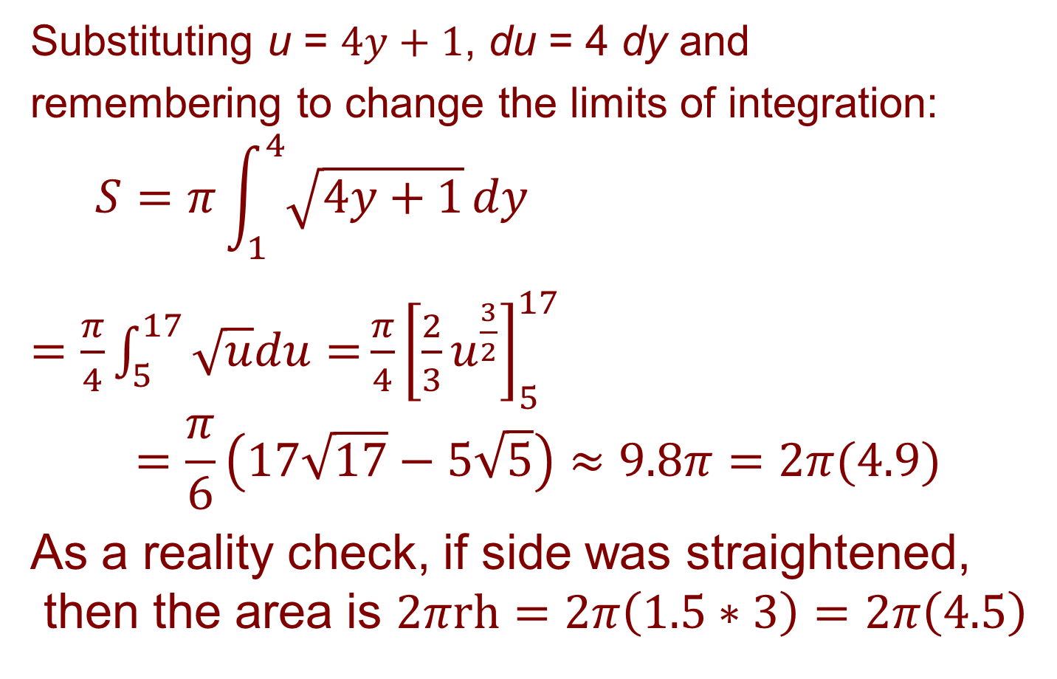
SURFACE AREA
Example 6 cont.
Substituting u = $4y+1$, du = 4 dy and
remembering to change the limits of integration:
$$S=π\int_{1}^{4}{\sqrt{4y+1}}dy$$
$=\frac{π}{4}\int_{5}^{17}{\sqrt{u}du=}\frac{π}{4}{\left[\frac{2}{3}u^{\frac{3}{2}}\right]}_{5}^{17}$
$$=\frac{π}{6}\left(17\sqrt{17}−5\sqrt{5}\right)≈9.8π=2π(4.9)$$
As a reality check, if side was straightened, then the area is $2πrh=2π\left(1.5∗3\right)=2π\left(4.5\right)$

Slide 43
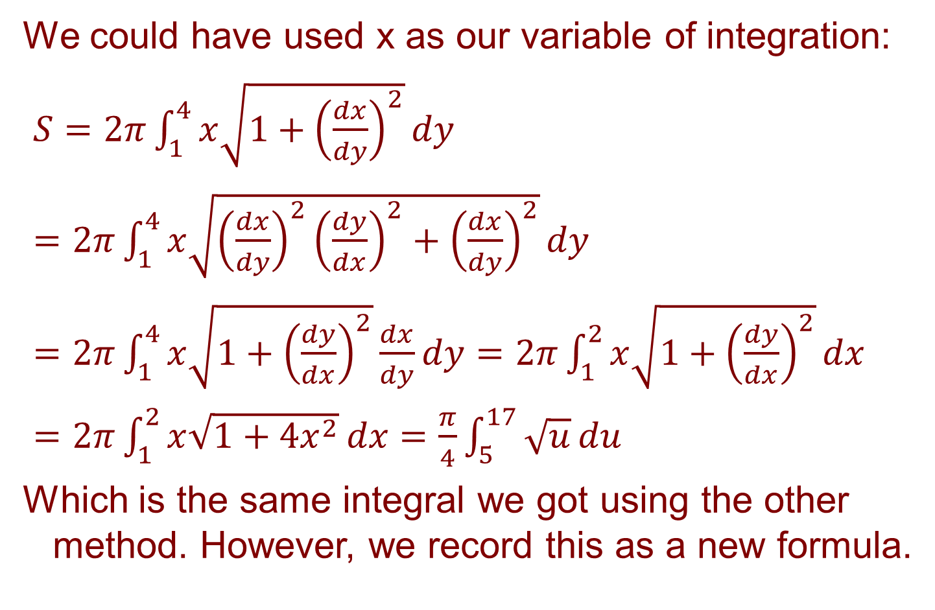
SURFACE AREA
Example 6 alternate solution
We could have used x as our variable of integration:
$S=2π\int_{1}^{4}{x\sqrt{1+{\left(\frac{dx}{dy}\right)}^{2}}}dy$
$=2π\int_{1}^{4}{x\sqrt{{\left(\frac{dx}{dy}\right)}^{2}{\left(\frac{dy}{dx}\right)}^{2}+{\left(\frac{dx}{dy}\right)}^{2}}}dy$
$=2π\int_{1}^{4}{x\sqrt{1+{\left(\frac{dy}{dx}\right)}^{2}}}\frac{dx}{dy}dy=2π\int_{1}^{2}{x\sqrt{1+{\left(\frac{dy}{dx}\right)}^{2}}}dx$
$=2π\int_{1}^{2}{x\sqrt{1+4x^{2}}}dx=\frac{π}{4}\int_{5}^{17}{\sqrt{u}}du$
Which is the same integral we got using the other method. However, we record this as a new formula.

Slide 44


SURFACE AREA—ALTERNATE FORMULA
Think of 2πx as the circumference of a circle traced out by the point (x, y) on the curve as it is rotated about the y-axis.
$\sqrt{1+{\left(\frac{dy}{dx}\right)}^{2}}$ dx is the
arc length of a thin band
$$S=2π\int_{a}^{b}{x \sqrt{1+{\left(\frac{dy}{dx}\right)}^{2}}}dx$$

Slide 45

SURFACE AREA
Example 7
Find the area of surface generated by rotating the curve y = e^{x}, 0 ≤ x ≤ 1, about the x-axis.
Using Formula 4 with y = e^{x} and dy/dx = e^{x}, we have:
$S=\int_{0}^{1}{2πy}\sqrt{1+{\left(\frac{dy}{dx}\right)}^{2}}dx$
$=2π\int_{0}^{1}{e^{x}\sqrt{1+e^{2x}}}dx$
$=2π\int_{1}^{e}{\sqrt{1+u^{2}}}du$
$(\text{where} u=e^{x})$

Slide 46

SURFACE AREA
Example 7
$$S=2π\int_{1}^{e}{\sqrt{1+u^{2}}}du$$
$$=2π\int_{\frac{π}{4}}^{α}{\sec^{3}{θ}}dθ(\text{where} u=\tan{θ}\text{and} α=\tan^{−1}{e})$$
$$=2π\frac{1}{2}{\left[\sec{θ}\tan{θ}+\ln\left|\sec{θ}+\tan{θ}\right|\right]}_{\frac{π}{4}}^{α}$$
$$=π\left[\sec{α}\tan{α}+\ln\left(\sec{α}+\tan{α}\right)\right.\left.−\sqrt{2}−\ln\left(\sqrt{2+1}\right)\right]$$
Since tan α = e, we have sec²α = 1 + tan α = 1 + e²
Thus,
$$S=π\left[e\sqrt{1+e^{2}}\right.+\ln\left(e+\sqrt{1+e^{2}}\right)\left.−\sqrt{2}−\ln\left(\sqrt{2+1}\right)\right]$$

