Slide 1
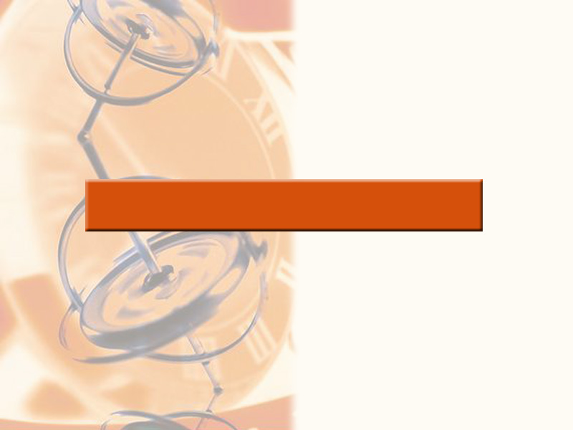
7
APPLICATIONS OF INTEGRATION

Slide 2
APPLICATIONS OF INTEGRATION
7.3
Volumes by
Cylindrical Shells
In this section, we will learn:
How to apply the method of cylindrical shells
to find out the volume of a solid.

Slide 3
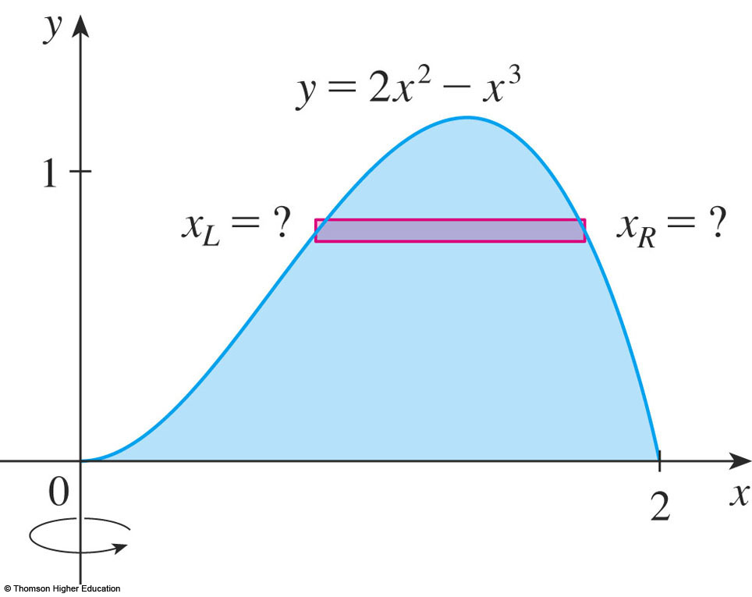
VOLUMES BY CYLINDRICAL SHELLS
Some volume problems are difficult to handle by the methods discussed in Section 7.2
For example consider solid obtained by rotating about y-axis the region bounded by y = 0 and y = 2x² - x³.
If we slice perpendicular to y-axis, we get a washer.
We would then solve for x.
There is a cubic formula but it is complicated.
Fortunately, the method of cylindrical shells exists.

Slide 4
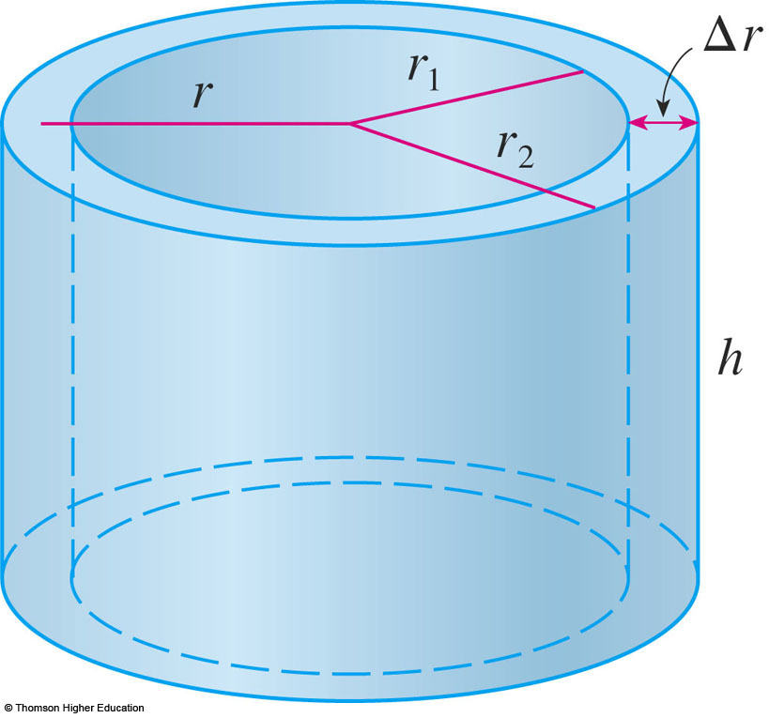
CYLINDRICAL SHELLS METHOD
The figure shows a cylindrical shell with inner radius r₁, outer radius r₂, & height h.
Its volume V is calculated by subtracting the volume V₁ of the inner cylinder from the volume of the outer cylinder V₂ .
$$V=V_{2}−V_{1} \\ =π{r_{2}}^{2}h−π{r_{1}}^{2}h \\ =π({r_{2}}^{2}−{r_{1}}^{2})h \\ =π(r_{2}+r_{1})(r_{2}−r_{1})h \\ =2π\frac{r_{2}+r_{1}}{2}h(r_{2}−r_{1})$$

Slide 5
CYLINDRICAL SHELLS METHOD
Formula 1
Let ∆r = r₂ – r₁ (thickness of the shell) and $r=\frac{1}{2}\left(r_{2}+r_{1}\right)$(average radius of the shell).
Then, formula for volume
of a cylindrical shell
$V=2π\frac{r_{2}+r_{1}}{2}h(r_{2}−r_{1})$
becomes
$V=2πrhΔr$
The equation can be remembered as:
V = [circumference] [height] [thickness]

Slide 6
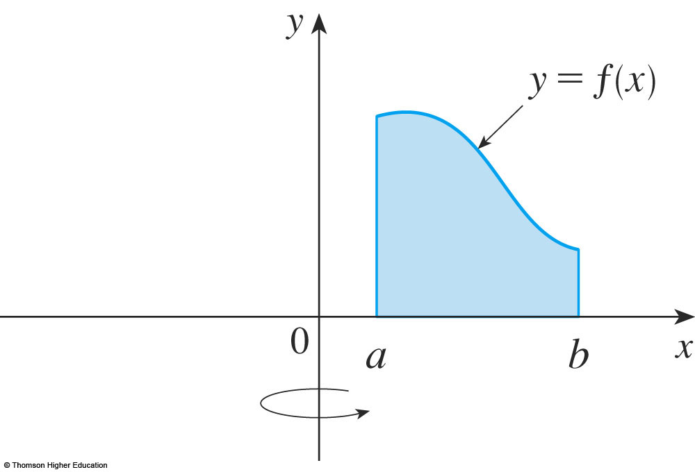
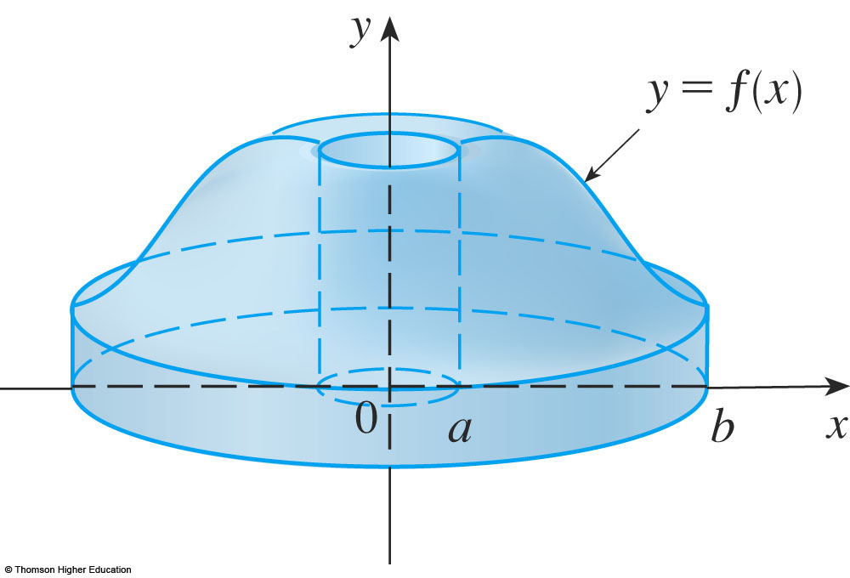
CYLINDRICAL SHELLS METHOD
Now, let S be the solid
obtained by rotating
about the y-axis the
region bounded by:
y = f(x)
y = 0
x = a
x = b

Slide 7
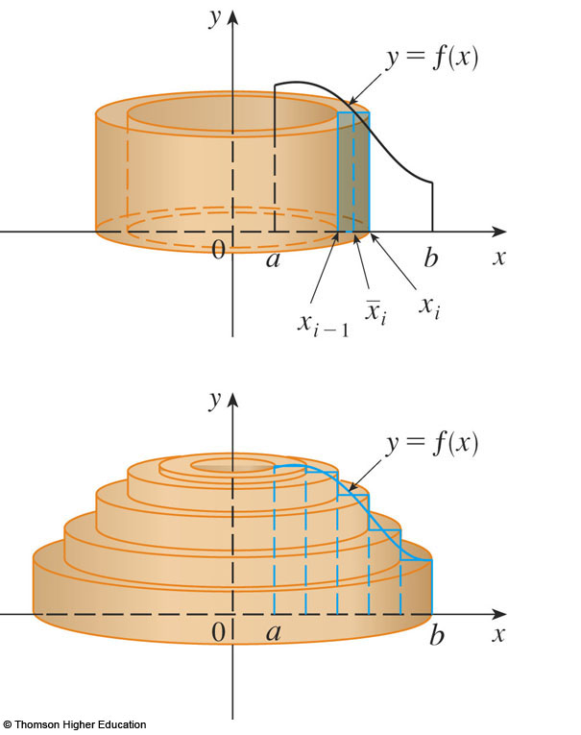
CYLINDRICAL SHELLS METHOD
Divide interval [a, b] into n subintervals [x_{i - 1}, x_{i} ] of equal width $Δx$.
Let ${\bar{x}}_{i}$ be the midpoint of the i ^{th} subinterval.

Slide 8
CYLINDRICAL SHELLS METHOD
The result is a cylindrical shell with average radius ${\bar{x}}_{i}$, height $f({\bar{x}}_{i})$ and thickness ∆x.
The volume of the shell is: $V_{i}=(2π{\bar{x}}_{i})[f({\bar{x}}_{i})]Δx$

Slide 9
CYLINDRICAL SHELLS METHOD
The volume of the shell is:${ V}_{i}=\left(2π{\bar{x}}_{i}\right)\left[f\left({\bar{x}}_{i}\right)\right]Δx$
We do this for each subinterval and then sum
Hence, an approximate volume for the solid is:
$$V≈\sum_{i=1}^{n}{V_{i}}=\sum_{i=1}^{n}{2π{\bar{x}}_{i}}f({\bar{x}}_{i})Δx$$

Slide 10
CYLINDRICAL SHELLS METHOD
The approximation will become better as n →∞ and we get:
$$\lim_{n→∞}{\sum_{i=1}^{n}{2π{\bar{x}}_{i}}}f\left({\bar{x}}_{i}\right)Δx=\int_{a}^{b}{2πxf(x)dx}$$

Slide 11
CYLINDRICAL SHELLS METHOD
Formula 2
The volume of the solid obtained by rotating about the y-axis the region under the curve y = f(x) from a to b is: where 0 ≤ a < b

Slide 12
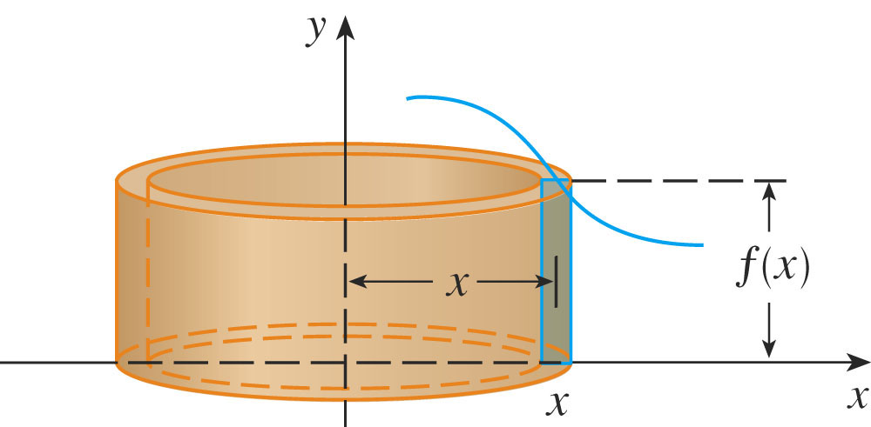
CYLINDRICAL SHELLS METHOD
Here’s the best way to remember the formula.
Think of a typical shell, cut and flattened, with radius x, circumference 2πx, height f(x), and thickness ∆x or dx:
This type of reasoning will be helpful in other situations—such as when we rotate about lines other than the y-axis.

Slide 13
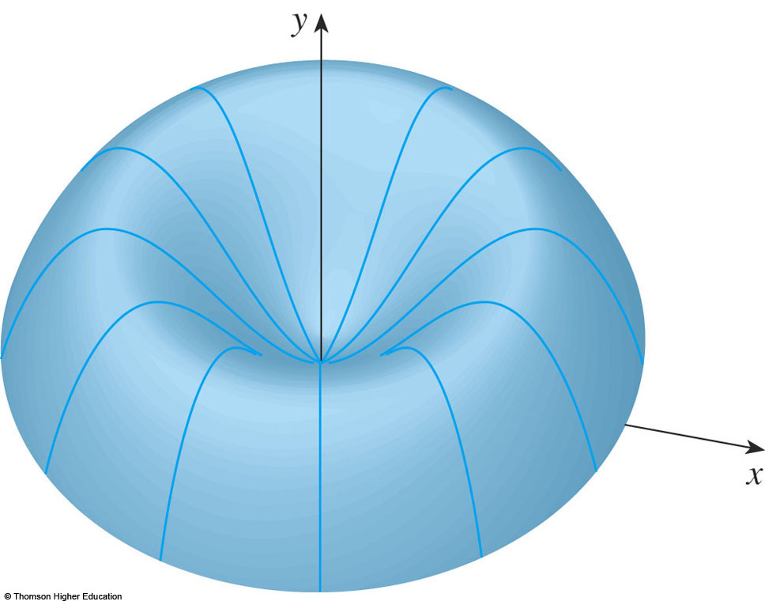
CYLINDRICAL SHELLS METHOD
Example 1
Find the volume of the solid obtained by rotating about the y-axis the region bounded by y = 2x² - x³ and y = 0.
This is the problem introduced on the first (nontitle)slide!

Slide 14
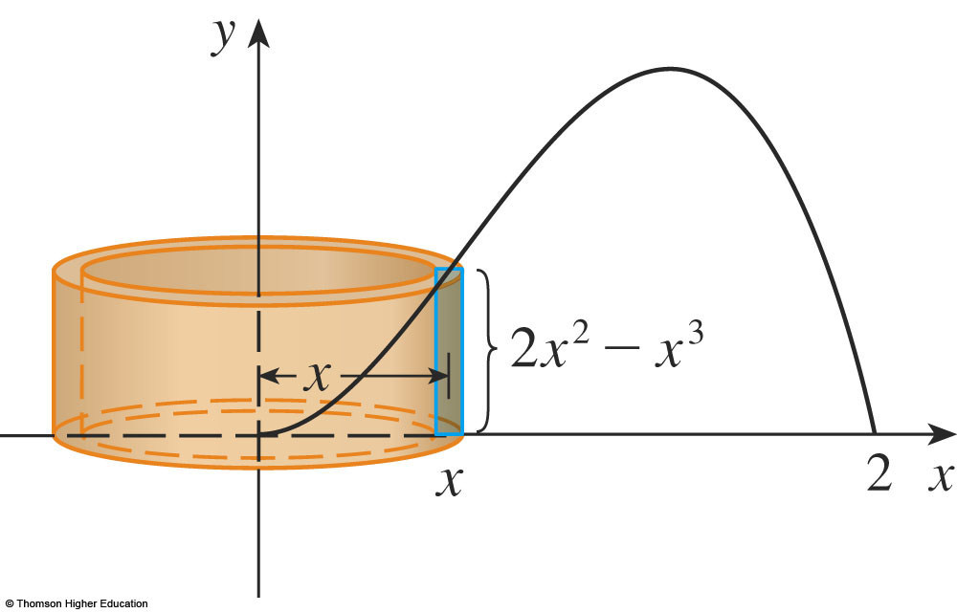
CYLINDRICAL SHELLS METHOD
Example 1 (cont.)
We see that a typical shell has radius x, circumference 2πx, & height f(x) = 2x² - x³.
$V=\int_{0}^{2}{\left(2πx\right)\left(2x^{2}−x^{3}\right)}dx$
$=2π\int_{0}^{2}{ (2x^{3}−x^{4})dx}$
$=2π{\left[\frac{1}{2}x^{4}−\frac{1}{5}x^{5}\right]}_{0}^{2}$
$=2π\left(8−\frac{32}{5}\right)=\frac{16}{5}π$

Slide 15
Followup NOTE for example 1
Continuing the remarks at the beginning of the section: why is the cylindrical shells method easier than the washer method for this problem?
We did not have to find coordinates for the local maximum.
We did not have to solve the equation of the curve for x in terms of y.
However, for other examples, the methods learned in Section 7.2 may be easier.

Slide 16
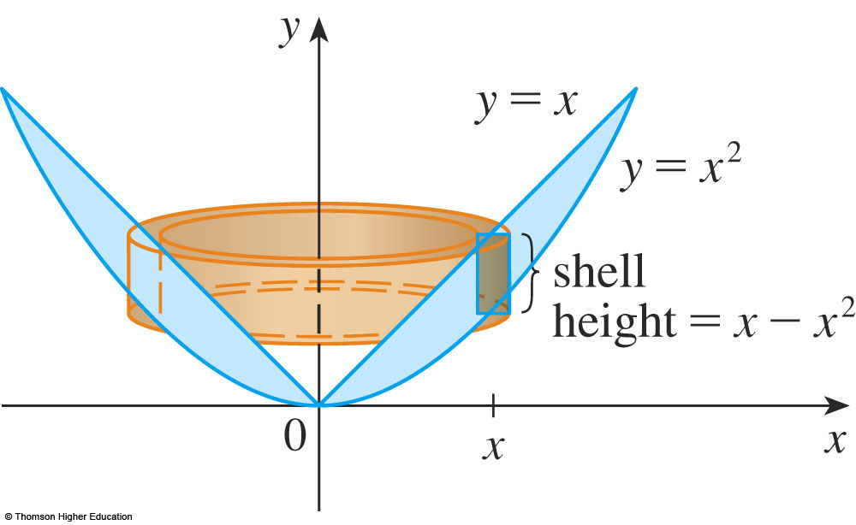
CYLINDRICAL SHELLS METHOD
Example 2
Rotate about y-axis region between y = x & y = x²
The shell has radius x, circumference 2πx & height x-x²
$$V=\int_{0}^{1}{\left(2πx\right)\left(x−x^{2}\right)}dx$$
$$=2π\int_{0}^{1}{\left(x^{2}−x^{3}\right)}dx$$
$$=2π{\left[\frac{x^{3}}{3}−\frac{x^{4}}{4}\right]}_{0}^{1}=\frac{π}{6}$$

Slide 17
CYLINDRICAL SHELLS METHOD
As the following example shows, the shell method works just as well if we rotate about the x-axis (or on a line parallel to it).
Our shells will be oriented horizontally
As usual draw a diagram to identify the radius (vertical) and height (horizontal)of a typical shell.
The thickness of the shell will be Δy.
The integration will be with respect to y.

Slide 18
CYLINDRICAL SHELLS METHOD
Example 3
Use cylindrical shells to find the volume of
the solid obtained by rotating about the x-axis
the region under the curve $y=\sqrt{x}$ from 0 to 1.
This problem was solved using disks in Example 2 in Section 7.2

Slide 19
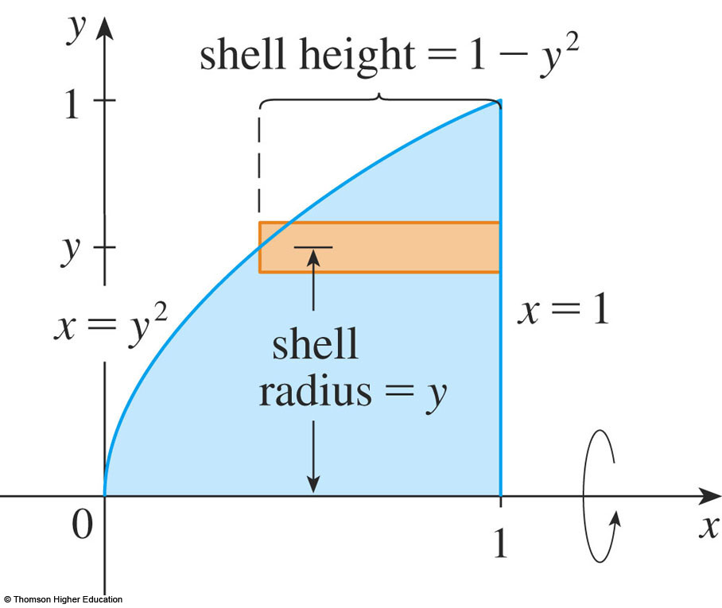
CYLINDRICAL SHELLS METHOD
Example 3
To use shells, we solve $y=\sqrt{x}$ for x & get x = y
For rotation about the x-axis, we see that a typical shell has radius y, circumference 2πy, and height 1 - y².
$$V=\int_{0}^{1}{\left(2πy\right)\left(1−y^{2}\right)}dy$$
$$=2π\int_{0}^{1}{(y−y^{3})dy}$$
$$=2π{\left[\frac{y^{2}}{2}−\frac{y^{4}}{4}\right]}_{0}^{1}=\frac{π}{2}$$
In this problem, the disk
method was simpler.

Slide 20
CYLINDRICAL SHELLS METHOD
Example 4
Find the volume of the solid obtained by rotating the region bounded by y = x - x² and y = 0 about the line x = 2.
The figures show the region and a cylindrical shell formed by rotation about the line x = 2:
radius 2 - x, circumference 2π(2 - x), height x - x²

Slide 21
CYLINDRICAL SHELLS METHOD
Example 4
radius 2 - x, circumference 2π(2 - x), height x - x²
$$V=\int_{1}^{0}{2π\left(2−x\right)\left(x−x^{2}\right)dx}$$
$$=2π\int_{1}^{0}{\left(x^{3}−3x^{2}+2x\right)dx}$$
$$=2π{\left[\frac{x^{4}}{4}−x^{3}+x^{2}\right]}_{0}^{1}=\frac{π}{2}$$

