Slide 1

8
Sequences and Series

Slide 2
8.5
Alternating Series & Absolute Converge

Slide 3
Absolute Convergence
Given any series Σ a_{n}, we can consider the corresponding series
| a_{n} | = | a₁| + | a₂| + | a₃| + . . .
whose terms are the absolute values of the terms of the original series.

Slide 4
Absolute Convergence and convergence
Notice that if Σ a_{n} is a series with positive terms, then | a_{n} | = a_{n} and so absolute convergence is the same as convergence in this case.
Theorem: any series that is absolutely convergent is also convergent.

Slide 5
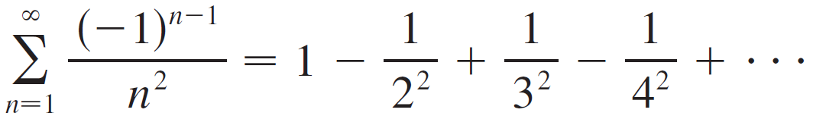
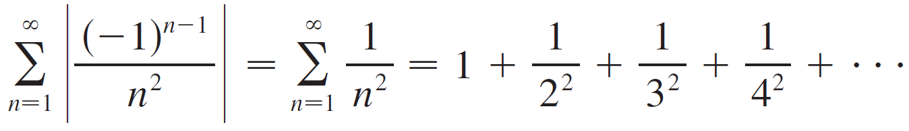
Example 1: series that is absolutely convergent
The series
is absolutely convergent because
is a convergent p-series (p = 2).

Slide 6
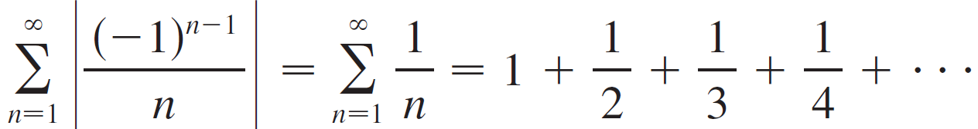
Example 2: series which is not absolutely convergent
The alternating harmonic series is
is not absolutely convergent because the corresponding series of absolute values is
the harmonic series (p-series with p = 1) and is therefore divergent.
However, it does converge, a result which follows from the next theorem.

Slide 7
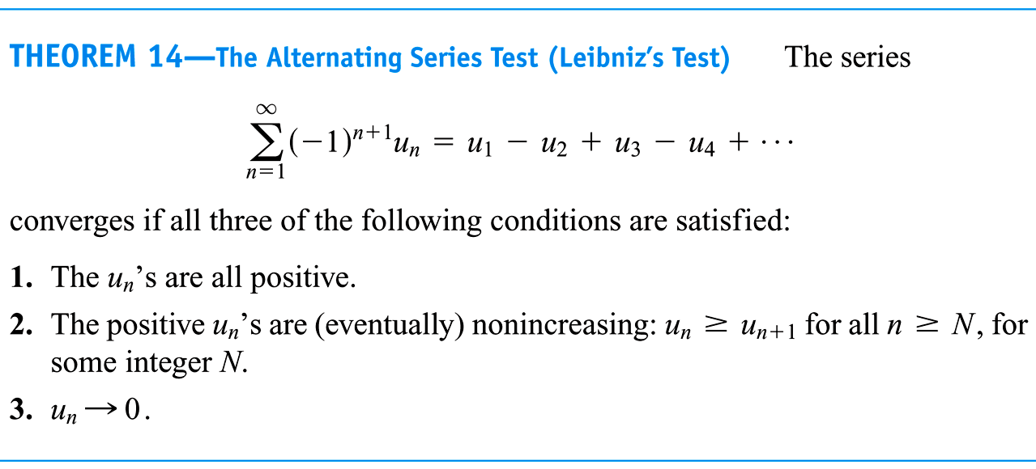

Slide 8
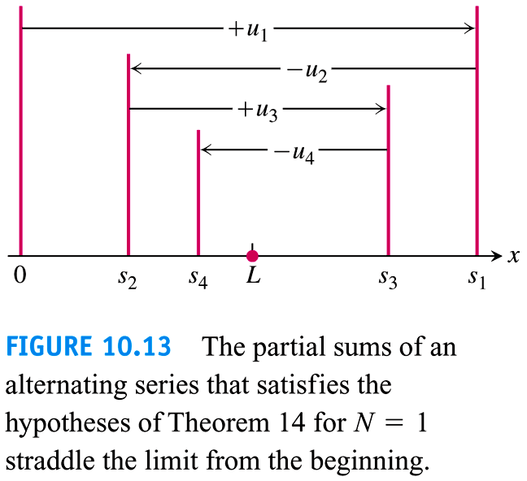
Proof of alternating series theorem
The partial sums of an alternating series that satisfy the hypotheses starting with n=1, straddle the limit from the beginning.
Because a_{n} is decreasing, the amount by which S_{n} bounces up/down decreases.
Moreover, the odd terms of S_{n} form a decreasing, bounded sequence, while the even terms of S_{n} form an increasing, bounded sequence. Since bounded, monotonic sequences converge (see Theorem 59) and the terms of a_{n} approach 0, one can show that the odd and even terms of Sn converge to the same common limit L.

Slide 9
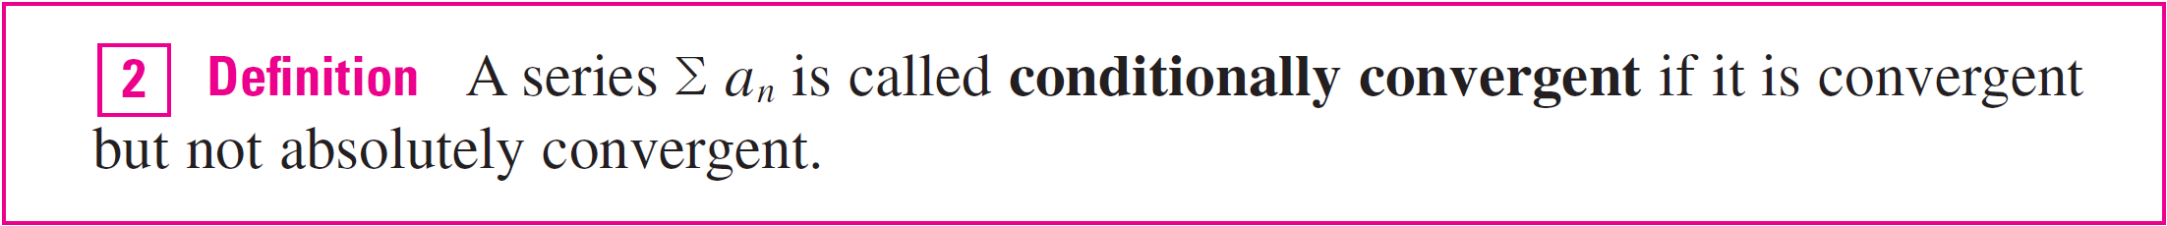
Conditional Convergence
Example 2, the alternating harmonic series, is conditionally convergent. Thus it is possible for a series to be convergent but not absolutely convergent.
However, the next theorem shows that absolute convergence implies convergence.
So even, though we could apply the alternating series test to example 1, there is no need.

Slide 10
Rearrangements
In fact more is true as the book points out:
This is in contrast to what can happen with a conditionally convergent sequence. The book (p.449) shows that the terms of the alternating harmonic series can be rearranged to get the sum ½ ln 2 when its actual sum is ln 2.

Slide 11
Example 3
Determine whether the series
is convergent or divergent.
Solution:
This series has both positive and negative terms, but it is not alternating. (The first term is positive, the next three are negative, and the following three are positive: The signs change irregularly.)

Slide 12
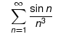
Example 3 – Solution
cont’d
We apply the Comparison Test to the series of absolute values
Since | cos n | ≤ 1 for all n, we have
We know that Σ 1/n² is convergent (p-series with p = 2) and
therefore Σ | cos n |/n² is convergent by the Comparison Test.
Thus the given series Σ (cos n)/n² is absolutely convergent and therefore convergent by Theorem 3.
Exercise: Determine convergence of

Slide 14
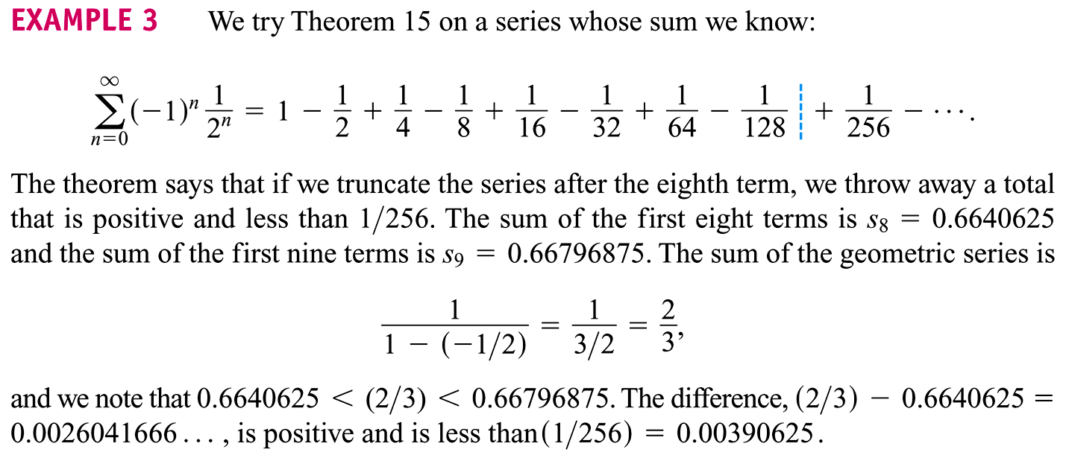
Example 4a: estimate of error for alternating series
We try theorem 71 on a series whose sum we know:
Note how this theorem is reminiscent of the Taylor Polynomial error analysis. Both use the next term as an error bound.

Slide 15
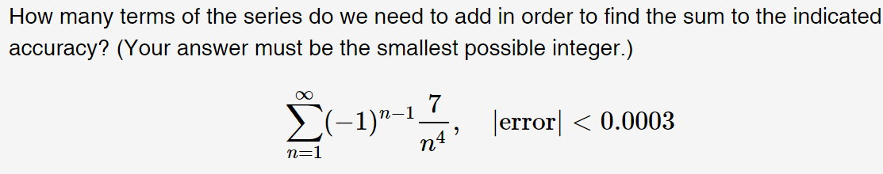

Example 4b: estimate of error for alternating series
We solve the inequality $\frac{7}{{\left(n+1\right)}^{4}}<0.0003$ to get $n>\sqrt[4]{\frac{7}{0.0003}}−1=11.36$.
So a partial sequence of 12 terms is first one to have an error below this bound.

Slide 16
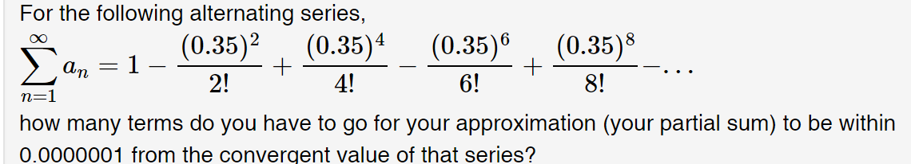
Example 4c: estimate of error for alternating series
Since both the exponent and the factorial are dependent on n,
the equation can't be easily solved for n.
Instead, we make a table of the absolute value of the terms
and then look for the first term that dips below the bound (0.0000001=1x10⁻⁷).
This happens when n=5.
Hence 4 terms suffice to bring the partial sum below the bound.
The Excel table to right can be opened.

Slide 17
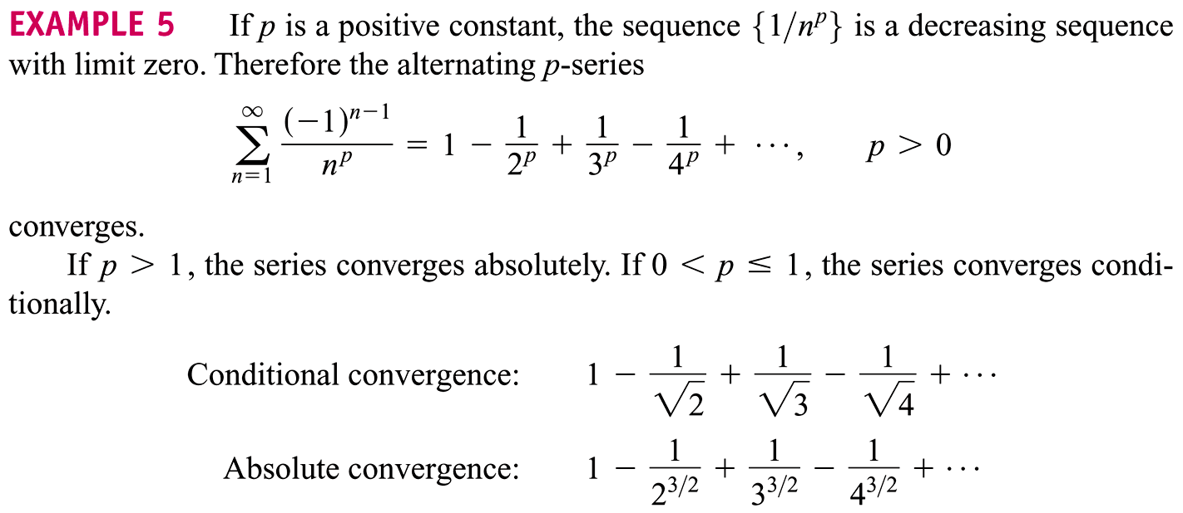
Absolute and conditional convergence for p-series

Slide 18
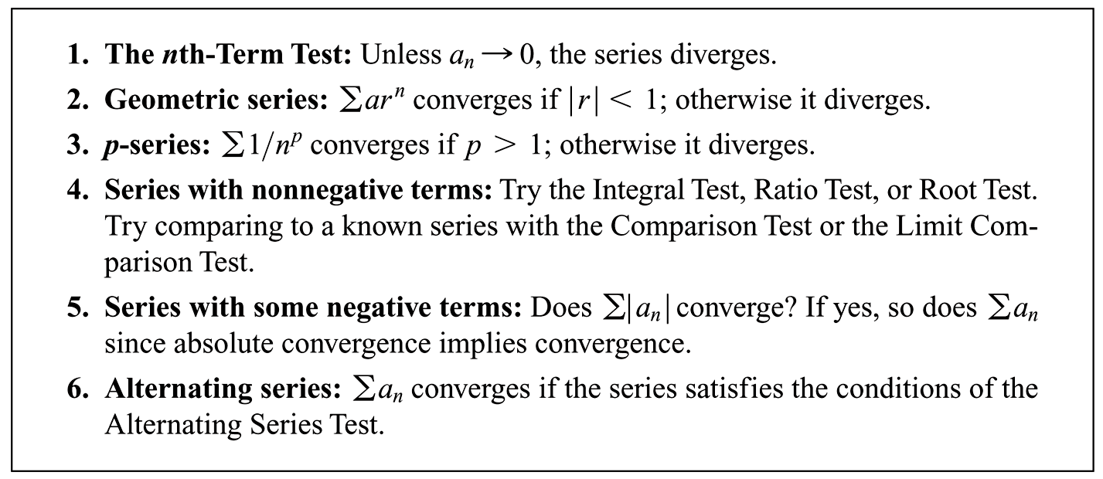
Summary of series tools and tests
This basically concludes our work with individual series (no variables).
We next turn our attention to power series, each of which is a family of series.
A variable is present & we get an individual series for each value of variable.

