Slide 1

8
Sequences and Series

Slide 2

8.2
Series

Slide 3
Motivating example to study series
Start at a corner and walk towards a spot 2 blocks away.
Half-way to the spot, stop and then iterate the procedure.
How far do you travel during the n^{th} iteration?
How far have you travelled altogether after the n^{th} iteration?
Assuming that you can do this an infinite number of times, in the limit, how far will you have travelled?

Slide 4
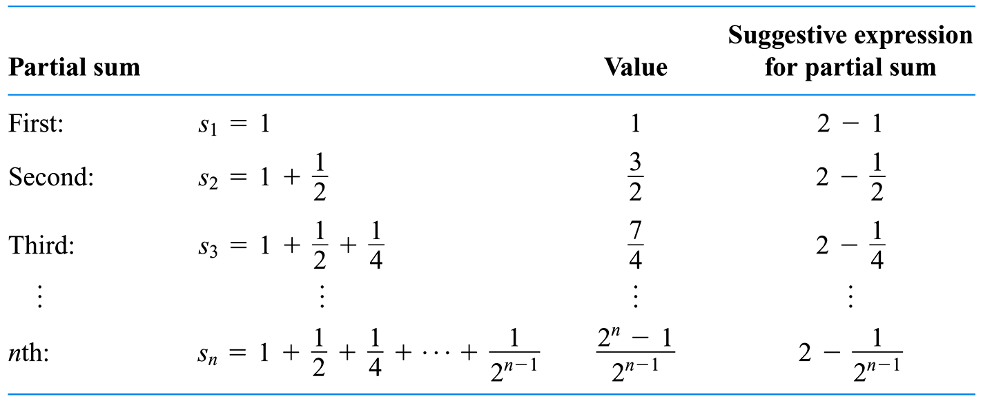
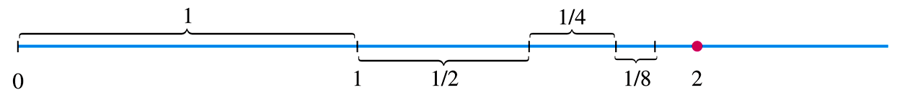
Walking half-way to location 2 blocks away and then iterating.
As the lengths 1, ½, ¼, 1/8, … are added one by one, the sum approaches 2.

Slide 5
Another motivating example for the study of series
What do we mean when we express a # as an infinite decimal? For instance, what does it mean to write
π = 3.14159 26535 89793 23846 26433 83279 50288 . . .
The convention behind our decimal notation is that any number can be written as an infinite sum. Here it means that
where the three dots (. . .) indicate that the sum continues forever, and the more terms added, the closer we get to actual value of π.

Slide 6

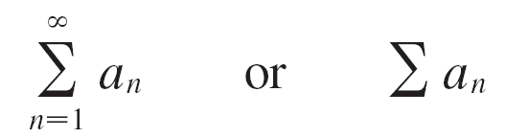
Series
In general, if we add terms of an infinite sequence
we get an expression of the form
a₁ + a₂ + a₃+ . . . + a_{n} + . . .
called an infinite series (or just a series) and denote for short, using summation notation, as
(the sideways "M" is the upper case version of the Greek letter sigma)

Slide 7
Examples of a diverging and a converging series
It would be impossible to find a finite sum for the series
1 + 2 + 3 + 4 + 5 + . . . + n + . . .
because if we start adding the terms we get the cumulative sums 1, 3, 6, 10, 15, 21, . . . and, after the nth term, we get n(n + 1)/2, which becomes very large as n increases.
However, if we start to add the terms of the series
we get
(This is the sidewalk example once more
but this time how far are you trying to travel?)

Slide 8
Table for convergent Series example
The table shows that as we add more and more terms, these partial sums become closer and closer to 1.

Slide 9
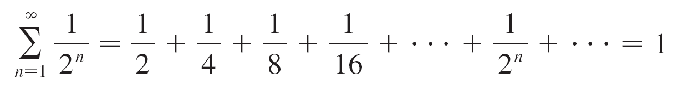
Series
In fact, by adding sufficiently many terms of the series we can make the partial sums as close as we like to 1.
So it seems reasonable to say that the sum of this infinite series is 1 and to write

Slide 10
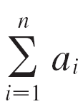
Series and the sequence of partial sums
Let s₁ = a_{1,} s₂ = a₁ + a₂ , s₃ = a₁ + a₂ + a₃
s₄ = a₁ + a₂ + a₃ + a₄ and, in general,
s_{n} = a₁ + a₂ + a₃ + . . . + a_{n} =
These partial sums form a new sequence {s_{n}}, which may or may not have a limit.
If lim_{n →∞} s_{n} = s exists (as a finite number), then, as in the preceding example, we call it the sum of the infinite series Σa_{n}.

Slide 11
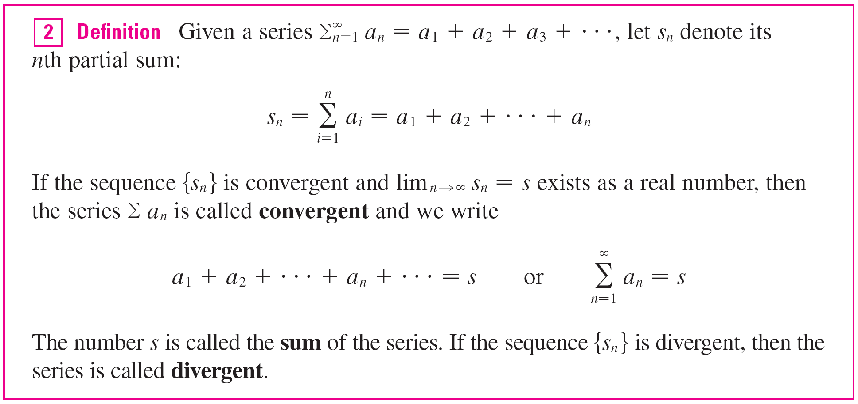
Series Convergence and Divergence definition

Slide 12
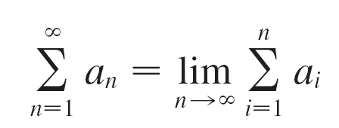
Series
Thus the sum of a series is the limit of the sequence of partial sums.
So when we write a_{n} = s, we mean that by adding sufficiently many terms of the series we can get as close as we like to the number s.
Notice that

Slide 13
Example 2
An important example of an infinite series is the geometric series
a + ar + ar² + ar³ + . . . + ar ^{n–1} + . . . = a ≠ 0
Each term is obtained from the preceding one by multiplying it by the common ratio r.
If r = 1, then s_{n} = a + a + . . . + a = na → ± ∞.
Since lim_{n →∞} s_{n} doesn’t exist, the geometric series diverges in this case.

Slide 14
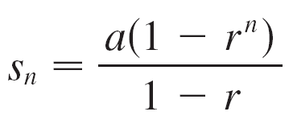
Example 2
cont’d
If r ≠ 1, we have
s_{n} = a + ar + ar² + . . . + ar ^{n-1}
and rs_{n} = ar + ar² + . . . + ar ^{n-1} + ar ^{n}
Subtracting these equations, we get
s_{n} – rs_{n} = a – ar ^{n}
Solving for s_{n} gives us:

Slide 15
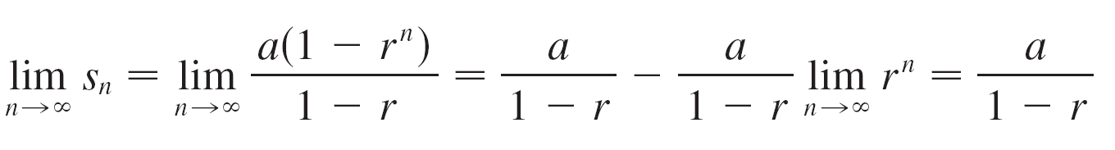
Example 2
cont’d
If –1< r < 1, we know that as r ^{n} → 0 as n → ∞,
so
Thus when | r | < 1 the geometric series is convergent and its sum is a/(1 – r ).
If r ≤ –1 or r > 1, the sequence {r ^{n}} is divergent and so, lim_{n →∞}s_{n} does not exist.
Therefore, the geometric series diverges in those cases.

Slide 16
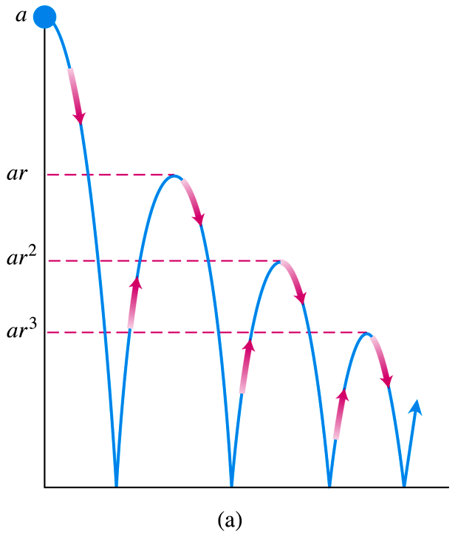
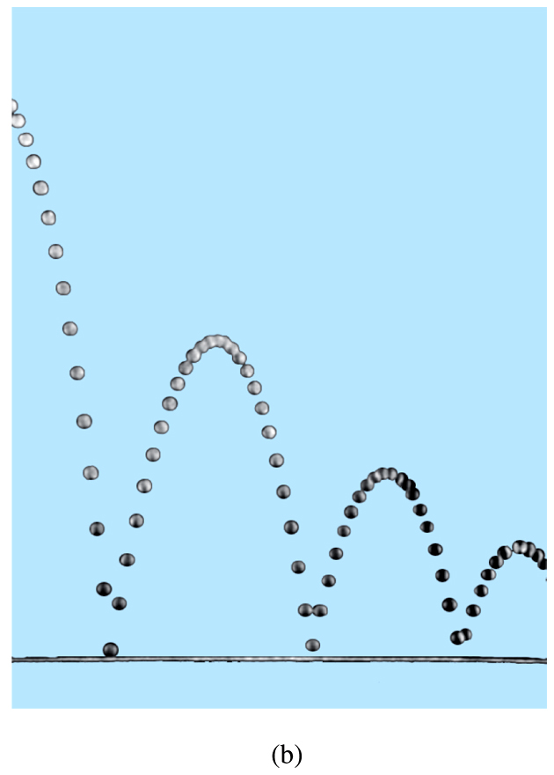
Geometric Series example: bouncing ball
What is the total vertical distance travelled if the ball is dropped from a height of a and each time the ball bounces, its new height is reduced by a factor of r?
Stroboscopic photo

Slide 17
Geometric Series formulae and results

Slide 18
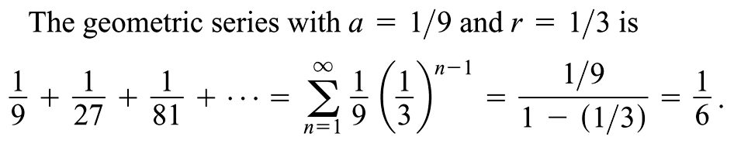
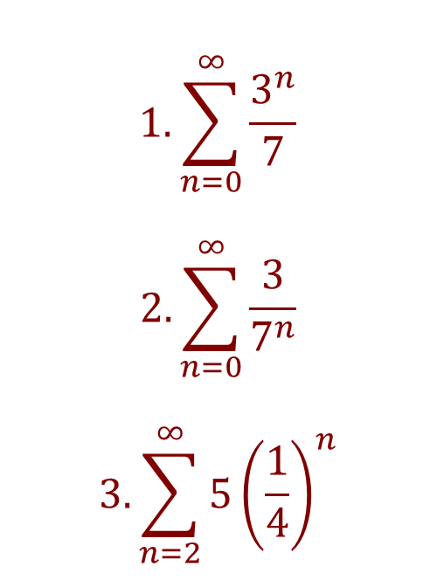
Geometric Series example and exercises
$$1.\sum_{n=0}^{∞}{\frac{3^{n}}{7}}$$
$$2.\sum_{n=0}^{∞}{\frac{3}{7^{n}}}$$
$$3.\sum_{n=2}^{∞}{5{\left(\frac{1}{4}\right)}^{n}}$$

Slide 19
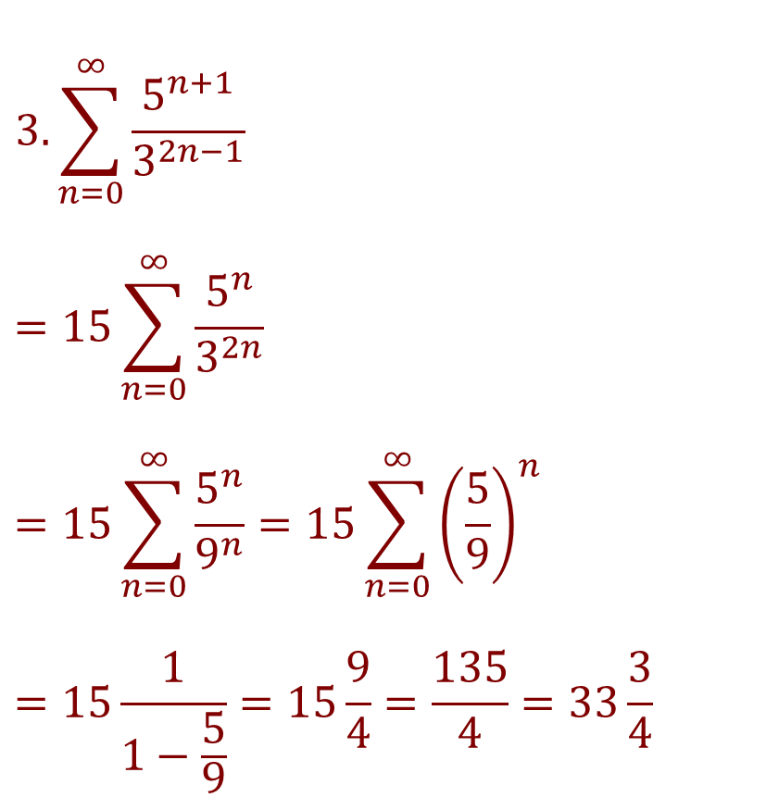
Geometric Series exercises continued
$$3.\sum_{n=0}^{∞}{\frac{5^{n+1}}{3^{2n−1}}}$$
$$=15\sum_{n=0}^{∞}{\frac{5^{n}}{3^{2n}}}$$
$$=15\sum_{n=0}^{∞}{\frac{5^{n}}{9^{n}}}=15\sum_{n=0}^{∞}{{\left(\frac{5}{9}\right)}^{n}}$$
$$=15\frac{1}{1−\frac{5}{9}}=15\frac{9}{4}=\frac{135}{4}=33\frac{3}{4}$$

Slide 20
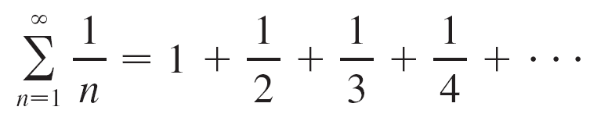

Divergent example: harmonic series
Show that the partial sums s₂, s₄, s₈, s₁₆, s₃₂, . . .become arbitrarily large.

Slide 21

Divergent example:
harmonic series
cont’d
Similarly, s₃₂ > 1 + , s₆₄ > 1 + , and in general
This shows that → ∞ as n → ∞ and so {s_{n}} is divergent.
Therefore the harmonic series diverges.

Slide 22
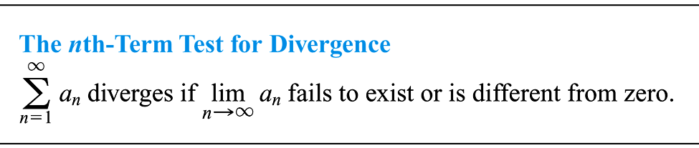
The terms of a convergent series must approach 0
We can use this to show divergence.
For the example 1 + 2 + 3 + 4 + 5 + . . . + n + . . . , the terms do not even converge, let alone to 0.

Slide 23
The terms of a convergent series must approach 0
Converse of Theorem is not true in general, i.e.,
If lim_{n→ ∞} a_{n} = 0, we cannot conclude that Σ a_{n} is convergent.
An example is the harmonic series.

Slide 24
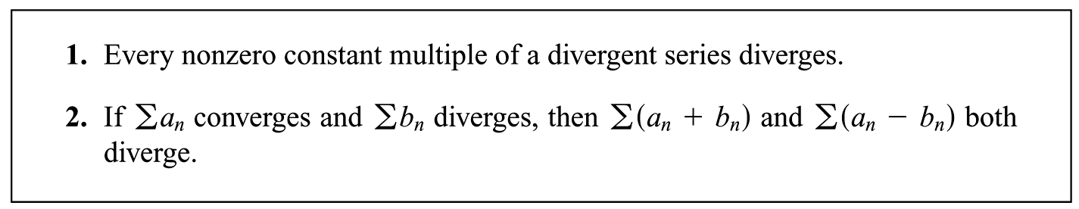
Series properties (a smaller list than for sequences).
Can you say anything if both series Σa_{n} and Σb_{n} diverge?

Slide 25
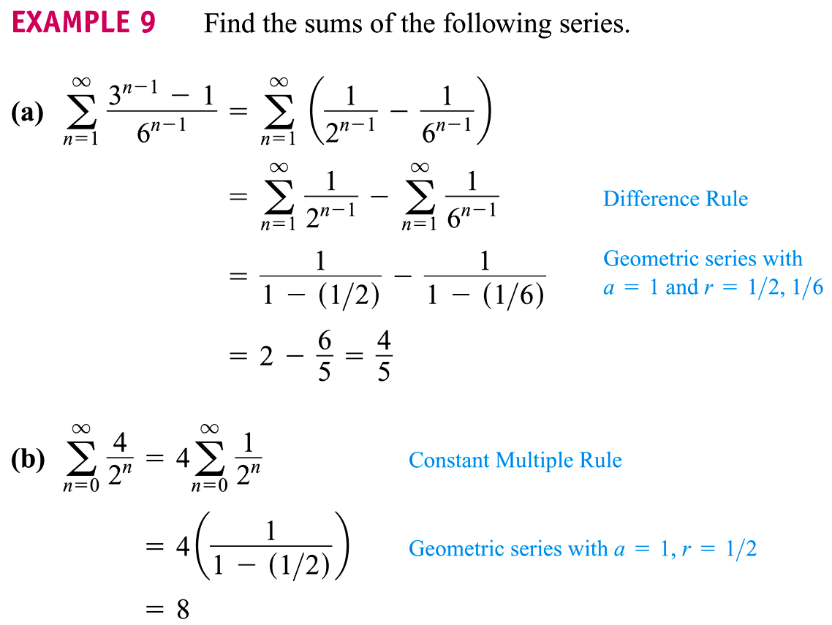
Examples which use properties

Slide 26
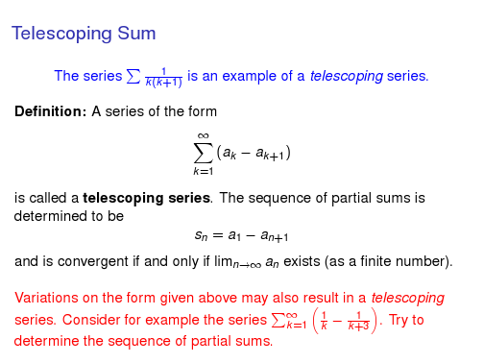
Telescoping

Slide 27
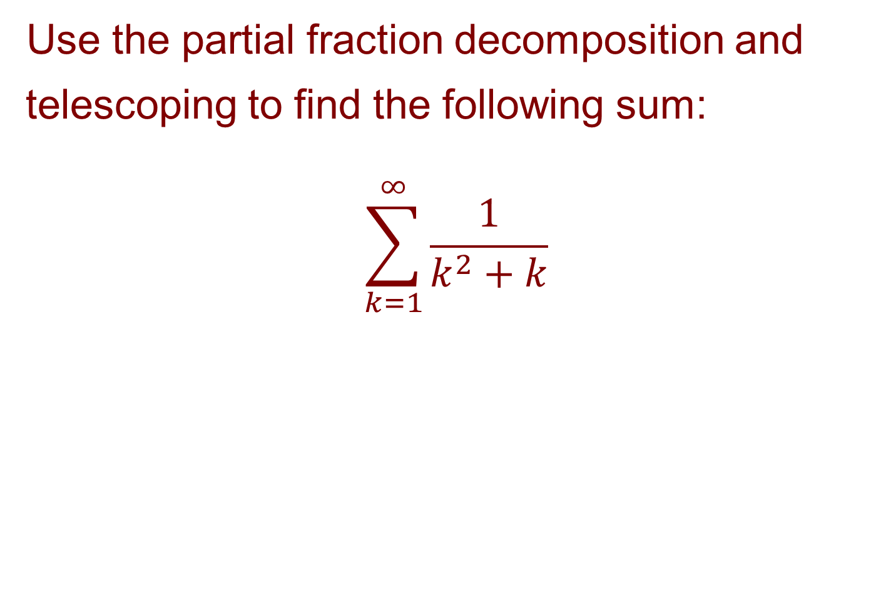
Partial fraction example
Use the partial fraction decomposition and telescoping to find the following sum:
$$\sum_{k=1}^{∞}{\frac{1}{k^{2}+k}}$$

