Slide 1
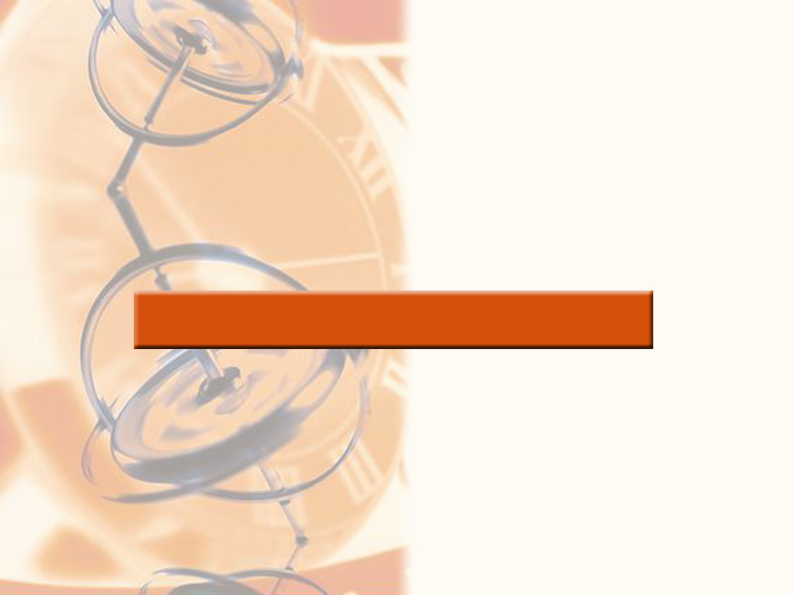
5
Integration

Slide 2
5.5
Riemann Sums

Slide 3
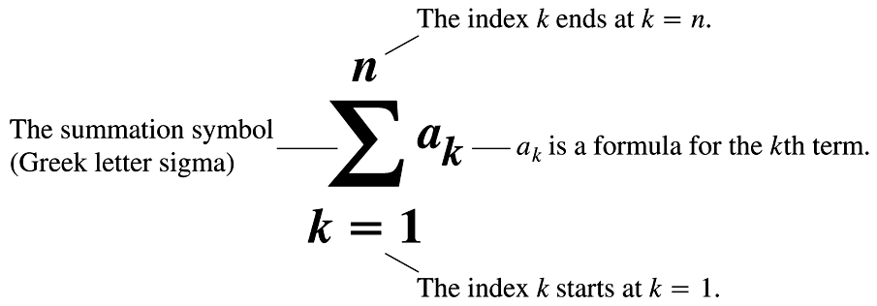
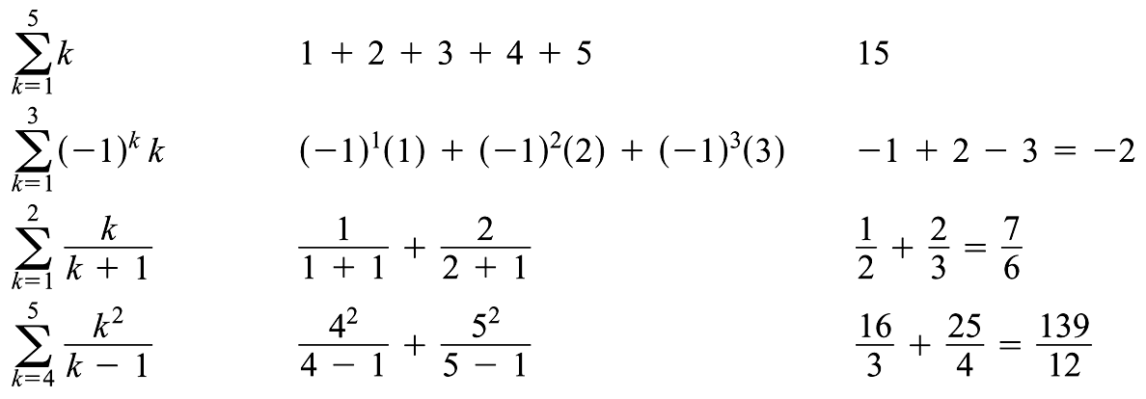
Reminder of sigma notation and examples

Slide 4
Exercise: write each sum using sigma notation

Slide 5
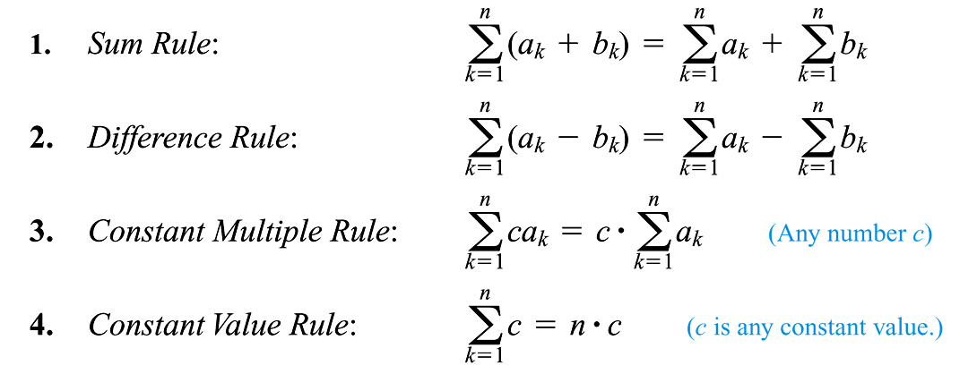
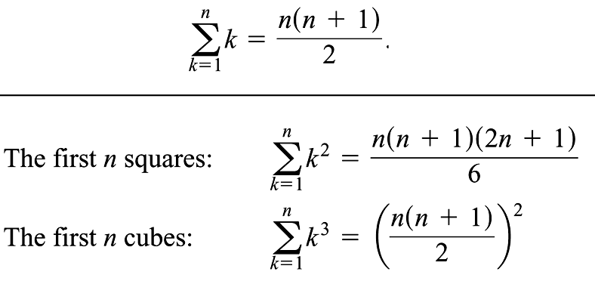
Properties of summations and some useful formulae

Slide 6
Exercises using the properties and formulae:

Slide 7
Motivation for study of Riemann sums
We sometimes need to approximate an integral, for reasons
practical
  when finding the area under a curve which doesn't have a readily found antiderivative
theoretical
  when defining the definite integral

Slide 8
Distance Traveled
Suppose that you drive on a straight highway at a constant velocity of 72 mph for 1.5 hours, and then at 60 mph for 2 hours. How far are you (what is your displacement) from your starting point?
Your displacement can be viewed as the area between the velocity function and the t-axis.
In this example, your total displacement is 228 miles.
80
40
velocity
Area =
108
Area = 120
1 2 3 4 time

Slide 9
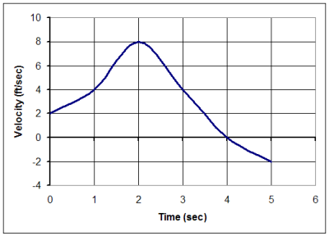
More Realistic – Distance Traveled
Velocity is rarely constant for an extended period of time, as moving objects need to speed up or slow down.
How might we find
the displacement of
this moving object
over the interval
0 < t < 4 ?

Slide 10
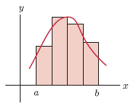

Area Under a Graph
To estimate the area under the graph of f (x) from x = a to x = b:
Divide up the interval into partitions (or subintervals);
  each one having width where n = # of partitions.
[In the example below, n = 4.]
2. Choose heights of the rectangles, usually in some systematic way, called a rule.
A Riemann Sum is the sum of the areas of these rectangles.

Slide 11
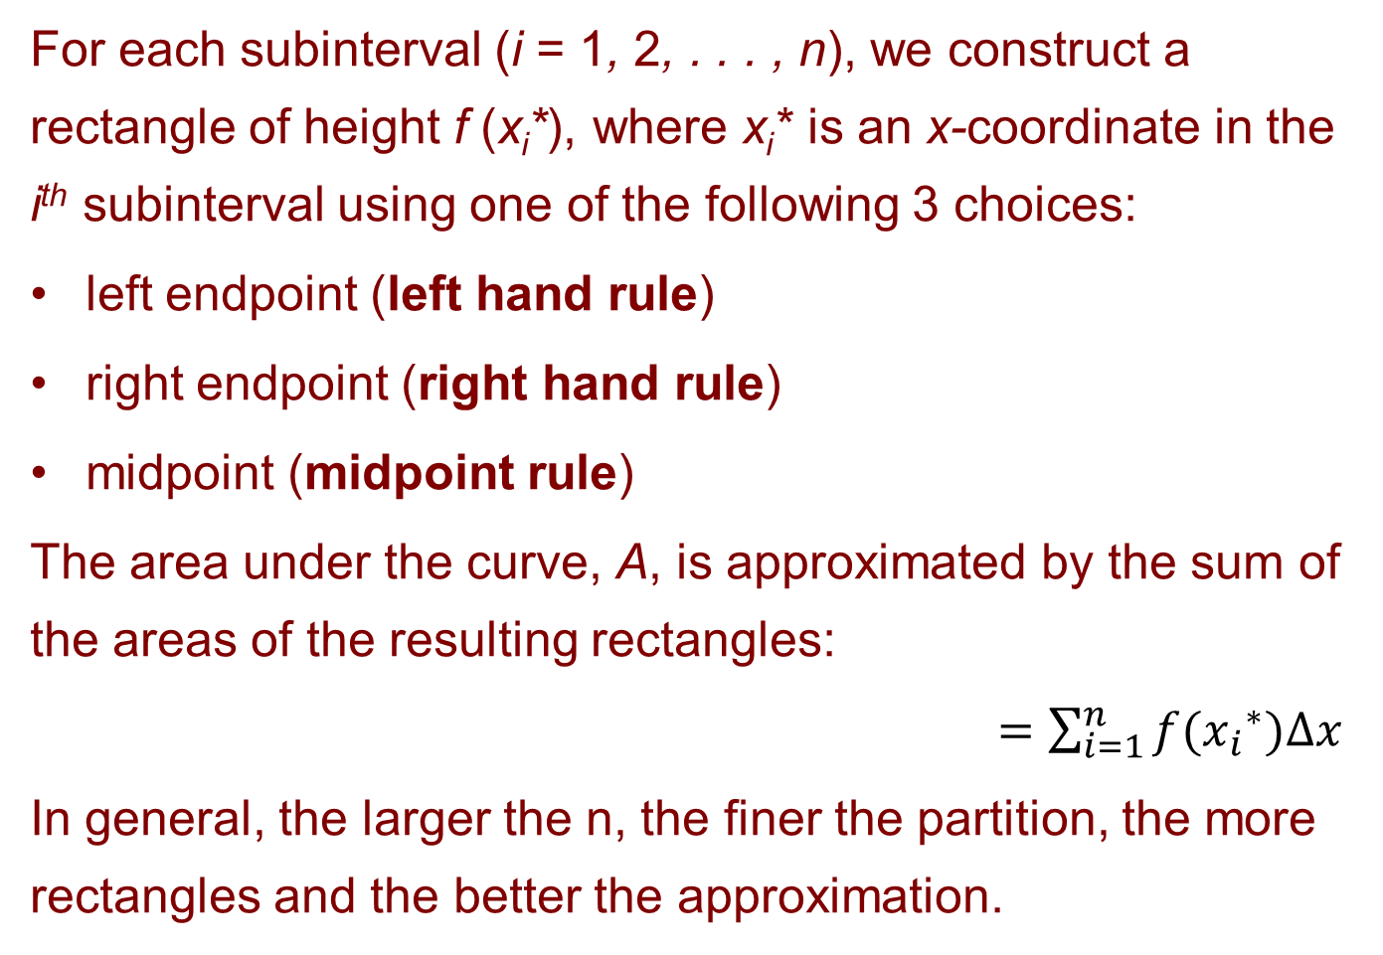
Our Riemann Sums
For each subinterval (i = 1, 2, . . . , n), we construct a rectangle of height f (x_{i}*), where x_{i}* is an x-coordinate in the i^{th} subinterval using one of the following 3 choices:
left endpoint (left hand rule)
right endpoint (right hand rule)
midpoint (midpoint rule)
The area under the curve, A, is approximated by the sum of the areas of the resulting rectangles:
$=\sum_{i=1}^{n}{f({x_{i}}^{∗})∆x}$
In general, the larger the n, the finer the partition, the more rectangles and the better the approximation.

Slide 12
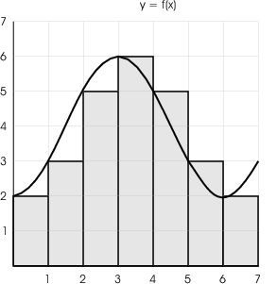
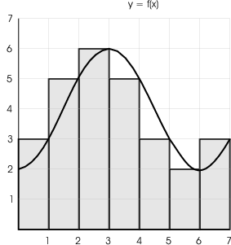
Left hand rule = 26
Right hand rule = 27
2 3 5 6 5 3 2
3 5 6 5 3 2 3

Slide 13
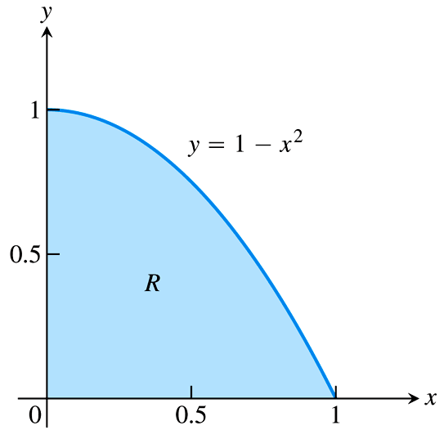
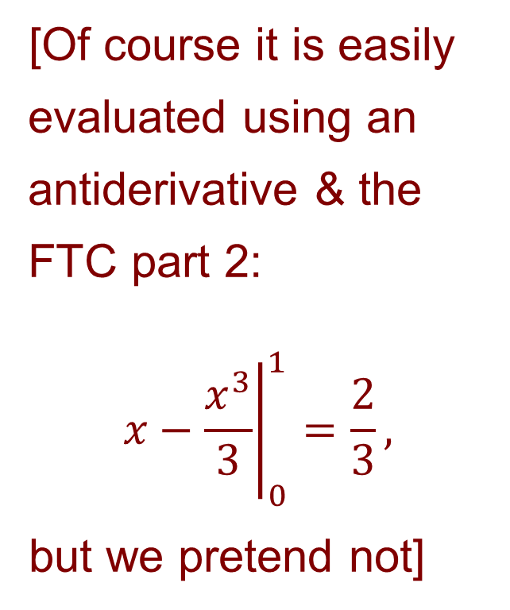
An easy example to demonstrate the basics:
[Of course it is easily evaluated using an antiderivative & the FTC part 2:
$${\left.x−\frac{x^{3}}{3}\right|}_{0}^{1}=\frac{2}{3},$$
but we pretend not]

Slide 14
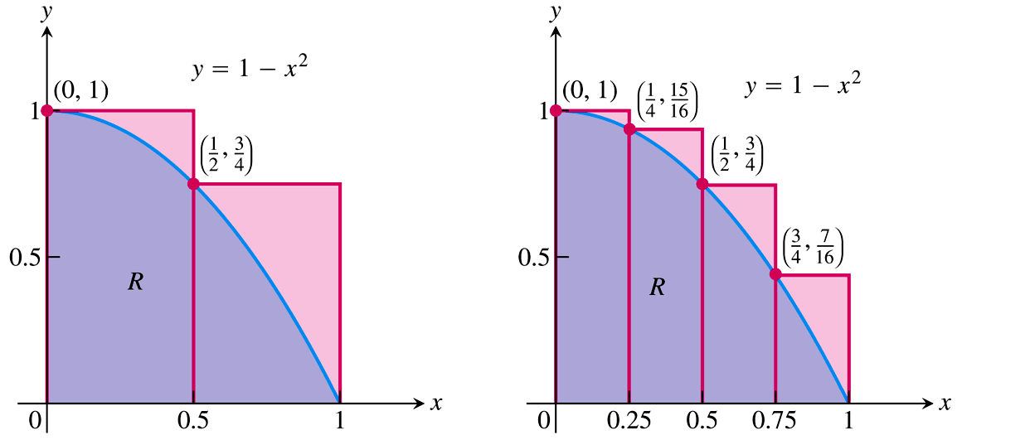
Left hand rule used with 2 partitions
Exercise: write down the Riemann sums, calculate them and then compare with the exact area.

Slide 15
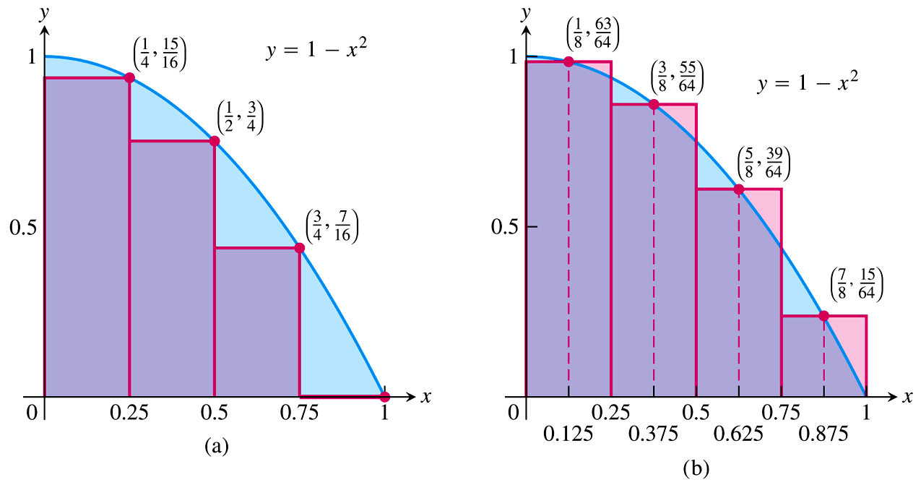
Right hand and midpoint rules, both n=4
Exercise: use technology to find the Riemann sums, and then compare with the exact area. So far who is closest?

Slide 16
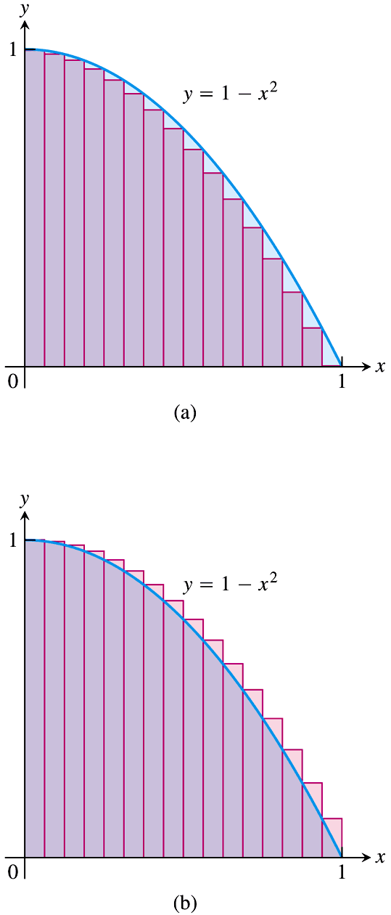
n=16: Left hand rule
Right hand rule
Is one an under estimate and the other an over estimate?
Could we get an better rule by averaging?
Exercise: use technology to find these sums.

Slide 17
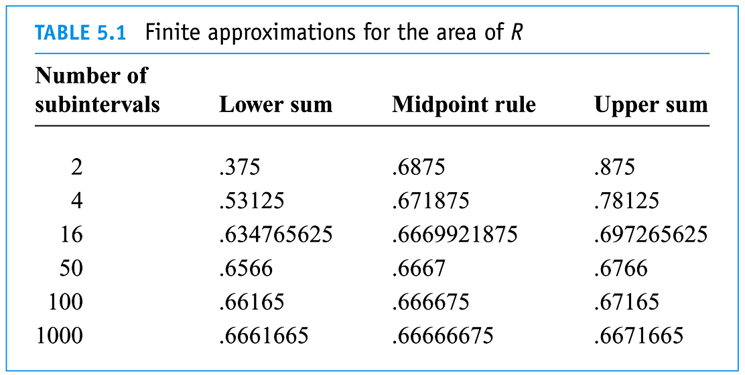
Left hand rule
Right hand rule

Slide 18
Riemann Sum notation and formulae

Slide 19
Definite Integrals and the Limit of Riemann Sums
Basic idea is that no matter which rule you use, the Riemann Sum approaches the definite integral as the number of partitions increases and the partition width decreases.

Slide 20
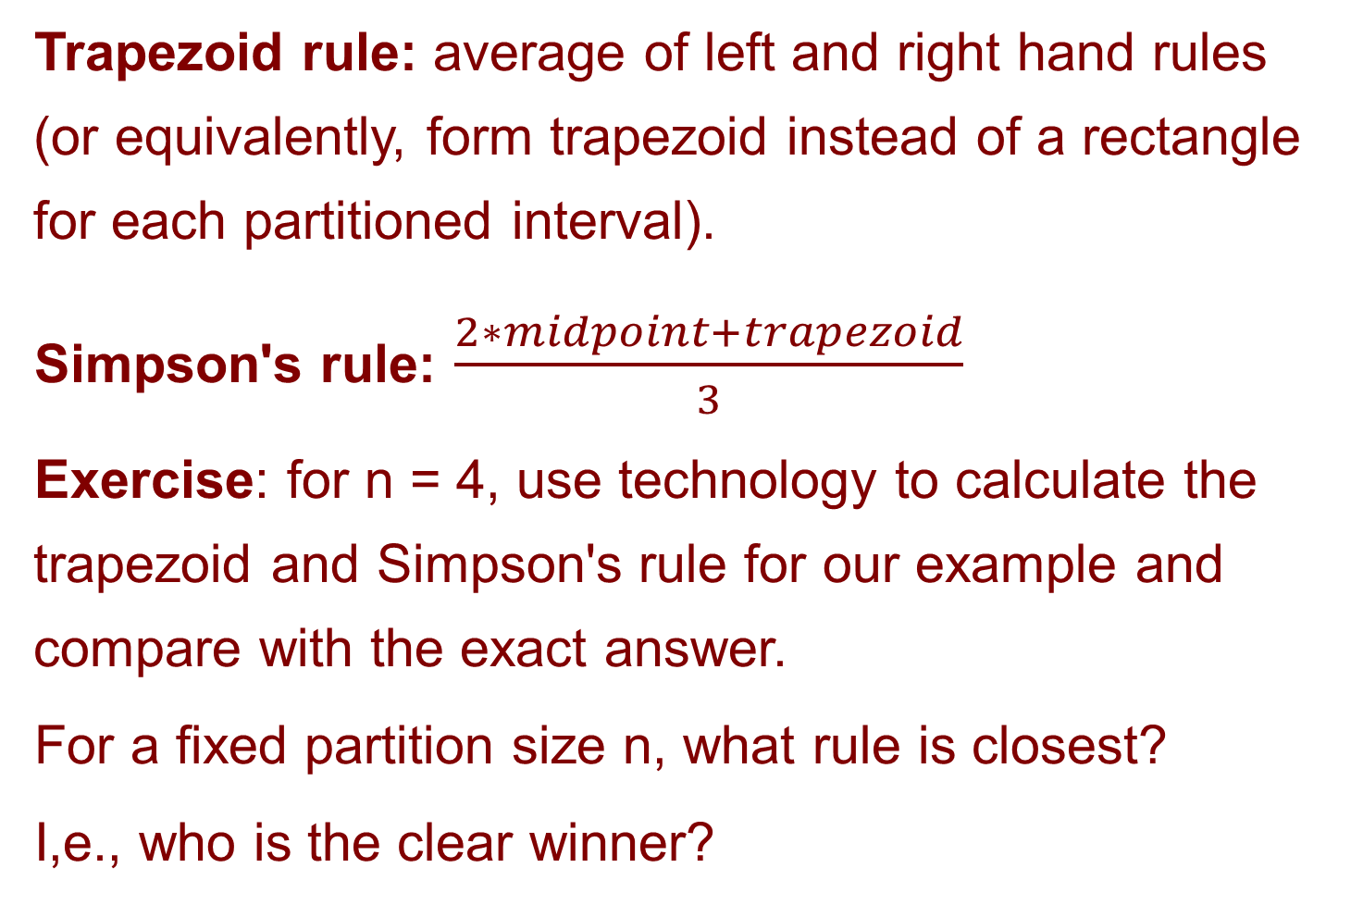
Some more advanced rules
Trapezoid rule: average of left and right hand rules (or equivalently, form trapezoid instead of a rectangle for each partitioned interval).
Simpson's rule: $\frac{2∗midpoint+trapezoid}{3}$
Exercise: for n = 4, use technology to calculate the trapezoid and Simpson's rule for our example and compare with the exact answer.
For a fixed partition size n, what rule is closest?
I,e., who is the clear winner?

