Slide 1
4.7 Counting Principles
MAT 1372 Stat w/ Prob
NYCCT (CUNY)
Ezra Halleck

Slide 2
Basic Principle of Counting
Suppose experiment consists of two parts:
if part 1 can result in any of n possible outcomes &
if for each outcome of part 1 there are m possible outcomes in part 2
then there is a total of nm possible outcomes of experiment.
Example: there are 20 students in class and each student takes
3 exams over the course of semester,
then the instructor can look forward to grading 20*3=60 exams.

Slide 3
Generalized Basic Principle of Counting
An experiment consists of r parts. If there are
  n₁ possible outcomes of part 1
  n₂ possible outcomes of part 2
  n₃ possible outcomes of part 3, and so on.
Then there is total of n₁ · n₂ · · · n_{r} possible outcomes of experiment.

Slide 4
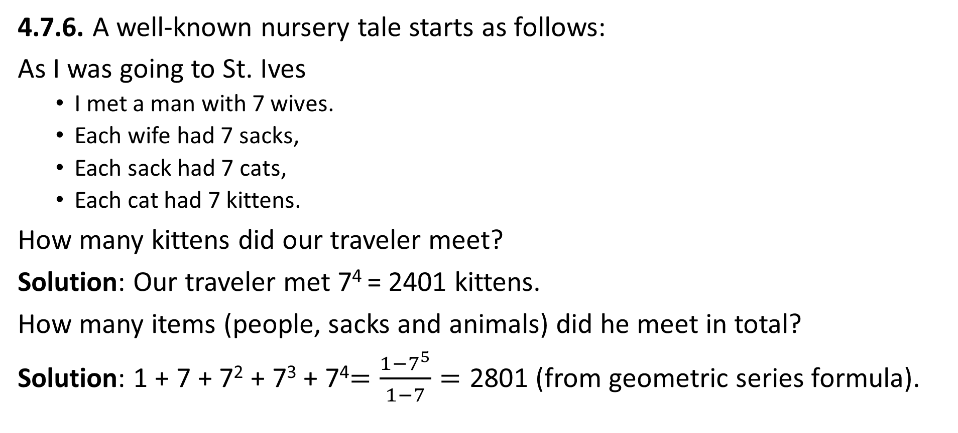
Example of generalized principle
4.7.6. A well-known nursery tale starts as follows:
As I was going to St. Ives
  I met a man with 7 wives.
  Each wife had 7 sacks,
  Each sack had 7 cats,
  Each cat had 7 kittens.
How many kittens did our traveler meet?
Solution: Our traveler met 7⁴ = 2401 kittens.
How many items (people, sacks and animals) did he meet in total?
Solution: 1 + 7 + 7² + 7³ + 7⁴$=\frac{1−7^{5}}{1−7}=\text{2801}$ (from geometric series formula).

Slide 5
Permutations (generalized)
If a random, ordered selection of size m is made of n distinct objects without replacement (n distinct balls in urn), then # of possibilities is
4.7.2. How many different batting orders are possible for baseball team consisting of 9 players? 15 players?
(Assume national league rules, i.e., no designated hitter)
With a TI-84 calculator, command is 15 nPr 9.
In Excel, it is =permut(15,9).

Slide 6
Permutation example: birthday problem!
Example 4.20 (see Excel file) If 25 people are in a room, what is chance that no two of them celebrate their birthday on the same day of the year (ignore leap year complication)?
Solution: If each person gives their birthday, he or she must have a birthday different from those given earlier so
365 nPr 25 = 365*364….341 is count for distinct birthdays.
The overall count (repeated birthdays allowed) is 365²⁵, so
P(distinct birthdays) = 365*364….341/365²⁵ » 43%.
Perhaps surprisingly Þ greater than even chance of repeated birthdays!
What important assumptions are being made?
What is the tipping point (# where chance of repeats > 50/50)?

Slide 7
Combinations
If a random, unordered selection of size m is made of n distinct objects without replacement (e.g. differently colored balls in an urn), then the number of possibilities is “n choose m”:
Example: Consider a group of 10 people. A committee of 5 must be chosen, with one member designated as chairperson. How many possible committees are there?
Solution: First choose the chairperson, then select other 4 members (unordered):

Slide 8
4.7.12. A delivery company has 10 trucks, of which 3 have faulty brakes.
If an inspector randomly chooses 2 of the trucks for a brake check, what is the probability that none of the trucks with faulty brakes are chosen?
(see Excel file)

Slide 9
4.7.14. In a state lottery, a player must choose 8 of the numbers from 1 to 40.
The Lottery Commission then performs an experiment that selects 8 of these 40 numbers. Assuming that the choice of the Lottery Commission is equally likely to be any of the combinations, what is the probability that a player has
(a) All 8 of the selected numbers?
(b) Seven of the selected numbers?
(c) At least 6 of the selected numbers?
(see Excel file)

Slide 10
Summary of 4.7 Counting
Given a pool of size n, ways to select m objects:
If ∃REPLACEMENT of objects and ORDER applies, then #outcomes each time is n and so total # ways =
Example: #5 letter words = 26⁵.
If ∄REPLACEMENT but order still applies, then #outcomes initially is n but then decrements each time so total # ways =
Example: #3 letter words with DISTINCT letters:
If ∄REPLACEMENT and ORDER does NOT apply, then total #outcomes is a binomial coefficient:
Example: #committees of size 7 from a pool of 20:

