Slide 1
Calories Vs Fat

Slide 2
Introduction
In this quantitative study, we examined the calories versus the fat content per serving in grocery store snacks. We believe that the higher the fat content in grams per serving the higher the calories will be per serving.

Slide 3
The Experiment

Slide 4
Explanatory
Variable
Fat content in grams per serving

Slide 5
Response
Variable
Calories per serving

Slide 6
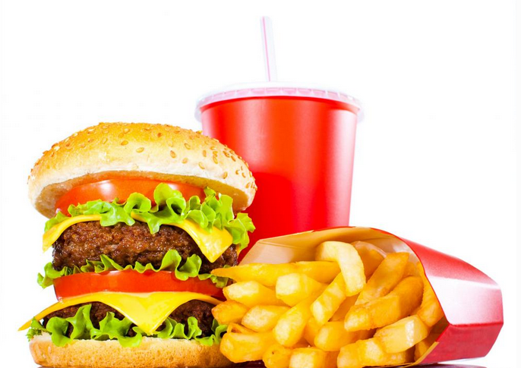
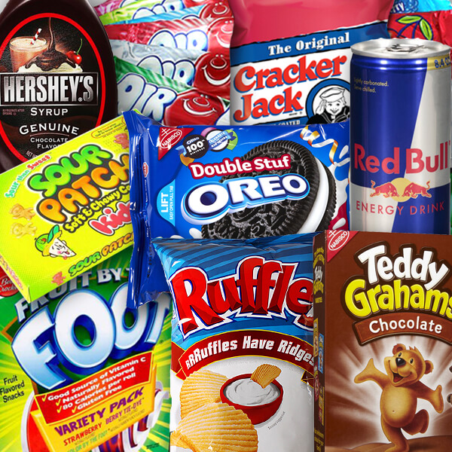
Procedure
Our sample size included 69 different types of grocery store snacks
In excel we labeled each snack by the calories per serving, and fat content in (g) per serving, and serving size.
Then we identified the frequencies for fat and calories
Calculation of mean, median, range, std, and presented graphs to clearly illustrate statistical significance.

Slide 7
Research Question
Could there be a correlation
between the calories in snacks
and fat content?

Slide 8
Hypothesis
Snack foods with higher fat
content have higher calories.

Slide 9
We expect a positive correlation!

Slide 10
Hypothesis support
We think that the higher the fat content in (g) per serving in snacks will have a higher caloric value
Variables that may affect the outcome...
Empty calories
Processed and unprocessed foods
Serving size

Slide 11
Experimental Data
Calories
Mean | 160.6507246
Range | (41-485)
Std | 81.50737899
Median | 150
Q1 | 100
Q3 | 202.5
IQR | 102.5
Outliers | 485
 | -53.75
 | 356.25
Bins (For Calories) | Frequency
40-120 | 24
120-200 | 24
200-280 | 13
280-360 | 7
260-440 | 0
440-520 | 1

Slide 12
Experimental Data
Calories cont’d
 | 5 Number Summary (Calories)
Calories Per Serving
Minimum | 41 | 0.5
Lower Quartile | 100 | 0.5
Median | 150 | 0.5
Upper Quartile | 202.5 | 0.5
Maximum | 485 | 0.5

Slide 13
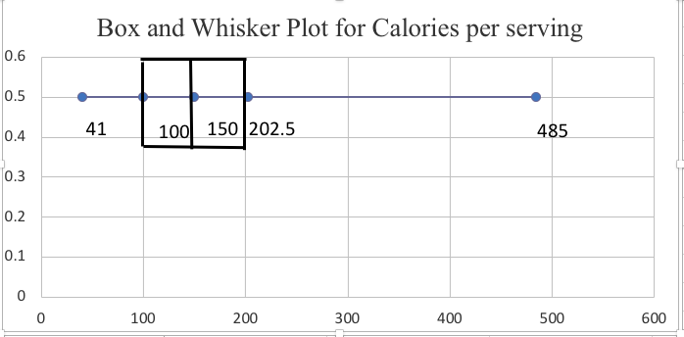
Experimental Data
Calories cont’d

Slide 14
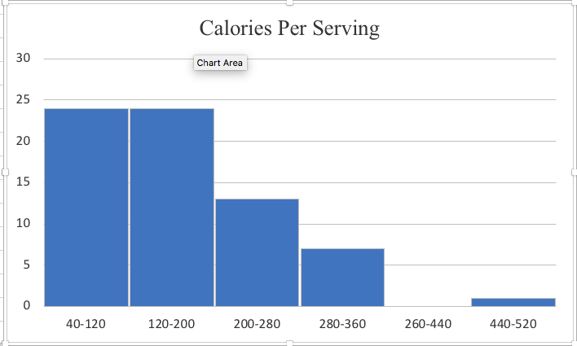
Calories cont’d
Experimental Data

Slide 15
Experimental Data
Fat
Mean | 6.236086957
Range | (0-19)
Std | 4.583134754
Median | 6
Q1 | 2.5
Q3 | 9
IQR | 6.5
Outliers | 19
 | -7.25
 | 18.75
Bins (For Fat) | Frequency
(0-4) | 25
(4-8) | 20
(8-12) | 14
(12-16) | 8
(16-20) | 2

Slide 16
Experimental Data
Fat Cont’d
 | 5 Number Summary (Fat)
Fat Per Serving
Minimum | 0 | 0.5
Lower Quartile | 2.5 | 0.5
Median | 6 | 0.5
Upper Quartile | 9 | 0.5
Maximum | 19 | 0.5

Slide 17
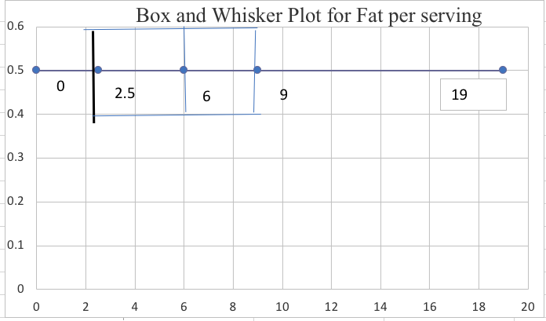
Experimental Data
Fat Cont’d

Slide 18
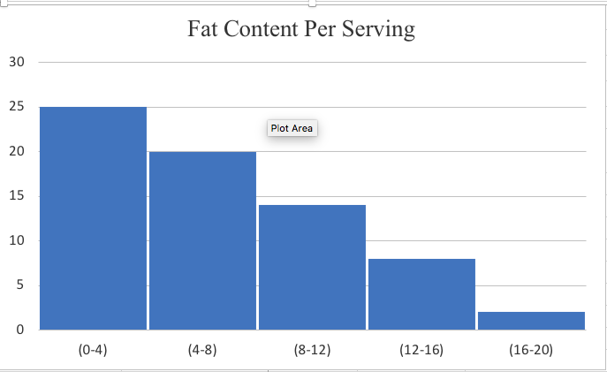
Experimental Data
Fat Cont’d

Slide 19
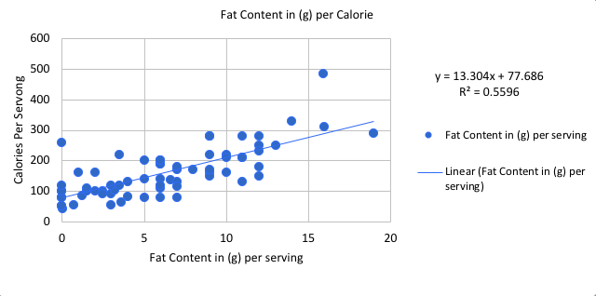
Experimental Data
Fat Content in (g) per Calorie

Slide 20
Conclusion
In conclusion our hypothesis was correct that snack foods with higher fat content have higher calories. Demonstrated in the scatter plot we see a positive correlation between the fat content in (g) per calorie

