Slide 1
MAT 1372 Statistics with probability
6.2 CONTINUOUS RANDOM VARIABLES

Slide 2
Review of Random variables
What is a random variable?
What is a discrete random variable?
Example: rounded height (e.g., to the nearest cm)
Give 5 other examples (think, pair, share)
Some characteristics of discrete RV’s
Number of outcomes may be
Finite (roll of a single die or the sum of 2 dice)
Infinite (count #coin flips it takes to get one)
Probability of any outcome in sample space should be positive
Otherwise just leave it out
In symbols: if k∈S, then P(k)>0
Sum of probabilities of all outcomes is 1: $\sum_{\text{k}\text{∈}\text{S}}{P(k)}=1$
For an event A Í S, $P\left(A\right)=\sum_{\text{k}\text{∈}\text{A}}{P(k)}$

Slide 3
Continuous RV’s
Sample space S = subset of the real number of line
Examples:
Height: exact!
Age: this is trickier to pin down, since you are constantly getting older!
Commute time (say door-to-door)
Annual income: sort-of, since most of us don’t earn fractions of pennies!
Now it is your turn:
Give 5 other examples (think, pair, share)

Slide 4
outcomes and events
Probability of any particular outcome is 0
To get a positive probability, events are given as a single interval [a, b] or a union of intervals
Examples:
height 5’10” - really means height is in the interval [5’9.5”, 5’10.5”)
What is the chance that a student is shorter than 4’ or taller than 6’?
$$P\left[\left(−∞,4\right)∪\left(6,∞\right)\right]=?$$
For each of your 5 continuous RV examples, provide examples of events.

Slide 5
Instruments for calculating probability
What is instrument for calculating probabilities for discrete RV’s?
To find the probability of an event,
sum the probabilities of each outcome in the event.
Example: rolling 2 dice and summing. $S=\left\{2,3,…,12\right\}$
Let event $A=\left\{k∈S:k<6\right\}$
Exercise: find $P(A)$
For continuous RV’s:
The instrument is a density function.
$$=\{2, 3, 4, 5\}$$

Slide 6
What is a density function?
A density function $f(x)$ is graphic view of the chance of getting near a particular outcome.
Its domain is the sample space $S \text{Í} R$, i.e., a subset of the real #’s.
Its range is a subset of the nonnegative real numbers.
The total area under the curve is 1.

Slide 7
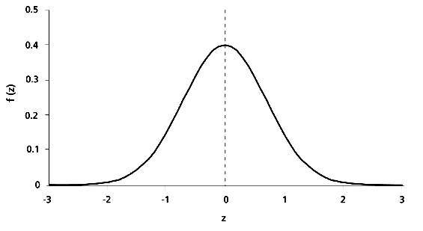
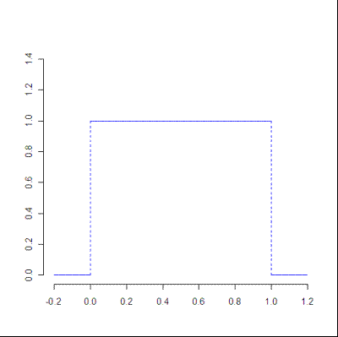
Density function $f(x)$ examples
Standard normal distribution
“Standard” uniform distribution

Slide 8
How to find a continuous probability
Graph the density function
Mark the event on the x-axis (an interval or union of intervals)
Draw vertical lines to mark the boundaries of the event
Shade under the curve within these lines above the event
Find area of your shaded region.
Label the probability on graph.

Slide 9
Example of probability calculation
Graph the density function: std unif
Mark event on x-axis, $A=\{x:0.2≤x≤0.6\}$
Draw vertical lines to mark boundaries
Shade under curve within these lines
Find area of your shaded region:
A = l × w = 1 × (0.6 − 0.2) = 0.4
6. Label the probability on graph
P(A) = $P(0.2≤X≤0.6)$ = 0.4 = 40%

Slide 10
Exercise: Suppose that density function is the uniform distribution with footprint [1,5], i.e., a horizontal line between x = 1 and x = 5 with a uniform height h and 0 everywhere else.
What is the height h? Hint: total area under curve is 1.
What is the probability that an outcome is between 2 and 3?
$$P\left(2≤X≤3\right)=P(\left[2, 3\right])$$
What is the probability that an outcome is > 3.5?
$$P\left(X≥3.5\right)=P(\left[3.5 ,5\right])$$

Slide 11
6.2.4. You are to meet a friend at 2 p.m. However, while you are always exactly on time, your friend is always late and indeed will arrive at the meeting place at a time uniformly distributed between 2 and 3 p.m. Find the probability that you will have to wait
(a) At least 30 minutes
(b) Less than 15 minutes
(c) Between 10 and 35 minutes

Slide 12
6.2.4. You are to meet a friend at 2 p.m. However, while you are always exactly on time, your friend is always late and indeed will arrive at the meeting place at a time uniformly distributed between 2 and 3 p.m. Find the probability that you will have to wait
(a) At least 30 minutes | P(X ≥ 30) = P([30, 60])
(b) Less than 15 minutes
(c) Between 10 and 35 minutes

Slide 13
6.2.4. You are to meet a friend at 2 p.m. However, while you are always exactly on time, your friend is always late and indeed will arrive at the meeting place at a time uniformly distributed between 2 and 3 p.m. Find the probability that you will have to wait
(a) At least 30 minutes | P(X ≥ 30) = P([30, 60])
(b) Less than 15 minutes | P(X ≤ 15) = P([0, 15])
(c) Between 10 and 35 minutes

Slide 14
6.2.4. You are to meet a friend at 2 p.m. However, while you are always exactly on time, your friend is always late and indeed will arrive at the meeting place at a time uniformly distributed between 2 and 3 p.m. Find the probability that you will have to wait
(a) At least 30 minutes | P(X ≥ 30) = P([30, 60])
(b) Less than 15 minutes | P(X ≤ 15) = P([0, 15])
(c) Between 10 and 35 minutes | P(10 ≤ X ≤ 35) = P([10, 35])

