Slide 1
MAT 1372 statistics with probability
Probability continued

Slide 2
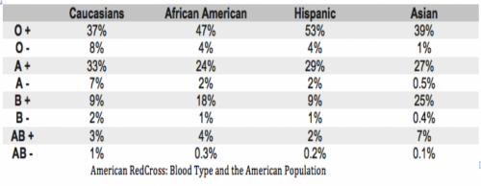
Review Quiz
What is chance that a randomly chosen Latino has:
Type B blood?
Any type other than type B?
Any type with a negative Rh factor?
(Type B) OR (any negative Rh factor) blood?

Slide 3
Mendel’s Peas
Gregor Mendel was a scientist from the mid-late 1800’s. His research centered around what we now recognize as dominant and recessive genetic traits.
Mendel did a study on pea plants, looking at the gene trait that determines pea pod color. Green pea pods are a dominant trait, while yellow pods are a recessive trait. A single pea plant has two copies of this gene – and if either one is the dominant version, the plant will have green pea pods.
In order to determine whether a single plant had two copies of the dominant gene (homozygote) or if it had one of each (heterozygote), Mendel crossed the plant to itself so its offspring had a single parent. Looking at 10 offspring of the single plant, if all ten had green pods, he inferred that the parent plant was a homozygote. If any of the offspring had yellow pods, he inferred that the parent plant was a heterozygote.

Slide 4
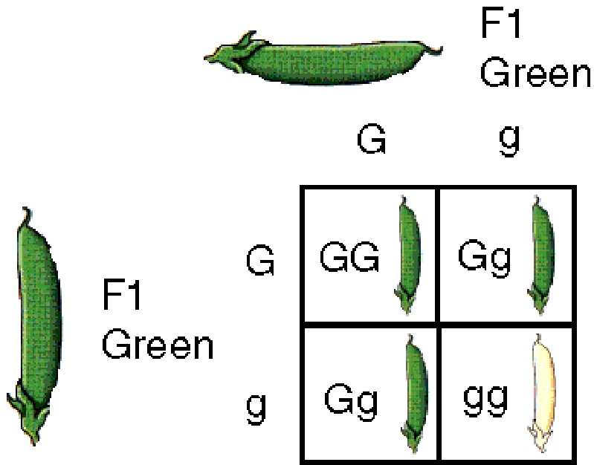
Mendel’s peas
By using the same plant as both “mother” and “father”
Mendel eliminated all extra variables, and caused the following:

Slide 5
Mendel’s Peas Computation
So, if Mendel took 10 offspring in order to determine whether or not the single parent was a homozygote or a heterozygote – is there any chance he was wrong?
Are the different offspring “independent” in a probability sense? Yes.
What are the odds of an offspring having yellow pods? ¼ (or 0.25)
Meaning that there’s a 75% chance that an offspring still has green pods.
What are the odds that ALL TEN have green pods?
Pr[first is green and second is green and … and tenth is green] =
¾ · ¾ · ¾ · ¾ · ¾ · ¾ · ¾ · ¾ · ¾ · ¾
Or ( ¾ )¹⁰ which is approximately 0.056 (or 5.6%)

Slide 6
Probability Trees
When looking at the probability of multiple events, sometimes it’s useful to use a “probability tree” to visualize the possible outcomes (and aid in calculating resulting probabilities for each outcome).
For example, consider a couple that is planning to have two children.
What are the possible outcomes?
MM, MF, FM, FF
Statistics indicate that the probability of a male child is 0.512, so what are the odds of each possible outcome?

Slide 7
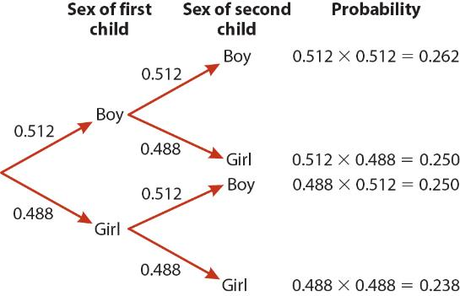
Probability Trees
Use a tree to map out the possible outcomes, then apply the multiplication property to find the resulting probability for each outcome:

Slide 8
Dependent Events
Not all events are independent. Sometimes the outcome of one event will change the probabilities of a subsequent event.
A basic example can be seen using playing cards. Drawing one card from the deck has 52 possible outcomes. But if you then draw a second card – all probabilities have changed because there are now only 51 possible outcomes.
Notation:
Pr[ B | A ]
(the probability of event B given that event A has already occurred.)

Slide 9
Jewel Wasps
The jewel wasp is considered a parasite – laying eggs on a live host. When the host dies, the offspring emerge from the pupal case and mate immediately.
Jewel wasp females have the incredible ability to manipulate the sex of their offspring when they lay their eggs.
When a female finds a “fresh” host that has not already been parasitized by another female jewel wasp, she lays mainly female eggs – producing just enough males to fertilize all her daughters.
But if the host has already been parasitized by another female, the newcomer will lay mostly male eggs – as there are mostly female eggs already laid in this host.
A host has a 20% chance of having already been parasitized.
When laying eggs in a new host, the female jewel wasp will lay 95% female eggs.
When laying eggs in an already parasitized host, the female will lay only 10% female eggs.

Slide 10
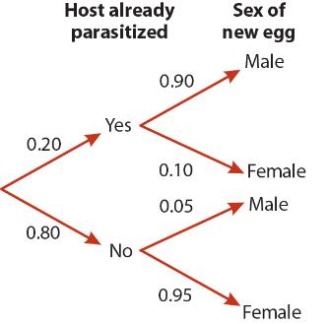
Jewel Wasps
This is a prime example of dependent events. “Finding a fresh host” determines the resulting probabilities for “laying a male egg” or “laying a female egg”.
Determine the probability for each outcome.

Slide 11
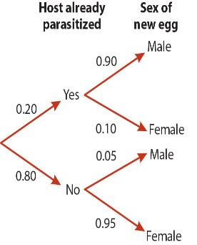
Jewel Wasps
This is a prime example of dependent events. “Finding a fresh host” determines the resulting probabilities for “laying a male egg” or “laying a female egg”.
Pr[male|parasitized] = 0.90
Pr[female|parasitized] = 0.10
Pr[male|fresh] = 0.05
Pr[female|fresh] = 0.95
Pr[parasitized] = 0.20
Pr[fresh] = 0.80

Slide 12
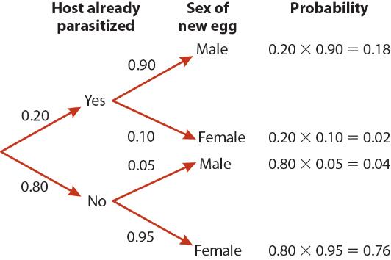
Jewel Wasps
Pr[ male and parasitized ] = 0.18

Slide 13
Jewel Wasps
Pr[ female and parasitized ] = 0.02

Slide 14
Jewel Wasps
Pr[ male and fresh ] = 0.04

Slide 15
Jewel Wasps
Pr[ female and fresh ] = 0.76

Slide 16
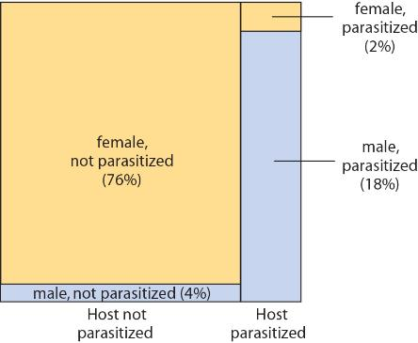
Jewel Wasps
This is a perfect time for a mosaic plot.

Slide 17
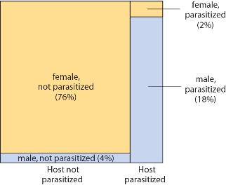
Jewel Wasps
This is a very useful diagram for answering the following:
What is the total probability of being male? Of being female?

Slide 18
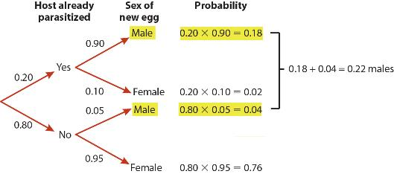
Jewel Wasps
Pr[male and parasitized] + Pr[male and fresh] = 0.18 + 0.04
Pr[female and parasitized] + Pr[female and fresh] = 0.02 + 0.76

Slide 19
Conditional multiplication rule
As we saw with the wasps:
Pr[ male and parasitized ] = Pr[parasitized] x Pr[male | parasitized]
in general:
Pr[A and B] = Pr[B] x Pr[A|B]
Or
Pr[A and B] = Pr[A] x Pr[B|A]
(both cases result in consideration of both A and B happening)
We cannot say simply Pr[A] x Pr[B] because the probability of one of our events depends on what happens with the other event.

Slide 20
Bayes’ Theorem
Because there are two different ways to represent the probability of “A and B” when A and B are not independent – we know that the two representations will be equal.
(Because the probability of “A and B” is a fixed value – so the two different representations must have the same result!)
Pr[B] x Pr[A|B] = Pr[A and B] = Pr[A] x Pr[B|A]

Slide 21
Bayes’ Theorem
Because there are two different ways to represent the probability of “A and B” when A and B are not independent – we know that the two representations will be equal.
(Because the probability of “A and B” is a fixed value – so the two different representations must have the same result!)
Pr[B] x Pr[A|B] = Pr[A and B] = Pr[A] x Pr[B|A]

Slide 22
Bayes’ Theorem
Because there are two different ways to represent the probability of “A and B” when A and B are not independent – we know that the two representations will be equal.
(Because the probability of “A and B” is a fixed value – so the two different representations must have the same result!)
Pr[B] x Pr[A|B] = Pr[A and B] = Pr[A] x Pr[B|A]

Slide 23
Bayes’ Theorem
Because there are two different ways to represent the probability of “A and B” when A and B are not independent – we know that the two representations will be equal.
(Because the probability of “A and B” is a fixed value – so the two different representations must have the same result!)
Pr[B] x Pr[A|B] = Pr[A and B] = Pr[A] x Pr[B|A]
So…
Pr[B] x Pr[A|B] = Pr[A] x Pr[B|A]

Slide 24
Bayes’ Theorem
Because there are two different ways to represent the probability of “A and B” when A and B are not independent – we know that the two representations will be equal.
(Because the probability of “A and B” is a fixed value – so the two different representations must have the same result!)
Pr[B] x Pr[A|B] = Pr[A and B] = Pr[A] x Pr[B|A]
So…
Pr[B] x Pr[A|B] = Pr[A] x Pr[B|A]
And therefore:

Slide 25
Detecting Down Syndrome
Down Syndrome (DS) is a chromosomal condition that occurs in approximately one in 1000 pregnancies. The most accurate test for DS carries a risk of miscarriage (about one in 200), so a less accurate test (the “triple test”) is used initially to avoid this risk.
The triple test is not perfect. It does not always detect DS (a false negative), and it sometimes identifies a non-DS fetus as having DS (a false positive).
Under normal conditions, the triple test correctly detects DS with probability 0.60. The false-positive rate is 0.05.
What are our events of interest?
+ = “positive result” or − = “negative result”
D = “DS” or N = “no DS”
Which probabilities do we know?
P[ D ] = 0.001 P[ +|D ] = 0.6 P[+|N ] = 0.05

Slide 26
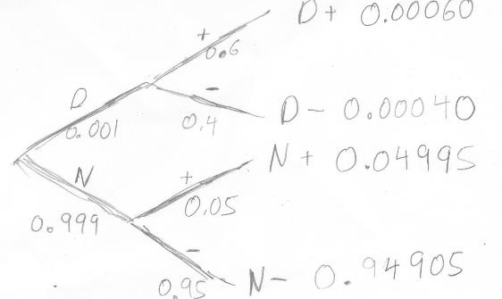
Down Syndrome
We often are interested in the opposite conditional probabilities from the information given about the test.
In particular, we want to know chance that a fetus has the syndrome given a positive result:
Pr[ D | + ] = $\frac{Pr[D+]}{P[+]}$
We use Bayes’ Theorem to compute this.
However, we use a tree approach rather a long formula found in many textbooks.

Slide 27
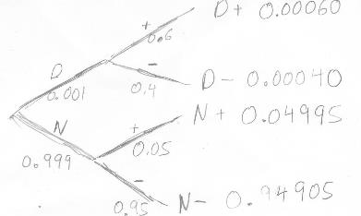
Down Syndrome
The intermediate calculations are:
Pr[D+]=(0.60 x 0.001) = 0.00060
Pr[+] = (0.60 x 0.001) + (0.05 x 0.999)
= 0.00060 + 0.04995 = 0.05055
Thus, Pr[ D | + ] = $\frac{Pr[ D+ ]}{Pr[ + ]}=\frac{0.00060}{0.05055}=0.012≈1\%$
In other words, if the test is positive, then there is only a 1% chance that the fetus has Down's Syndrome.
Showing that the test by itself is virtually worthless and hence the need for multiple tests ("triple").

