Slide 1
MAT 1372 statistics with probability
Lesson 07 probability basics

Slide 2
Randomness and Probabilities
Say you’re listening to music on your phone and you hit ‘shuffle’. Your phone randomly selects one track to play from your library of songs.
What is the chance that your single most favorite song is played?
Pressing “shuffle” on your phone is an example of a random trial.
A ‘random trial’ is a process or experiment with two or more outcomes whose occurrence cannot be predicted with certainty.

Slide 3
Defining probability
First, we must determine all possible outcomes for a random trial.
- There are 2350 songs on my phone. Each song represents a possible outcome when I hit “shuffle”.
Then, we must define the event of interest.
An “event of interest” is the subset of possible outcomes in which we are interested.
There is just one “single most favorite song” on my phone.
Other possible events of interest might be “songs rated 5-stars”; “songs by MF DOOM”; or “songs longer than 8 minutes”

Slide 4
Probability
The “probability” of an event is the proportion of all random trials in which the specified event occurs, provided that the same random process is repeated over and over again independently and under the same conditions. (Probabilities range from 0 to 1.)
Notation:We use Pr[A] or P(A) to represent “probability of event A”
Examples (suppose we have 112 songs by MF DOOM and 155 songs longer than 8 minutes):
Pr[playing my single most favorite song] = 1/2350 ≈ 0.00043
Pr[playing a song by MF DOOM] = 112/2350 ≈4.8%
Pr[playing a song longer than 8 minutes] = 155/2350 ≈ 6.3%

Slide 5
Dice
Example: a six-sided die.
What are the possible outcomes of rolling the die?
(i.e., What is the sample space?)
Pr[rolling a four] = ______
Pr[rolling an even number] = ______
Pr[rolling a number greater thafn two] = _______

Slide 6
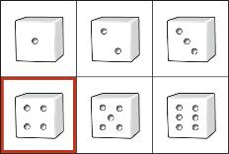
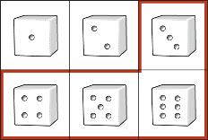
Using a “venn diagram”
What is Pr[rolling a four] = ?
What is Pr[rolling a number greater than two] = ?

Slide 7
Why do we study dice, coins & cards?
Dice are simple and familiar, and so it’s easier to think about the structure of probability in this context.
The same issues, structure and properties that we see with
rolling dice
flipping coins
drawing cards
are also present in important (non-gambling) applications:
Medical informatics: mutations and health issues
Astronomy: distance, age and collision prediction
Engineering: fatigue, deterioration and risks

Slide 8
Mutual exclusivity
Two events are called “mutually exclusive” if they cannot both occur at the same time.
For example: A six-sided die cannot roll two different numbers simultaneously. Rolling a two and rolling a three are mutually exclusive events.
Non-example: A six-sided die can roll an even number AND a multiple of three at the same time. These two events are NOT mutually exclusive.
Events “A” and “B” are mutually exclusive if Pr[A and B] = 0
(the probability that both events occur at once is zero.)

Slide 9
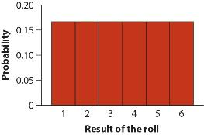
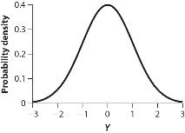
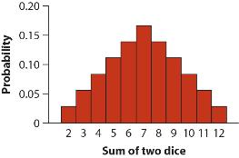
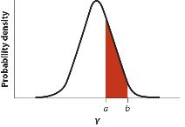
Discrete vs. continuous distributions
Discrete Probability Distribution
Continuous Probability Distribution

Slide 10
Discrete vs. continuous distributions
Discrete Probability Distribution
In a discrete probability distribution, the variable is either discrete numeric or categorical.
Each rectangle has an area that is proportional to the probability of each discrete event occurring.
Continuous Probability Distribution
In a continuous distribution, the explanatory variable is continuous numeric.
The probability of any particular value occurring is zero. [Imagine the probability of hitting a specific point on a dartboard.]
Because of this, probabilities are measured for ranges of values. [regions on a dartboard)

Slide 11
PROBABILITIES OF COMBINED EVENTS
“AND”, “OR”, and “NOT” IN PROBABILITY

Slide 12
THE “OR” COMBINATION OF EVENTS
When two events are mutually exclusive,
the probability of “event A OR event B” is itself a new event;
And its probability is the sum of the probabilities of each event
Pr[A or B] = Pr[A] + Pr[B]
What is the probability of a random individual having “Type O” blood?
“having Type O+” OR “having type O-”
First, are these two events mutually exclusive?

Slide 13
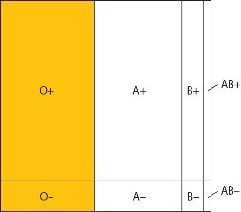
Example of an “OR” event
A person cannot have two different types of blood – so the two events, “having Type O-” OR “having Type O+” are mutually exclusive.
So, Pr[type O]
= Pr[Type O-] + Pr[Type O+]

Slide 14
“NOT” – the opposite of an event
Probability of an event NOT occurring is whatever is left out of 100%.
Symbolically:
Pr[not A] = 1 – Pr[A]
Probabilities may be written as proportions instead of percentages… and 100% = 1.00

Slide 15
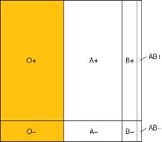
“OR” for non-mutually exclusive events
What happens if two events are NOT mutually exclusive, but we still want to know the probability of getting one event OR the other event?
We still add the probabilities of each event together…
But we might be counting some outcomes TWICE! (because some outcomes belong to BOTH events)
A: having positive blood B: Having type O blood
type
Who is being double-counted here?

Slide 16
The general addition property
We have 2 ways to calculate the probability of “event A” OR “event B”
Depending on whether there is overlap between the events (outcomes common to both events).
Mutually Exclusive:
Pr[A or B] = Pr[A] + Pr[B]
Not Mutually Exclusive:
Pr[A or B] = Pr[A] + Pr[B] – Pr[A and B]

Slide 17
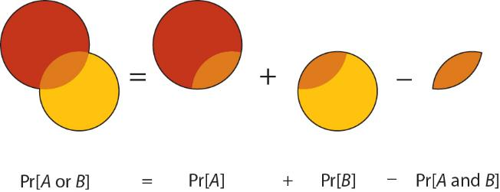
Just remember the one
You don’t need to learn both properties, just this one.
WHY NOT?

Slide 18
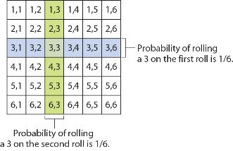
Independence and multiplication
Two events are “independent” if the chance of one event occurring does not affect the chances of the other event occurring.
Example: Rolling a die twice. The odds of rolling a three on a six-sided die do not change if you roll the die more than once.

Slide 19
The multiplication TEST
Two events A and B are independent if and only if
Pr[A and B] = Pr[A] x Pr[B]
For our dice example:
1/36=Pr[(first roll is a 3) and (second roll is a 3)] =
Pr[first roll is a 3] x Pr[second roll is a 3]=1/6*1/6

Slide 20
Non-example of independence
Drawing a card with a certain denomination from a deck of playing cards without replacement.
The odds of drawing a three are not the same on the second attempt.
The odds depend on what happened the first attempt.
Calculate the "conditional" probabilities.
Is getting a 3 on the first card independent of getting a 3 on the 2nd card?
Use the multiplication test to show "no".

