Slide 1
MAT 1372 Biostatistics

Slide 2
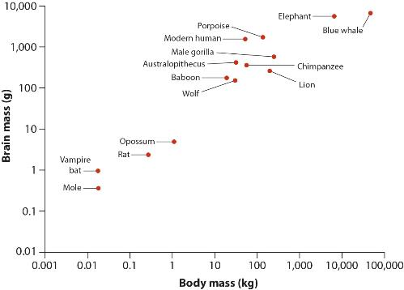
Linear Correlation
The linear correlation coefficient measures the tendency of two numerical variables (call them X and Y) to co-vary – that is to change together along a line.

Slide 3
Correlation Coefficient
The correlation coefficient measures the strength and direction of the association between two numerical variables.
X and Y must have
the same length.
Values from X are paired
with values of Y.
In this case, each pair
of values corresponds
to the body & brain masses
of a particular animal.
Note the log-log scale

Slide 4
Computing correlation coefficient
In order to compute an estimate for the correlation coefficient, we must first compute the average for both X and Y.
Then our estimate for the correlation coefficient is:
The numerator is the sum of products, measuring how X and Y vary together.
The denominator is the product (of the square roots) of the sums of squares for each of X and Y separately. (Similar to standard deviation)
When doing exercises for this section, it is important to use the definition rather than the built in function. It is suggested that you try them using both Excel and R.

Slide 5
Possible values
The potential values for “r” range from -1 to +1.
The strongest correlations are -1 and +1. These values indicate that our data is exactly linear, and are very, very unlikely to occur naturally.
Correlations close to zero indicate that our data is not at all linearly correlated. This means that our data is all over the place, or that we have a correlation that is simply nonlinear.

Slide 6
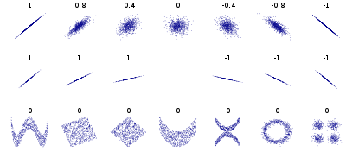
More Examples

Slide 7
R code with an example
This data pairs the number of visits by non-parent seabirds with the birds’ future likelihood to engage in aggressive behavior.
Enter this data into two lists in R: “numvisits” and “futureaggro”
(These lists must end up being the same size!)
Compute the average for each list: “avgvisits” and “avgaggro”
Compute the sums:
sumproduct = sum( (numvisits-avgvisits)(futureaggro-avgaggro) )
ssvisits = sum( (numvisits-avgvisits)^2 )
ssaggro = sum( (futureaggro-avgaggro)^2 )
r = sumproduct / ( sqrt(ssvisits)*sqrt(ssaggro) )
cor( numvisits, futureaggro) #this is the built-in
With both commands, we should end up with r = 0.534…

Slide 8
Standard error
As with all sample statistics, there is a standard error for our approximation of the correlation coefficient.
Remember that “n” is the number of pairs that we’re working with.
We then convert our r and our SE into another context that is normally distributed, compute the confidence interval and then convert back.

Slide 9
Fisher’s z-transformation
Our first step is to convert our r statistic via “Fisher’s z-transformation”:
Not to be confused with the “Z”-score, Fisher’s “z” is lower-case.
We’ll also need the standard error for the sampling distribution of z:

Slide 10
Fisher’s z-transformation Example
Our first step is to convert our r statistic via “Fisher’s z-transformation”:
Not to be confused with the “Z”-score, Fisher’s “z” is lower-case.
We’ll also need the standard error for the sampling distribution of z:

Slide 11
Confidence interval for z
Because “z” is normally distributed (and “r” was not), we then use basic facts about the normal distribution to build a confidence interval.
And then convert our results back into a correlation coefficient:

Slide 12
Confidence interval for z example
For our example, here is what we get:
And converting our results back into a correlation coefficient:

