Slide 1
MAT 1372 statistics w/ probability

Slide 2
Day 3 summary-reminder: Measures of central location
In the last session, we studied 3 measures of central location:
Mean (or average)
Median (half-way point)
Mode (observation(s) that occur(s) most frequently)

Slide 3
Reminders from session 3 (cont.)
mean or average is the most common measure of central location:
Sum of all observations divided by #observations.
Sensitive to (heavily influenced) by outliers, skewing.
median is middle measurement(s) when observations are put in numerical order. When #observations is
ODD: middle observation.
EVEN: average the TWO “middle” measurements.
Better choice for highly skewed data sets such as income distribution.
The mode is the set of observations that occur most frequently.
If observations aregrouped, then mode is location(s) of peak(s) in distribution (sometimes we want just highest, sometimes we want the set of all peaks).

Slide 4
Day 4: Measures of spread
In this session, we study measures of spread:
Range = max - min (also provided as an interval)
Inter-quartile range IQR = Q3 - Q1 (3rd quartile − 1st quartile)
Variance = sum of squares of deviations from mean
Standard deviation = sqrt(variance)

Slide 5
Range = max − min
Sometimes provided as an interval, i.e., "(min, max)"
The range is a crude measure of spread.
Only for uniform distribution (where each observation is equally likely) does it tell whole story.
If the observations are integers:
Range = max - min + 1
Example: if ages at birthday party are 3 to 7, range is 7 – 3 + 1 = 5.
(There may be 3, 4, 5, 6 & 7 year old's present: five categories.)

Slide 6
quartiles
Median = “middle” number in a sorted list of values,
The lower quartile Q1 and upper quartile Q3 are the the middles of the two halves of data on either side of the median.
Example: 1, 2, 3, 4, 5, 6, 7, 8, 9 (the median is in red.)
What is Q1, the median of the “bottom half”?
What about Q3, the median of the “top half”?
In R, Quartiles for the mpg of mtcars can be gotten using summary(mtcars$mpg):
quantile(mtcars$mpg) will give a 5# summary without the mean:
0% 25% 50% 75% 100%
10.400 15.425 19.200 22.800 33.900
Exercise: On a # line, plot points using the values of the 5# summary and then make a box plot above the # line.
Min. | 1st Qu. | Median | Mean | 3rd Qu. | Max.
10.4 | 15.43 | 19.2 | 20.09 | 22.8 | 33.9

Slide 7
Interquartile range
The “interquartile range” (IQR) is the span from the first quartile to the third quartile. This measures the range for the “middle 50%” of the data.
Measurements that are 1.5 × IQR ABOVE the third quartile, OR 1.5 × IQR BELOW the first quartile are considered to be “outliers”.
What’s the IQR for the mpg data?
Are there any outliers for the mpg data?
To find IQR, subtract Q1 from Q3:
quartiles[4]-quartiles[2]
Or use the built-in function:
IQR(mtcars$mpg)

Slide 8
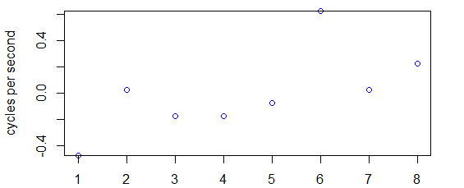
Standard Deviation
The standard deviation is the
most commonly used measure of the ‘spread’ of a sample’s distribution.
Measures how far "on average" individual observations are from the mean.
Deviation of a data value x is its distance from the mean
What does our list of deviations look like?
deviations = Variable - mean(Variable)
When we subtract a number from a list, R interprets that as
“subtract this value from EVERY item in the list” (USEFUL!)
Let's go back to the snake data set; here is list of individual “deviations”:
SRR = c(0.9, 1.4, 1.2, 1.2, 1.3, 2.0, 1.4, 1.6); ave=mean(SRR)
deviations = SRR - mean(SRR); deviations
-0.475 0.025 -0.175 -0.175 -0.075 0.625 0.025 0.225

Slide 9
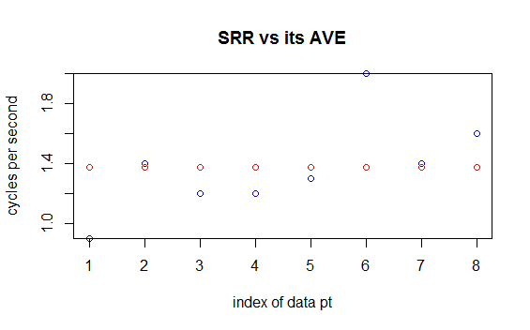
A closer look at data and deviations
The deviations are essentially a translation of our data so that is around the x-axis. Here is the snake data plotted together with average:

Slide 10
What do we do with these deviations?
Well, we have an issue here:
Some values are negative and some are positive!
We want distance which is always measured positively.
Exercise: Find sum of individual deviations sum(deviations). Is it really 0?

Slide 11
What do we do with these deviations?
One approach would be to take the abs and then find its mean:
mean(abs(deviations))
This is a valid measure of spread, but rarely used.

Slide 12
Calculating the variance
We instead combine the deviations in the following way:
Square each (making them positive) and then sum
Unfortunately the calculation separates in 2.
For population data: divide by n (size of population)
variance = mean((Variable - mean(Variable))^2)
For sample data: divide by n − 1 (size of sample minus 1)
variance = sum((Variable - mean(Variable))^2)/ ( length(Variable) - 1 )
[As a justification for this split, a sample has more uncertainty and we do not want to minimize the spread, so we make it slightly bigger]

Slide 13
Calculating the STD DEV
The variance should be looked at as a stepping stone.
Our main measure of spread is:
STD DEV = $\sqrt{variance}$ [in R: stddev = sqrt(variance)]
This brings back our original unit of measure.
Informally think of STD DEV as average "distance" of data point from mean.
In actuality, it is slightly larger than the average distance for 2 reasons:
The sample variance is $\frac{n}{n−1}$ times an average. For a data set of size 51,
this is a boost of 2%, which means a 1% boost for std dev.
Taking square root of a sum of squares weights larger deviations more.
For example, if deviations are 6 and 8. Then average deviation is 7.
However, $\sqrt{\frac{6^{2}+8^{2}}{2}}=\sqrt{\frac{100}{2}}=5\sqrt{2}≈7.07$ which is another 1% boost.

Slide 14
Of course there are built-in functions
var(Variable)
sd(Variable)

Slide 15
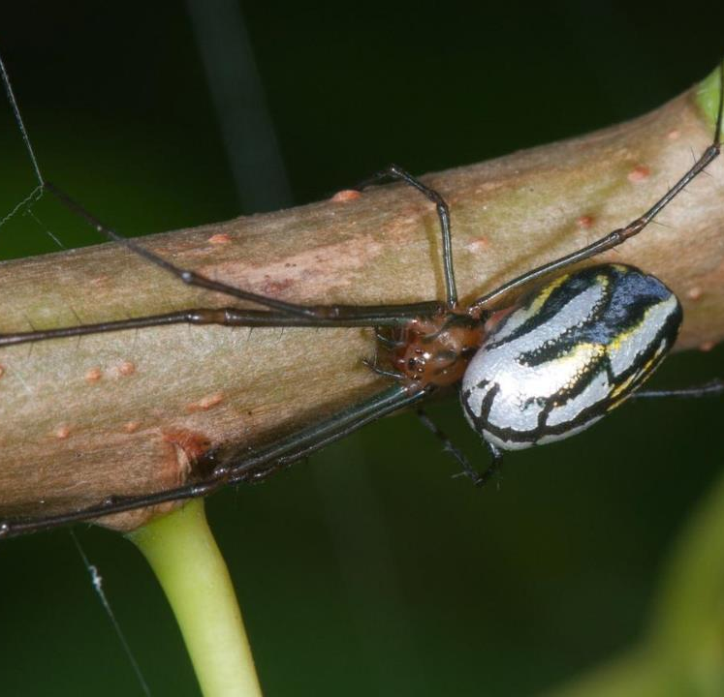
You did what now?
A study in spider mating habits

Slide 16
Tidarren Spiders
Male tidarren spiders
are, on average, 100x smaller than females;
have disproportionately large sexual organs (pedipalps), constituting roughly 10% of their body mass.
just before reaching sexual maturity voluntarily amputate one of their two pedipalps.
Scientists hypothesized that the males do this in order to improve their speed – in order to improve their hunt for a mate.
Testing this theory, they studied the running speed of male tidarren spiders prior to amputation and then again after.

Slide 17
Male spider speed data
Prior to amputation:
1.25, 2.94, 2.38, 3.09, 3.41, 3.00, 2.31, 2.93,
2.98, 3.55, 2.84, 1.64, 3.22, 2.87, 2.37, 1.91
And after:
2.40, 3.50, 4.49, 3.17, 5.26, 3.22, 2.32, 3.31,
3.70, 4.70, 4.94, 5.06, 3.22, 3.52, 5.45, 3.40
Save each of these sets to variables in R.
Calculate the quartile data for both sets of measurements.
What’s the IQR for each?
Do this for the other measures of spread using the definitions rather than the built-in functions.

Slide 18
Constructing a Data Frame in R
We often need to deal with data sets that are more complex than just a single list of observed measurements.
In R, we call these constructions data frames:
NewVariable = data.frame(ListOne, ListTwo, … )
ListOne and ListTwo become columns in the new data frame that we created and named NewVariable.
Use the male spider data to create a data frame.
Use your newly created data frame to create:
A box plot : boxplot(…)
A scatterplot: plot(…)
Use xlab, ylab, and main to give this last graph appropriate labels.

Slide 19
Customization of graph
Sometimes, the automatic values for the x-axis or y-axis are NOT what we want. We can adjust them by adding a few extra parameters:
xlim = c(min, max)
ylim = c(min, max)
Use the spider speed data to generate a scatter plot, but this time specify that scale on BOTH x and y-axis ranges from 0 to 6: c(0,6)
To add a sub-heading use: sub="subtitle"
To change main title to red, subheading to blue & axis labels to green:
col.main="red", col.sub="blue", col.lab="green"
Complete code is available on openlab.
See the plots on the next slide for results.

Slide 20
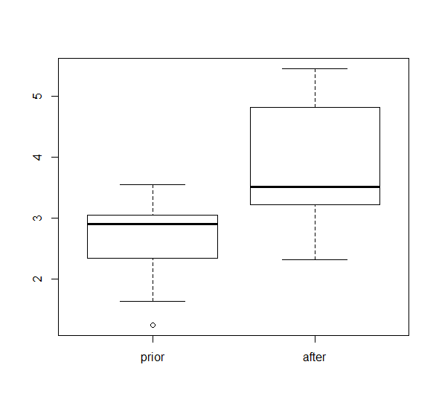
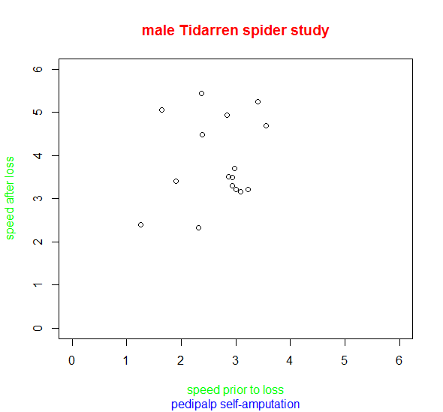

Slide 21
Exercise 3.5.11 (a,b,c): translation
(a) 1, 2, 3, 4, 5
(b) 6, 7, 8, 9, 10
(c) 11, 12, 13, 14, 15
Compute sample variance and standard deviation of data sets.
Each data set is symmetric so mean is the respective middle value.
If we take middle value away, then half the time, we are 1 unit from the mean and half the time 2 units from mean, so s should = ~1.5.
Doing the calculations, we get s = 1.58 for each data set
(typically s is slightly bigger than average distance to mean)
Conclusion s (and s²) are invariant under translation, i.e.,
if we change a data set by adding or subtracting the same thing from each data value, s (and s²) stays the same.

Slide 22
Exercise 3.5.11 (d,e): translation and scaling
(a) 1, 2, 3, 4, 5
(d) 2, 4, 6, 8, 10
(e) 10, 20, 30, 40, 50
Compute sample variance and standard deviation of data sets.
Each data set is symmetric so mean is the respective middle value.
In (d), if we take middle value away, then half the time, we are 2 units from the mean and half the time 4 units from mean, so s = ~3.
Doing the calculations for (d), we get s = 3.16.
In (e), if we take middle value away, then half the time, we are 10 units from the mean and half the time 20 units from mean, so s = ~15.
Doing the calculations for (e), we get s = 15.8.
Conclusion: if we change a data set by scaling, s is scaled in the same.
How is s² affected by scaling?

Slide 23
3.5.17 acidity of 40 successive rainfalls
The acidity is measured on a pH scale: 1 (very acidic) to 7 (neutral).
3.71, 4.23, 4.16, 2.98, 3.23, 4.67, 3.99, 5.04, 4.55, 3.24, 2.80, 3.44,
3.27, 2.66, 2.95, 4.70, 5.12, 3.77, 3.12, 2.38, 4.57, 3.88, 2.97, 3.70, 2.53, 2.67,
4.12, 4.80, 3.55, 3.86, 2.51, 3.33, 3.85, 2.35, 3.12, 4.39, 5.09, 3.38, 2.73, 3.07
Find
(a) s, sample standard deviation
(b) r, range (max – min)
(c) iqr, interquartile range (Q3 – Q1)
(d) Box plot
Create a grouped frequency table and a histogram.
Analyze the distribution.

Slide 24
3.5.17 acidity of 40 successive rainfalls
The acidity is measured on a pH scale: 1 (very acidic) to 7 (neutral).
3.71, 4.23, 4.16, 2.98, 3.23, 4.67, 3.99, 5.04, 4.55, 3.24, 2.80, 3.44,
3.27, 2.66, 2.95, 4.70, 5.12, 3.77, 3.12, 2.38, 4.57, 3.88, 2.97, 3.70, 2.53, 2.67,
4.12, 4.80, 3.55, 3.86, 2.51, 3.33, 3.85, 2.35, 3.12, 4.39, 5.09, 3.38, 2.73, 3.07
Find
(a) s: sample standard deviation = 0.8
(b) R: range (max – min) = 2.8
(c) IQR: interquartile range (Q3 – Q1) =1.2
(d) Box plot
Create a grouped frequency table
and a histogram. Analyze the distribution
Since mean > median, skewed to right

Slide 25
Exercise 2.5.16 (example with frequency table)
Find sample standard deviation of data set given by frequency table:
Val Freq
3 1
4 2
3
6 2
Do this in both Excel and R (create 2 vectors and use basic operations). Answers are:
Mean = 1.07
s = 1.04
Now put result in words using informal words such as average and distance.

Slide 26
3.6 Normal Data Sets & the Empirical Rule
Many of the large data sets one encounters in practice have histograms with the following properties:
symmetric about their point of highest frequency
decrease on both sides of this point in a bell-shaped fashion.
Such data sets are said to be normal.

Slide 30
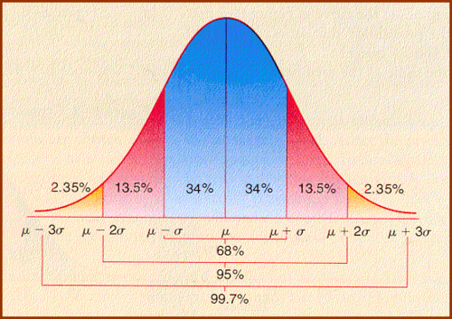

Slide 31
Acid rain revisited
Recall the data set from 3.5.17
(a) Is this normal?
No! Appears uniform or triangular.
(b) Pretend that the answer to (a) is yes & give an interval that you would expect to contain approximately 95 percent of the data observations.
Mean is 3.6 and s is 0.8, so interval is [3.6-2*0.8, 3.6+2*0.8]=[2.0, 5.2]
(c) What percentage of the data lies in the interval given in part (g)?
100% There are no tails to cut off!

