Slide 1
Mat 1372 statistics with probability
Lesson 02 – Displaying Data

Slide 2
Frequency Distribution
The ’frequency distribution’ of a variable is the number of observations having that particular measurement.
First step is to create a table;
Second step is to display in graphic form.
Bar graphs for categorical or where just a few possibilities
e.g. where do students live (by borough or outside city)?
Histograms for numerical where each category is range
e.g. heights of students in class

Slide 3
Bar Graphs vs. Histograms
Bar graphs
histograms
Bar graphs are used to display frequencies of categorical variables.
Individual bars are separated from each other by whitespace.
Histograms are used to display frequencies of numerical variables.
There is no space between the bars in a histogram.

Slide 4
“Relative frequency”
The ’relative frequency’ refers to the portion of observations having a given measurement usually written as decimal or percentage.
Converting a frequency distribution into a relative frequency distribution means dividing count for each category by #observations.
Graphical display tool of choice is often the pie chart.

Slide 5
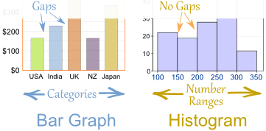
Side by side comparison

Slide 6
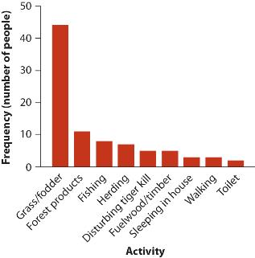
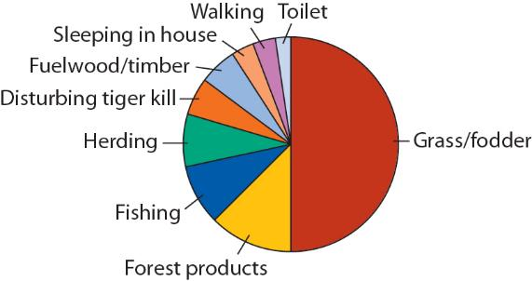
Pie Charts
Pie charts are used to represent the relative frequency
. The most common observed value usually stands out quite easily
May be be difficult to compare relative frequencies for other values.

Slide 7
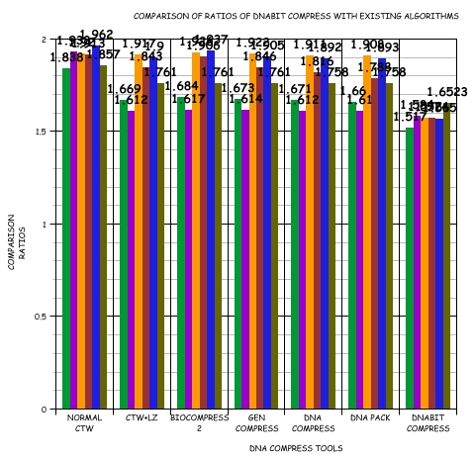
Best practices for Bar graphs and histograms
Don’t let this happen to you.

Slide 8
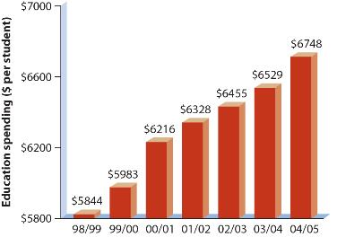
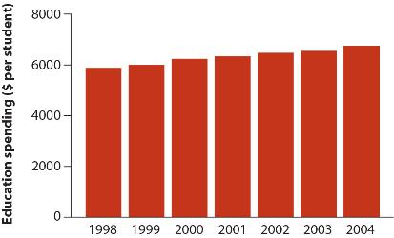
Represent magnitudes honestly
It is generally wise to start your vertical axis from ZERO
to ensure that areas are proportional to magnitude of each measurement.

Slide 9
Choose appropriate interval sizes
Each of the following graphs are visualizations of the exact same data.
What are the advantages and/or disadvantages of each?

Slide 10
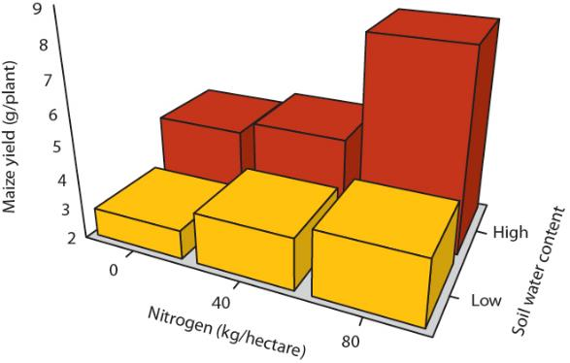
Avoid unnecessary 3d effects
How do these measurements compare to each other?
3D effects can obscure the data we’re trying to represent.

Slide 11
Visualizing the connection between multiple variables

Slide 12
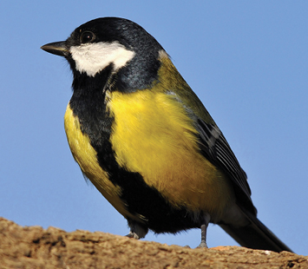
Connecting categorical variables

Slide 13
Reproduction and malaria in birds
Is reproduction hazardous to health?
Scientists wondered why some birds seemed to limit their number of offspring. They theorized that it may be potentially hazardous to produce multiple offspring. Oppliger et al. (1996) investigated the impact of reproductive effort on the susceptibility to malaria in the breeding of parus major.
65 nesting females were divided into two groups. One group of 30 females had two eggs stolen from their nests, causing them to lay an additional egg. The remaining 35 were left alone, forming the control group.
14 days after hatching their eggs, each bird had a blood sample taken and tested for avian malaria.

Slide 14
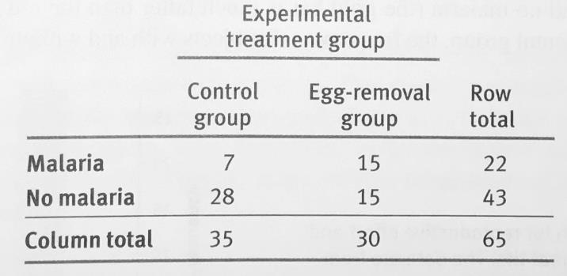
Contingency table
When attempting to display the relationship between explanatory and response variables, while also comparing experimental and control groups, you may want to use a contingency table.

Slide 15
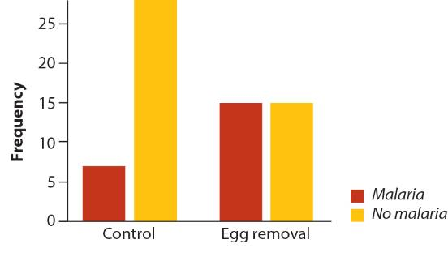
Grouped Bar Graph
This is essentially the usual bar graph, displaying frequency data with some additional grouping. Bars are grouped by the explanatory variable, while the response variables are ‘grouped’ by color.
Notes:
Is this better than a contingency table?
What is gained? Lost?

Slide 16
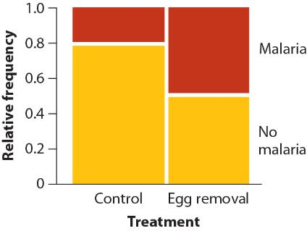
Mosaic plot
A mosaic plot again uses the bar graph format, this time replacing absolute frequency data with relative frequency. The other major change is that the response variable bars are stacked vertically.
Notes:
Why is relative frequency used here?
What information is gained? lost?

Slide 17
Connecting numerical variables

Slide 18
Inherited attractiveness in fish
Do fish inherit ‘attractiveness’ from their fathers?
A laboratory study by Brooks (2000) studied the ‘attractive’ traits in guppies and measured how these traits are passed to offspring.
The attractiveness of sons
(a score representing the rate of visits by females)
was compared with their fathers’ ornamentation
(a composite index of several aspects of male color and brightness).
The father’s ornamentation is taken as the explanatory variable – with the son’s attractiveness rating as the response variable.
What would the raw data look like?

Slide 19
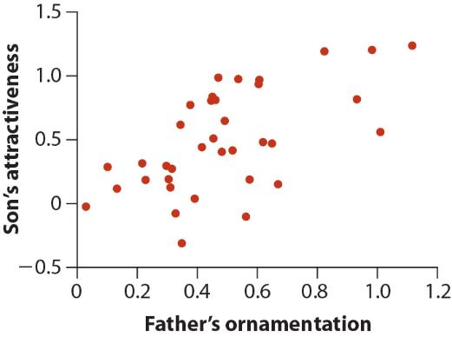
Scatter plot
a visual comparison of two numerical variables
observation is represented as a point on a graph with two axes.

Slide 20
Connecting mixed variables

Slide 21
Blood responses to high elevation
The amount of oxygen in each breath at high altitude can be as low as one-third that obtained at sea level. Do indigenous populations living at high altitudes have physiological attributes to compensate for this difference?
A reasonable expectation is that they should have more hemoglobin, the molecule that binds and transports oxygen in the blood.
Beall et al. (2002) tested this theory by sampling blood from males in three high-altitude human populations: the Andes, Ethiopia, and Tibet, along with a sea-level population from the USA to serve as a control.

Slide 22
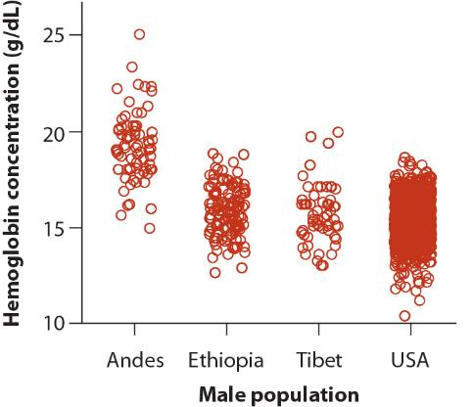
Strip Chart
A strip chart is similar to a scatter plot.
One of variables is categorical & pnts are clustered together in ‘strips’.
With large quantities of data, weoften spread the points out a little bit, so that they can be distinguished.
Notes:
What can we tell from this graph?
What kind of data might be best/worst for this kind of chart?

Slide 23
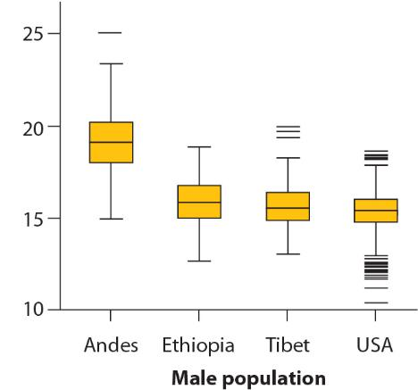
Box plot
Also known as ‘box and whisker’
uses lines and rectangles to display
median
quartiles
range
extreme measurements (outliers)
Can you make a conclusion?
Notes:
What do we gain/lose with this kind of chart?

Slide 24
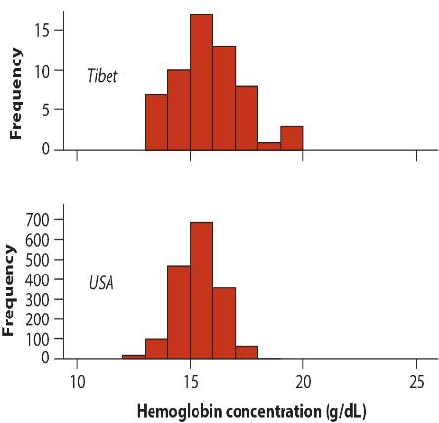
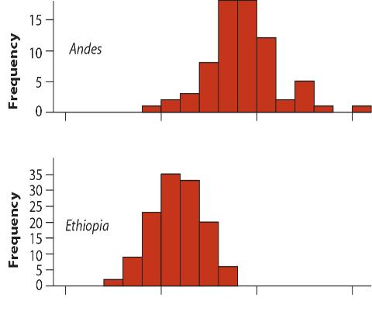
Multiple histograms

Slide 25
Showing trends in time and space

Slide 26
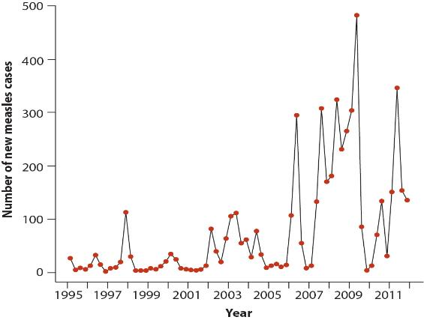
Line Graph
May be used in place of a bar graph for numerical data.
If the measurements represent values of the variable at points in time, then the graph is a time series.

Slide 27
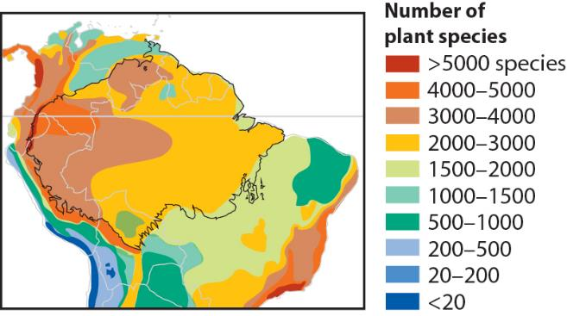
Heat map
A heat map uses swaths of color on a map to indicate regions of similar measurement.

Slide 28
Let’s make some graphs!

Slide 29
Using R to create Frequency tables
We use the ‘mtcars’ data set.
Use the “<-” or “->” to save a data set to a new variable
Use the “$” sign to refer to subsets of data within a larger collection
“mtcars$gear” refers to only the “gear” data within the “mtcars” set
Combining these two, we can use a command like:
gearfreq <- table(mtcars$gear)
to create a basic frequency table for each number of gears.
* Repeat this for other categories in mtcars: “cyl”, “vs”, “am”, and “carb”

Slide 30
Turn Frequency tables into graphs
Use the “barplot” command to create the following bar graphs.
Compare the results of the following commands:
barplot(gearfreq)
barplot(gearfreq, main="Title")
barplot(gearfreq, xlab="Horizontal Axis")
barplot(gearfreq, main="Car Distribution", xlab="Number of Gears")
barplot(gearfreq, horiz=TRUE)
Repeat this for different categories of data: “cyl”, “vs”, “am”, and “carb”
Change the text for the title and x-axis in each to something appropriate.

Slide 31
Creating complex frequency tables
You can also create frequency tables for multiple variables with the “table” command.
It will be best to use a true/false variable for comparison with “gear”
Here, I choose to use the “vs” variable.
vsgearfreq <- table(mtcars$vs, mtcars$gear)

Slide 32
Turning into bar graphs
And creating a bar graph with this comparison frequency data is also accomplished with the “barplot” command.
I’ve split up this command for visual effect, you’ll type it all in on one line.
barplot(vsgearfreq,
main="Main Title",
xlab="Horizontal Axis Label",
col=c("darkblue","red"),
legend=rownames(vsgearfreq),
beside=TRUE
)
the names of various colors are available here:
http://www.stat.columbia.edu/~tzheng/files/Rcolor.pdf

Slide 33
Box plots
We can also create box-and-whisker plots easily.
In this example, we’ll compare miles per gallon between cars with the same number of cylinders.
boxplot(mpg~cyl,
data=mtcars,
main="Car Mileage Data",
xlab="Number of Cylinders",
ylab="Miles Per Gallon"
)
* Repeat, comparing “mpg” to “gears”, “am”, “vs” and “carb”

