Slide 1
Mat 1372 statistics with probabiility

Slide 2
Important terminology
You’ll probably want to copy these down!

Slide 3
“population”
A “population” is the entire group we are interested in measuring, studying, or saying something about.
This could be:
* All residents of New York City between 18-24 years of age;
* All patients with a specific form of cancer;
* All trees in Yellowstone National Park;
* All fish in the Hudson Bay

Slide 4
“Sample”
A ‘sample’ is a subset of the population that is measured for the purpose of finding out about the population itself.
Measuring an entire population is usually too cumbersome to manage.
As a result, we resort to measuring a smaller group within the population
Later, we use the measurements to say something about the population.
It is crucial to be very careful about selecting a sample, to ensure that it is a ‘representative’ sample to avoid bias.

Slide 5
“Parameter”
A ‘parameter’ is one (of possibly many) characteristic(s) that we are interested in measuring and/or estimating.
The word ‘parameter’ is used specifically to refer to the actual value of the characteristic across the entire population.
We use ‘samples’ to gather data in order to estimate these parameters.

Slide 6
“Sampling error”
‘Sampling error’ refers to the difference between the parameter (for the population) and the estimate (from our sample).
Unbiased samples are more likely to result in a lower sampling error.
Samples that are NOT representative of the population may result in a higher sampling error.
Exercise: pair up and come up with an example of a population, sample and parameter and be prepared to discuss possible bias. After 5 minutes, you will be asked to share with a neighboring pairing.

Slide 7
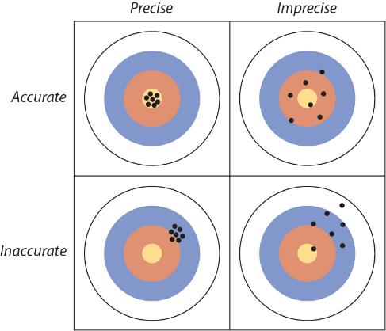
Precision vs. accuracy
Precision is determined by our methods for measuring parameters.
Precision is indicated by consistency of repeated measurements.
Accuracy is determined by the bias (or lack of bias) within our chosen sample.
How can we determine accuracy?

Slide 8
Sources of bias
Or “How to Screw Up When Using Statistics”

Slide 9
independence
Selection of an individual should not influence the selection of any other participant.
Example: When conducting interviews, you select a random participant – and they’re with a friend, who then also wishes to participate.
How might this impact our results?

Slide 10
Sample of convenience
This sort of bias occurs when a researcher chooses to gather data from a readily available source.
Example: In attempting to measure the cod population in the North Atlantic, researchers relied on the rates at which fish were caught by fishing boats.
However, fishermen went to locations where cod were still more plentiful (duh!), leading to overestimation of the cod population.

Slide 11
Volunteer bias
Measuring human populations may often require volunteers to participate.
There may be systematic differences in the “volunteer population” as compared to the entire population we seek to estimate.
Volunteers may be:
Be more proactive;
Be lower-income (especially if participation is compensated);
more desperate for treatment;
have more time on their hands;
more opinionated.

Slide 12
Variables and data
What are we even measuring?

Slide 13
Variables
“Variables” are very closely associated to parameters.
‘Variables’ refer to the individual characteristics themselves – whereas ‘parameters’ refer to the actual VALUES for those variables.
Variables can be ‘categorical’ or ‘numerical’

Slide 14
Categorical Variables
“Categorical Variables” are not readily quantified.
Examples:
* variables with a value of “yes” or “no”
* eye or hair color
* life stage (egg, larva, juvenile, subadult, adult)
* comparative pain scale (discomforting, distressing, unbearable)
“Ordinal” categorical variables have an implicit order.
“Nominal” categorical variables have no inherent order.

Slide 15
Numerical Variables
“Numerical Variables” are variables who’s measurements are described with numbers.
Examples:
* temperature
* height or weight
* number of cigarettes smoked per day (or per week)
“Discrete” numerical variables are integer-valued (1,2,3…)
“Continuous” numerical values are real-valued (15.71, 3.8)

Slide 16
Explanatory vs. response variables
Explanatory:
used as ‘predictors’ of values for other variables.
Example: “hours spent studying per week”
Response:
‘dependent’ on (or have their values affected by) the explanatory variable(s).
Example: GPA

Slide 17
Experimental vs. Observational Studies
Experimental
Observational
The researcher randomly assigns participants to experimental and control groups.
Preferred.
The researcher is not able to decide who receives treatment and who doesn’t.
Not always possible for ethics reasons.

