Slide 1
MAT 1372 Statistics with Probability
Ezra Halleck NYC College of Technology
Sections 3.5-3.6
Measures of spread or variability and empirical rule

Slide 2
3.5 Sample variance
Formula:
In words: sample variance is sum of the squares of the deviations divided by one fewer than the number of data points
Essentially: it is the average square of the deviation from the mean.

Slide 3
Example using frequency table
val | dev | freq | dev square | prod of dev square & freq
-1 | -1.2 | 3 | 1.44 | 4.32
0 | -.2 | 2 | .04 | .08
1 | .8 | 5 | .64 | 3.2
 |  | sum |  | 7.6
To get the sample variance s², we divide this sum by n-1=10-1=9 to get .84.

Slide 4
Sample standard deviation “s”
It is the square root of the sample variance.
Roughly the average distance (always nonnegative) from the mean.
For previous example, s = √.84 = .92
In conclusion, a data value is on average .9 units from the mean of .2.

Slide 5
Exercise 3.5.11: translation and scaling
(a) 1, 2, 3, 4, 5
(b) 6, 7, 8, 9, 10
(c) 11, 12, 13, 14, 15
(d) 2, 4, 6, 8, 10
(e) 10, 20, 30, 40, 50
Compute the sample variance and
standard deviation of the data sets.
Note that each data set is symmetric. Hence, mean is the middle value.
If we take the middle value away, then half the time, we are 1 unit from the mean (in the 1st 3 sets) and half the time 2 units from the mean, so s should be roughly 1.5, except that the middle value may lower it a bit.
It turns out that because of the squaring, we underestimate s. For the first 3 sets s = 1.58
s and s² are invariant under translation: if we change a data set by adding or subtracting the same thing from each data value, s and s² stay the same.
Last 2 data sets are scalings of the first set. How is s² and s affected by scaling?

Slide 6
3.5.17 acidity of 40 successive rainfalls
The acidity is measured on a pH scale: 1 (very acidic) to 7 (neutral).
3.71, 4.23, 4.16, 2.98, 3.23, 4.67, 3.99, 5.04, 4.55, 3.24, 2.80, 3.44,
3.27, 2.66, 2.95, 4.70, 5.12, 3.77, 3.12, 2.38, 4.57, 3.88, 2.97, 3.70, 2.53, 2.67,
4.12, 4.80, 3.55, 3.86, 2.51, 3.33, 3.85, 2.35, 3.12, 4.39, 5.09, 3.38, 2.73, 3.07
Find
(a) s, sample standard deviation
(b) r, range (max – min)
(c) iqr, interquartile range (Q3 – Q1)
(d) Box plot
Create a grouped frequency table and a histogram.
Analyze the distribution.

Slide 7
3.5.17 acidity of 40 successive rainfalls
The acidity is measured on a pH scale: 1 (very acidic) to 7 (neutral).
3.71, 4.23, 4.16, 2.98, 3.23, 4.67, 3.99, 5.04, 4.55, 3.24, 2.80, 3.44,
3.27, 2.66, 2.95, 4.70, 5.12, 3.77, 3.12, 2.38, 4.57, 3.88, 2.97, 3.70, 2.53, 2.67,
4.12, 4.80, 3.55, 3.86, 2.51, 3.33, 3.85, 2.35, 3.12, 4.39, 5.09, 3.38, 2.73, 3.07
Find
(a) s: sample standard deviation = 0.8
(b) R: range (max – min) = 2.8
(c) IQR: interquartile range (Q3 – Q1) =1.2
(d) Box plot
Create a grouped frequency table and a histogram.
Analyze the distribution
Since mean > median, skewed to right

Slide 8
Exercise 2.5.16 (example with frequency table)
Find sample standard deviation of data set given by frequency table:
Val Freq
3 1
4 2
3
6 2
Mean = 1.07
s = 1.04

Slide 9
3.6 Normal Data Sets & the Empirical Rule
Many of the large data sets one encounters in practice have histograms with the following properties:
symmetric about their point of highest frequency
decrease on both sides of this point in a bell-shaped fashion.
Such data sets are said to be normal.

Slide 13
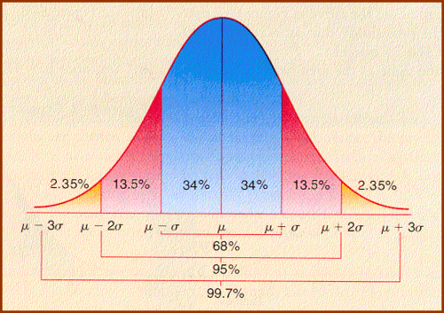

Slide 14
Acid rain revisited
Recall the data set from 3.5.17
(a) Do the data appear to be approximately normal?
No!
(b) Pretend that the answer to (a) is yes & give an interval that you would expect to contain approximately 95 percent of the data observations.
Mean is 3.6 and s is 0.8, so interval is [3.6-2*0.8, 3.6+2*0.8]=[2.0, 5.2]
(c) What percentage of the data lies in the interval given in part (g)?
100%
There are no tails to cut off!

