Slide 1
Chapter 4: Probability (Ross’s Introductory Statistics)
Sections 4.1 to 4.4
plus tree diagrams (not in Ross)
Homework:

Slide 2
Events will be denoted by the capital letters A, B, C, etc.
Some important definitions:
An experiment is any process that produces an observation or outcome.
The sample space is the set of all possible outcomes.
An event is a set of outcomes
(i.e., a subset of the sample space).

Slide 3
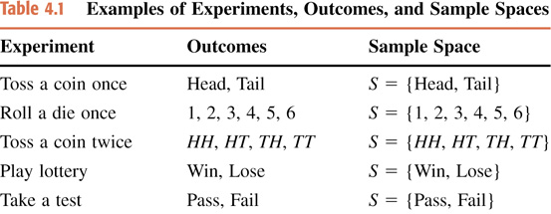

Slide 4
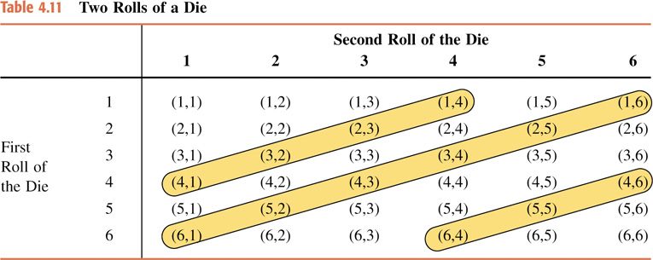
2 Rolls of a Die example: ▪ sample space (entire inside of table) ▪ event: sum is 5, 7 or 10 (circled in yellow)

Slide 5
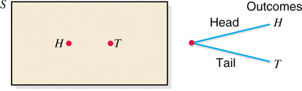
One toss of a coin Venn diagram tree diagram

Slide 6
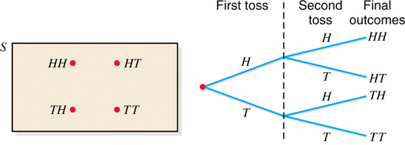
Two tosses of a coin Venn diagram tree diagram

Slide 7
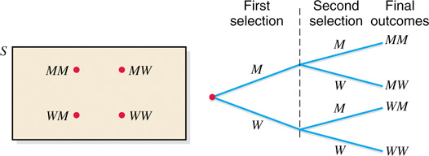
Selecting 2 adults from a pool of 2 men and 2 women and keeping track only of the genders Venn diagram tree diagram

Slide 8
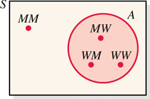
Venn diagram for
event A: At least one of selected is a woman.

Slide 9
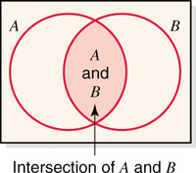
A ∩ B
Intersection of events A and B.

Slide 10
P is a probability function
if the following 4 properties hold:
0 ≤ P(A) ≤ 1 for any event A
P(S) = 1
For any disjoint (non intersecting) events A and B: P(A U B) = P(A) +P(B)
If A ⊆ B then P(A) ≤ P(B)

Slide 11
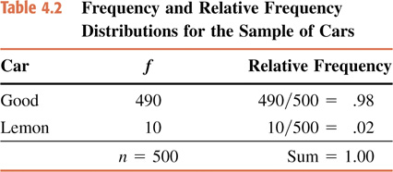
Data are used to guess underlying probabilities:
we predict approximately that
P(good car)= .98
P(lemon)= .02

Slide 12
Case Study danger of predictions based on small amount of data
Handedness of Presidents of the United States since 1989:
George H. W. Bush | 1989–1993 | Left-handed
Bill Clinton | 1993–2001 | Left-handed
George W. Bush | 2001–2009 | Right-handed
Barack Obama | 2009–present | Left-handed
3 out of the last 4 presidents were left-handed.
Is the chance of a new president being left handed 75%?
FYI: neither Hillary nor Donald are left-handed!
Source: wikipedia

Slide 13
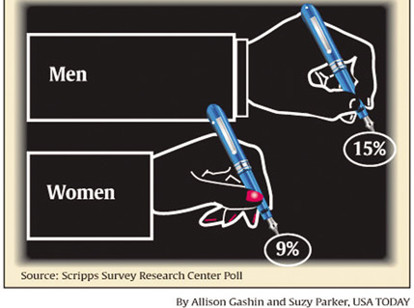
Case Study (cont.) danger of predictions based on small amount of data
Handedness of Presidents of the United States since 1929:
President | Term | Handedness
Herbert Hoover | 1929–1933 | Left-handed
Franklin D. Roosevelt | 1933–1945 | Right-handed
Harry S. Truman | 1945–1953 | Left-handed^{[4]}
Dwight D. Eisenhower | 1953–1961 | Right-handed
John F. Kennedy | 1961–1963 | Right-handed
Lyndon B. Johnson | 1963–1969 | Right-handed
Richard Nixon | 1969–1974 | Right-handed
Gerald Ford | 1974–1977 | Left-handed
Jimmy Carter | 1977–1981 | Right-handed
Ronald Reagan | 1981–1989 | Ambidextrous
George H. W. Bush | 1989–1993 | Left-handed
Bill Clinton | 1993–2001 | Left-handed
George W. Bush | 2001–2009 | Right-handed
Barack Obama | 2009–present | Left-handed
Go back further and we see chance is closer to that of general population.
Source: wikipedia

Slide 14
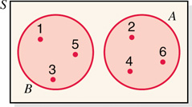
odd or even: disjoint (no intersection) events A and B.
Rolling a single die: disjoint example
P(A U B) = P(A) +P(B)
1 = 3/6 + 3/6

Slide 15
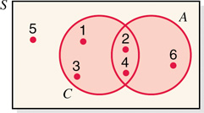
Intersecting (non disjoint) events A (even) and C (less than 5).
Rolling a single die: intersecting example
P(C U A) ? P(C) +P(A)
5/6 ≠ 4/6 + 3/6 = 7/6
Can you find a formula that works in this more general situation?

Slide 16
Intersecting (non disjoint) events A (even) and C (less than 5).
Rolling a single die: intersecting example
P(C U A) = P(C) +P(A) − P(C ∩ A)
5/6 = 4/6 + 3/6 − 2/6

Slide 17
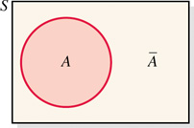
Note: complement can be indicated with a “c” superscript or with a “bar”.
Venn diagram of two complementary events
P(A^{c}) = 1 − P(A)

Slide 18
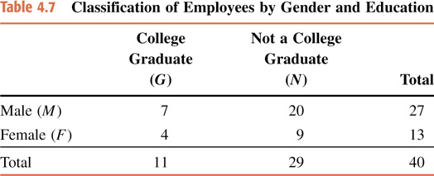

Slide 19
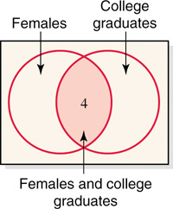
Intersection of events F and G.

Slide 20
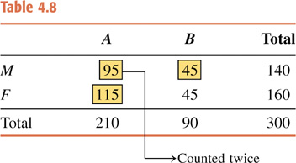
Given a random senior who attends a center, what is the chance that the senior is from center A or is male?
For 2 senior centers A and B, the gender makeup is:

Slide 21
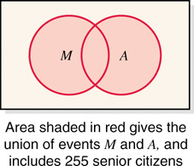

Slide 22
P(A U M) = (95+ 45 + 115) / 300 =255/300
We can answer this question 3 ways:
1. By direct counting

Slide 23
P(A U M) = P(A) +P(M) − P(A ∩ M)
= 140/300 + 210/300 − 95/300 = 255/300
We can answer this question 3 ways:
2. By using the equation with intersection

Slide 24
P(A U M) = 1 − P((B ∩ F)^{c}) = 1 − 45 / 300 = 255 / 300
We can answer this question 3 ways:
3. By using the complements

