Slide 1

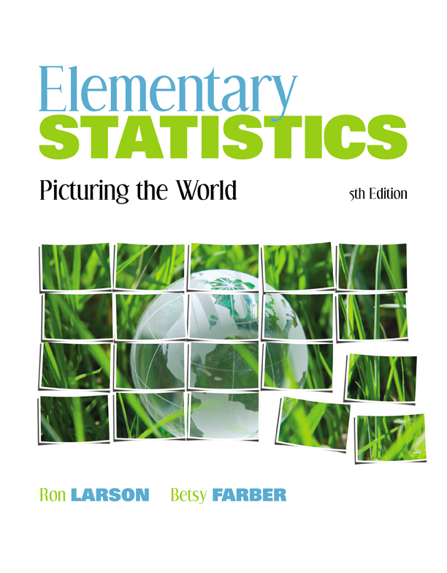

Chapter
4
Discrete Probability Distributions
© 2012 Pearson Education, Inc.
All rights reserved.
1 of 63

Slide 2
Chapter Outline
4.1 Probability Distributions
4.2 Binomial Distributions
© 2012 Pearson Education, Inc. All rights reserved.
2 of 63

Slide 3
Section 4.1
Probability Distributions
© 2012 Pearson Education, Inc. All rights reserved.
3 of 63

Slide 4
Section 4.1 Objectives
Distinguish between discrete random variables and continuous random variables
Construct a discrete probability distribution and its graph
Determine if a distribution is a probability distribution
Find the mean, variance, and standard deviation of a discrete probability distribution
Find the expected value of a discrete probability distribution
© 2012 Pearson Education, Inc. All rights reserved.
4 of 63

Slide 5
Random Variables
Random Variable
Represents a numerical value associated with each outcome of a probability distribution.
Denoted by x
Examples
  x = Number of sales calls a salesperson makes in one day.
  x = Hours spent on sales calls in one day.
© 2012 Pearson Education, Inc. All rights reserved.
5 of 63

Slide 6
Random Variables
Discrete Random Variable
Has a finite or countable number of possible outcomes that can be listed.
Example
  x = Number of sales calls a salesperson makes in one day.
x
0
1
2
3
4
5
© 2012 Pearson Education, Inc. All rights reserved.
6 of 63

Slide 7
Random Variables
Continuous Random Variable
Has an uncountable number of possible outcomes, represented by an interval on the number line.
Example
  x = Hours spent on sales calls in one day.
x
0
1
2
3
…
24
© 2012 Pearson Education, Inc. All rights reserved.
7 of 63

Slide 8
Example: Random Variables
Decide whether the random variable x is discrete or continuous.
xx = The number of Fortune 500 companies that lost money in the previous year.
Solution:
Discrete random variable (The number of companies that lost money in the previous year can be counted.)
{0, 1, 2, 3, …, 500}
© 2012 Pearson Education, Inc. All rights reserved.
8 of 63

Slide 9
Example: Random Variables
Decide whether the random variable x is discrete or continuous.
xx = The volume of gasoline in a 21-gallon tank.
Solution:
Continuous random variable (The amount of gasoline in the tank can be any volume between 0 gallons and 21 gallons.)
© 2012 Pearson Education, Inc. All rights reserved.
9 of 63

Slide 10
Discrete Probability Distributions
Discrete probability distribution
Lists each possible value the random variable can assume, together with its probability.
Must satisfy the following conditions:
In Words In Symbols
The probability of each value of the discrete random variable is between 0 and 1, inclusive.
The sum of all the probabilities is 1.
0 ≤ P (x) ≤ 1
ΣP (x) = 1
© 2012 Pearson Education, Inc. All rights reserved.
10 of 63

Slide 11
Constructing a Discrete Probability Distribution given data
Let x be a discrete random variable with possible outcomes x₁, x₂, … , x_{n}.
Make a frequency distribution using the data (observed outcomes).
Find the sum of the frequencies.
Find the probability of each possible outcome by dividing its frequency by the sum of the frequencies.
Check that each probability is between 0 and 1, inclusive, and that the sum of all probabilities is 1.
© 2012 Pearson Education, Inc. All rights reserved.
11 of 63

Slide 12
Example: Constructing a Discrete Probability Distribution
An industrial psychologist administered a personality inventory test for passive-aggressive traits to 150 employees. Individuals were given a score from 1 to 5, where 1 was extremely passive and 5 extremely
aggressive. A score of 3 indicated neither trait. Construct a probability distribution for the random variable x. Then graph the distribution using a histogram.
Score, x | Frequency, f
1 | 24
2 | 33
3 | 42
4 | 30
5 | 21
© 2012 Pearson Education, Inc. All rights reserved.
12 of 63

Slide 13
Solution: Constructing a Discrete Probability Distribution
Divide the frequency of each score by the total number of individuals in the study to find the probability for each value of the random variable.
Discrete probability distribution:
x | 1 | 2 | 3 | 4 | 5
P(x) | 0.16 | 0.22 | 0.28 | 0.20 | 0.14
© 2012 Pearson Education, Inc. All rights reserved.
13 of 63

Slide 14
Solution: Constructing a Discrete Probability Distribution
x | 1 | 2 | 3 | 4 | 5
P(x) | 0.16 | 0.22 | 0.28 | 0.20 | 0.14
This is a valid discrete probability distribution since
Each probability is between 0 and 1, inclusive,
0 ≤ P(x) ≤ 1.
The sum of the probabilities equals 1,
ΣP(x) = 0.16 + 0.22 + 0.28 + 0.20 + 0.14 = 1.
© 2012 Pearson Education, Inc. All rights reserved.
14 of 63

Slide 15
Solution: Constructing a Discrete Probability Distribution
Histogram
Because the width of each bar is one, the area of each bar is equal to the probability of a particular outcome.
© 2012 Pearson Education, Inc. All rights reserved.
15 of 63

Slide 16
Mean
Mean of a discrete probability distribution
μ = ΣxP(x)
Each value of x is multiplied by its corresponding probability and the products are added.
© 2012 Pearson Education, Inc. All rights reserved.
16 of 63

Slide 17
Example: Finding the Mean
The probability distribution for the personality inventory test for passive-aggressive traits is given. Find the mean score.
Solution:
x | P(x) | xP(x)
1 | 0.16 | 1(0.16) = 0.16
2 | 0.22 | 2(0.22) = 0.44
3 | 0.28 | 3(0.28) = 0.84
4 | 0.20 | 4(0.20) = 0.80
5 | 0.14 | 5(0.14) = 0.70
μ = ΣxP(x) = 2.94
© 2012 Pearson Education, Inc. All rights reserved.
17 of 63

Slide 18
Variance and Standard Deviation
Variance of a discrete probability distribution
σ² = Σ(x – μ)²P(x)
Standard deviation of a discrete probability distribution
© 2012 Pearson Education, Inc. All rights reserved.
18 of 63

Slide 19
Example: Finding the Variance and Standard Deviation
The probability distribution for the personality inventory test for passive-aggressive traits is given. Find the variance and standard deviation. ( μ = 2.94)
x | P(x)
1 | 0.16
2 | 0.22
3 | 0.28
4 | 0.20
5 | 0.14
© 2012 Pearson Education, Inc. All rights reserved.
19 of 63

Slide 20
Solution: Finding the Variance and Standard Deviation
Recall μ = 2.94
x | P(x) | x – μ | (x – μ)² | (x – μ)²P(x)
1 | 0.16 | 1 – 2.94 = –1.94 | (–1.94)² ≈ 3.764 | 3.764(0.16) ≈ 0.602
2 | 0.22 | 2 – 2.94 = –0.94 | (–0.94)² ≈ 0.884 | 0.884(0.22) ≈ 0.194
3 | 0.28 | 3 – 2.94 = 0.06 | (0.06)² ≈ 0.004 | 0.004(0.28) ≈ 0.001
4 | 0.20 | 4 – 2.94 = 1.06 | (1.06)² ≈ 1.124 | 1.124(0.20) ≈ 0.225
5 | 0.14 | 5 – 2.94 = 2.06 | (2.06)² ≈ 4.244 | 4.244(0.14) ≈ 0.594
Variance:
σ² = Σ(x – μ)²P(x) = 1.616
Standard Deviation:
© 2012 Pearson Education, Inc. All rights reserved.
20 of 63

Slide 21
Expected Value
Expected value of a discrete random variable
Equal to the mean of the random variable.
E(x) = μ = ΣxP(x)
© 2012 Pearson Education, Inc. All rights reserved.
21 of 63

Slide 22
Example: Finding an Expected Value
At a raffle, 1500 tickets are sold at $2 each for four prizes of $500, $250, $150, and $75. You buy one ticket. What is the expected value of your gain?
© 2012 Pearson Education, Inc. All rights reserved.
22 of 63

Slide 23
Solution: Finding an Expected Value
To find the gain for each prize, subtract
the price of the ticket from the prize:
  Your gain for the $500 prize is $500 – $2 = $498
  Your gain for the $250 prize is $250 – $2 = $248
  Your gain for the $150 prize is $150 – $2 = $148
  Your gain for the $75 prize is $75 – $2 = $73
If you do not win a prize, your gain is $0 – $2 = –$2
© 2012 Pearson Education, Inc. All rights reserved.
23 of 63

Slide 24
Solution: Finding an Expected Value
Probability distribution for the possible gains (outcomes)
Gain, x | $498 | $248 | $148 | $73 | –$2
P(x)
You can expect to lose an average of $1.35 for each ticket you buy.
© 2012 Pearson Education, Inc. All rights reserved.
24 of 63

Slide 25
Section 4.1 Summary
Distinguished between discrete random variables and continuous random variables
Constructed a discrete probability distribution and its graph
Determined if a distribution is a probability distribution
Found the mean, variance, and standard deviation of a discrete probability distribution
Found the expected value of a discrete probability distribution
© 2012 Pearson Education, Inc. All rights reserved.
25 of 63

Slide 26
Section 4.2
Binomial Distributions
© 2012 Pearson Education, Inc. All rights reserved.
26 of 63

Slide 27
Section 4.2 Objectives
Determine if a probability experiment is a binomial experiment
Find binomial probabilities using the binomial probability formula
Find binomial probabilities using technology, formulas, and a binomial probability table
Graph a binomial distribution
Find the mean, variance, and standard deviation of a binomial probability distribution
© 2012 Pearson Education, Inc. All rights reserved.
27 of 63

Slide 28
Binomial Experiments
The experiment is repeated for a fixed number of trials, where each trial is independent of other trials.
There are only two possible outcomes of interest for each trial. The outcomes can be classified as a success (S) or as a failure (F).
The probability of a success P(S) is the same for each trial.
The random variable x counts the number of successful trials.
© 2012 Pearson Education, Inc. All rights reserved.
28 of 63

Slide 29
Notation for Binomial Experiments
Symbol | Description
n | The number of times a trial is repeated
p = P(S) | The probability of success in a single trial
q = P(F) | The probability of failure in a single trial (q = 1 – p)
x | The random variable represents a count of the number of successes in n trials: x = 0, 1, 2, 3, … , n.
© 2012 Pearson Education, Inc. All rights reserved.
29 of 63

Slide 30
Example: Binomial Experiment?
Decide whether the experiment is a binomial experiment. If it is, specify the values of n, p, and q, and list the possible values of the random variable x.
A certain surgical procedure has an 85% chance of success. A doctor performs the procedure on eight patients. The random variable represents the number of successful surgeries.
© 2012 Pearson Education, Inc. All rights reserved.
30 of 63

Slide 31
Solution: Binomial Experiment
Each surgery represents a trial. There are eight surgeries, and each one is independent of the others.
There are only two possible outcomes of interest for each surgery: a success (S) or a failure (F).
The probability of a success, P(S), is 0.85 for each surgery.
The random variable x counts the number of successful surgeries.
© 2012 Pearson Education, Inc. All rights reserved.
31 of 63

Slide 32
Solution: Binomial Experiment
n = 8 (number of trials)
p = 0.85 (probability of success)
q = 1 – p = 1 – 0.85 = 0.15 (probability of failure)
x = 0, 1, 2, 3, 4, 5, 6, 7, 8 (number of successful surgeries)
© 2012 Pearson Education, Inc. All rights reserved.
32 of 63

Slide 33
Example: Binomial Experiment?
Decide whether the experiment is a binomial experiment. If it is, specify the values of n, p, and q, and list the possible values of the random variable x.
A jar contains five red marbles, nine blue marbles, and six green marbles. You randomly select 3 marbles one at a time with replacement and record their colors. The random variable represents the number of red marbles.
© 2012 Pearson Education, Inc. All rights reserved.
33 of 63

Slide 34
Solution: Binomial Experiment
The probability of selecting a red marble for each trial is 5/20=1/4.
The trials are independent and the probability of a success is the same for each trial.
n = 3 (number of trials)
p = 0.25 (probability of success)
q = 1 – p = 1 – 0.25 = 0.75 (probability of failure)
x = 0, 1, 2, 3 (number of red balls selected)
© 2012 Pearson Education, Inc. All rights reserved.
34 of 63

Slide 35
Solution: Binomial Experiment
n = 3 (number of trials)
p = 0.25 (probability of success)
q = 1 – p = 1 – 0.25 = 0.75 (probability of failure)
x = 0, 1, 2, 3 (number of red balls selected)
© 2012 Pearson Education, Inc. All rights reserved.
35 of 63

Slide 36
Example: Binomial Experiments?
Decide whether the experiment is a binomial experiment. If it is, specify the values of n, p, and q, and list the possible values of the random variable x.
A jar contains five red marbles, nine blue marbles, and six green marbles. You randomly select three marbles from the jar, without replacement. The random variable represents the number of red marbles.
© 2012 Pearson Education, Inc. All rights reserved.
36 of 63

Slide 37
Solution: Not a Binomial Experiment
The probability of selecting a red marble on the first trial is 5/20.
Because the marble is not replaced, the probability of success (red) for subsequent trials is no longer 5/20.
The trials are not independent and the probability of a success is not the same for each trial.
© 2012 Pearson Education, Inc. All rights reserved.
37 of 63

Slide 38
Binomial Probability Formula
Binomial Probability Formula
The probability of exactly x successes in n trials is
n = number of trials
p = probability of success
q = 1 – p probability of failure
x = number of successes in n trials
© 2012 Pearson Education, Inc. All rights reserved.
38 of 63

Slide 39
Example: Finding Binomial Probabilities
Microfracture knee surgery has a 75% chance of success on patients with degenerative knees. The surgery is performed on three patients. Find the probability of the surgery being successful on exactly two patients.
© 2012 Pearson Education, Inc. All rights reserved.
39 of 63

Slide 40
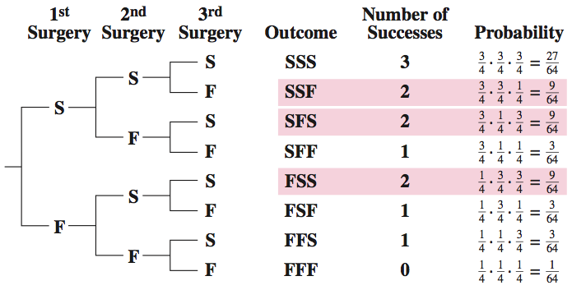
Solution: Finding Binomial Probabilities
Method 1: Draw a tree diagram and use the Multiplication Rule
© 2012 Pearson Education, Inc. All rights reserved.
40 of 63

Slide 41
Solution: Finding Binomial Probabilities
Method 2: Binomial Probability Formula
© 2012 Pearson Education, Inc. All rights reserved.
41 of 63

Slide 42
Binomial Probability Distribution
Binomial Probability Distribution
List the possible values of x with the corresponding probability of each.
Example: Binomial probability distribution for Microfracture knee surgery: n = 3, p =
  Use the binomial probability formula to find probabilities.
x | 0 | 1 | 2 | 3
P(x) | 0.016 | 0.141 | 0.422 | 0.422
© 2012 Pearson Education, Inc. All rights reserved.
42 of 63

Slide 43
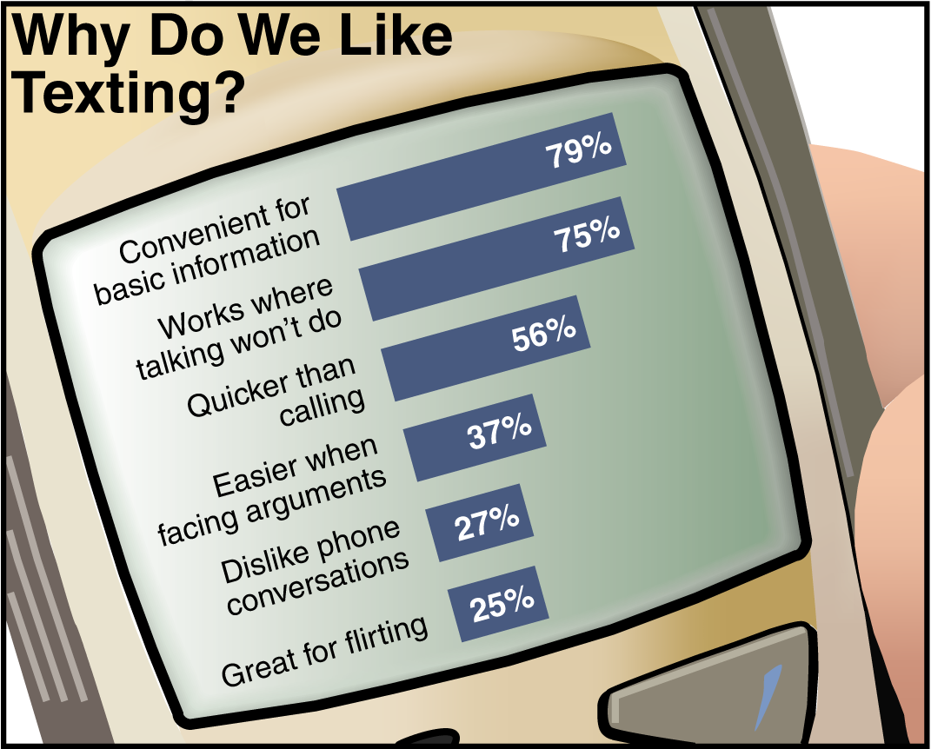
Example: Constructing a Binomial Distribution
In a survey, U.S. adults were asked to give reasons why they liked texting on their cellular phones. Seven adults who participated in the survey are randomly selected and asked whether they like texting because it is quicker than
calling. Create a binomial probability distribution for the number of adults who respond yes.
© 2012 Pearson Education, Inc. All rights reserved.
43 of 63

Slide 44
Solution: Constructing a Binomial Distribution
56% of adults like texting because it is quicker than calling.
n = 7, p = 0.56, q = 0.44, x = 0, 1, 2, 3, 4, 5, 6, 7
P(0) = ₇C₀(0.56)⁰(0.44)⁷ = 1(0.56)⁰(0.44)⁷ ≈ 0.0032
P(1) = ₇C₁(0.56)¹(0.44)⁶ = 7(0.56)¹(0.44)⁶ ≈ 0.0284
P(2) = ₇C₂(0.56)²(0.44)⁵ = 21(0.56)²(0.44)⁵ ≈ 0.1086
P(3) = ₇C₃(0.56)³(0.44)⁴ = 35(0.56)³(0.44)⁴ ≈ 0.2304
P(4) = ₇C₄(0.56)⁴(0.44)³ = 35(0.56)⁴(0.44)³ ≈ 0.2932
P(5) = ₇C₅(0.56)⁵(0.44)² = 21(0.56)⁵(0.44)² ≈ 0.2239
P(6) = ₇C₆(0.56)⁶(0.44)¹ = 7(0.56)⁶(0.44)¹ ≈ 0.0950
P(7) = ₇C₇(0.56)⁷(0.44)⁰ = 1(0.56)⁷(0.44)⁰ ≈ 0.0173
© 2012 Pearson Education, Inc. All rights reserved.
44 of 63

Slide 45
Solution: Constructing a Binomial Distribution
x | P(x)
0 | 0.0032
1 | 0.0284
2 | 0.1086
3 | 0.2304
4 | 0.2932
5 | 0.2239
6 | 0.0950
7 | 0.0173
All of the probabilities are between 0 and 1 and the sum of the probabilities is 1.
© 2012 Pearson Education, Inc. All rights reserved.
45 of 63

Slide 46
Example: Finding Binomial Probabilities Using Technology
The results of a recent survey indicate that 67% of U.S. adults consider air conditioning a necessity. If you randomly select 100 adults, what is the probability that exactly 75 adults consider air conditioning a necessity? Use a technology tool to find the probability. (Source: Opinion Research Corporation)
Solution:
Binomial with n = 100, p = 0.67, x = 75
© 2012 Pearson Education, Inc. All rights reserved.
46 of 63

Slide 47
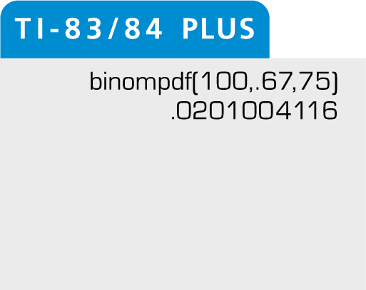
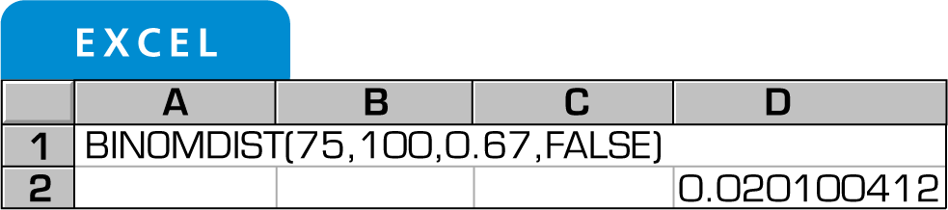
Solution: Finding Binomial Probabilities Using Technology
From the displays, you can see that the probability that exactly 75 adults consider air conditioning a necessity is about 0.02.
© 2012 Pearson Education, Inc. All rights reserved.
47 of 63

Slide 48
Example: Finding Binomial Probabilities
A survey indicates that 41% of women in the U.S. consider reading their favorite leisure-time activity. You randomly select four U.S. women and ask them if reading is their favorite leisure-time activity. Find the probability that at least two of them respond yes.
Solution:
n = 4, p = 0.41, q = 0.59
At least two means two or more.
Find the sum of P(2), P(3), and P(4).
© 2012 Pearson Education, Inc. All rights reserved.
48 of 63

Slide 49
Solution: Finding Binomial Probabilities
P(2) = ₄C₂(0.41)²(0.59)² = 6(0.41)²(0.59)² ≈ 0.351094
P(3) = ₄C₃(0.41)³(0.59)¹ = 4(0.41)³(0.59)¹ ≈ 0.162654
P(4) = ₄C₄(0.41)⁴(0.59)⁰ = 1(0.41)⁴(0.59)⁰ ≈ 0.028258
P(x ≥ 2) = P(2) + P(3) + P(4)
≈ 0.351094 + 0.162654 + 0.028258
≈ 0.542
© 2012 Pearson Education, Inc. All rights reserved.
49 of 63

Slide 50
Example: Finding Binomial Probabilities Using a Table
About ten percent of workers (16 years and over) in the United States commute to their jobs by carpooling. You randomly select eight workers. What is the probability that exactly four of them carpool to work? Use a table to find the probability. (Source: American Community Survey)
Solution:
Binomial with n = 8, p = 0.10, x = 4
© 2012 Pearson Education, Inc. All rights reserved.
50 of 63

Slide 51
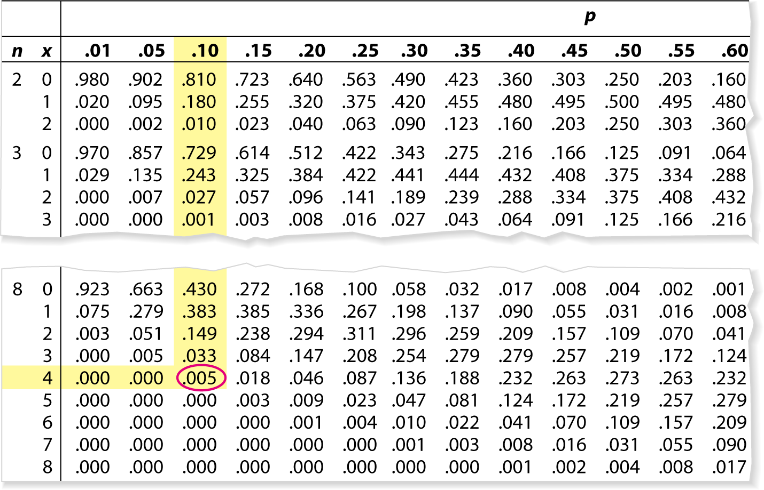
Solution: Finding Binomial Probabilities Using a Table
A portion of Table 2 is shown
The probability that exactly four of the eight workers carpool to work is 0.005.
© 2012 Pearson Education, Inc. All rights reserved.
51 of 63

Slide 52
Example: Graphing a Binomial Distribution
Sixty percent of households in the U.S. own a video game console. You randomly select six households and ask each if they own a video game console. Construct a probability distribution for the random variable x. Then graph the distribution. (Source: Deloitte, LLP)
Solution:
n = 6, p = 0.6, q = 0.4
Find the probability for each value of x
© 2012 Pearson Education, Inc. All rights reserved.
52 of 63

Slide 53
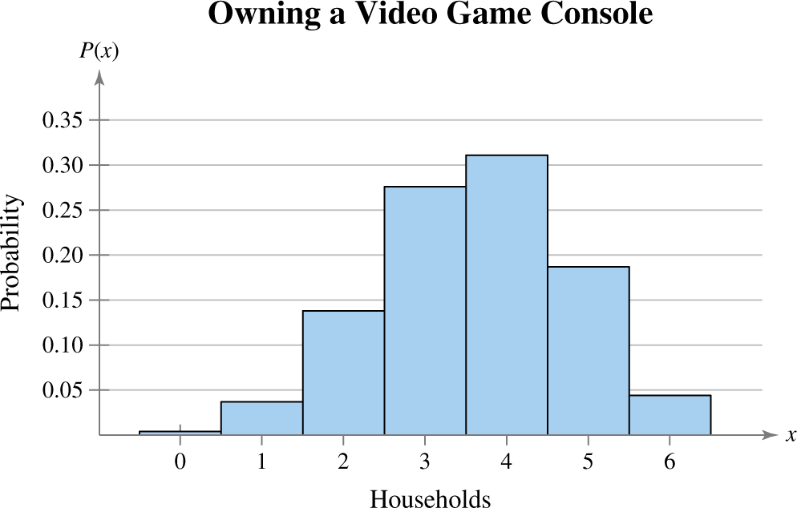
Solution: Graphing a Binomial Distribution
x | 0 | 1 | 2 | 3 | 4 | 5 | 6
P(x) | 0.004 | 0.037 | 0.138 | 0.276 | 0.311 | 0.187 | 0.047
Histogram:
© 2012 Pearson Education, Inc. All rights reserved.
53 of 63

Slide 54
Mean, Variance, and Standard Deviation
Mean: μ = np
Variance: σ² = npq
Standard Deviation:
© 2012 Pearson Education, Inc. All rights reserved.
54 of 63

Slide 55
Example: Finding the Mean, Variance, and Standard Deviation
In Pittsburgh, Pennsylvania, the likelihood of a June day being cloudy is 56%. Find the mean, variance, and standard deviation for the number of cloudy days during the month of June. Interpret the results and determine any unusual values. (Source: National Climatic Data Center)
Solution: n = 30, p = 0.56, q = 0.44
Mean: μ = np = 30∙0.56 = 16.8
Variance: σ² = npq = 30∙0.56∙0.44 ≈ 7.4
Standard Deviation:
© 2012 Pearson Education, Inc. All rights reserved.
55 of 63

Slide 56
Solution: Finding the Mean, Variance, and Standard Deviation
μ = 16.8 σ² ≈ 7.4 σ ≈ 2.7
On average, there are 16.8 cloudy days during the month of June.
The standard deviation is about 2.7 days.
Values that are more than two standard deviations from the mean are considered unusual.
  16.8 – 2(2.7) =11.4, a June with 11 cloudy days or fewer would be unusual.
  16.8 + 2(2.7) = 22.2, a June with 23 cloudy days or more would also be unusual.
© 2012 Pearson Education, Inc. All rights reserved.
56 of 63

Slide 57
Section 4.2 Summary
Determined if a probability experiment is a binomial experiment
Found binomial probabilities using the binomial probability formula
Found binomial probabilities using technology and a binomial table
Graphed a binomial distribution
Found the mean, variance, and standard deviation of a binomial probability distribution
© 2012 Pearson Education, Inc. All rights reserved.
57 of 63

