Slide 1

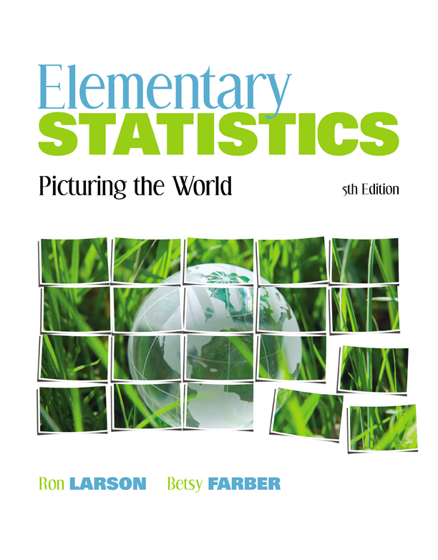

Chapter
2
Descriptive Statistics
© 2012 Pearson Education, Inc.
All rights reserved.
1 of 149

Slide 2
Chapter Outline
2.1 Frequency Distributions and Their Graphs
2.2 More Graphs and Displays
2.3 Measures of Central Tendency
2.4 Measures of Variation
2.5 Measures of Position
© 2012 Pearson Education, Inc. All rights reserved.
2 of 149

Slide 3
Section 2.1
Frequency Distributions
and Their Graphs
© 2012 Pearson Education, Inc. All rights reserved.
3 of 149

Slide 4
Section 2.1 Objectives
Construct frequency distributions
Construct frequency histograms, frequency polygons, relative frequency histograms, and ogives
© 2012 Pearson Education, Inc. All rights reserved.
4 of 149

Slide 5
Frequency Distribution
Frequency Distribution
A table that shows classes or intervals of data with a count of the number of entries in each class.
The frequency, f, of a class is the number of data entries in the class.
Class | Frequency, f
1–5 | 5
6–10 | 8
11–15 | 6
16–20 | 8
21–25 | 5
26–30 | 4
Class width 6 – 1 = 5
Lower class
limits
Upper class
limits
© 2012 Pearson Education, Inc. All rights reserved.
5 of 149

Slide 6
Constructing a Frequency Distribution
Decide on a range for the number of classes.
  Usually between 5 and 10; otherwise, it may be difficult to detect any patterns.
Find the class width.
  Determine the range of the data: max - min
  Divide the range by 10 and by 5 to get a sandwich inequality for class width.
  Choose the class width, usually an integer and a multiple of 5 or 10 if possible.
© 2012 Pearson Education, Inc. All rights reserved.
6 of 149

Slide 7
Constructing a Frequency Distribution
Find the class limits.
  Make sure that the minimum data entry is at least a great as the lower limit of the first class.
  Find the remaining lower limits (add the class width to the lower limit of the preceding class).
  Find the upper limit of the first class. Remember that classes cannot overlap.
  Find the remaining upper class limits.
© 2012 Pearson Education, Inc. All rights reserved.
7 of 149

Slide 8
Constructing a Frequency Distribution
Make a tally mark for each data entry in the row of the appropriate class.
Count the tally marks to find the total frequency f for each class.
© 2012 Pearson Education, Inc. All rights reserved.
8 of 149

Slide 9
Example: Constructing a Frequency Distribution
The following sample data set lists the prices (in dollars) of 30 portable global positioning system (GPS) navigators. Construct a frequency distribution that has seven classes.
90 130 400 200 350 70 325 250 150 250
275 270 150 130 59 200 160 450 300 130
220 100 200 400 200 250 95 180 170 150
© 2012 Pearson Education, Inc. All rights reserved.
9 of 149

Slide 10
Solution: Constructing a Frequency Distribution
90 130 400 200 350 70 325 250 150 250
275 270 150 130 59 200 160 450 300 130
220 100 200 400 200 250 95 180 170 150
range = max – min = 450-59 = 391
Find the class width:
Choose 50 for the width
© 2012 Pearson Education, Inc. All rights reserved.
10 of 149

Slide 11
Solution: Constructing a Frequency Distribution
Use 50 (multiple of 50 ≤ minimum value) as first lower limit. Add the class width of 50 to get the lower limit of the next class.
50+50= 100
Find the remaining lower limits.
Lower limit | Upper limit
50
100
150
200
250
300
350 400 450
Class width = 50
© 2012 Pearson Education, Inc. All rights reserved.
11 of 149

Slide 12
Solution: Constructing a Frequency Distribution
The upper limit of the first class is 99 (one less than the lower limit of the second class).
Add the class width of 50 to get the upper limit of the next class.
99 + 50 = 149
Find the remaining upper limits.
Lower limit | Upper limit
50 | 99
100 | 149
150 | 199
200 | 249
250 | 299
300 | 349
350 400 450 | 399 449 499
Class width = 50
© 2012 Pearson Education, Inc. All rights reserved.
12 of 149

Slide 13
Solution: Constructing a Frequency Distribution
Make a tally mark for each data entry in the row of the appropriate class.
Count the tally marks to
find the total frequency f
for each class.
Class | Tally | Frequency, f
50-99 | | | | | | 4
100-149 | | | | | | 4
150-199 | | | | | | | | 6
200-249 | | | | | | | 5
250-299 | | | | | | | 5
300-349 | | | | 2
350-399 400-449 450-499 | | | | | | 1 2 1
© 2012 Pearson Education, Inc. All rights reserved.
13 of 149

Slide 14
Determining the Midpoint
Midpoint of a class
Class | Midpoint | Frequency, f
50–99 |  | 4
100-149 |  | 4
150–199 |  | 6
Class width = 50
© 2012 Pearson Education, Inc. All rights reserved.
14 of 149

Slide 15
Determining the Relative Frequency
Relative Frequency of a class
Portion or percentage of the data that falls in a particular class.
Class | Frequency, f | Relative Frequency
50–99 | 4
100-149 | 4
150–199 | 6
© 2012 Pearson Education, Inc. All rights reserved.
15 of 149

Slide 16
Determining the Cumulative Frequency
Cumulative frequency of a class
The sum of the frequencies for that class and all previous classes.
Class | Frequency, f | Cumulative frequency
50–99 | 4
100-149 | 4
150–199 | 6
4
+
8
+
14
© 2012 Pearson Education, Inc. All rights reserved.
16 of 149

Slide 17
Expanded Frequency Distribution
Class | Frequency, f | Midpoint | Relative frequency | Cumulative frequency
50-99 | 4 | 74.5 | .13 | 4
100-149 | 4 | 124.5 | .13 | 8
150-199 | 6 | 174.5 | .20 | 14
200-249 | 5
250-299 | 5
300-349 | 2
350-399 400-449 450-499 | 1 2 1
Σf = 30
© 2012 Pearson Education, Inc. All rights reserved.
17 of 149

Slide 18
Expanded Frequency Distribution
Class | Frequency, f | Midpoint | Relative frequency | Cumulative frequency
50-99 | 4 | 74.5 | 13% | 4
100-149 | 4 | 124.5 | 13% | 8
150-199 | 6 | 174.5 | 20% | 14
200-249 | 5 | 224.5 | 17% | 19
250-299 | 5 | 274.5 | 17% | 24
300-349 | 2 | 324.5 | 7% | 26
350-399 | 1 | 374.5 | 3% | 27
400-449 | 2 | 424.5 | 7% | 29
450-499 | 1 | 474.5 | 3% | 30
Σf = 30
© 2012 Pearson Education, Inc. All rights reserved.
18 of 149

Slide 19
Graphs of Frequency Distributions
Frequency Histogram
A bar graph that represents the frequency distribution.
The horizontal scale is quantitative and measures the data values.
The vertical scale measures the frequencies of the classes.
Consecutive bars must touch.
frequency
data values
© 2012 Pearson Education, Inc. All rights reserved.
19 of 149

Slide 20
Class Boundaries
Class boundaries
The numbers that separate classes without forming gaps between them.
First class lower boundary
= 50 – 0.5 = 49.5
First class upper boundary
= 99 + 0.5 = 99.5
Class | Class boundaries | Frequency, f
50-99 | 49.5-99.5 | 4
100-149 | 99.5-149.5 | 4
150-199 | 149.5-199.5 | 6
© 2012 Pearson Education, Inc. All rights reserved.
20 of 149

Slide 21
Example: Frequency Histogram
Construct a frequency histogram
for the Global Positioning system
(GPS) navigators.
Class | Frequency, f
50-99 | 4
100-149 | 4
150-199 | 6
200-249 | 5
250-299 | 5
300-349 | 2
350-399 | 1
400-449 | 2
450-499 | 1
© 2012 Pearson Education, Inc. All rights reserved.
21 of 149

Slide 22
Solution: Frequency Histogram
(using Intervals as horizontal label)
You can see that 14, which is slightly less than half , of the GPS navigators are priced below $200.
© 2012 Pearson Education, Inc. All rights reserved.
22 of 149

Slide 23
Graphs of Frequency Distributions
Frequency Polygon
A line graph that emphasizes the continuous change in frequencies.
frequency
data values
© 2012 Pearson Education, Inc. All rights reserved.
23 of 149

Slide 24
Example: Frequency Polygon
Construct a frequency polygon for the GPS navigators frequency distribution, using midpoint as the axis label.
Class | Frequency, f | Midpoint
50-99 | 4 | 74.5
100-149 | 4 | 124.5
150-199 | 6 | 174.5
200-249 | 5 | 224.5
250-299 | 5 | 274.5
300-349 | 2 | 324.5
350-399 | 1 | 374.5
400-449 | 2 | 424.5
450-499 | 1 | 474.5
© 2012 Pearson Education, Inc. All rights reserved.
24 of 149

Slide 25
Solution: Frequency Polygon
The graph should begin and end on the horizontal axis, so extend the left side to one class width before the first class midpoint and extend the right side to one class width after the last class midpoint.
You can see that the frequency of GPS navigators increases up to $174.50 and then decreases.
© 2012 Pearson Education, Inc. All rights reserved.
25 of 149

Slide 26
Graphs of Frequency Distributions
Relative Frequency Histogram
Has the same shape and the same horizontal scale as the corresponding frequency histogram.
The vertical scale measures the relative frequencies, not frequencies.
relative frequency
data values
© 2012 Pearson Education, Inc. All rights reserved.
26 of 149

Slide 27
Relative Frequency Histogram
From this graph you can see that 20% of GPS navigators are priced between $150 and $199.
© 2012 Pearson Education, Inc. All rights reserved.
27 of 149

Slide 28
Graphs of Frequency Distributions
Cumulative Frequency Graph or Ogive
A line graph that displays the cumulative frequency of each class at its upper class boundary.
The upper boundaries are marked on the horizontal axis.
Cumulative frequencies are marked on the vertical axis.
cumulative frequency
data values
© 2012 Pearson Education, Inc. All rights reserved.
28 of 149

Slide 29
Constructing an Ogive
Construct a frequency distribution that includes cumulative frequencies as one of the columns.
Specify the horizontal and vertical scales.
  The horizontal scale consists of the upper class boundaries.
  The vertical scale measures cumulative frequencies.
Plot points that represent the upper class boundaries and their corresponding cumulative frequencies.
© 2012 Pearson Education, Inc. All rights reserved.
29 of 149

Slide 30
Constructing an Ogive
Connect the points in order from left to right.
The graph should start at the lower boundary of the first class (cumulative frequency is zero) and should end at the upper boundary of the last class (cumulative frequency is equal to the sample size).
© 2012 Pearson Education, Inc. All rights reserved.
30 of 149

Slide 31
Example: Ogive
Construct an ogive for GPS navigators frequency distribution.
Class | Frequency, f | Upper boundary | Cumulative frequency
0-49 | 0 | 49.5 | 0
50-99 | 4 | 99.5 | 4
100-149 | 4 | 149.5 | 8
150-199 | 6 | 199.5 | 14
200-249 | 5 | 249.5 | 19
250-299 | 5 | 299.5 | 24
300-349 | 2 | 349.5 | 26
350-399 | 1 | 399.5 | 27
400-449 | 2 | 449.5 | 29
450-499 | 1 | 499.5 | 30
© 2012 Pearson Education, Inc. All rights reserved.
31 of 149

Slide 32
Solution: Ogive
From ogive, you can see that about 24 GPS navigators cost < $300. The greatest increase occurs between $150 and $200.
© 2012 Pearson Education, Inc. All rights reserved.
32 of 149

Slide 33
Section 2.2
More Graphs and Displays
© 2012 Pearson Education, Inc. All rights reserved.
33 of 149

Slide 34
Section 2.2 Objectives
Graph quantitative data using stem-and-leaf
Graph qualitative data using pie
© 2012 Pearson Education, Inc. All rights reserved.
34 of 149

Slide 35
Graphing Quantitative Data Sets
Stem-and-leaf plot
Each number is separated into a stem and a leaf.
Similar to a histogram.
Still contains original data values.
26
Data: 21, 25, 25, 26, 27, 28,
30, 36, 36, 45
2
1 5 5 6 7 8
3
0 6 6
4
5
© 2012 Pearson Education, Inc. All rights reserved.
35 of 149

Slide 36
Example: Constructing a Stem-and-Leaf Plot
The following are the numbers of text messages sent last week by the cellular phone users on one floor of a college dormitory. Display the data in a stem-and-leaf plot.
159 144 129 105 145 126 116 130 114 122 112 112 142 126
118 108 122 121 109 140 126 119 113 117 118 109 109 119
139 122 78 133 126 123 145 121 134 124 119 132 133 124
129 112 126 148 147
© 2012 Pearson Education, Inc. All rights reserved.
36 of 149

Slide 37
Solution: Constructing a Stem-and-Leaf Plot
159 144 129 105 145 126 116 130 114 122 112 112 142 126
118 108 122 121 109 140 126 119 113 117 118 109 109 119
139 122 78 133 126 123 145 121 134 124 119 132 133 124
129 112 126 148 147
The data entries go from a low of 78 to a high of 159.
Use the rightmost digit as the leaf.
  For instance,
78 = 7 | 8 and 159 = 15 | 9
List the stems, 7 to 15, to the left of a vertical line.
For each data entry, list a leaf to the right of its stem.
© 2012 Pearson Education, Inc. All rights reserved.
37 of 149

Slide 38
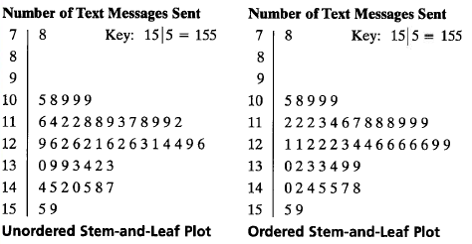
Solution: Constructing a Stem-and-Leaf Plot
Include a key to identify the values of the data.
From the display, you can conclude that more than 50% of the cellular phone users sent between 110 and 130 text messages.
© 2012 Pearson Education, Inc. All rights reserved.
38 of 149

Slide 39
Example: Constructing a Dot Plot
Use a dot plot organize the text messaging data.
159 144 129 105 145 126 116 130 114 122 112 112 142 126
118 108 122 121 109 140 126 119 113 117 118 109 109 119
139 122 78 133 126 123 145 121 134 124 119 132 133 124
129 112 126 148 147
So that each data entry is included in the dot plot, the horizontal axis should include numbers between 70 and 160.
To represent a data entry, plot a point above the entry's position on the axis.
If an entry is repeated, plot another point above the previous point.
© 2012 Pearson Education, Inc. All rights reserved.
39 of 149

Slide 40
Graphing Qualitative Data Sets
Pie Chart
A circle is divided into sectors that represent categories.
The area of each sector is proportional to the frequency of each category.
© 2012 Pearson Education, Inc. All rights reserved.
40 of 149

Slide 41
Example: Constructing a Pie Chart
The numbers of earned degrees conferred (in thousands) in 2007 are shown in the table. Use a pie chart to organize the data. (Source: U.S. National Center for Educational Statistics)
Type of degree | Number (thousands)
Associate’s | 728
Bachelor’s | 1525
Master’s | 604
First professional | 90
Doctoral | 60
© 2012 Pearson Education, Inc. All rights reserved.
41 of 149

Slide 42
Solution: Constructing a Pie Chart
Find the relative frequency (percent) of each category.
Type of degree | Frequency, f | Relative frequency
Associate’s | 728
Bachelor’s | 1525
Master’s | 604
First professional | 90
Doctoral | 60
Σf = 3007
© 2012 Pearson Education, Inc. All rights reserved.
42 of 149

Slide 43
Solution: Constructing a Pie Chart
Construct the pie chart using the central angle that corresponds to each category.
  To find the central angle, multiply 360º by the category's relative frequency.
  For example, the central angle for associate’s degrees is
  360º(0.24) ≈ 86º
© 2012 Pearson Education, Inc. All rights reserved.
43 of 149

Slide 44
Solution: Constructing a Pie Chart
Type of degree | Frequency, f | Relative frequency | Central angle
Associate’s | 728 | 0.24
Bachelor’s | 1525 | 0.51
Master’s | 604 | 0.20
First professional | 90 | 0.03
Doctoral | 60 | 0.02
360º(0.24)≈86º
360º(0.51)≈184º
360º(0.20)≈72º
360º(0.03)≈11º
360º(0.02)≈7º
© 2012 Pearson Education, Inc. All rights reserved.
44 of 149

Slide 45
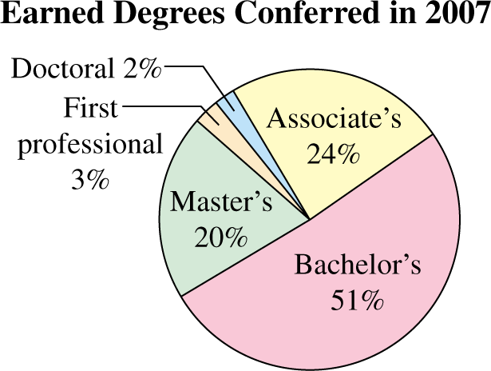
Solution: Constructing a Pie Chart
Type of degree | Relative frequency | Central angle
Associate’s | 0.24 | 86º
Bachelor’s | 0.51 | 184º
Master’s | 0.20 | 72º
First professional | 0.03 | 11º
Doctoral | 0.02 | 7º
From the pie chart, you can see that over one half of the degrees conferred in 2007 were bachelor’s degrees.
© 2012 Pearson Education, Inc. All rights reserved.
45 of 149

Slide 46
Section 2.3
Measures of Central Tendency
© 2012 Pearson Education, Inc. All rights reserved.
46 of 149

Slide 47
Section 2.3 Objectives
Determine the mean, median, and mode of a population and of a sample
Determine the weighted mean of a data set and the mean of a frequency distribution
Describe the shape of a distribution as symmetric, uniform, or skewed and compare the mean and median for each
© 2012 Pearson Education, Inc. All rights reserved.
47 of 149

Slide 48
Measures of Central Tendency
Measure of central tendency
A value that represents a typical, or central, entry of a data set.
Most common measures of central tendency:
  Mean
  Median
  Mode
© 2012 Pearson Education, Inc. All rights reserved.
48 of 149

Slide 49
Measure of Central Tendency: Mean
Mean (average)
The sum of all the data entries divided by the number of entries.
Sigma notation: Σx = add all of the data entries (x) in the data set.
Population mean:
Sample mean:
© 2012 Pearson Education, Inc. All rights reserved.
49 of 149

Slide 50
Example: Finding a Sample Mean
The prices (in dollars) for a sample of round-trip flights from Chicago, Illinois to Cancun, Mexico are listed. What is the mean price of the flights?
872 432 397 427 388 782 397
© 2012 Pearson Education, Inc. All rights reserved.
50 of 149

Slide 51
Solution: Finding a Sample Mean
872 432 397 427 388 782 397
The sum of the flight prices is
Σx = 872 + 432 + 397 + 427 + 388 + 782 + 397 = 3695
To find the mean price, divide the sum of the prices by the number of prices in the sample
The mean price of the flights is about $527.90.
© 2012 Pearson Education, Inc. All rights reserved.
51 of 149

Slide 52
Measure of Central Tendency: Median
Median
The value that lies in the middle of the data when the data set is ordered.
Measures the center of an ordered data set by dividing it into two equal parts.
If the data set has an
  odd number of entries: median is the middle data entry.
  even number of entries: median is the mean of the two middle data entries.
© 2012 Pearson Education, Inc. All rights reserved.
52 of 149

Slide 53
Example: Finding the Median
The prices (in dollars) for a sample of roundtrip flights from Chicago, Illinois to Cancun, Mexico are listed. Find the median of the flight prices.
872 432 397 427 388 782 397
© 2012 Pearson Education, Inc. All rights reserved.
53 of 149

Slide 54
Solution: Finding the Median
872 432 397 427 388 782 397
First order the data.
  388 397 397 427 432 782 872
There are seven entries (an odd number), the median is the middle, or fourth, data entry.
The median price of the flights is $427.
© 2012 Pearson Education, Inc. All rights reserved.
54 of 149

Slide 55
Example: Finding the Median
The flight priced at $432 is no longer available. What is the median price of the remaining flights?
872 397 427 388 782 397
© 2012 Pearson Education, Inc. All rights reserved.
55 of 149

Slide 56
Solution: Finding the Median
872 397 427 388 782 397
First order the data.
  388 397 397 427 782 872
There are six entries (an even number), the median is the mean of the two middle entries.
The median price of the flights is $412.
© 2012 Pearson Education, Inc. All rights reserved.
56 of 149

Slide 57
Measure of Central Tendency: Mode
Mode
The data entry that occurs with the greatest frequency.
A data set can have one mode, more than one mode, or no mode.
If no entry is repeated the data set has no mode.
If two entries occur with the same greatest frequency, each entry is a mode (bimodal).
© 2012 Pearson Education, Inc. All rights reserved.
57 of 149

Slide 58
Example: Finding the Mode
The prices (in dollars) for a sample of roundtrip flights from Chicago, Illinois to Cancun, Mexico are listed. Find the mode of the flight prices.
872 432 397 427 388 782 397
© 2012 Pearson Education, Inc. All rights reserved.
58 of 149

Slide 59
Solution: Finding the Mode
872 432 397 427 388 782 397
Ordering the data helps to find the mode.
  388 397 397 427 432 782 872
The entry of 397 occurs twice, whereas the other data entries occur only once.
The mode of the flight prices is $397.
© 2012 Pearson Education, Inc. All rights reserved.
59 of 149

Slide 60
Example: Finding the Mode
At a political debate a sample of audience members was asked to name the political party to which they belong. Their responses are shown in the table. What is the mode of the responses?
Political Party | Frequency, f
Democrat | 34
Republican | 56
Other | 21
Did not respond | 9
© 2012 Pearson Education, Inc. All rights reserved.
60 of 149

Slide 61
Solution: Finding the Mode
Political Party | Frequency, f
Democrat | 34
Republican | 56
Other | 21
Did not respond | 9
The mode is Republican (the response occurring with the greatest frequency). In this sample there were more Republicans than people of any other single affiliation.
© 2012 Pearson Education, Inc. All rights reserved.
61 of 149

Slide 62
Comparing the Mean, Median, and Mode
All three measures describe a typical entry of a data set.
Advantage of using the mean:
  The mean is a reliable measure because it takes into account every entry of a data set.
Disadvantage of using the mean:
  Greatly affected by outliers (a data entry that is far removed from the other entries in the data set).
© 2012 Pearson Education, Inc. All rights reserved.
62 of 149

Slide 63
Example: Comparing the Mean, Median, and Mode
Find the mean, median, and mode of the sample ages of a class shown. Which measure of central tendency best describes a typical entry of this data set? Are there any outliers?
Ages in a class
20 | 20 | 20 | 20 | 20 | 20 | 21
21 | 21 | 21 | 22 | 22 | 22 | 23
23 | 23 | 23 | 24 | 24 | 65
© 2012 Pearson Education, Inc. All rights reserved.
63 of 149

Slide 64
Solution: Comparing the Mean, Median, and Mode
Ages in a class
20 | 20 | 20 | 20 | 20 | 20 | 21
21 | 21 | 21 | 22 | 22 | 22 | 23
23 | 23 | 23 | 24 | 24 | 65
Mean:
Median:
Mode:
20 years (the entry occurring with the
greatest frequency)
© 2012 Pearson Education, Inc. All rights reserved.
64 of 149

Slide 65
Solution: Comparing the Mean, Median, and Mode
Mean ≈ 23.8 years Median = 21.5 years Mode = 20 years
The mean takes every entry into account, but is influenced by the outlier of 65.
The median also takes every entry into account, and it is not affected by the outlier.
In this case the mode exists, but it doesn't appear to represent a typical entry.
© 2012 Pearson Education, Inc. All rights reserved.
65 of 149

Slide 66
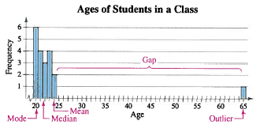
Solution: Comparing the Mean, Median, and Mode
Sometimes a graphical comparison can help you decide which measure of central tendency best represents a data set.
In this case, the median best describes the data set.
© 2012 Pearson Education, Inc. All rights reserved.
66 of 149

Slide 67
Weighted Mean
Weighted Mean
The mean of a data set whose entries have varying weights.
where w is the weight of each entry x
© 2012 Pearson Education, Inc. All rights reserved.
67 of 149

Slide 68
Example: Finding a Weighted Mean
Your grade is determined from five sources:
  50% from your test mean (86)
  15% from your midterm (96)
  20% from your final exam (82)
  10% from your computer lab work (98)
  5% from your homework. (100)
What is the weighted mean of your scores?
If minimum average for A is 90, did you get an A?
© 2012 Pearson Education, Inc. All rights reserved.
68 of 149

Slide 69
Solution: Finding a Weighted Mean
Source | Score, x | Weight, w | x∙w
Test Mean | 86 | 0.50 | 86(0.50)= 43.0
Midterm | 96 | 0.15 | 96(0.15) = 14.4
Final Exam | 82 | 0.20 | 82(0.20) = 16.4
Computer Lab | 98 | 0.10 | 98(0.10) = 9.8
Homework | 100 | 0.05 | 100(0.05) = 5.0
 |  | Σw = 1 | Σ(x∙w) = 88.6
Your weighted mean for the course is 88.6. You did not get an A.
© 2012 Pearson Education, Inc. All rights reserved.
69 of 149

Slide 70
Mean of Grouped Data
Mean of a Frequency Distribution
Approximated by
where x and f are the midpoints and frequencies of a class, respectively
© 2012 Pearson Education, Inc. All rights reserved.
70 of 149

Slide 71
Finding the Mean of a Frequency Distribution
In Words In Symbols
Find the midpoint of each class.
Find the sum of the products of the midpoints and the frequencies.
Find the sum of the frequencies.
Find the mean of the frequency distribution.
© 2012 Pearson Education, Inc. All rights reserved.
71 of 149

Slide 72
Example: Find the Mean of a Frequency Distribution
Use the frequency distribution to approximate the mean number of minutes that a sample of Internet subscribers spent online during their most recent session.
Class | Midpoint | Frequency, f
7 – 18 | 12.5 | 6
19 – 30 | 24.5 | 10
31 – 42 | 36.5 | 13
43 – 54 | 48.5 | 8
55 – 66 | 60.5 | 5
67 – 78 | 72.5 | 6
79 – 90 | 84.5 | 2
© 2012 Pearson Education, Inc. All rights reserved.
72 of 149

Slide 73
Solution: Find the Mean of a Frequency Distribution
Class | Midpoint, x | Frequency, f | (x∙f)
7 – 18 | 12.5 | 6 | 12.5∙6 = 75.0
19 – 30 | 24.5 | 10 | 24.5∙10 = 245.0
31 – 42 | 36.5 | 13 | 36.5∙13 = 474.5
43 – 54 | 48.5 | 8 | 48.5∙8 = 388.0
55 – 66 | 60.5 | 5 | 60.5∙5 = 302.5
67 – 78 | 72.5 | 6 | 72.5∙6 = 435.0
79 – 90 | 84.5 | 2 | 84.5∙2 = 169.0
 |  | n = 50 | Σ(x∙f) = 2089.0
© 2012 Pearson Education, Inc. All rights reserved.
73 of 149

Slide 74
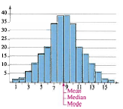
The Shape of Distributions
Symmetric Bell-shaped Distribution
A vertical line can be drawn through the middle of a graph of the distribution and the resulting halves are approximately mirror images.
© 2012 Pearson Education, Inc. All rights reserved.
74 of 149

Slide 75
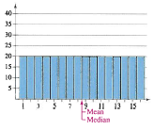
The Shape of Distributions
Uniform Distribution (rectangular)
All entries or classes in the distribution have equal or approximately equal frequencies.
Symmetric.
© 2012 Pearson Education, Inc. All rights reserved.
75 of 149

Slide 76
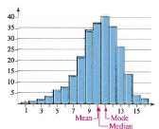
The Shape of Distributions
Skewed Left Distribution (negatively skewed)
The “tail” of the graph elongates more to the left.
The mean is to the left of the median.
© 2012 Pearson Education, Inc. All rights reserved.
76 of 149

Slide 77
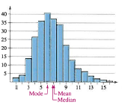
The Shape of Distributions
Skewed Right Distribution (positively skewed)
The “tail” of the graph elongates more to the right.
The mean is to the right of the median.
© 2012 Pearson Education, Inc. All rights reserved.
77 of 149

Slide 78
Section 2.4
Measures of Variation
© 2012 Pearson Education, Inc. All rights reserved.
78 of 149

Slide 79
Section 2.4 Objectives
Determine the range of a data set
Determine the variance and standard deviation of a population and of a sample
Use the Empirical Rule to interpret standard deviation
Approximate the sample standard deviation for grouped data
© 2012 Pearson Education, Inc. All rights reserved.
79 of 149

Slide 80
Range
Range
The difference between the maximum and minimum data entries in the set.
The data must be quantitative.
Range = (Max. data entry) – (Min. data entry)
© 2012 Pearson Education, Inc. All rights reserved.
80 of 149

Slide 81
Example: Finding the Range
A corporation hired 10 graduates. The starting salaries for each graduate are shown. Find the range of the starting salaries.
Starting salaries (1000s of dollars)
41 38 39 45 47 41 44 41 37 42
© 2012 Pearson Education, Inc. All rights reserved.
81 of 149

Slide 82
Solution: Finding the Range
Ordering the data helps to find the least and greatest salaries.
  37 38 39 41 41 41 42 44 45 47
Range = (Max. salary) – (Min. salary)
= 47 – 37 = 10
The range of starting salaries is 10 or $10,000.
minimum
maximum
© 2012 Pearson Education, Inc. All rights reserved.
82 of 149

Slide 83
Deviation, Variance, and Standard Deviation
Deviation
The difference between the data entry, x, and the mean of the data set.
Population data set:
  Deviation of x = x – μ
Sample data set:
  Deviation of
© 2012 Pearson Education, Inc. All rights reserved.
83 of 149

Slide 84
Example: Finding the Deviation
A corporation hired 10 graduates. The starting salaries for each graduate are shown. Find the deviation of the starting salaries.
Starting salaries (1000s of dollars)
41 38 39 45 47 41 44 41 37 42
Solution:
First determine the mean starting salary.
© 2012 Pearson Education, Inc. All rights reserved.
84 of 149

Slide 85
Solution: Finding the Deviation
Determine the deviation for each data entry.
Salary ($1000s), x | Deviation ($1000s) x – μ
41 | 41 – 41.5 = –0.5
38 | 38 – 41.5 = –3.5
39 | 39 – 41.5 = –2.5
45 | 45 – 41.5 = 3.5
47 | 47 – 41.5 = 5.5
41 | 41 – 41.5 = –0.5
44 | 44 – 41.5 = 2.5
41 | 41 – 41.5 = –0.5
37 | 37 – 41.5 = –4.5
42 | 42 – 41.5 = 0.5
Σx = 415
Σ(x – μ) = 0
© 2012 Pearson Education, Inc. All rights reserved.
85 of 149

Slide 86
Deviation, Variance, and Standard Deviation
Population Variance
Population Standard Deviation
Sum of squares, SS_{x}
© 2012 Pearson Education, Inc. All rights reserved.
86 of 149

Slide 87
Finding the Population Variance & Standard Deviation
In Words In Symbols
Find the mean of the population data set.
Find the deviation of each entry.
Square each deviation.
Add to get the sum of squares.
x – μ
(x – μ)²
SS_{x} = Σ(x – μ)²
© 2012 Pearson Education, Inc. All rights reserved.
87 of 149

Slide 88
Finding the Population Variance & Standard Deviation
In Words In Symbols
Divide by N to get the population variance.
Find the square root of the variance to get the population standard deviation.
© 2012 Pearson Education, Inc. All rights reserved.
88 of 149

Slide 89
Example: Finding the Population Standard Deviation
A corporation hired 10 graduates. The starting salaries for each graduate are shown. Find the population variance and standard deviation of the starting salaries.
Starting salaries (1000s of dollars)
41 38 39 45 47 41 44 41 37 42
Recall μ = 41.5.
© 2012 Pearson Education, Inc. All rights reserved.
89 of 149

Slide 90
Solution: Finding the Population Standard Deviation
Determine SS_{x}
N = 10
Salary, x | Deviation: x – μ | Squares: (x – μ)²
41 | 41 – 41.5 = –0.5 | (–0.5)² = 0.25
38 | 38 – 41.5 = –3.5 | (–3.5)² = 12.25
39 | 39 – 41.5 = –2.5 | (–2.5)² = 6.25
45 | 45 – 41.5 = 3.5 | (3.5)² = 12.25
47 | 47 – 41.5 = 5.5 | (5.5)² = 30.25
41 | 41 – 41.5 = –0.5 | (–0.5)² = 0.25
44 | 44 – 41.5 = 2.5 | (2.5)² = 6.25
41 | 41 – 41.5 = –0.5 | (–0.5)² = 0.25
37 | 37 – 41.5 = –4.5 | (–4.5)² = 20.25
42 | 42 – 41.5 = 0.5 | (0.5)² = 0.25
Σ(x – μ) = 0
SS_{x} = 88.5
© 2012 Pearson Education, Inc. All rights reserved.
90 of 149

Slide 91
Solution: Finding the Population Standard Deviation
Population Variance
Population Standard Deviation
The population standard deviation is about 3.0, or $3000.
© 2012 Pearson Education, Inc. All rights reserved.
91 of 149

Slide 92
Deviation, Variance, and Standard Deviation
Sample Variance
Sample Standard Deviation
© 2012 Pearson Education, Inc. All rights reserved.
92 of 149

Slide 93
Finding the Sample Variance & Standard Deviation
In Words In Symbols
Find the mean of the sample data set.
Find the deviation of each entry.
Square each deviation.
Add to get the sum of squares.
© 2012 Pearson Education, Inc. All rights reserved.
93 of 149

Slide 94
Finding the Sample Variance & Standard Deviation
In Words In Symbols
Divide by n – 1 to get the sample variance.
Find the square root of the variance to get the sample standard deviation.
© 2012 Pearson Education, Inc. All rights reserved.
94 of 149

Slide 95
Example: Finding the Sample Standard Deviation
The starting salaries are for the Chicago branches of a corporation. The corporation has several other branches, and you plan to use the starting salaries of the Chicago branches to estimate the starting salaries for the larger population. Find the sample standard deviation of the starting salaries.
Starting salaries (1000s of dollars)
41 38 39 45 47 41 44 41 37 42
© 2012 Pearson Education, Inc. All rights reserved.
95 of 149

Slide 96
Solution: Finding the Sample Standard Deviation
Determine SS_{x}
n = 10
Salary, x | Deviation: x – μ | Squares: (x – μ)²
41 | 41 – 41.5 = –0.5 | (–0.5)² = 0.25
38 | 38 – 41.5 = –3.5 | (–3.5)² = 12.25
39 | 39 – 41.5 = –2.5 | (–2.5)² = 6.25
45 | 45 – 41.5 = 3.5 | (3.5)² = 12.25
47 | 47 – 41.5 = 5.5 | (5.5)² = 30.25
41 | 41 – 41.5 = –0.5 | (–0.5)² = 0.25
44 | 44 – 41.5 = 2.5 | (2.5)² = 6.25
41 | 41 – 41.5 = –0.5 | (–0.5)² = 0.25
37 | 37 – 41.5 = –4.5 | (–4.5)² = 20.25
42 | 42 – 41.5 = 0.5 | (0.5)² = 0.25
Σ(x – μ) = 0
SS_{x} = 88.5
© 2012 Pearson Education, Inc. All rights reserved.
96 of 149

Slide 97
Solution: Finding the Sample Standard Deviation
Sample Variance
Sample Standard Deviation
The sample standard deviation is about 3.1, or $3100.
© 2012 Pearson Education, Inc. All rights reserved.
97 of 149

Slide 98
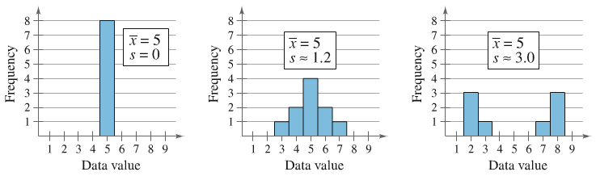
Interpreting Standard Deviation
Standard deviation is a measure of the typical amount an entry deviates from the mean.
The more the entries are spread out, the greater the standard deviation.
© 2012 Pearson Education, Inc. All rights reserved.
98 of 149

Slide 99
Interpreting Standard Deviation: Empirical Rule (68 – 95 – 99.7 Rule)
For data with a (symmetric) bell-shaped distribution, the standard deviation has the following characteristics:
About 68% of the data lie within one standard deviation of the mean.
About 95% of the data lie within two standard deviations of the mean.
About 99.7% of the data lie within three standard deviations of the mean.
© 2012 Pearson Education, Inc. All rights reserved.
99 of 149

Slide 100
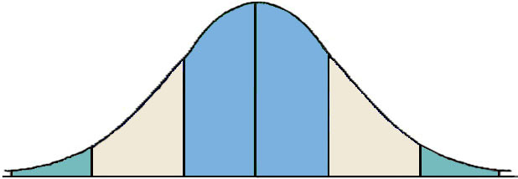
Interpreting Standard Deviation: Empirical Rule (68 – 95 – 99.7 Rule)
99.7% within 3 standard deviations
95% within 2 standard deviations
68% within 1 standard deviation
34%
34%
2.35%
2.35%
13.5%
13.5%
© 2012 Pearson Education, Inc. All rights reserved.
100 of 149

Slide 101
Example: Using the Empirical Rule
In a survey conducted by the National Center for Health Statistics, the sample mean height of women in the United States (ages 20-29) was 64.3 inches, with a sample standard deviation of 2.62 inches. Estimate the percent of the women whose heights are between 59.06 inches and 64.3 inches.
© 2012 Pearson Education, Inc. All rights reserved.
101 of 149

Slide 102
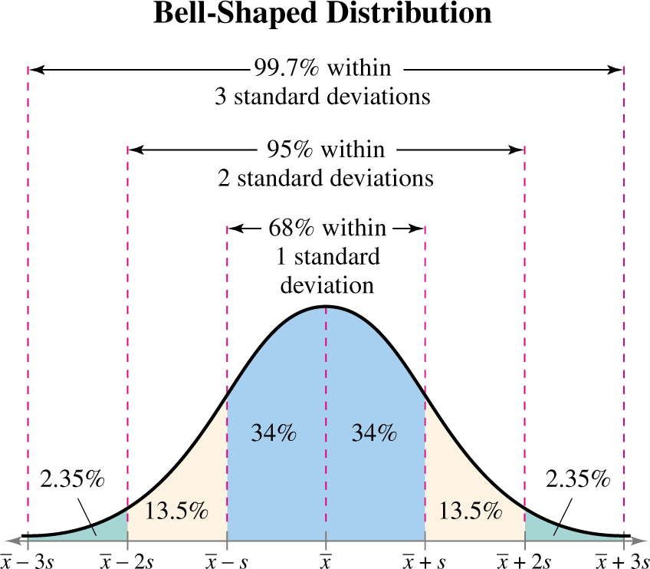
Solution: Using the Empirical Rule
34% + 13.5% = 47.5% of women are between 59.06 and 64.3 inches tall.
© 2012 Pearson Education, Inc. All rights reserved.
102 of 149

Slide 103
Standard Deviation for Grouped Data
Sample standard deviation for a frequency distribution
When a frequency distribution has classes, estimate the sample mean and the sample standard deviation by using the midpoint of each class.
where n = Σf (the number of entries in the data set)
© 2012 Pearson Education, Inc. All rights reserved.
103 of 149

Slide 104
Example: Finding the Standard Deviation for Grouped Data
You collect a random sample of the number of children per household in a region. Find the sample mean and the sample standard deviation of the data set.
Number of Children in 50 Households
1 | 3 | 1 | 1 | 1
1 | 2 | 2 | 1 | 0
1 | 1 | 0 | 0 | 0
1 | 5 | 0 | 3 | 6
3 | 0 | 3 | 1 | 1
1 | 1 | 6 | 0 | 1
3 | 6 | 6 | 1 | 2
2 | 3 | 0 | 1 | 1
4 | 1 | 1 | 2 | 2
0 | 3 | 0 | 2 | 4
© 2012 Pearson Education, Inc. All rights reserved.
104 of 149

Slide 105
Solution: Finding the Standard Deviation for Grouped Data
First construct a frequency distribution.
Find the mean of the frequency distribution.
x | f | xf
0 | 10 | 0(10) = 0
1 | 19 | 1(19) = 19
2 | 7 | 2(7) = 14
3 | 7 | 3(7) =21
4 | 2 | 4(2) = 8
5 | 1 | 5(1) = 5
6 | 4 | 6(4) = 24
The sample mean is about 1.8 children.
Σf = 50
Σ(xf )= 91
© 2012 Pearson Education, Inc. All rights reserved.
105 of 149

Slide 106
Solution: Finding the Standard Deviation for Grouped Data
Determine the sum of squares.
x | f
0 | 10 | 0 – 1.8 = –1.8 | (–1.8)² = 3.24 | 3.24(10) = 32.40
1 | 19 | 1 – 1.8 = –0.8 | (–0.8)² = 0.64 | 0.64(19) = 12.16
2 | 7 | 2 – 1.8 = 0.2 | (0.2)² = 0.04 | 0.04(7) = 0.28
3 | 7 | 3 – 1.8 = 1.2 | (1.2)² = 1.44 | 1.44(7) = 10.08
4 | 2 | 4 – 1.8 = 2.2 | (2.2)² = 4.84 | 4.84(2) = 9.68
5 | 1 | 5 – 1.8 = 3.2 | (3.2)² = 10.24 | 10.24(1) = 10.24
6 | 4 | 6 – 1.8 = 4.2 | (4.2)² = 17.64 | 17.64(4) = 70.56
© 2012 Pearson Education, Inc. All rights reserved.
106 of 149

Slide 107
Solution: Finding the Standard Deviation for Grouped Data
Find the sample standard deviation.
The standard deviation is about 1.7 children.
© 2012 Pearson Education, Inc. All rights reserved.
107 of 149

Slide 108
Section 2.5
Measures of Position
© 2012 Pearson Education, Inc. All rights reserved.
108 of 149

Slide 109
Section 2.5 Objectives
Determine the quartiles of a data set
Determine the interquartile range of a data set
Create a box-and-whisker plot
Interpret other fractiles such as percentiles
Determine and interpret the standard score (z-score)
© 2012 Pearson Education, Inc. All rights reserved.
109 of 149

Slide 110
Quartiles
Fractiles are numbers that partition (divide) an ordered data set into equal parts.
Quartiles approximately divide an ordered data set into four equal parts.
  First quartile, Q₁: About one quarter of the data fall on or below Q₁.
  Second quartile, Q₂: About one half of the data fall on or below Q₂ (median).
  Third quartile, Q₃: About three quarters of the data fall on or below Q₃.
© 2012 Pearson Education, Inc. All rights reserved.
110 of 149

Slide 111
Example: Finding Quartiles
The number of nuclear power plants in the top 15 nuclear power-producing countries in the world are listed. Find the first, second, and third quartiles of the data set.
7 18 11 6 59 17 18 54 104 20 31 8 10 15 19
Solution:
Q₂ divides the data set into two halves.
6 7 8 10 11 15 17 18 18 19 20 31 54 59 104
Lower half
Upper half
Q₂
© 2012 Pearson Education, Inc. All rights reserved.
111 of 149

Slide 112
Solution: Finding Quartiles
The first and third quartiles are the medians of the lower and upper halves of the data set.
6 7 8 10 11 15 17 18 18 19 20 31 54 59 104
Lower half
Upper half
Q₁
Q₂
Q₃
About one fourth of the countries have 10 or fewer nuclear power plants; about one half have 18 or fewer; and about three fourths have 31 or fewer.
© 2012 Pearson Education, Inc. All rights reserved.
112 of 149

Slide 113
Interquartile Range
Interquartile Range (IQR)
The difference between the third and first quartiles.
IQR = Q₃ – Q₁
© 2012 Pearson Education, Inc. All rights reserved.
113 of 149

Slide 114
Example: Finding the Interquartile Range
Find the interquartile range of the data set.
7 18 11 6 59 17 18 54 104 20 31 8 10 15 19
Recall Q₁ = 10, Q₂ = 18, and Q₃ = 31
Solution:
IQR = Q₃ – Q₁ = 31 – 10 = 21
The number of power plants in the middle portion of the data set vary by at most 21.
© 2012 Pearson Education, Inc. All rights reserved.
114 of 149

Slide 115
Box-and-Whisker Plot
Box-and-whisker plot
Exploratory data analysis tool.
Highlights important features of a data set.
Requires (five-number summary):
  Minimum entry
  First quartile Q₁
  Median Q₂
  Third quartile Q₃
  Maximum entry
© 2012 Pearson Education, Inc. All rights reserved.
115 of 149

Slide 116
Drawing a Box-and-Whisker Plot
Find the five-number summary of the data set.
Construct a horizontal scale that spans the range of the data.
Plot the five numbers above the horizontal scale.
Draw a box above the horizontal scale from Q₁ to Q₃ and draw a vertical line in the box at Q₂.
Draw whiskers from the box to the minimum and maximum entries.
Box
Whisker
Whisker
Minimum entry
Maximum entry
Q₁
Median, Q₂
Q₃
© 2012 Pearson Education, Inc. All rights reserved.
116 of 149

Slide 117
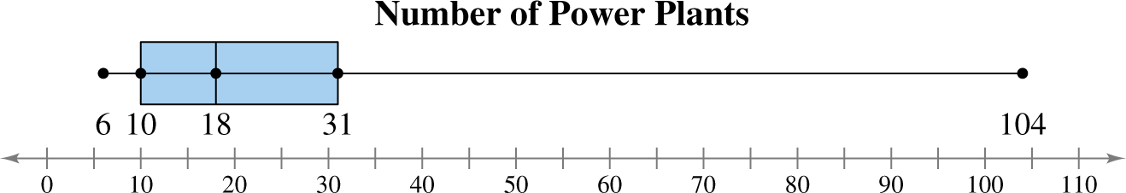
Example: Drawing a Box-and-Whisker Plot
Draw a box-and-whisker plot that represents the data set.
7 18 11 6 59 17 18 54 104 20 31 8 10 15 19
Min = 6, Q₁ = 10, Q₂ = 18, Q₃ = 31, Max = 104,
Solution:
About half the data values are between 10 and 31. By looking at the length of the right whisker, you can conclude 104 is a possible outlier.
© 2012 Pearson Education, Inc. All rights reserved.
117 of 149

Slide 118
Percentiles and Other Fractiles
Fractiles | Summary | Symbols
Quartiles | Divide a data set into 4 equal parts | Q₁, Q₂, Q₃
Deciles | Divide a data set into 10 equal parts | D₁, D₂, D₃,…, D₉
Percentiles | Divide a data set into 100 equal parts | P₁, P₂, P₃,…, P₉₉
© 2012 Pearson Education, Inc. All rights reserved.
118 of 149

Slide 119
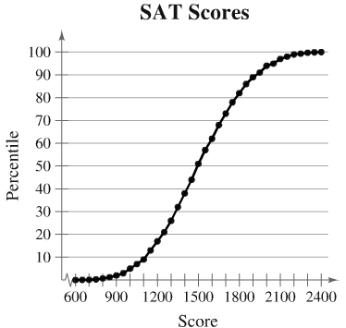
Example: Interpreting Percentiles
The ogive represents the cumulative frequency distribution for SAT test scores of college-bound students in a recent year. What test score represents the 62nd percentile? How should you interpret this? (Source: College Board)
© 2012 Pearson Education, Inc. All rights reserved.
119 of 149

Slide 120
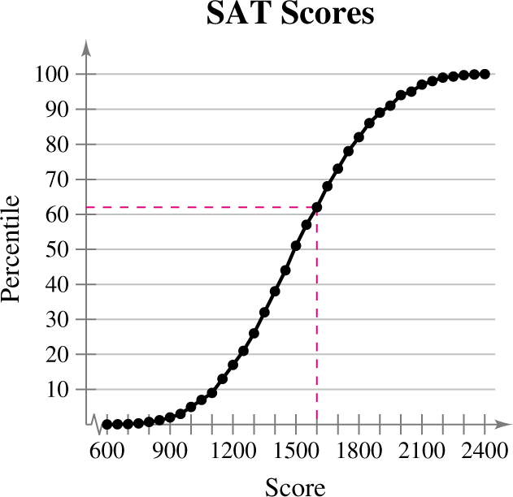
Solution: Interpreting Percentiles
The 62nd percentile corresponds to a test score of 1600.
This means that 62% of the students had an SAT score of 1600 or less.
© 2012 Pearson Education, Inc. All rights reserved.
120 of 149

Slide 121
The Standard Score
Standard Score (z-score)
Represents the number of standard deviations a given value x falls from the mean μ.
© 2012 Pearson Education, Inc. All rights reserved.
121 of 149

Slide 122

Example: Comparing z-Scores from Different Data Sets
In 2009, Heath Ledger won the Oscar for Best Supporting Actor at age 29 for his role in the movie The Dark Knight. Penelope Cruz won the Oscar for Best Supporting Actress at age 34 for her role in Vicky Cristina Barcelona. The mean age of all Best Supporting Actor winners is 49.5, with a standard deviation of 13.8. The mean age of all Best Supporting Actress winners is 39.9, with a standard deviation of 14.0. Find the z-scores that correspond to the ages of Ledger and Cruz. Then compare your results.
© 2012 Pearson Education, Inc. All rights reserved.
122 of 149

Slide 123
Solution: Comparing z-Scores from Different Data Sets
Heath Ledger
1.49 standard deviations below the mean
Penelope Cruz
0.42 standard deviations below the mean
© 2012 Pearson Education, Inc. All rights reserved.
123 of 149

Slide 124
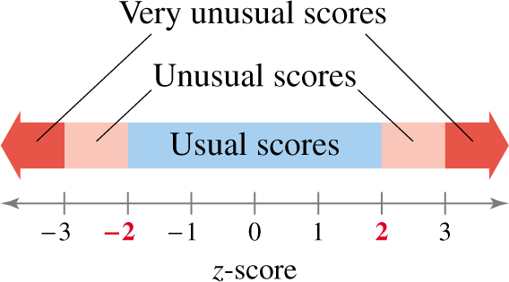
Solution: Comparing z-Scores from Different Data Sets
Both z-scores fall between –2 and 2, so neither score would be considered unusual. Compared with other Best Supporting Actor winners, Heath Ledger was relatively younger, whereas the age of Penelope Cruz was only slightly lower than the average age of other Best Supporting Actress winners.
© 2012 Pearson Education, Inc. All rights reserved.
124 of 149

