Slide 1
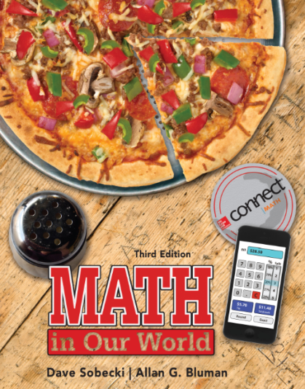
Section 12.8
Math in Our World
Correlation and Regression Analysis

Slide 2
Learning Objectives
Draw and analyze scatter plots for two data sets.
Calculate correlation coefficients.
Determine if correlation coefficients are significant.
Find a regression line for two data sets.
Use regression lines to make predictions.

Slide 3
Correlation
In statistics, correlation is a term that describes an attempt to determine if a relationship exists between two sets of data.
In order to decide if a relationship exists between two data sets, we have to first gather data in such a way that values from each set can be paired together.
We can then plot a graph designating one set of data as the x variable or independent variable and the other as the y variable or dependent variable.

Slide 4
Scatter Plot
A scatter plot is a graph of the ordered pairs (x, y) consisting of data from two data sets.
After the scatter plot is drawn, we can analyze the graph to see if there is a pattern. If there is a noticeable pattern, such as the points falling in an approximately straight line, then a possible relationship between the two variables may exist.

Slide 5
EXAMPLE 1 Drawing a Scatter Plot
A medical researcher selects a sample of small hospitals in his state and hopes to discover if there is a relationship between the number of beds and the number of personnel employed by the hospital. Construct a scatter plot for the data shown.
No. of beds (x) | 28 | 56 | 34 | 42 | 45 | 78 | 84 | 36 | 74 | 95
Personnel (y) | 72 | 195 | 74 | 211 | 145 | 139 | 184 | 131 | 233 | 366

Slide 6
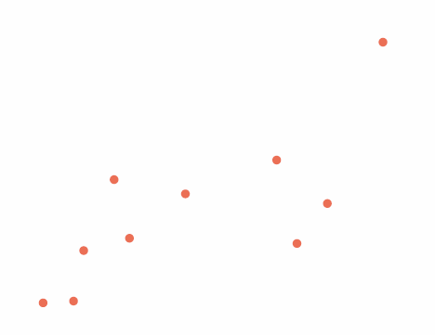
EXAMPLE 1 Constructing a Scatter Plot
SOLUTION
Step 1 Draw and label the x and y axes, as shown.
Personnel
Step 2 Plot the data pairs.
No. of beds (x) | 28 | 56 | 34 | 42 | 45 | 78 | 84 | 36 | 74 | 95
Personnel (y) | 72 | 195 | 74 | 211 | 145 | 139 | 184 | 131 | 233 | 366

Slide 7
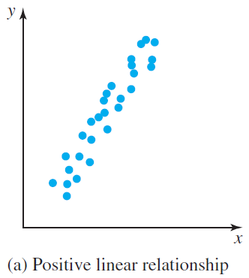
Analyzing the Scatter Plot
The types of patterns and corresponding relationships are:
1. A positive linear relationship exists when the points fall approximately in an ascending straight line from left to right, and both the x and y values increase at the same time.

Slide 8

Analyzing the Scatter Plot
The types of patterns and corresponding relationships are:
2. A negative linear relationship exists when the points fall approximately in a descending straight line from left to right. The relationship then is as the x values are increasing, the y values are decreasing.

Slide 9
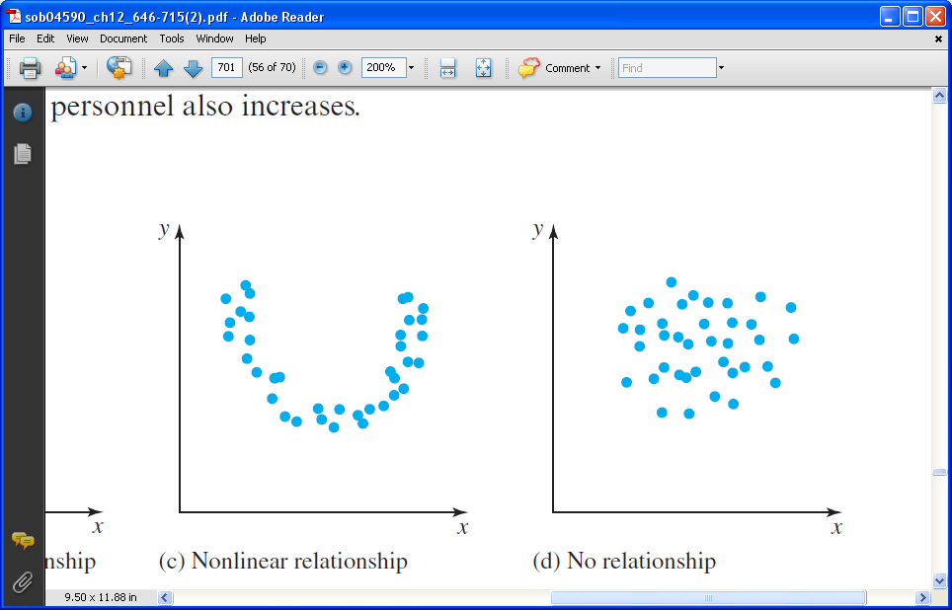
Analyzing the Scatter Plot
The types of patterns and corresponding relationships are:
3. A nonlinear relationship exists when the points fall in a curved line. The relationship is described by the nature of the curve.

Slide 10
Analyzing the Scatter Plot
The types of patterns and corresponding relationships are:
4. No relationship exists when there is no discernible pattern to the points.

Slide 11
The Correlation Coefficient
The correlation coefficient is a number that describes how close to a linear relationship there is between two data sets, represented by the letter r.
Correlation coefficients range from – 1 (perfect negative linear relationship) to + 1 (perfect positive linear relationship). The closer this number is to one in absolute value, the more likely it is that the data sets are related. A correlation coefficient close to zero indicates that the data are most likely not related at all.

Slide 12
The Correlation Coefficient
Formula for Finding the Value of r :
where
n = the number of data pairs
Σx = the sum of the x values
Σy = the sum of the y values
Σxy = the sum of the products of the x and y values for each pair
Σx² = the sum of the squares of the x values
Σy² = the sum of the squares of the y values

Slide 13
EXAMPLE 2 Calculating a
Correlation Coefficient
Find the correlation coefficient for the data in Example 1.
No. of beds (x) | 28 | 56 | 34 | 42 | 45 | 78 | 84 | 36 | 74 | 95
Personnel (y) | 72 | 195 | 74 | 211 | 145 | 139 | 184 | 131 | 233 | 366

Slide 14
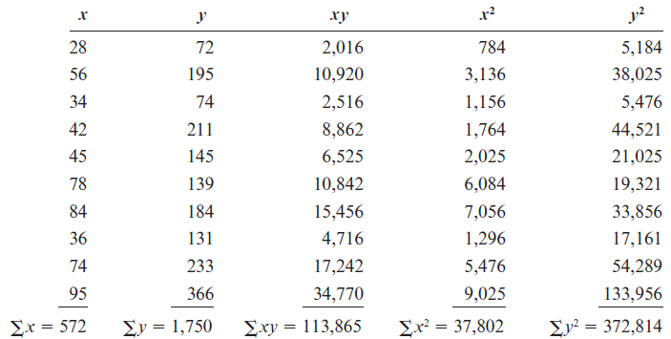
EXAMPLE 2 Calculating a
Correlation Coefficient
SOLUTION
Step 1 Make a table as shown.
Step 2 Find the values for the product xy, the values for x², the values for y²,
and place them in the columns as shown. Then find the sums of the columns.

Slide 15
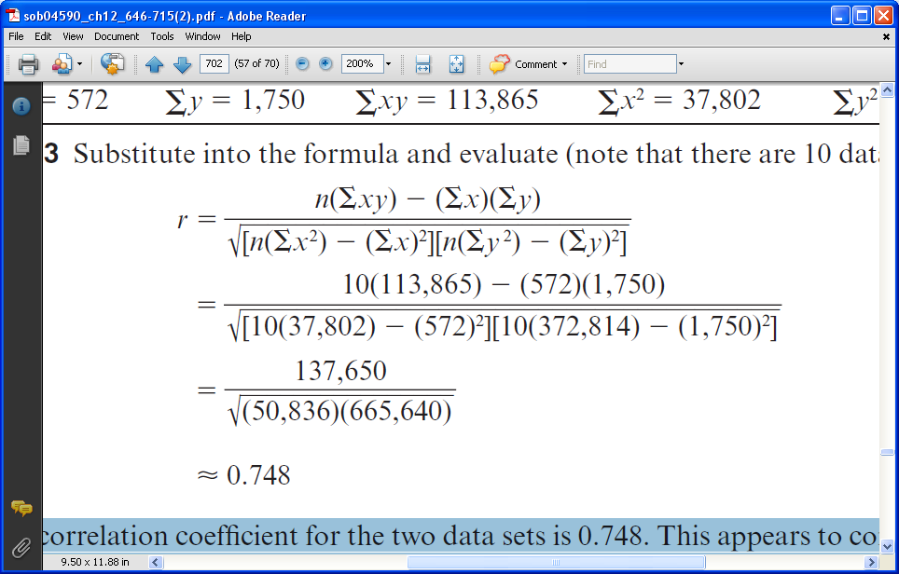
EXAMPLE 2 Calculating a
Correlation Coefficient
SOLUTION
Step 3 Substitute into the formula and evaluate (note that there are 10 data pairs):
The correlation coefficient for the two data sets is 0.748. This appears to confirm what that as bed space goes up, the number of personnel does as well.

Slide 16
Significance Levels
Statisticians have traditionally agreed that when we conclude that two data sets have a relationship, we can be satisfied with that conclusion if there is either a 95% or 99% chance that we’re correct. This corresponds to a 5% or 1% chance of being wrong. These percentages are called significance levels.

Slide 17
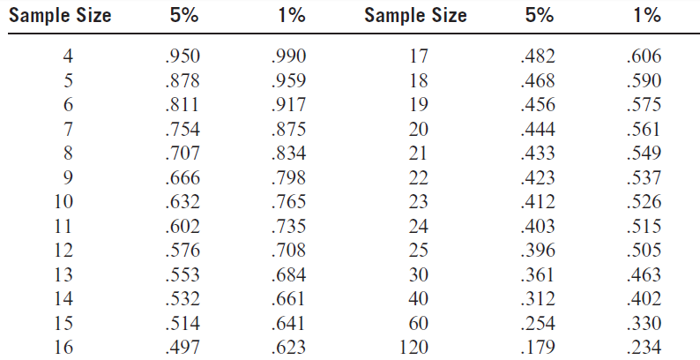
Significance Levels
If ⏐r ⏐ is greater than or equal to the value given in the table for either the 5% or 1% significance level, then we can reasonably conclude that the two data sets are related.

Slide 18
EXAMPLE 3 Deciding if a Correlation Coefficient is Significant
Determine if the correlation coefficient r = 0.748 found in Example 2 is significant at the 5% level.
SOLUTION
Since the sample size is n = 10 and the 5% significance level is used, the value of |r | must be greater than or equal to the number found in the table to be significant.
In this case, |r | = 0.748, which is greater than or equal to 0.632 obtained from the table.
We can conclude that there is a significant relationship between the data sets. However, we can’t conclude that there is a relationship between the data sets at the 1% significance level since |r | = 0.748 is not greater than or equal to 0.765.

Slide 19
Regression
Once we have concluded that there is a significant relationship between the two variables, the next step is to find the equation of the regression line through the data points.
We say it is the line that passes through the points in such a way that the overall distance each point is from the line is at a minimum. The regression line is also called the line of best fit.
Notes:
19

Slide 20
Regression
Recall from algebra that the equation of a line in the slope-intercept form is
y = mx + b,
where m is the slope and b is the y intercept.
In statistics, the equation of the regression line is written as
y = a + bx,
where a is the y intercept and b is the slope.
Notes:
20

Slide 21
Regression Line
In order to find the values for a and b, for the equation y = a + bn, two formulas are used.
Notes:
21

Slide 22
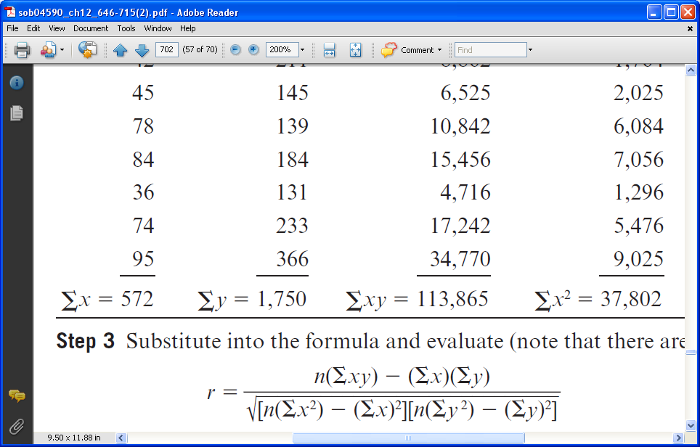
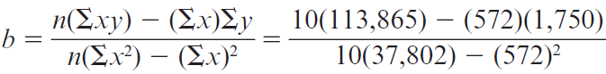
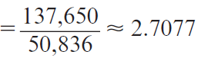
EXAMPLE 4 Finding a Regression Line
Find the equation of the regression line for the data in Example 1.
SOLUTION
We already calculated the values needed for each formula in Example 2. Substitute into the first formula to find the value for the slope, b. Recall that…

Slide 23
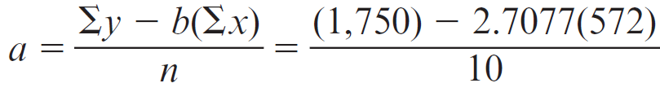
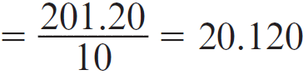
EXAMPLE 4 Finding a Regression Line
SOLUTION
Substitute into the second formula to find the value for the y intercept, a, when b = 2.7077.
The equation of the regression line is y = 20.102 + 2.708x.

Slide 24
EXAMPLE 4 Finding a Regression Line
SOLUTION
This image shows the regression line y = 20.120 + 2.7077x in comparison to the original scatter plot.

Slide 25
Regression Line vs. r
Two things should be noted about the relationship between the value of r and the regression line.
First, the value of r and the value of the slope, b, always have the same sign.
Second, the closer the value of r is to + 1 or – 1, the better the points will fit the line. In other words, the stronger the relationship, the better the fit.

Slide 26
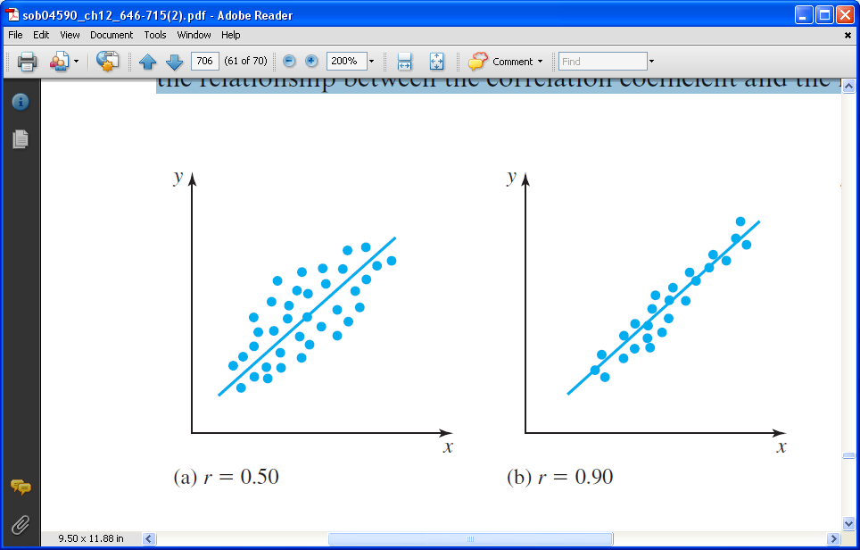
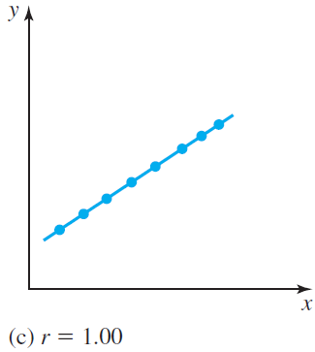
Regression Line vs. r
These graphs show the relationship between the correlation coefficient and the regression line.

Slide 27
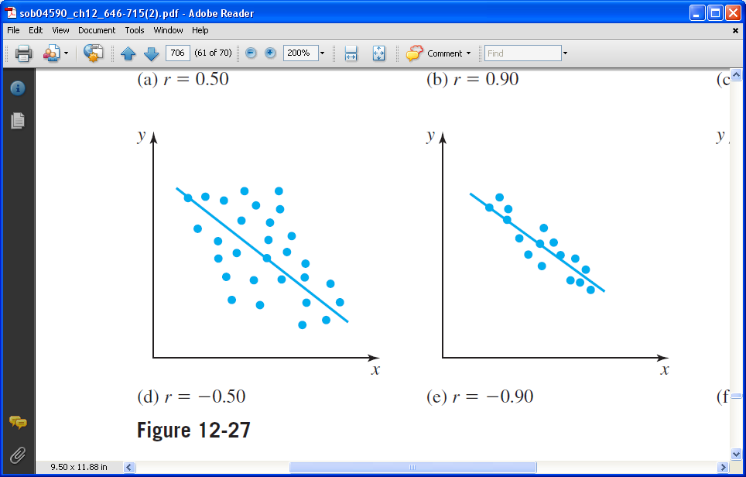
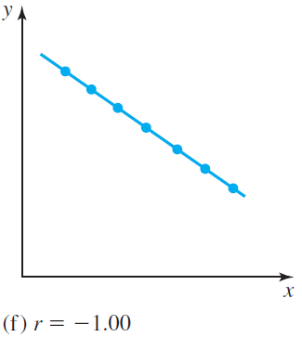
Regression Line vs. r
These graphs show the relationship between the correlation coefficient and the regression line.

Slide 28
EXAMPLE 5 Using a Regression Line to Make a Prediction
Use the equation of the regression line found in Example 4 (y = 20.120 + 2.7077x) to predict the approximate number of personnel for a hospital with 65 beds.
SOLUTION
Substitute 65 for x into the equation y = 20.120 + 2.7077x and find the value for y.
y = 20.120 + 2.7077(65) = 196.12
(which can be rounded to 196)
We predict that a hospital with 65 beds will have approximately 196 personnel.

Slide 29
Correlation and Causation
Possible Relationships between Data Sets
There is a direct cause-and-effect relationship between two variables. That is, x causes y.
There is a reverse cause-and-effect relationship between the variables. That is, y causes x.
The relationship between the variables may be caused by a third variable.
There may be a complexity of interrelationships among many variables.
The relationship might simply be coincidental.

