Slide 1
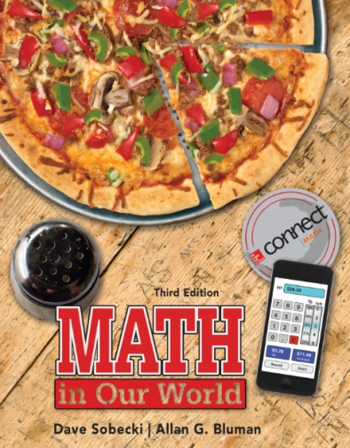
Section 12.5
Math in Our World
Measures of Position

Slide 2
Learning Objectives
Compute the percentile rank for a data value.
Find a data value corresponding to a given percentile.
Use percentile rank to compare values from different data sets.
Compute quartiles for a data set.
Draw a box plot.

Slide 3
Percentile
A percentile, or percentile rank, of a data value indicates the percent of data values in a set that are below that particular value.

Slide 4
EXAMPLE 1 Finding the Percentile Rank of a Data Value
Suppose you score 77 on a test in a class of 10 people, with the 10 scores listed below. What was your percentile rank?
93 82 64 75 98 52 77 88 90 71

Slide 5
EXAMPLE 1 Finding the Range of a Data Set
SOLUTION
Step 1 Arrange the scores in order.
52 64 71 75 77 82 88 90 93 98
Step 2 Find the number of data values below 77.
There are 4 values below 77.
Step 3 Divide the number below the score by the total number of data values and change the answer to a percent.
A test score of 77 is equivalent to the 40th percentile.

Slide 6
EXAMPLE 2 Finding a Data Value Corresponding to a Given Percentile
The number of words in each of the last 10 presidential inaugural addresses is listed below. Find the length that corresponds to the 30th percentile.
2,406 2,073 1,571 2,170 1,507
2,283 2,546 2,463 1,087 1,668

Slide 7
EXAMPLE 2 Finding a Data Value Corresponding to a Given Percentile
SOLUTION
Step 1 We are asked to find the number on the list that has 30% of the numbers below it. There are 10 numbers, and 30% of 10 is 3.
Step 2 Arrange the data in order from smallest to largest, and find the value that has 3 values below it.
1,087 1,507 1,571 1,668 2,073
2,170 2,283 2,406 2,463 2,546
The 30th percentile is the speech that consisted of 1,668 words.

Slide 8
EXAMPLE 3 Using Percentiles to Compare Data from Different Sets
Two students are competing for one remaining spot in a law school class. Miguel ranked 51st in a graduating class of 1,700, while Dustin ranked 27th in a class of 540. Which student’s position was higher in his class?

Slide 9
EXAMPLE 3 Interpreting Standard Deviation
SOLUTION
This is an ideal application of percentile rank. Miguel ranked 51st out of 1,700, so there were 1,700 – 51 = 1,649 students ranked below him. His percentile rank is
Dustin had 540 – 27 = 513 students ranked below him, so his percentile rank is
Both are excellent students, but Miguel’s ranking is higher.

Slide 10
Percentile
A quartile divides a data set into quarters.
The second quartile is the same as the median, and divides a data set into an upper half and a lower half.
The first quartile is the median of the lower half, and the third quartile is the median of the upper half.
We use the symbols Q₁, Q₂, and Q₃ for the first, second, and third quartiles respectively.

Slide 11
EXAMPLE 4 Finding Quartiles for a Data Set
The data below are the percentages of total electricity generated that comes from nuclear power for the 12 nations most reliant on nuclear power. Find the quartiles.
74.1 51.8 51.2 48.1 42.1 39.4 38.1 38.0 37.3 33.3 33.1 32.2
Source: International Atomic Energy Agency
SOLUTION

Slide 12
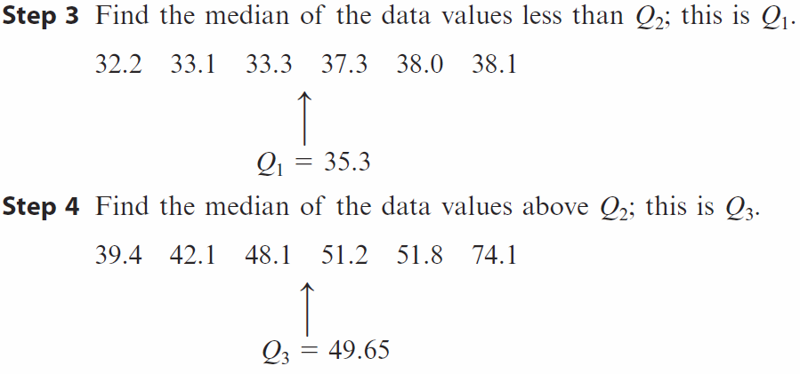
EXAMPLE 4 Finding Quartiles for a Data Set
SOLUTION
In summary, Q₁ = 35.3, Q₂ = 38.75, and Q₃ = 49.65.

Slide 13
EXAMPLE 5 Drawing and Interpreting a Box Plot
Draw a box plot for the nuclear power data in Example 4, then use it to answer some questions about the data.
(a) What does the position of the box tell you about the data set?
(b) Find any outliers in the data set.
(c) What information about the data set do the values inside the box represent?
SOLUTION

Slide 14
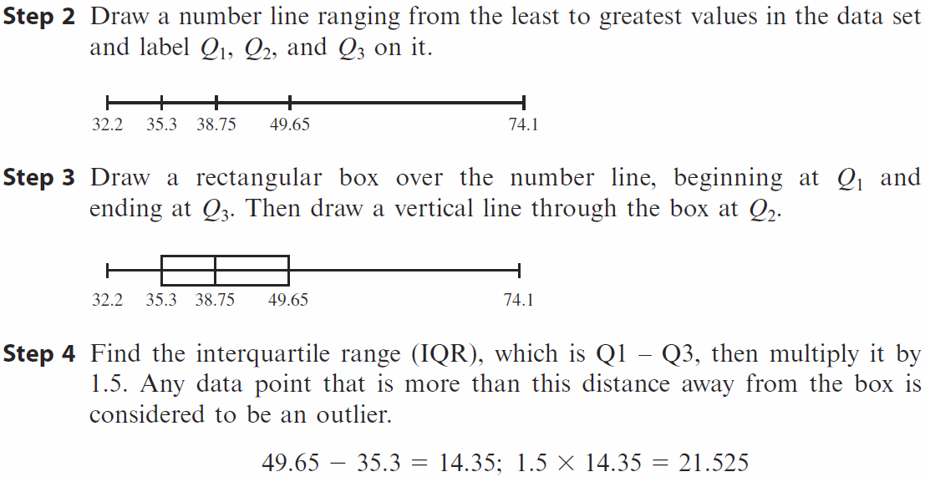
EXAMPLE 5 Drawing and Interpreting a Box Plot
SOLUTION

Slide 15
EXAMPLE 5 Drawing and Interpreting a Box Plot
SOLUTION

