Slide 1
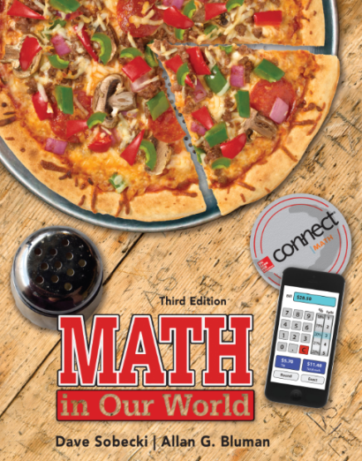
Section 11.4
Math in Our World
Tree Diagrams, Tables, and Sample Spaces

Slide 2
Learning Objectives
Use tree diagrams to find sample spaces and compute probabilities.
Use tables to find sample spaces and compute probabilities.

Slide 3
Tree Diagram
A tree diagram consists of branches corresponding to the outcomes of two or more probability experiments that are done in sequence.
When constructing a tree diagram, use branches emanating from a single point to show the outcomes for the first experiment, and then show the outcomes for the second experiment using branches emanating from each branch that was used for the first experiment, etc.

Slide 4
EXAMPLE 1 Using a Tree Diagram to Find a Sample Space
Use a tree diagram to find the sample space for the genders of three children in a family.
Sample Space
BBB
BGG
BGB
BGG
GBB
GBG
GGB
GGG
B
B
G
B
G
G
B
G
B
G
B
G
B
G
SOLUTION
There are two possibilities for the first child, boy (B) or girl (G), two for the second, boy or girl, and two for the third, boy or girl. So the tree diagram can be drawn as shown.

Slide 5
EXAMPLE 2 Computing a Probability
If a family has three children, find the probability that the three children are not of the same gender. (Assume that each child is equally likely to be a boy or a girl.)
SOLUTION
The sample space shown in Example 1 has eight outcomes, and only two of them have three kids with the same gender (BBB or GGG). So six of the eight outcomes have at least one boy and one girl, making the probability

Slide 6
EXAMPLE 3 Using a Tree Diagram to Compute Probabilities
A coin is tossed, and then a die is rolled. Use a tree diagram to find the probability of getting heads on the coin and an even number on the die.
Sample Space
H1
H2
H3
H4
H5
H6
T1
T2
T3
T4
T5
T6
H
1
T
1
4
4
2
3
5
6
2
3
5
6
SOLUTION
First, we’ll use a tree diagram to find the sample space. The coin will land on either heads or tails, and there are six outcomes for the die: 1, 2, 3, 4, 5, or 6.
Now list the sample space.

Slide 7
EXAMPLE 3 Using a Tree Diagram to Compute Probabilities
SOLUTION
The total number of outcomes for the experiment is 12.
Sample Space
H1
H2
H3
H4
H5
H6
T1
T2
T3
T4
T5
T6
H
1
T
1
4
4
2
3
5
6
2
3
5
6
The number of ways to get a head on the coin and an even number on the die is 3: H2, H4, or H6.
So, the probability of getting a head and an even number when a coin is tossed and a die is
rolled is

Slide 8
Tables
Another way of determining a sample space is by making a table.
Consider the sample space of selecting a card from a standard deck of 52 cards. (The cards are assumed to be shuffled to make sure that the selection occurs at random.)

Slide 9
Tables
There are four suits—hearts, diamonds, spades, and clubs, and 13 cards of each suit consisting of the denominations ace (A), 2, 3, 4, 5, 6, 7, 8, 9, 10, and 3 picture or face cards—jack (J), queen (Q), and king (K).

Slide 10
EXAMPLE 4 Using a Table to Compute Probabilities
A card is drawn from an ordinary deck. Use the sample space in the previous slide to find the probabilities of getting
A jack.
The 6 of clubs.
A 3 or a diamond.
SOLUTION
(a) There are four jacks and 52 possible outcomes, so

Slide 11
EXAMPLE 4 Using a Table to Compute Probabilities
SOLUTION
(b) Since there is only one 6 of clubs, the probability of getting a 6 of clubs is
(c) There are four 3s and 13 diamonds, but the 3 of diamonds is counted twice in this listing. So, there are 16 possibilities of drawing a 3 or a diamond, and

Slide 12
EXAMPLE 5 Using a Table to Compute Probabilities
When two dice are rolled, find the probability of getting
(a) A sum of 8.
(b) Doubles.
(c) A sum less than 5.
SOLUTION
Find the sample space using a table.
There are 36 possible outcomes.

Slide 13
EXAMPLE 5 Using a Table to Compute Probabilities
SOLUTION
(a) There are five ways to get a sum of 8: (2, 6), (3, 5), (4, 4), (5, 3), and (6, 2). So n(E) = 5, n(S) = 36, and
(b) There are six ways to get doubles. So n(E) = 6, n(S) = 36, and

Slide 14
EXAMPLE 5 Using a Table to Compute Probabilities
SOLUTION
(c) A sum less than 5 means a sum of 4 or 3 or 2. The number of ways this can occur is 6.
Sum of 4: (1, 3), (2, 2), (3, 1)
Sum of 3: (1, 2), (2, 1)
Sum of 2: (1, 1)
n(E) = 6, n(S) = 36, and so

