Slide 1
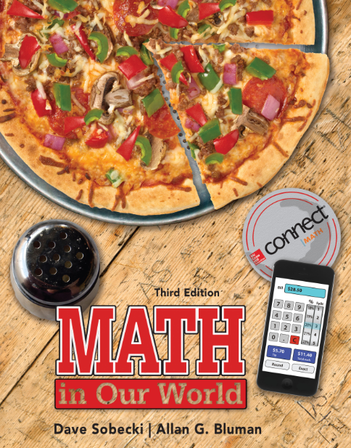
Section 10.2
Math in Our World
Triangles

Slide 2
Learning Objectives
Identify types of triangles.
Find one missing angle in a triangle.
Use the Pythagorean theorem to find side lengths.
Use similar triangles to find side lengths.

Slide 3
Closed Figures
A geometric figure is said to be closed when you can start at one point, trace the entire figure, and finish at the point you started without lifting your pen or pencil off the paper.

Slide 4
Triangle
A triangle is a closed geometric figure that has three sides and three angles. The three sides of the triangle are line segments, and the points where the sides intersect are called the vertices (plural of “vertex”).
One way we can name a triangle is according to its vertices, using the symbol Δ. For example, we could call the triangle shown ΔABC. (In this case, the order of the vertices doesn’t matter.)

Slide 5
Types of Triangles
Special names are given to certain types of triangles based on either the lengths of their sides or the measures of their angles.
For sides:
An isosceles triangle has two sides with the same length.
An equilateral triangle has three sides with the same length.
A scalene triangle has sides that are three different lengths.

Slide 6
Types of Triangles
Special names are given to certain types of triangles based on either the lengths of their sides or the measures of their angles.
For angles:
An acute triangle has three acute angles (less than 90°).
A right triangle has one right angle (90°).
An obtuse triangle has one obtuse angle (greater than 90° and less than 180°).

Slide 7
EXAMPLE 1 Identifying Types of Triangles
Identify the type of triangle.
SOLUTION
(a) Obtuse triangle since one angle is greater than 90°.
(b) Equilateral triangle since all sides are equal, or acute triangle since all angles are acute.
(c) Right triangle since one angle is 90°.

Slide 8
Sum of Angle Measures
In any triangle, the measures of the three angles add to 180°.
Draw any triangle on a piece of paper, then tear it into three pieces, one containing each angle.
Now arrange the three angles next to each other, as shown: you will find that when the vertices of the three angles are placed together, they always form a straight line (180°).

Slide 9
EXAMPLE 2 Finding an Angle in a Triangle
Find the measure of angle C in the triangle.
SOLUTION
Since the sum of the measures of the angles of a triangle is 180°,
The measure of angle C is 100°.

Slide 10
Pythagorean Theorem
The sum of the squares of the lengths of the two legs in a right triangle always equals the square of the length of the hypotenuse. If we use a and b to represent the lengths of the legs and c to represent the length of the hypotenuse, as in the figure, then
hypotenuse
a² + b² = c²
In addition, if the sides of any triangle satisfy this equation, the triangle is a right triangle.
c
a
legs
b

Slide 11
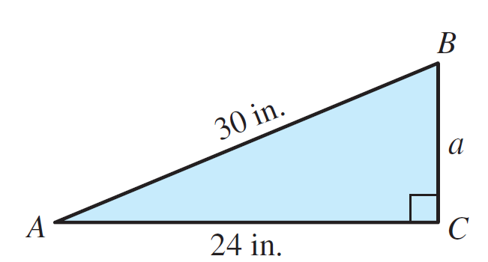
EXAMPLE 3 Using the Pythagorean Theorem
For the right triangle shown, find the length of side a.
SOLUTION
The missing side is 18 inches long.

Slide 12
EXAMPLE 4 Applying the Pythagorean Theorem
To build the frame for the roof of a shed, the carpenter must cut a 2 x 4 to fit on the diagonal. If the length of the horizontal beam is 12 feet and the height is 3 feet, find the length of the diagonal beam.

Slide 13
EXAMPLE 4 Applying the Pythagorean Theorem
SOLUTION
The frame forms two right triangles with legs of 3 feet and 6 feet. The length of the diagonal beam can be found using the Pythagorean theorem.
The length of the beam should be about 6.7 feet.

Slide 14
Similar Triangles
When two triangles have the same shape but not necessarily the same size, they are called similar triangles.
Since the measure of angle A and the measure of angle A’ are equal, they are called corresponding angles.

Slide 15
Similar Triangles
When two triangles are similar, then their corresponding angles will have the same measure. Also, if all of the corresponding angles have equal measure, we know
that two triangles are similar.

Slide 16
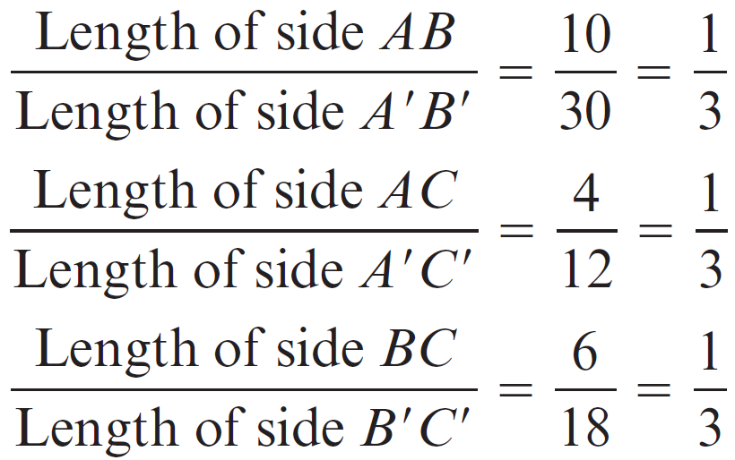
Similar Triangle Relationships
The sides that are opposite the corresponding angles are called corresponding sides. When two triangles are similar, the ratios of the corresponding sides are equal.

Slide 17
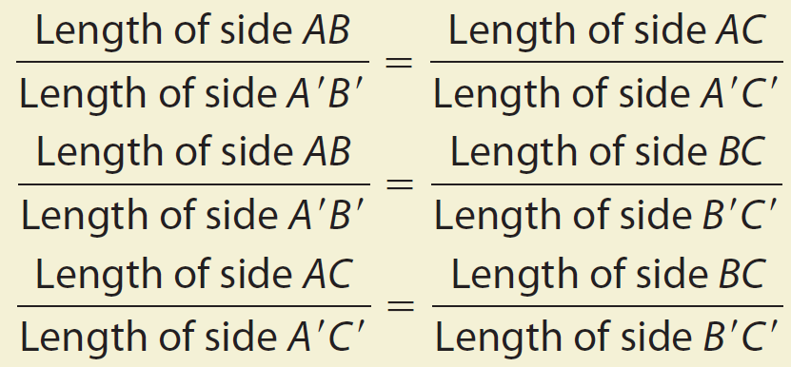
Similar Triangle Relationships
If triangle ABC is similar to triangle A’B’C’ then

Slide 18
EXAMPLE 5 Using Similar Triangles
If the two triangles below are similar, find the length of side B’C’.

Slide 19
EXAMPLE 5 Using Similar Triangles
SOLUTION
To begin, we will use the variable x to represent the length we’re asked to find.
Now we want to write ratios of corresponding sides. Sides AB and AB are corresponding, and sides BC and BC are as well. So the ratios formed from these corresponding sides will be equal:

Slide 20
EXAMPLE 5 Using Similar Triangles
SOLUTION
Now we substitute in the lengths and solve for x.
The length of side B’C’ is 9 inches.

Slide 21
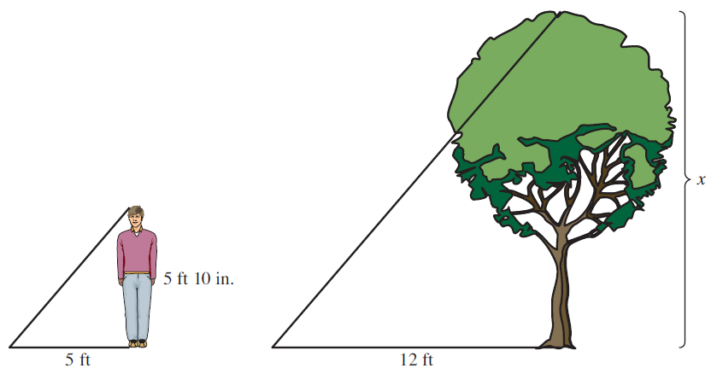
EXAMPLE 6 Using Similar Triangles in Measurement
If a tree casts a shadow 12 feet long and at the same time a person who is 5 feet 10 inches tall casts a shadow of 5 feet, find the height of the tree.

Slide 22
EXAMPLE 6 Using Similar Triangles in Measurement
SOLUTION
Both triangles in the diagram are right triangles, and since the sun makes the same angle with the ground in both diagrams, the triangles have two corresponding angles equal, and must be similar. That means we can set up and solve a proportion:

