Slide 1
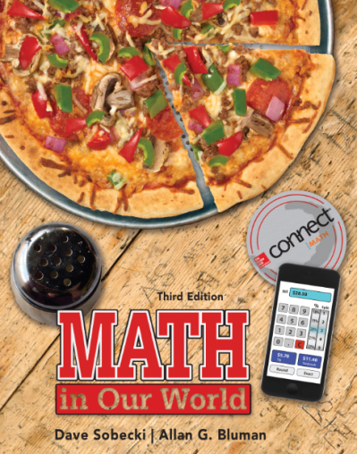
Section 9.2
Math in Our World
Measures of Area,
Volume and Capacity

Slide 2
Learning Objectives
Convert units of area in the English system.
Convert measurements between English and metric units of area.
Convert units of volume in the English system.
Convert units of volume in the metric system.
Convert measurements between English and metric units of volume.

Slide 3
Conversions of Area
Units of length are also called linear units, because they are used to measure along a line. The units used to measure the size of an object in two dimensions are called square units.
They are based on a very simple idea: one square unit is defined to be the area of a square that is one unit long on each side.

Slide 4
English Conversions

Slide 5
English & Metric Equivalents
2.47 acre ≈ 1 hectare
1 hectare = 10,000 m²
1 km² = 100 hectare

Slide 6
EXAMPLE 1 Converting Square Inches to Square Feet
A 52-in. wide-screen TV has a screen area of 1,064 in.². How many square feet is that?
SOLUTION
We want to replace in.² with ft², so we multiply by the following unit fraction:

Slide 7
EXAMPLE 2 Converting Acres to Square Miles
Yellowstone National Park has an area of 2,219,789 acres. How large is it in square miles?
SOLUTION
This time, we want a unit fraction with acres in the denominator and square miles in the numerator:

Slide 8
EXAMPLE 3 Converting Square Yards to Acres
An average of 2,191,781 square yards of carpet is discarded into landfills every day in the United States. How many acres would that carpet cover?
SOLUTION
There is no direct conversion between square yards and acres in the Table, so we will convert to square feet and then to acres.

Slide 9
EXAMPLE 4 Converting Area from English to Metric Units
The plans for building a deck call for 28 square meters of deck boards. John has already bought 300 square feet. Does he have enough?
SOLUTION
John needs to convert 28 square meters to square feet to see how much wood is required.
The 300 ft² that John bought is not quite enough.

Slide 10
EXAMPLE 5 Converting Area from Metric to English Units
Prince Edward County in Ontario, Canada, has an area of 1,050.1 square kilometers. Is it larger or smaller than Butler County, Ohio, which is 470 square miles?
SOLUTION
To find how many square miles in 1,050.1 square kilometers,
Butler County is about 64.6 square miles larger.

Slide 11
EXAMPLE 6 Finding the Cost of Carpeting a Room
Jane plans to have new carpet installed in her living room. She measures and finds that the room is 300 ft². The carpet she wants sells for $22 per square yard installed. How much will it cost to have the room carpeted?
SOLUTION
We first convert square feet to square yards, then use the unit fraction $22/1yd² to find the cost.
$$\text{•}\frac{\$22}{1yd^{2}}$$
$$=\$733.33$$

Slide 12
EXAMPLE 6a Converting km² to hectare
The Brazilian government has decided to protect 100 km² of rain forest land and has $10 million available for compensation. How much can the government afford to pay per hectare?
SOLUTION
We first convert sq km to hectares, then divide the money available by the number of hectares.
$$=10,000 hectares$$
$10,000,000 ÷10,000 hectares = $1,000 per hectare

Slide 13
Conversions of Volume & Capacity
Just as the measurements of area are based on the two-dimensional square, measurements of volume are based on the three-dimensional analog, the cube. So volume is measured in cubic units.
For example, 1 cubic foot consists of a cube whose measure is 12 inches on each side. Recall that to find the volume of a cube, we multiply the length times the width times the height.

Slide 14
Units of Capacity & Volume
English System
1 pint (pt) = 16 fluid ounces (oz)
1 quart (qt) = 2 pints (pt)
1 gallon (gal) = 4 quarts (qt)
Volume vs. Capacity
1 cubic foot ≈ 7.48 gal
1 cubic yard ≈ 202 gal
1 gal. ≈ 231 in.³
1 pt. water = 1 lb. (16 oz.)
1 ft³ water ≈ 62.5 lb
1 ft³ seawater ≈ 64 lb

Slide 15
EXAMPLE 7 Converting Cubic Feet to Gallons
If a water tank at an aquarium has a volume of 3,000 cubic feet, how many gallons of water will the tank hold?
SOLUTION
From the Table, 1 cubic foot = 7.48 gallons.

Slide 16
EXAMPLE 8 Finding Weight of a Liquid
If the tank in the previous example contains freshwater, find its weight.
SOLUTION
1 cubic foot of freshwater weighs 62.5 pounds, so

Slide 17
EXAMPLE 9 Computing the Weight of Water in Bottles
The team managers for a college football team carry quart bottles of water for the players to drink during breaks at practice. The bottles are stored in carrying racks that weigh 6 pounds and hold 16 bottles. How heavy (in pounds) is a rack when full?
(Ignore the weight of the empty bottles).

Slide 18
EXAMPLE 9 Computing the Weight of Water in Bottles
SOLUTION
First we will need to know how much a quart of freshwater weighs.
So 16 bottles weigh 16 x 2 = 32 1b; adding the 6 pounds for the rack, a full load weighs 38 pounds.

Slide 19
Units of Capacity & Volume
Metric System
1 cm³ = 1 mL
1,000 cm³ = 1 L
1 m³ = 1 kL
1 L ≈ 1.06 quarts

Slide 20
EXAMPLE 10 Converting Metric Units of Volume
A typical backyard in-ground pool has a volume of about 82.5 cubic meters. How many milliliters of water are needed to fill such a pool?
SOLUTION
There’s a conversion in the Table from mL to cm³, so we first convert to cm³, then to mL.

Slide 21
EXAMPLE 10 Converting Metric Units of Volume
A typical backyard in-ground pool has a volume of about 82.5 cubic meters. How many milliliters of water are needed to fill such a pool?
SOLUTION (alternative)
1 m³.= 1kL, so we have 82.5 kL Now convert to L and then finally mL

Slide 22
EXAMPLE 11 Converting Liters to Gallons
How many gallons of Seltzer water are in one 2-liter bottle?
SOLUTION
We know that 1 liter is about 1.06 quarts, and that 1 gallon is 4 quarts:

