Slide 1
Microdontia
(Peg-shaped lateral) and Macrodontia
Lucidania Naranjo
And
Gladys Valverde
DEN1218/232

Slide 2
Microdontia
Microdontia refers to smaller teeth than normal.
“Micro” means small and “Dontia” means a state relating to teeth. Thus abnormally small teeth is consider Microdontia. It is caused by genetic mutations.
Generalized: affect the entire dentition
Localized: affects one or few teeth
Generalized cases are rare.
Most frequent teeth affected are the maxillary lateral incisors and the third molars. Supernumerary teeth often tend to be microdonts with altered morphology
Microdontia is a common oral health problem that often runs in families. Adults affected by microdontia may have small teeth with gaps between them, making them look like baby teeth. Teeth that are too small may not fit together or chew properly, which can cause excessive wear and tear.

Slide 3
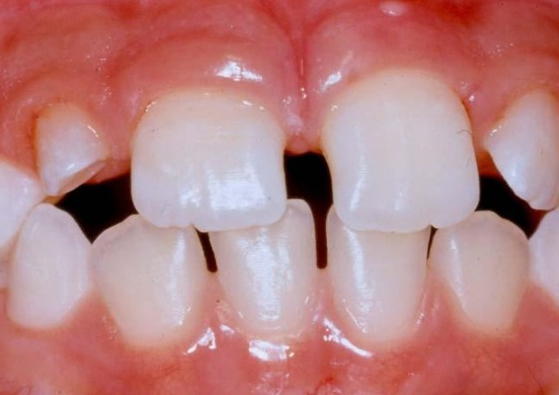
Microdontia Clinical Appearance
The individual tooth is smaller than the adjacent teeth and may have normal morphology.

Slide 4
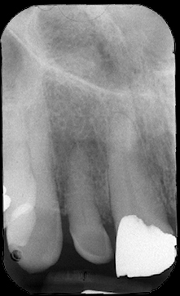
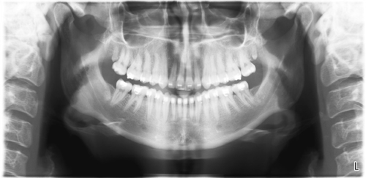
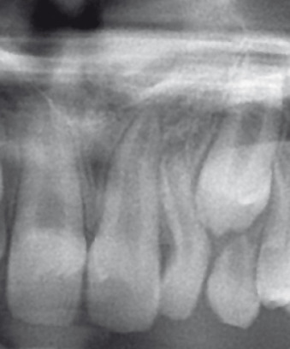
Microdontia
radiographic Appearance
Periapical radiographs shows a microdontic lateral peg shape.
Panoramic radiograph shows a microdontic third molar

Slide 5
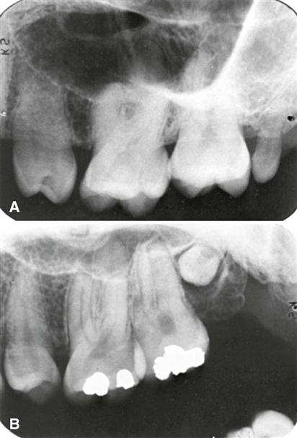
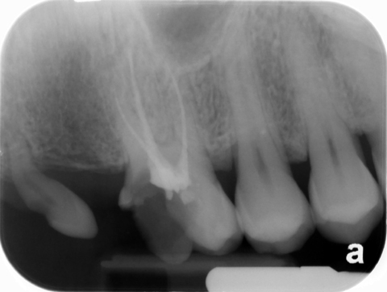
Microdontia
radiographic Appearance
Periapical radiographs shows a microdontic third molar.
http://drgstoothpix.com/radiographic-interpretation/tooth-anomalies/size-variations/microdont/

Slide 6
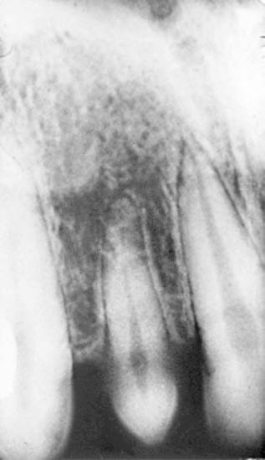
Microdontia radiographic Appearance
Peg-shaped deformity in microdontia of a maxillary lateral incisor.

Slide 7
Macrodontia
Is a type of localized gigantism in which teeth are larger than normal for the particular type(s) of teeth involved.
The condition may be caused by a systemic conditions such as childhood hyperpituitarism (gigantism) or Down's syndrome. It may also be caused by the effects of chemotherapeutic and radiation treatment during the tooth development age.
Macrodontia is a developmental dental anomaly, and it is often confused with taurodontism and fusion of the teeth.
Clinical Features. Clinically, macrodont teeth appear large and may be associated with crowding, malocclusion, or impaction.
Imaging Features. Images reveal the increased size of both unerupted and erupted macrodont teeth.

Slide 8
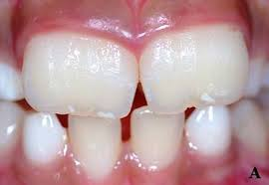
Macrodontia
clinical Appearance
https://dentagama.com/news/all-you-need-to-know-about-macrodontia

Slide 9
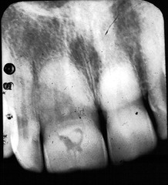
Macrodontia
radiographic Appearance
https://slideplayer.com/slide/13312955

Slide 10
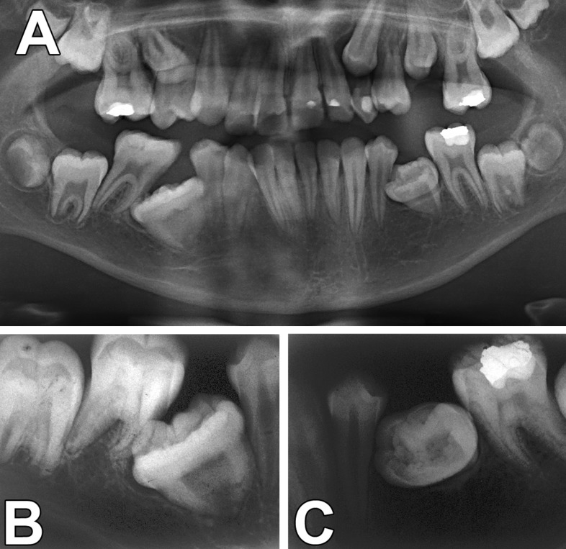
Macrodontia radiographic Appearance

Slide 11
Sources
Fehrenbach, M. J., Popowics, T., & Bath-Balogh, M. (2016). Illustrated dental embryology, histology, and anatomy. 4th Edition. Page 54 Maryland Heights: Elsevier/Saunders.
White, S. C., & Pharoah, M. J. (2014). Pages 586-587.Oral radiology: principles and interpretation. St. Louis, MO: Elsevier.
https://dentagama.com/news/all-you-need-to-know-about-macrodontia
https://slideplayer.com/slide/13312955
http://drgstoothpix.com/radiographic-interpretation/tooth-anomalies/size-variations/microdont/
https://www.sciencedirect.com/topics/medicine-and-dentistry/microdontia

