Slide 1
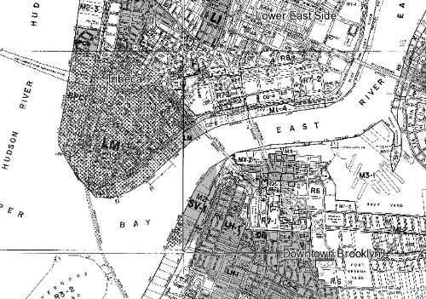
TEAM ZONING RESEARCH
R.A

Slide 2
Group II Members
Azmir Sultana
Cynthia Persaud
Yefeng Yan
Abdelsalam Mali
Richard Arenas
R.A

Slide 3
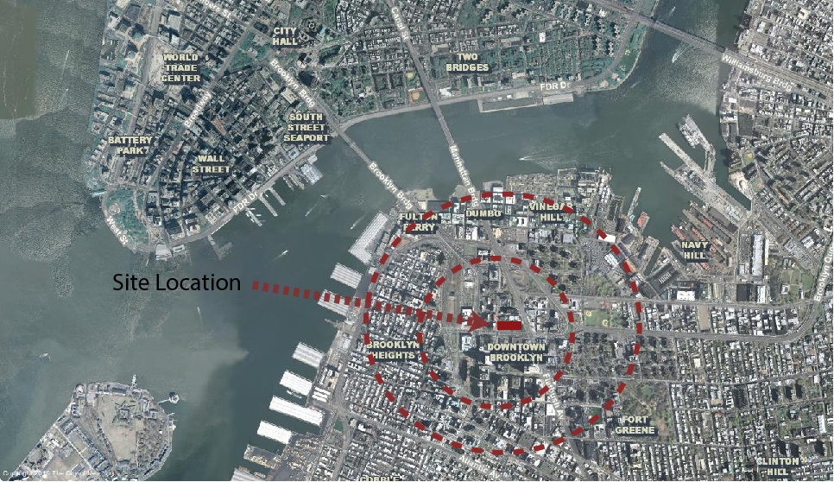
Aerial Map
R.A A.M C.P

Slide 4
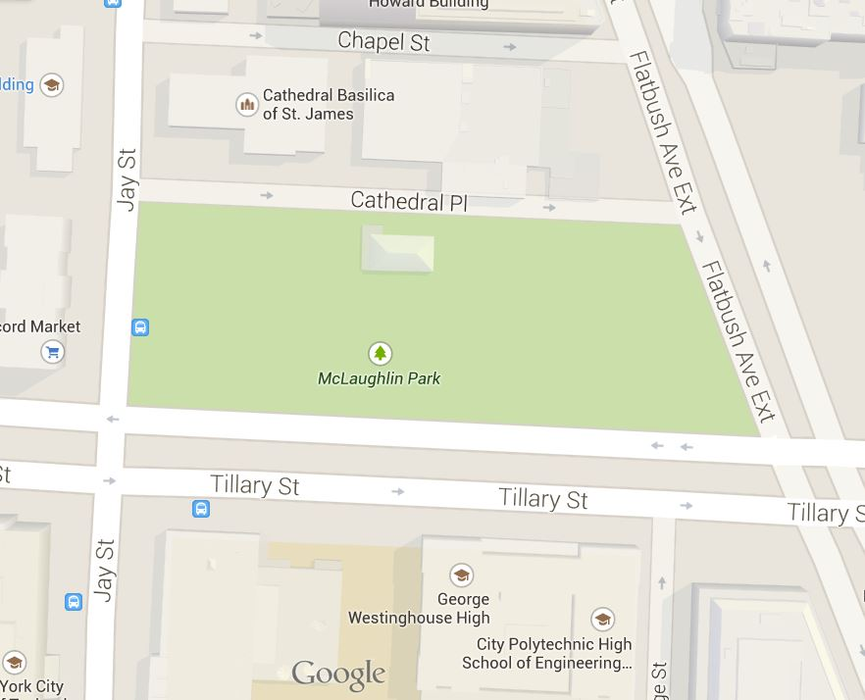
Environ Map
Site: 243 Jay street, Brooklyn ny
R.A A.M C.P

Slide 5
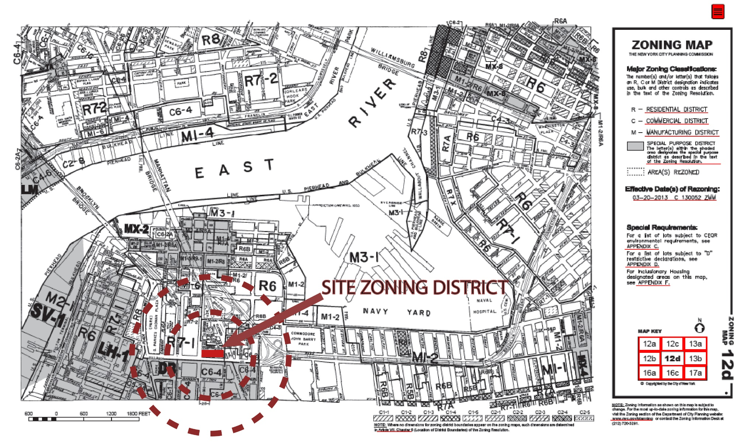
A.M

Slide 6
PROPERTY INFORMATION
Address: 243 JAY STREET, BROOKLYN 11201
Primary Zoning: Park
Lot Area: 85,289 sq ft
(493.5’ x 173.42’)
No residential Units just one small edification of 2,800 sq ft.
One floor
Floor Area Ratio: 10
Total floor area: 852,890 sq ft
Streets surrounding the site:
Jay St, Tillary St, Bridge St, Cathedral Place.
Zoning Code: C6-4
A.S
R.A

Slide 7
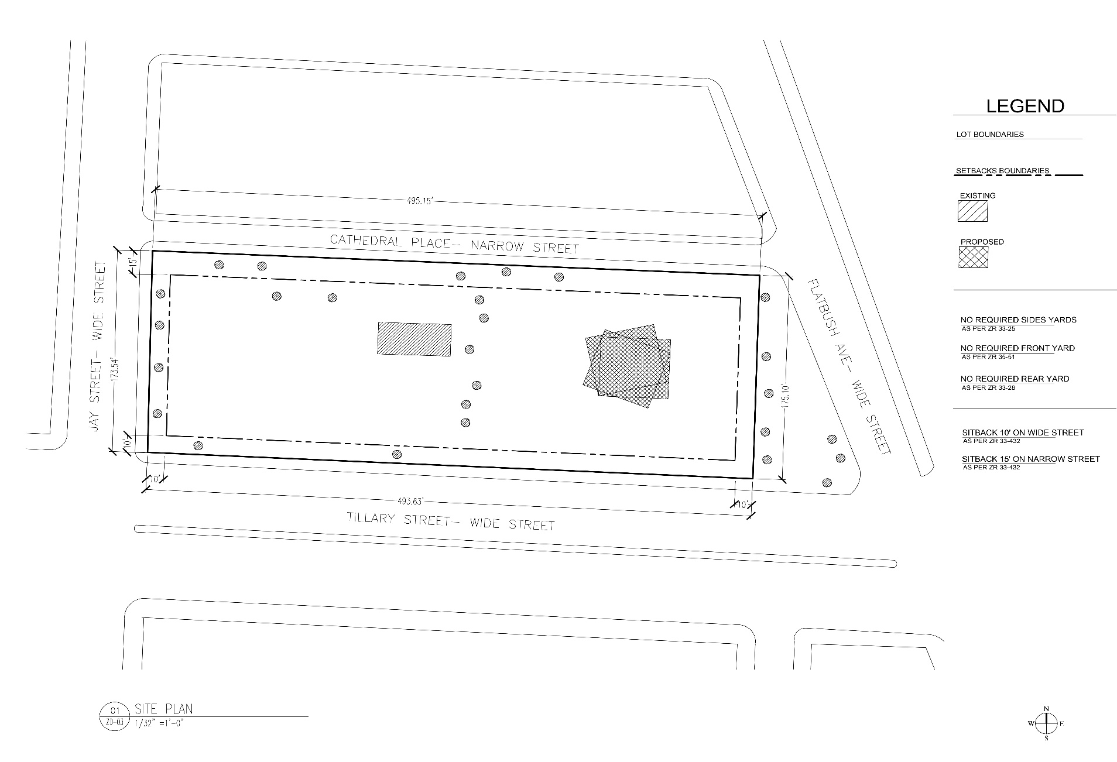
SITE PLAN
A.M

Slide 8
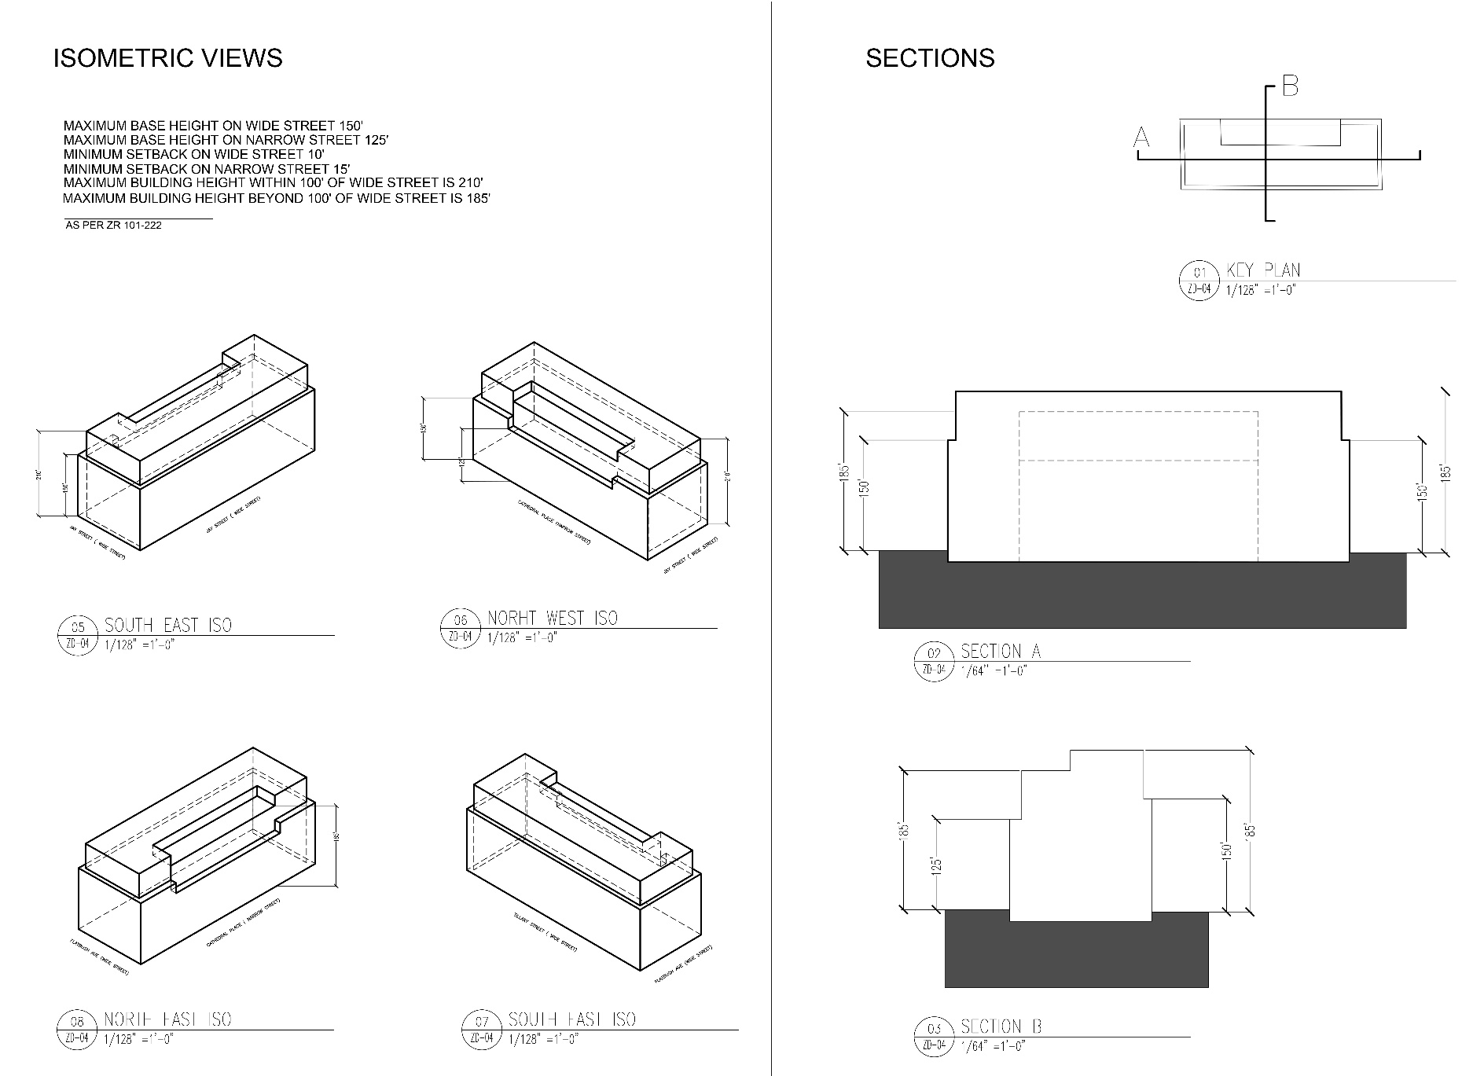
SECTION AND ISOMETRIC VIEWS
A.M

Slide 9
VIEWS
A.S

Slide 10
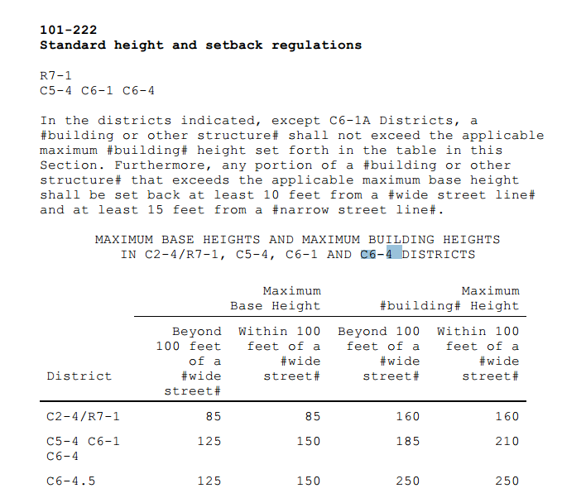
Zoning Code Information
Y.Y C.P

Slide 11
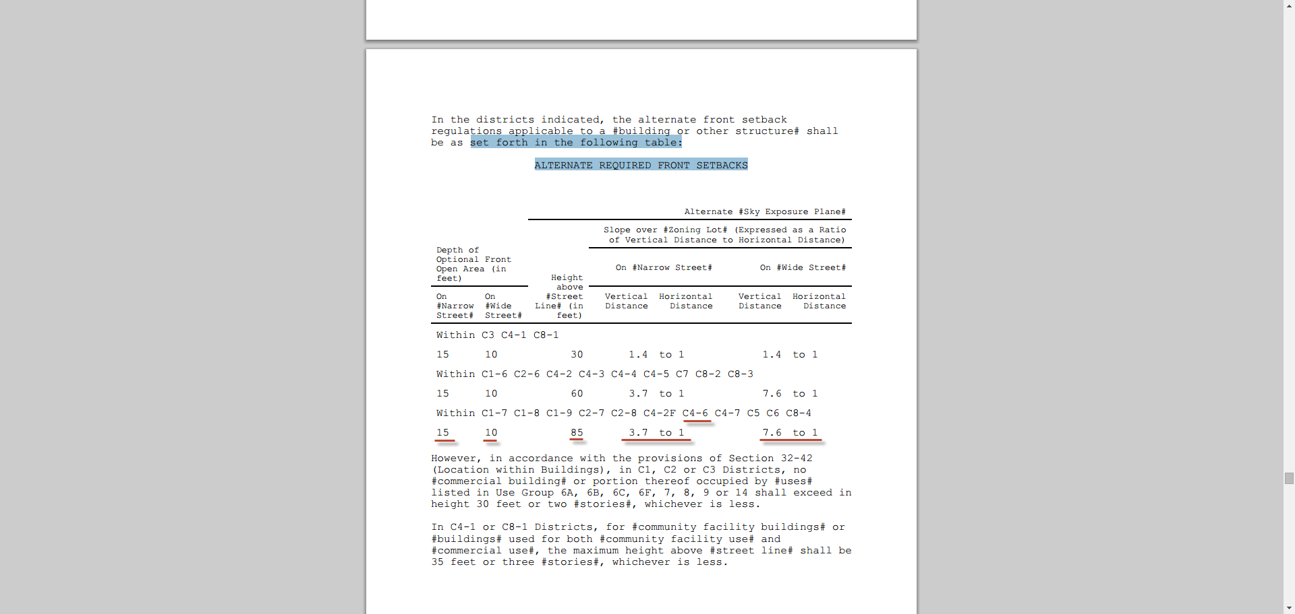
Sky exposure Information
A.S
Notes:
A.S

Slide 12
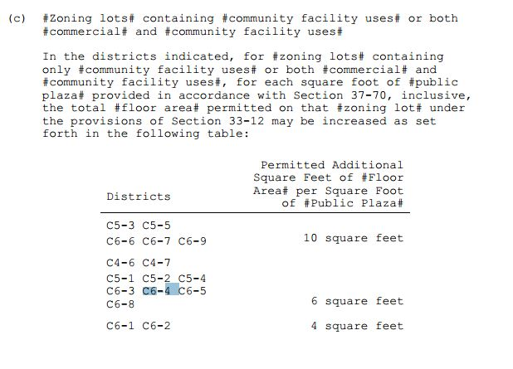
Zoning Code Information (Cont.)
C.P

Slide 13
Zoning Information (Cont.)
Y.Y C.P

