Slide 1
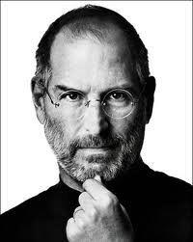
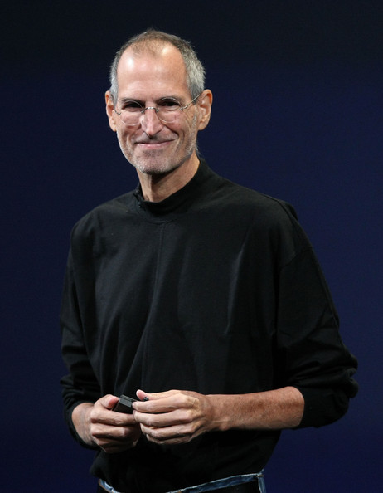
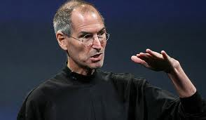
Steve Jobs
1955 - 2011

Slide 2
Q: What do you call an individual who is an innovator, creative genius, college dropout, self-proclaimed Buddhist, one of the richest people in the world and an technology pioneer?

Slide 3
A. You call them Steve Jobs.

Slide 4
Why Steve Jobs?
Steve Jobs determination did allow him to give up, regardless of almost being homeless, taking a salary of a dollar, and getting fired from Apple. He still wanted to change the world one way or another.
His technological innovations shaped web design, but his understanding of the importance of design also shaped the way in we see his creations, and technology.

Slide 5
Steve Jobs relationship with Art and Design and Graphic Arts.
Both Steve jobs and ADGA communicate through theie design/art that is created in order to convey an idea that they want another to understand.
Steve jobs helped bring art into technology and blend it very well. Art and Design/ Graphic Arts do the same.

Slide 6
The Life of an Icon
1955 - Steven Paul Jobs was born on February 24 in San Francisco, California,
to Joanne Schieble and Abdulfattah Jandall. He was put up for adoption
a week after his birth and his adopted parents were Clara and Paul
Jobs.
1968 - Jobs was offered a summer job at Hewlett-Packard Co. (HP) by William
Hewlett.
1970 - He meant, the soon to be co-founder of Apple, Steve Wozniak.
1972 - Jobs graduates from Homestead High School in Cupertino, California,
and attends Reed College in Portland, Oregon. Dropped out of his first
semester, but still continued to take classes he liked, such as
Calligraphy.
1974 - He got a job as a technician at Atari, a manufacturer of popular video games.
Also visited India, that made him return to California as a Buddhist.
1976 - Apples Computer Company was founded on April’s Fool Day as a partnership
ship, between Jobs, Wozniak and Ronald Wayne. The company also sold the Apple I
for $666.66.
1977 - Apple incorporates and releases the Apple II. The first personal computer produce
color graphics.

Slide 7
The Life of an Icon (cont.….)
1978 - Job’s daughter Lisa is born to girlfriend Chrisann Brennan.
1985 - He resigns as Apple’s chairman.
1986 - 1993 Job founds Next Inc., a company that makes machines for universities and
eventually discontinued its computers in the marketplace. He also bought Pixar.
1996 - 2000 Job’s returns to Apple as an adviser. The iMac is introduced and named the
CEO of Apple, with the annual salary of a $1.
2001 - 2004 Apple introduces the first iPod and iTunes. Jobs undergoes surgery to
remove a cancerous tumor in his pancreas.
2005 - 2009 The iPod Nano and the iPod with video, the iPhone, the iPod Touch and the
App Store is introduced. Disney buys Pixar from Jobs for $7.4 billion. Jobs takes a medical
leave for 6 months.
2010 - August 4, 2011 Apple presents the iPad and jobs resigns as CEO, and Tim Cook will take his
place, while he is chairman.
October 5, 2011 - “The visionary and creative genius,” Steve Jobs dies at the age of 56 of
Pancreatic cancer.

Slide 8
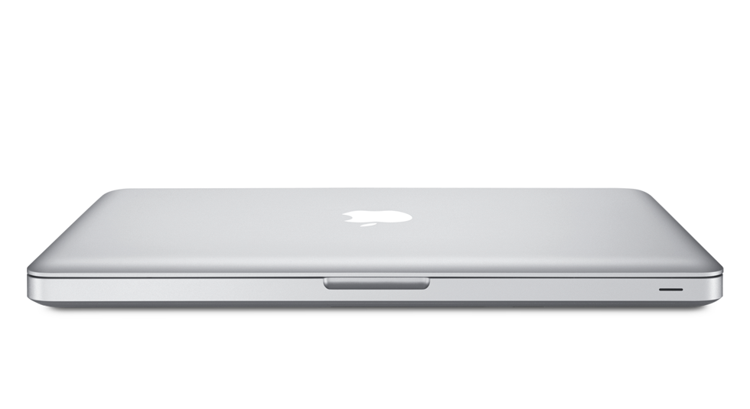
Accomplishments
He founded Apple, one of the great, innovative technology companies in the world with his partner, Steve Woziak.
Developed the first successful personal computer, the Apple II.
Developed the first user-friendly computer, the Macintosh, that included a mouse.
Created the iPod, a multimedia device for listening to music, watching videos, checking your email and connecting to the Internet, that became successful worldwide.
Developed the IPhone device, restoring the look and feel of such devices for the entire Smartphone industry.
Lastly, becoming an icon of technological change and innovation in society.

Slide 9
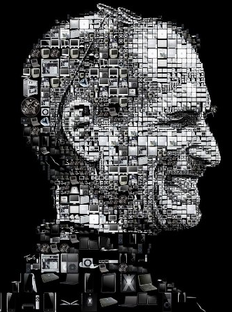
Why are his accomplishments appealing to ADGA?
They are appealing because he changed the way people perceive and interact with technology by making it available and efficient for anyone to use.
He also improved the pixels per inch making screen resolution smooth and easy on the eyes.
As well as, friendly user interface design ,such as apple’s logo and typeface, that is simple, clean, and contemporary. Three things characteristics a designer should be aware of when creating something of their own.

Slide 10
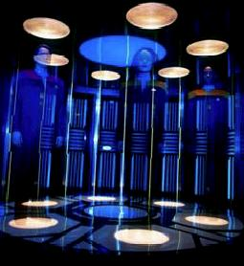
The Next iProduct? iPort
The iPort, will be a teleport device. That will allow a person to transport and item their self. It can be used better technology by diminishing mailing services if people can obtain the product.

Slide 11
Did you know?
Steve Jobs did give out money to charity, despite how rich he is.
At the age of 30, he found his biological sister, Mona Simpson, a novelist.
He is dyslexic- a learning disability that makes it difficult for a person to read.
He named the company, Apple, because apples were his favorite fruit.
He was moved to a night shift at Atari, because he had poor personal hygiene.

Slide 12
Conclusion
Steve Jobs was perceived from many as intelligent but abrasive. However, as the co-founder of Apple Computers, he is a force of nature and a smart businessman that will forever be a legend.

Slide 13
Resources/Bibliography
Moisesco, Romain. "Long Biography of Steve Jobs (Youth)." All about Steve Jobs.com. 2011. Web. 14 Dec. 2011. <http://allaboutstevejobs.com/bio/long/01.html>.
Griggs, Brandon. "Steve Jobs, Apple Founder, Dies - CNN." Featured Articles from CNN. CNN.com, 05 Oct. 2011. Web. 14 Dec. 2011. <http://articles.cnn.com/2011-10-05/us/us_obit-steve-jobs_1_jobs-and-wozniak-iphone-apple-founder?_s=PM:US>

Slide 14
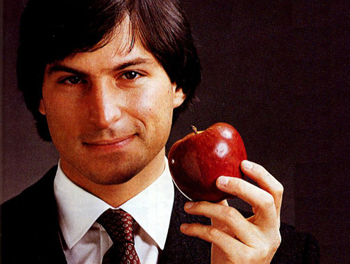
“Innovation distinguishes between a LEADER and a FOLLOWER .”
- Steve Jobs

