Slide 1
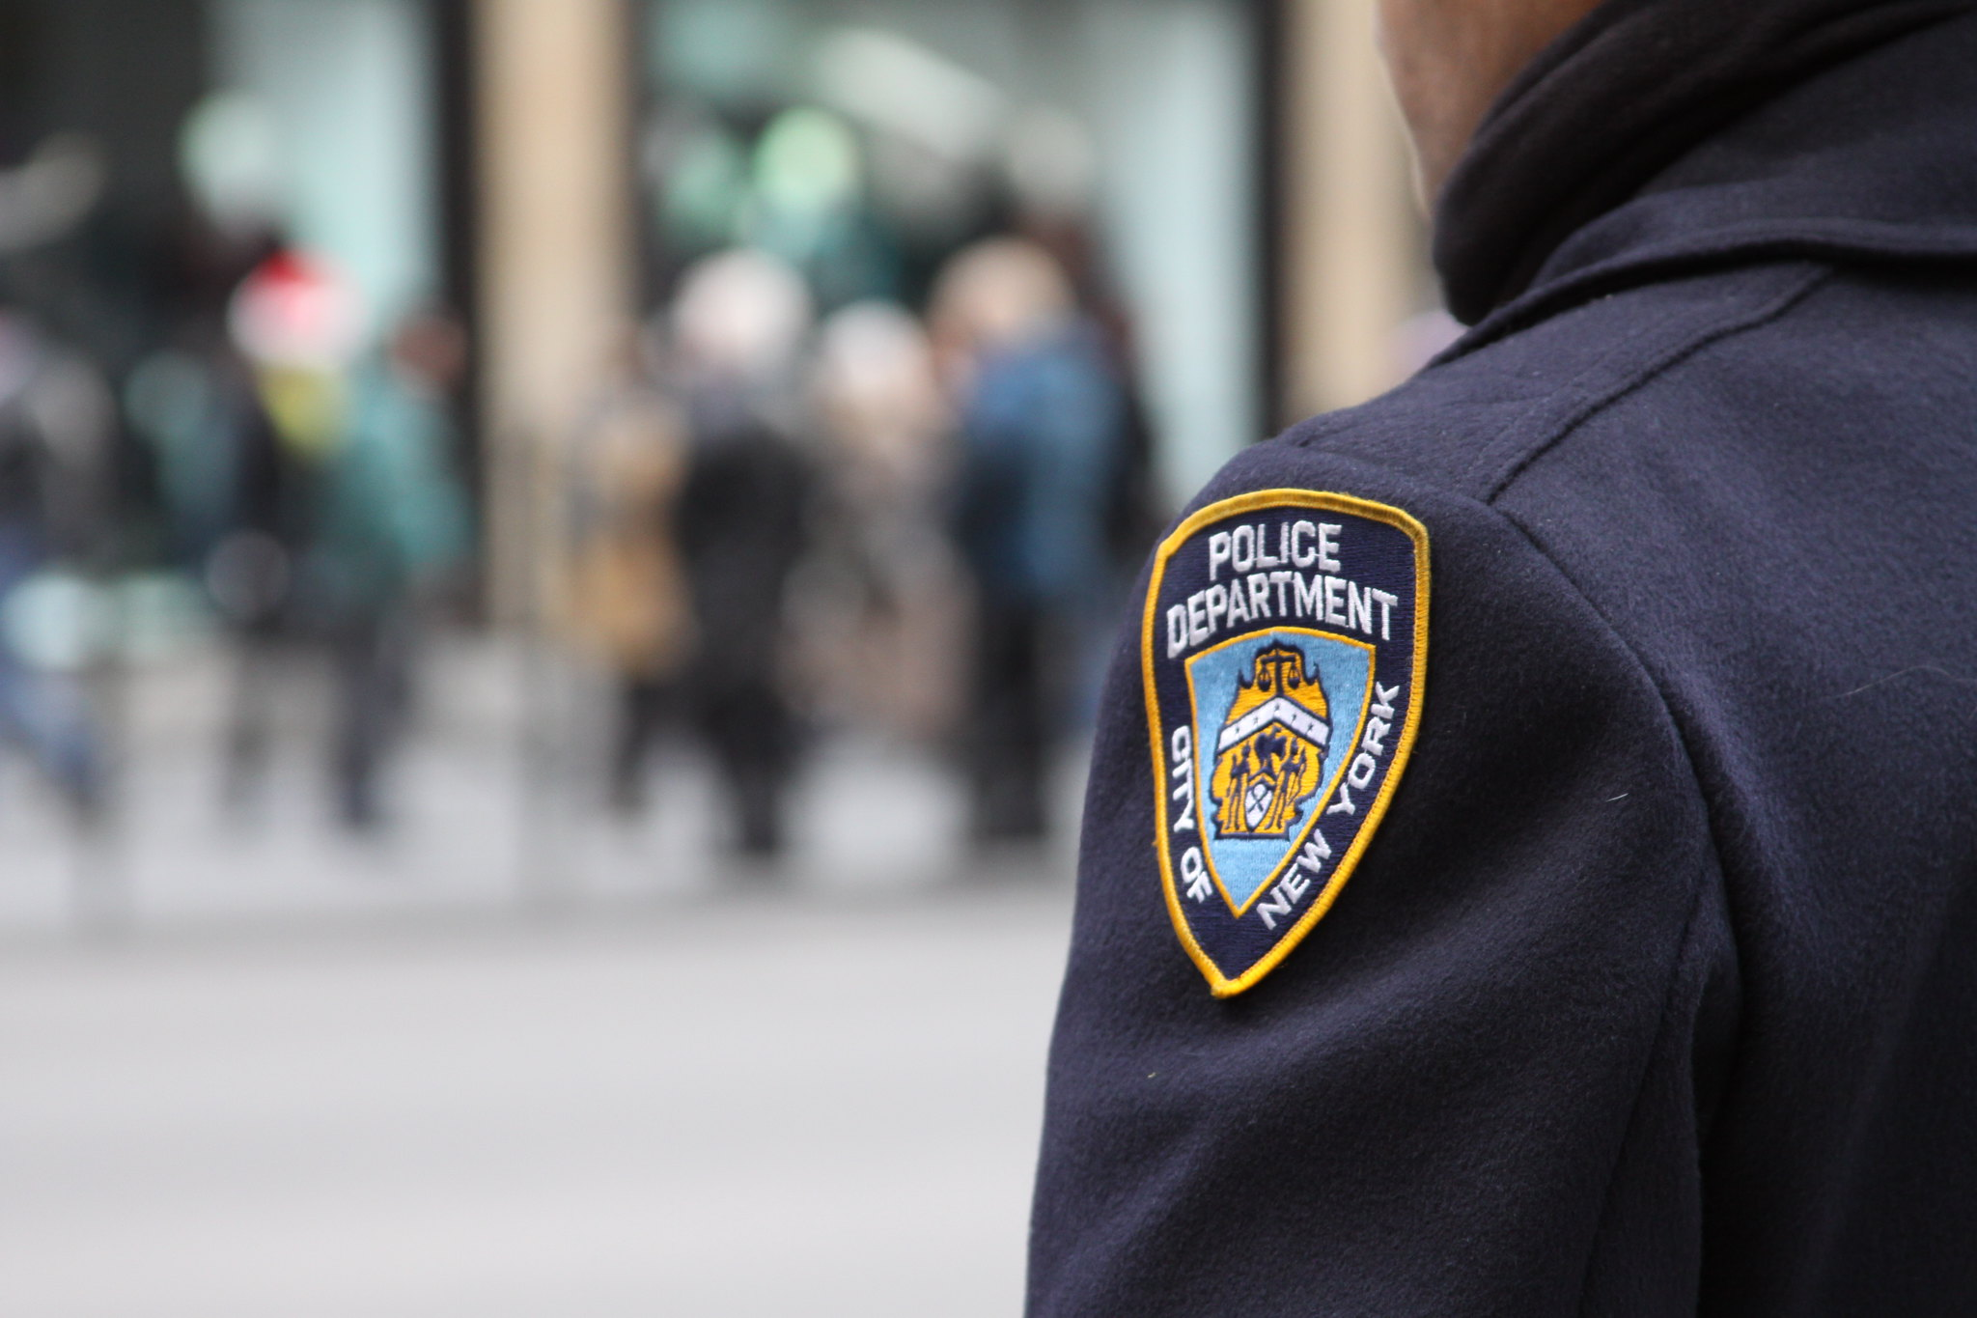
Chapter 16: Crime Policy
GOV 1101-American Government
"New York's Finest" by Dave Hosford is licensed under CC BY 2.0

Slide 2
Crime Policy
Protecting people from crime is one of government’s main responsibilities.
A balance must be struck between being tough on crime and respecting peoples’ constitutional rights.
Republicans and Democrats disagree over how to strike that balance.
Is “stop and frisk” a legitimate crime fighting tactic?

Slide 3
Crime Policy
What causes crime?
Experts debate this question.
Are some people born with a genetic propensity to commit crime?
Is crime primarily the result of social factors?
Poverty.
Drugs.
Unemployment.
Lack of educational opportunities.
Systemic racism.

Slide 4
Crime Policy
Crime in cities has decreased in the past 40 years.
Did crime decrease because of social factors?
The male teenage population has decreased.
Hard drug use (especially crack cocaine) has decreased.
Did crime decrease because of more aggressive policing?
“Broken Windows.”
“Stop and Frisk.”

Slide 5
Crime Policy
The NYPD’s “Stop and Frisk” policy led to a federal lawsuit, Floyd, et al. v. City of New York.
In 2013, a federal judge ruled that “Stop and Frisk” violated the constitutional rights of the people who were stopped.

Slide 6
Crime Policy
The constitutional right cited by the judge in the “Stop & Frisk” case is the 4th Amendment’s prohibition of unlawful search and seizure.
The government cannot search you or your property without:
Your consent; and/or
A judicial warrant; and/or
“Probable Cause.”
According to the exclusionary rule, material illegally obtained cannot be used as evidence.

Slide 7
Crime Policy
The 5th Amendment affords two constitutional protections:
Right to Due Process.
Protection from self-incrimination.
United States v. Miranda (1966):
Police are required to inform arrested persons or suspects that they have constitutional rights.

Slide 8
Crime Policy
6th Amendment:
The Right to a Speedy and Public Trial.
7th Amendment:
The Right to a Trial by Jury.
8th Amendment:
No “excessive bail.”
No “cruel or unusual punishment.”

Slide 9
Crime Policy
For the past several years a debate over criminal justice reform has begun.
Bail and sentencing reform.
Decriminalizing marijuana possession.
Police reform.
This debate is a response to police shootings, the Blacks Lives Matter movement, and the increasing recognition of systemic racism.
It is also a response to a decrease in crime and a desire to reduce the cost of prosecution and incarceration.

Slide 10
Crime Policy
A debate has also begun regarding the rights of people who have gone to jail and been released.
Restoration of voting rights.
Employment prospects for ex-convicts.

Slide 11
THE END

