Slide 1
Ricky Fung Presents
“The Garage”

Slide 2
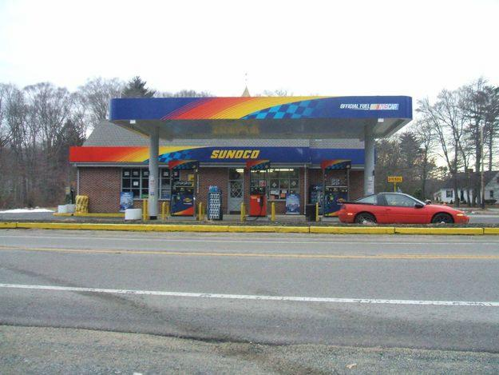

Slide 3
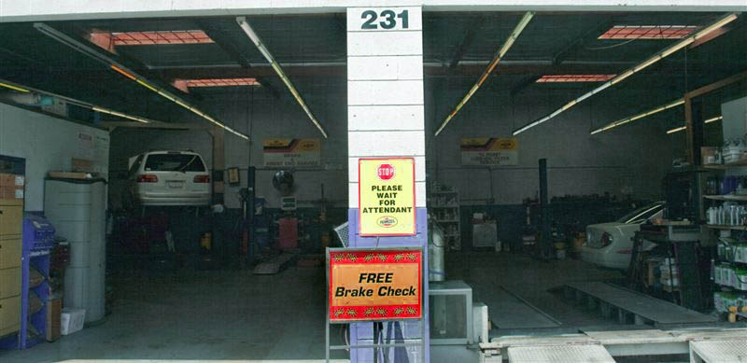
Dark Corners with water drips

Slide 6
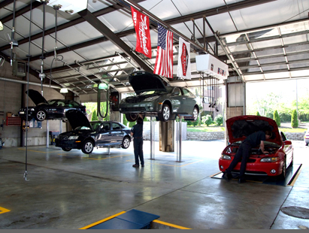

Slide 7
Pop trap door
http://www.youtube.com/watch?v=tBkGudFiOgg

Slide 9
Bang bang, bang!!!!!

Slide 10
This sucker is tight

Slide 11
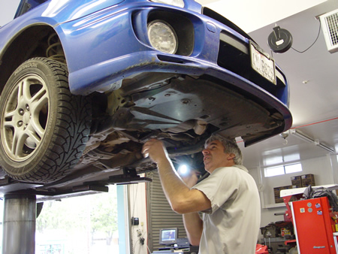
Hey kid, there is something wrong with this car!!!!

Slide 12
Caught between 2 stages

