Slide 1
Rick Owens
American designer b 1961

Slide 2
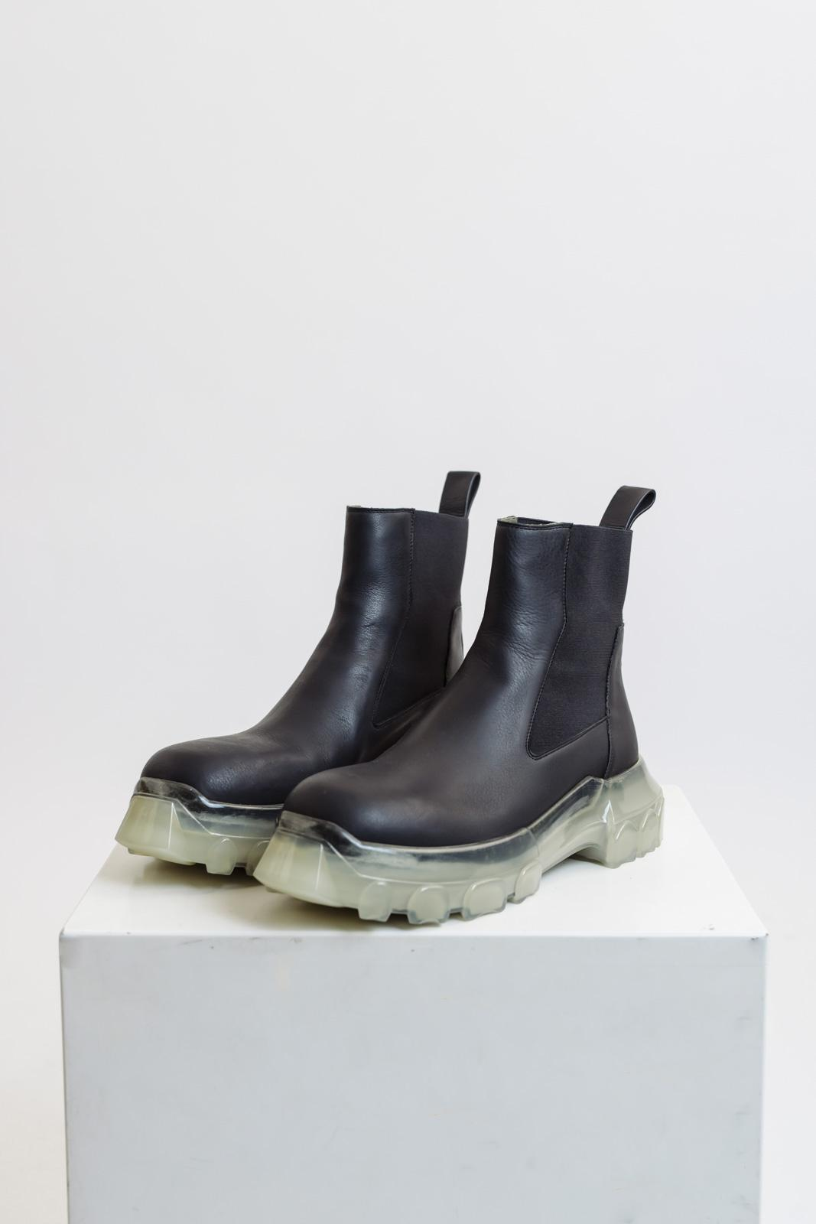
Rick Owens was known for having somewhat of a dark and gothic grunge upcoming which was displayed in his clothing . Owens was most known for his leather jackets. Owens was known more for his construction of boots compared to other fashion pieces. The first boot that Owen gained popularity for was the “Beetle” boot, this boot was constructed in his earlier years, it would be the most comparable to today’s chelsea boot, simple yet stylish. Most if not all of Rick Owens boots were made out of leather, The soles would be made from rubber nut always with a few inches or height. This boot appears to have an air bubble in it as well which is what makes it so uniquely shaped at the bottom.

Slide 3
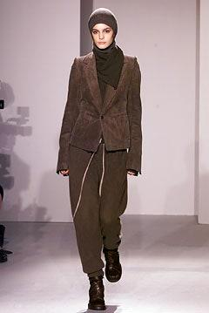
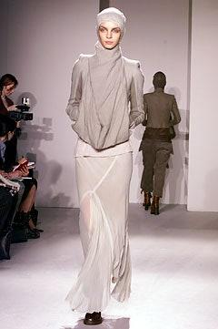
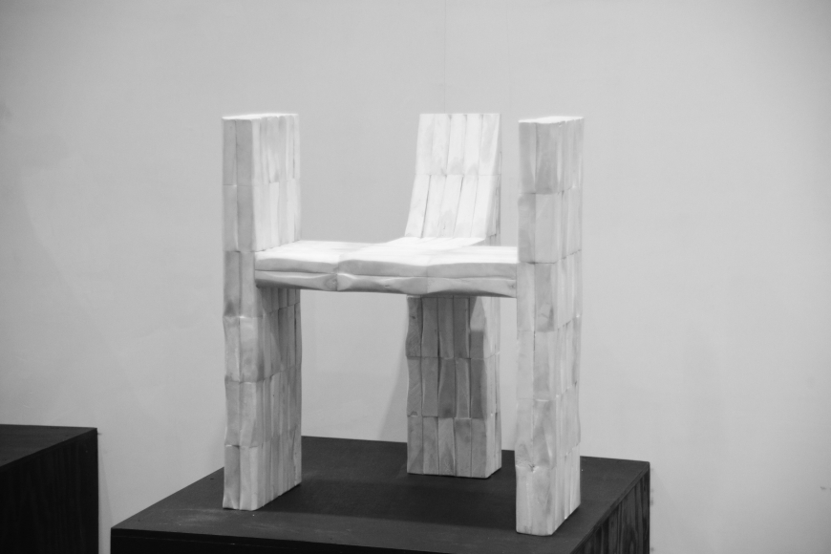
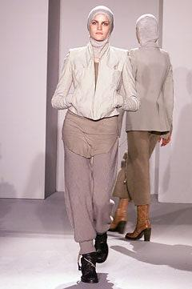
Owen started his fashion design career in 1994 at this time he was working for small fashion business, he worked his way through different design companies until he had his own show in New York during the 2002 and would then move to Paris later that year.
Rick Owen not only designed clothing but he also designed alot of art & furniture, His pieces were not too abstract but were simple enough to be interpreted by the everyday human. The name of this piece is “oxbone:, I would assume it is named this due to the color and seems to be texture of the piece. I feel like the chair was constructed good and even but it wouldn't be easy for someone to casually sit on it because of the shape, the seat is not completely flat.

Slide 4
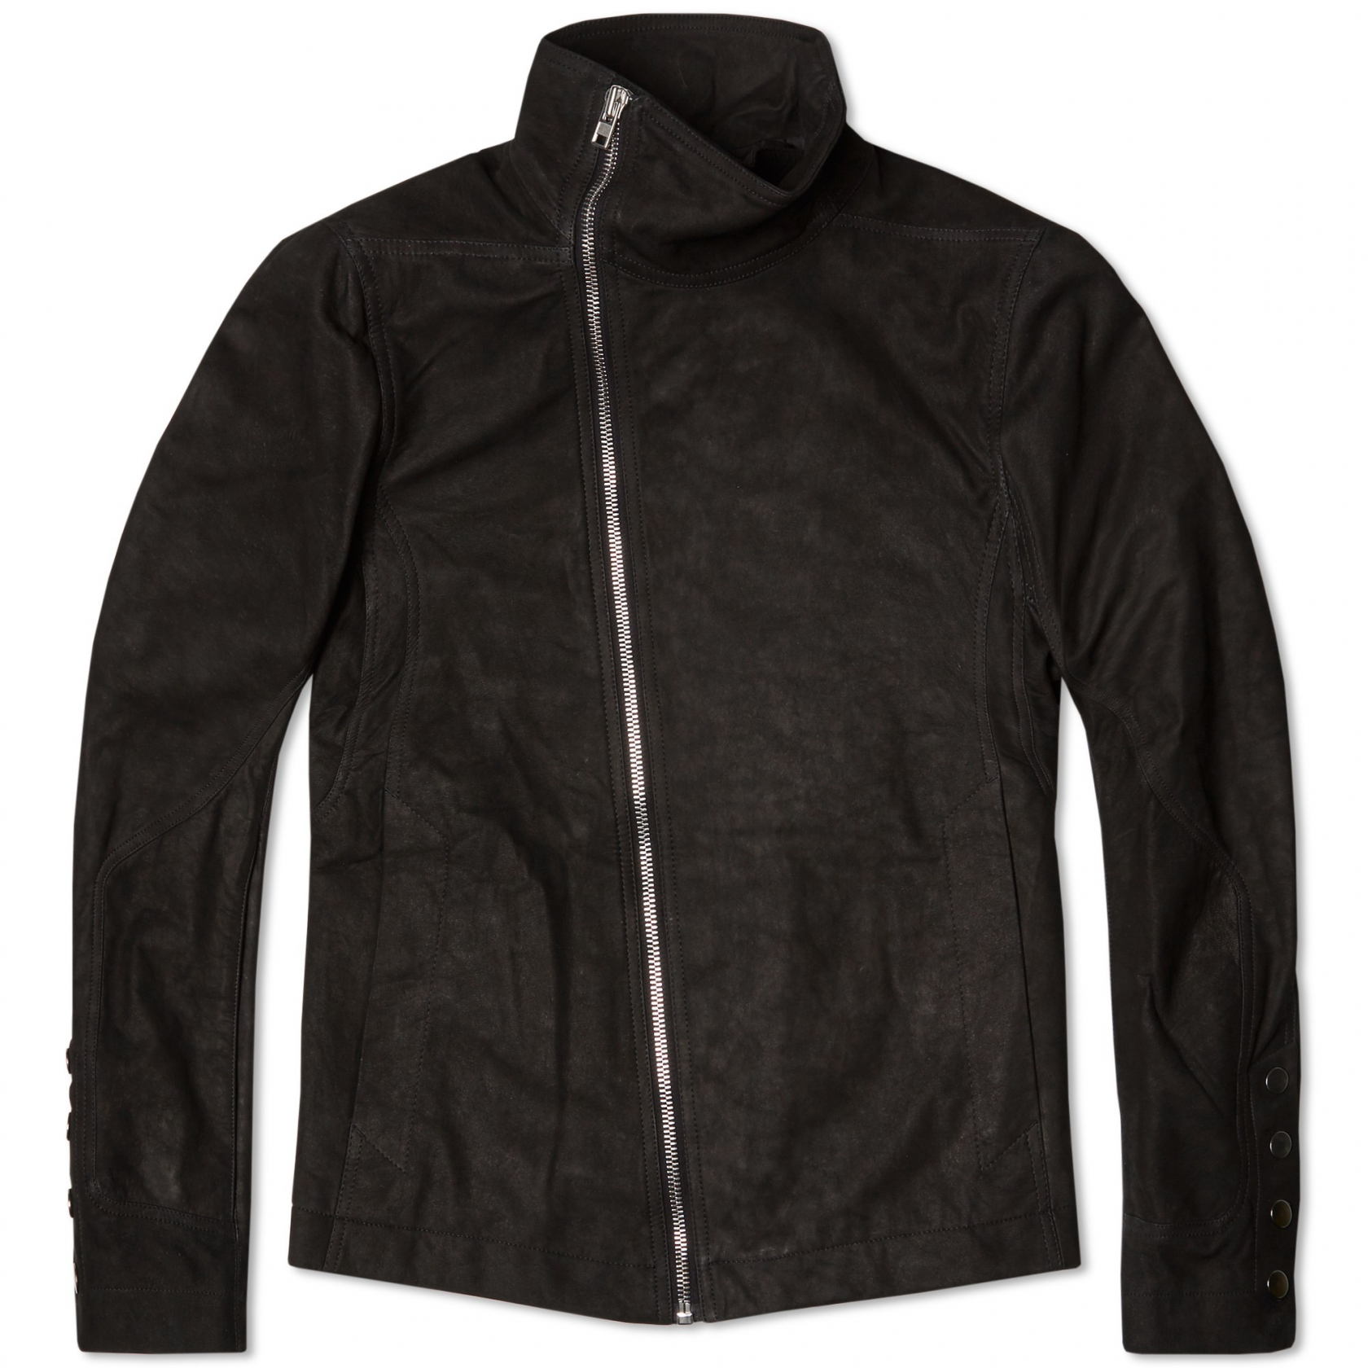
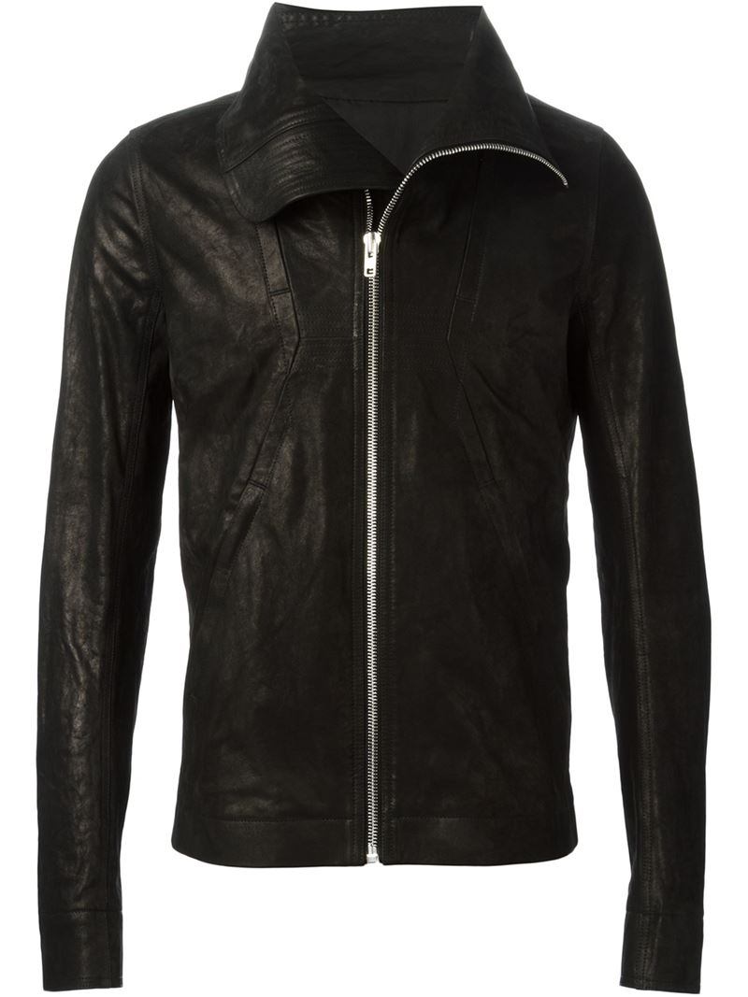
Bauhaus Coat
Geo jacket
This jacket was one of Owen's most famous jackets. Fue to the way it was styled and how the zipper is within the hoodie. Most if not all of Owens Jackets were made mostly of leather. This jacket was one of the first leather jackets which had a zipper lining down the bottom along with a brushed lining of fur.
This jacket is an older version than the one on the left. This jacket is from Owens spring/summer 15 collection. This jacket was made mostly of lamb skin which wasn't so easy to find at the time. This jacket is also slimmer than the other available in the collection. Unlike the left jacket this jacket was simply split down the middle with a zipper.

Slide 5
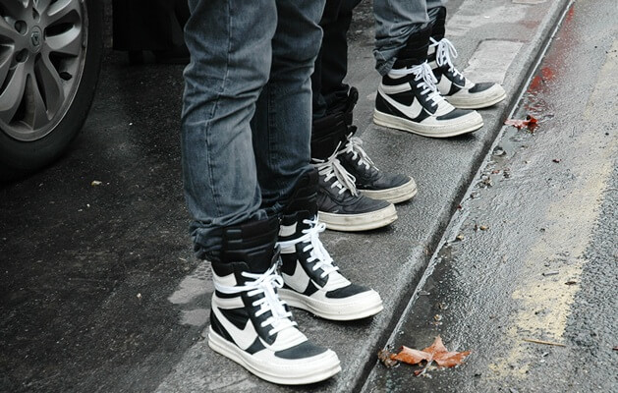
Owens was most likely one of the most famous designers of luxury sneakers..
These two sneakers are ones that are somewhat similar but do have their own special features to them.
Rick Owens Dunks
Rick Owens Geobaskets
Rick Owens “Geobaskets” sneaker is one sneaker that is most recognizable by Rick Owens fans, this shoe is also made of mostly leather and is a high top sneaker. This shoe is the most simple sneaker in the line of all his sneakers, all if not most of Owen’s sneakers are high top laced up sneakers.
Rick Owens “Dunks” is one sneaker that has been redefined. These sneakers were most closely resembling the famous High top Air Jordan 1, The most noticeable difference in this sneaker to the original AF1 is the High top ankle strap along with the white laces which are higher than the original form.

Slide 6
Citations
Anderson, James. “33 Things You Need to Know about Rick Owens.” I, 19 Dec. 2018, i-d.vice.com/en_us/article/mby45x/rick-owens-guide.

