Slide 1
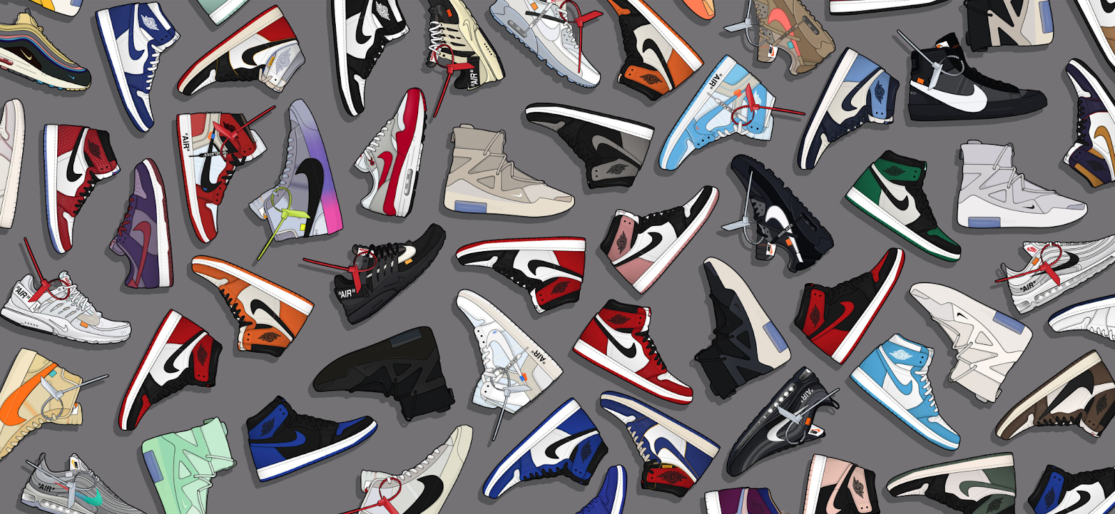
TG REPORT
Fall/Winter 2024-2025
Tanner Jules Gordon & Gerard Allison

Slide 2
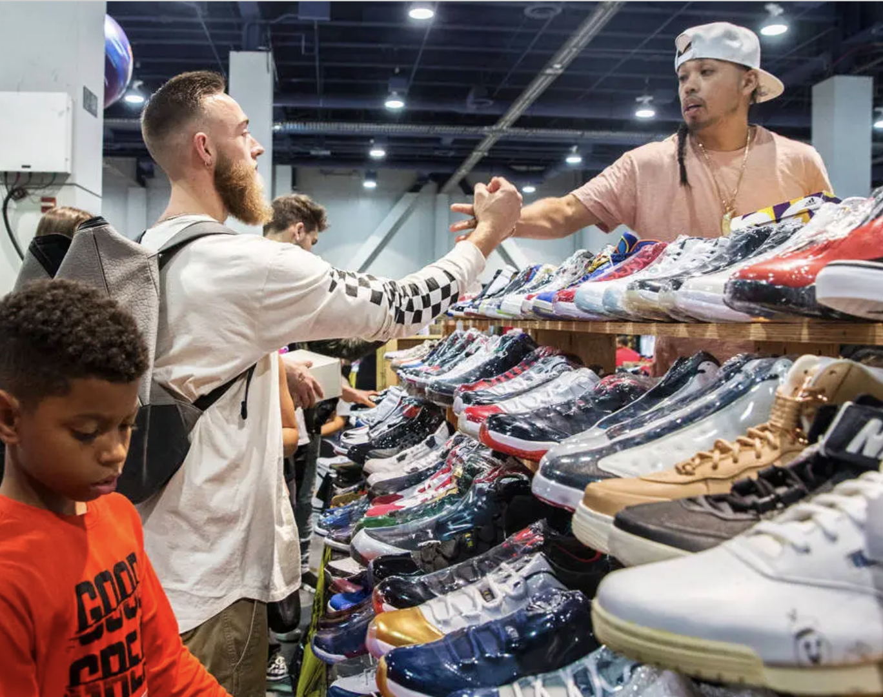
Consumer Profile
TG REPORT Summer/Spring 2024-2025
Demographics
Age - 20 yrs old - 25 yrs older
Within this age range a “sneakerhead” is projected to make about $46,000.
10% or about $4,600 goes towards sneaker purchases (Luber, 2016).
Men are targeted more than females women
Figure 1 : Las Vegas’ first Sneaker Con. Nov 2017
Las Veags very first sneaker con (above) shows us how diverse sneaker culture is, although the diversity can be seen studies show that the biggest race of consumer within the sneakerhead community are African Americans (Oleniacz, 2021).

Slide 3
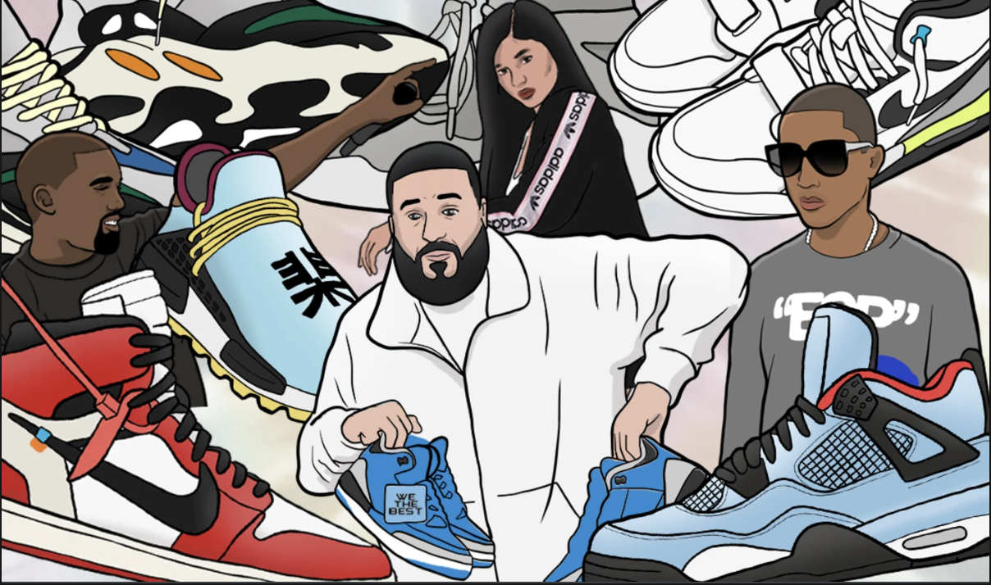
Current Trends & Zeitgeist
Famous artists like Kanye West start to use dark shades and different shades of brown in clothing (THR, 2016)
This led to the popularity of earth tones in many different clothing apparel
The “dad shoe” is now a must have for many peoples closet. It features comfort that other sneakers dont offer (Chan, 2018)
As federal reserve increases price rates and causes the United States to fall into a recession
Figure 2 : Illustration of influential sneaker designers
TG REPORT Summer/Spring 2024-2025

Slide 4
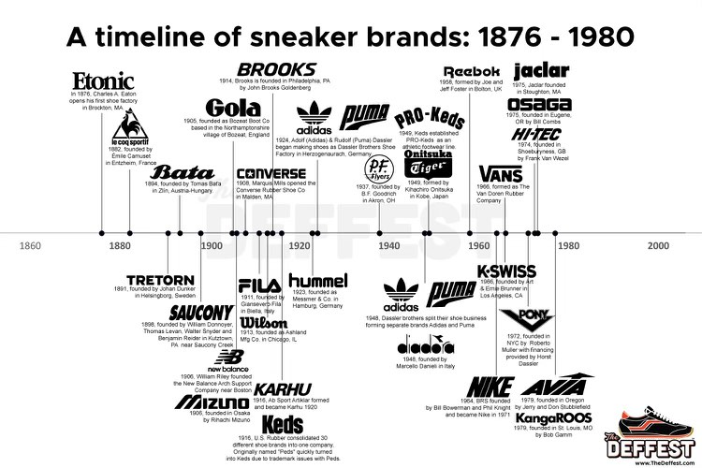
Historical Timeline
TG REPORT Summer/Spring 2024-2025
Figure 3 : Timeline of Sneaker Brands

Slide 5
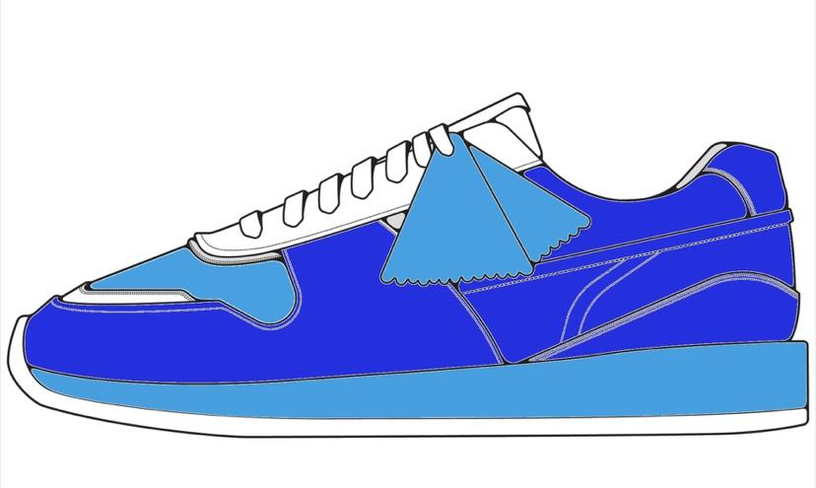
A New Hue
TG REPORT Summer/Spring 2024-2025
In today’s trends we see many dark shades and earth tones being used in sneakers
As we continue to exit Covid and leave the recession people aren’t going to want to be so dull anymore
Consumers are going to start wearing brighter colors
The color that will be trending is Persian Blue
The color blue promotes interaction (Dash, 2021)
Figure 5: Persian Blue Colorway

Slide 6
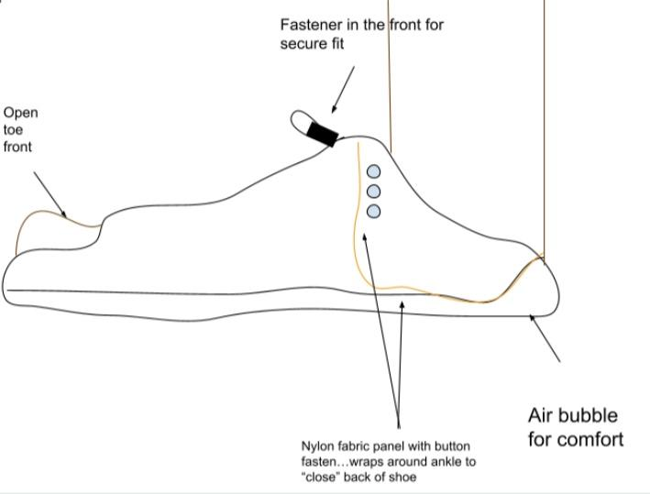
New Style
TG REPORT Summer/Spring 2024-2025
Open toe shoe designs will become more prominent
Toes will become the new erogenous zone
New shoe designs will go against normal footwear
Figure 6: Open Toe Concept

Slide 7
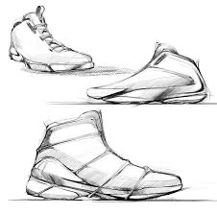
How High
TG REPORT Summer/Spring 2024-2025
The length of sneakers varies due to many considerations (basketball, skating, casual)
Right now low top sneakers are trending like Nike dunks and Air Forces
In 2024-2025 high tops will make a return as people are trying to switch up there style
The length of a sneaker has always been decided by its activity.
Figure 4 : High Top Sneaker

Slide 8
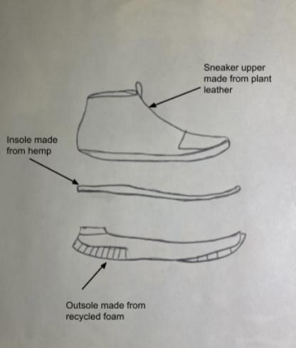
Going Green
TG REPORT Summer/Spring 2024-2025
Historically sneakers have not been made to be eco-friendly
More sneakers will be made to be much more sustainable as fashion moves towards being green
Fabrics such as:
Recycled Plastic
Hemp
Plant Leathers
Coconut Fiber (Cowley, 2021)
When customers shop they will be more eco conscious
Figure 7: Sneaker Textiles

Slide 9
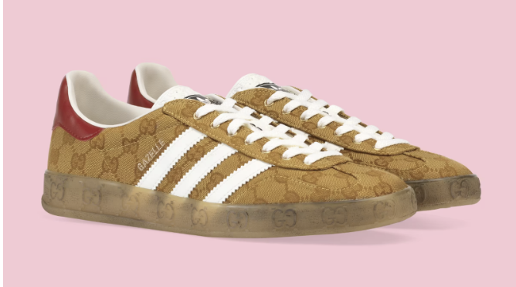
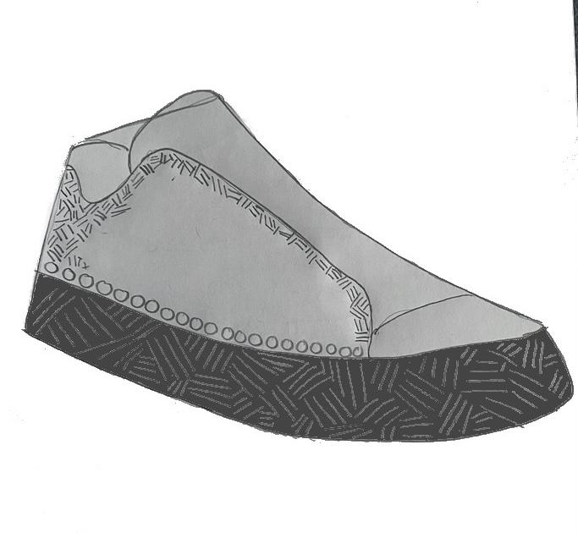
Flashy Feet
TG REPORT Summer/Spring 2024-2025
Most people go for simple colorways and designs
Most times when people are buying sneakers they do not care for designs/patterns
In the upcoming years we will see more animal prints, floral designs, and monograms being featured on sneakers
Figure 8: Adidas x Gucci, 2022
Figure 9: Patterns/Designs

Slide 10
Best Bets!
TG REPORT Summer/Spring 2024-2025
The best bets for the future will be:
Fabric
Color
Pattern
-As we head into a eco-friendly period in time, sustainability will be essential
-The “must have” colors are always changing and consumers will always want the trending new colors
-Wild and crazy new patterns will catch the eye of others which is what people will want after having minimal interaction

Slide 11
Works Cited
TG REPORT Summer/Spring 2024-2025
Cowley, L., J, G., Lin, Janine, Virendra, Ewaliko, D., Liné, Sunquan, Brian, Carlos, J. C., DashDNations, Hekuran, Valerie, NoBossExperience, & Chris. (2021, November 7). 15 best sustainable materials for shoes. Eco World. Retrieved June 21, 2022, from https://ecoworldonline.com/15-best-sustainable-materials-for-shoes/
Published: Jun 19, 2014L. U. S. 7. (2021, September 7). How to use the psychology of colors when marketing. Small Business Trends. Retrieved June 22, 2022, from https://smallbiztrends.com/2014/06/psychology-of-colors.html
Luber, J. (n.d.). Sneakerheads spend 10% of income on kicks - Stockx News. Sneakerheads spend 10% of income on kicks. Retrieved June 20, 2022, from https://stockx.com/news/sneakerheads-spend-10-of-income-on-kicks/
Oleniacz, L. (2021, February 3). Sneakerheads, not hypebeasts: Defining a sneaker-driven sub-culture. NC State News. Retrieved June 20, 2022, from https://news.ncsu.edu/2021/02/sneakerheads-not-hypebeasts-defining-a-sneaker-driven-sub-culture/
VALS. (n.d.). Strategic business insights (SBI) logo. Strategic Business Insights. Retrieved June 20, 2022, from http://www.strategicbusinessinsights.com/vals/ustypes/strivers.shtml

