Slide 1
Gen Ed Committee
Course Coordination Working Group
2014-2016 Summary Report
2016-2018 Planning
May 13, 2016 Gen Ed Meeting
Presenters: Jose Reyes Alamo and Gretta Fernandes
Gen Ed Course Coordination Working Group
New York City College of Technology:
Navid Allaverdi, Alexander Aptekar, Nathan Astrof, Maria-Elena Bilello, Pamela Brown, Renata Budny, Renata Ferdinand, Gretta Fernandes, Asm Delowar Hossain, Jennett Ingrassia, Julia Jordan, Kara Pasner, Susan Phillip, Jose Reyes Alamo, Maura Smale (on fellowship leave: Marta Effinger-Crichlow, Benjamin Shepard)

Slide 2
Gen Ed Committee
Gen Ed Course Coordination Working Group
Goal:
Department Course Coordination led by
Department Course Coordination Liaisons

Slide 3
Gen Ed Committee
Gen Ed Course Coordination Working Group
Goal: Department Course Coordination
Evolution of Course Coordination Efforts
2013-2014 Activities & Accomplishments
Surveyed department chairs regarding course coordination, current practices, definitions and value to the departments
Results of the survey were reported at Chairs Colloquium, Spring 2014
2014-2015 Activities & Accomplishments
Course Coordination definition and responsibilities completed by all departments
Gen Ed Course Coordination Day: Making Gen Ed Live, Thursday, January 22, 2015
Gen Ed was made visible through Course Coordination framework in concert with Living Lab
Selected Course Coordinators reviewed Gen Ed outcomes; developed implementation strategy
Progress reported at Chairs Colloquium and Gen Ed Committee Meeting in Spring 2015
2015-2016 Activities & Accomplishments
Department CC Liaisons conducted Workshops w/full-time and part-time faculty
Progress report meetings with department CC Liaisons and School Deans; sharing best practices
Faculty lead collaborative effort in course coordination and implementation of Gen Ed SLOs in chosen courses, 100% departmental participation
2-year cycle outcomes reported at Gen Ed Committee Meeting and CUE Conference in Spring 2016

Slide 4
Two-year Course Coordination Cycle
Fall 2014 – Spring 2016
2014-2016 Liaison Charge:
Two-year commitment as part of a continuous cycle of defining, delivering, refining, and sharing effective course coordination practices with the Schools and Gen Ed Committees
2014-2016 Long-term Goal:
Design a college-wide framework that supports course coordination, integrates selected Gen Ed SLO/s in each course, and review the process on a cyclical basis in synch with Gen Ed Assessment cycle.
Gen Ed Course Coordination Working Group
(CCWG)
Function: Support
Department Course Coordination Liaison
(CCL)
Function: Course-level Coordination of GenEd SLOs
CCLs Report Plans to School Deans & CCWG
Fall 2015
School Deans
Function:
Charge CCL
CCLs Report Progress to School Deans & CCWG
Spring
2016

Slide 5

Activities: Train the Trainer Workshop
Effective Workshop Design
Participants: Course Coordination Liaisons & Gen Ed Working Group
Spring 2015
In Person Meeting (formal and informal)
Open Lab
(discussion groups)
Emails
Surveys
Phone Conversations
Resources for Effective Workshop Design developed in collaboration with Living Lab can be found at:
https://openlab.citytech.cuny.edu/livinglab/train-the-trainers-workshop/

Slide 6
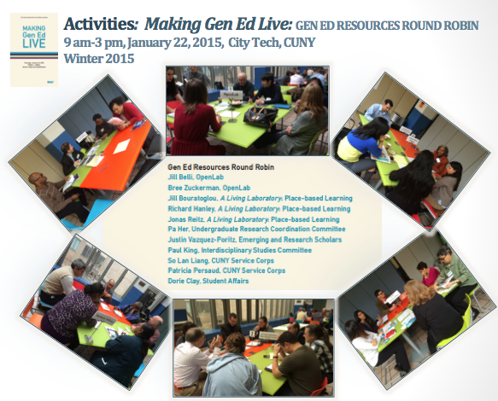

Slide 7
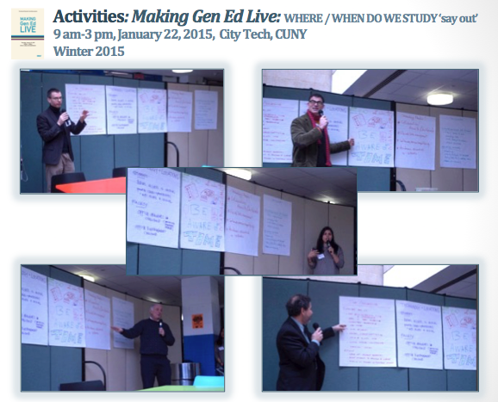

Slide 8
Gen Ed CC Working Group Website
Developed by Prof. Jose. M. Reyes Alamo, Computer Engineering Technology, NYCCT
Gen Ed CC Working Group website: https://openlab.citytech.cuny.edu/gened/working-groups/course-coordination/
Gen Ed CC Working Group Documents: https://openlab.citytech.cuny.edu/gened/working-groups/course-coordination/ccdocuments/
Notes:
Our Website is an example of what came out of the collaboration between Gen Ed CC Working Group and Department Liaisons. Now all our documentation is in one place easy for all involved to find and access.

Slide 9
School Progress Meetings with Department CC Liaisons
Gen Ed CC Working Group
Fall 2015 & Spring 2016
Approaches to Gen Ed SLOs Implementation
Varied Gen Ed SLOs
Assessment Strategies
One Course
Multiple Courses
Curriculum Specific Courses
Interdisciplinary Courses
Entire Curriculum
Visual Tools
Testing Tools
Assessment Tools
Students Feedback
Faculty Feedback
Reviewing courses on the cyclical basis

Slide 10
School Progress Meetings with Department CC Liaisons
Gen Ed CC Working Group
Fall 2015 & Spring 2016
Outcomes:
100% of departments (28) are engaged in course coordination; ~50% departments were previously conducting Gen Ed related activities as part of departmental accreditation requirements.
Departments are at various stages of the course coordination cycle due to different approaches and priorities.
Full- and part-time faculty implement and assess Gen Ed SLOs in various sections of the course(s) and are included and engaged in an ongoing course coordination process at the department level.
The coordination process is now transparent, intentional and valued

Slide 11
School Progress Meetings with Department CC Liaisons
Gen Ed CC Working Group
Fall 2015 & Spring 2016
Identified Challenges
Discrepancies in transfer of knowledge between courses
Discrepancies in transfer of knowledge from faculty to students
Lack of standardization across all sections of the course
Lack of faculty discussion about calibration in multiple sections
Lack of adjunct faculty integration
Lack of systematic approach to use feedback for course improvement from students and faculty, especially adjuncts

Slide 12
Next Steps: 2-year Course Coordination Cycle
Fall 2016 – Spring 2018
2016-2018 Course Coordination Liaison Charge:
A two-year commitment to lead course-level improvement of student learning and the student experience. Course coordination liaisons (CCL) will work with course instructors, other members of their department/chairs, fellow liaisons, deans, members of the Gen Ed and Assessment Committees and others to evaluate course content, course materials and pedagogical practices, and implement, reassess, and share effective course coordination practices.
Department
Gen Ed Liaison
Supported by
Gen Ed Committee
Collaboration based on department, college/university, and professions specific goals
Department Course Coordination Liaison
Supported by
Gen Ed Course Coordination Working Group
Department Assessment Liaison
Supported by Assessment Committee

Slide 13
School of Professional Studies
Acknowledgements:
2014-2016 Department Course Coordination Liaisons
School of Technology and Design
Joseph Bohm, Health Services Administration
Jierong Cheng, Business
Susan Davide, Dental Hygiene
Mery Diaz, Health and Human Services
Jeannette Espinoza, Law and Paralegal Studies
Eric Lobel, Radiologic Technology and Medical Imaging
Lisette Santisteban, Nursing
Avis Smith, Restorative Dentistry
Joseph Sollecito, Vision Care Technology
Claire Stewart, Hospitality Management
Hon Jie Teo, Career and Technology Teacher Education
Celeste Waddy, Nursing
David Smith, Dean
Steven Brodeur, Communication Design
Catherine Cullen, Environmental Control & Facilities Management
Asm Delowar Hossain, Electrical and Telecommunications Engineering Technology
Jason Montgomery, Architectural Technology
Doug Moody, Computer System Technology
Hamidreza Norouzi, Construction Management and Civil Engineering Technology
Kevin Patton, Entertainment Technology
Yu Wang, Computer Engineering Technology
Ozlem Yasar, Mechanical Engineering Technology
Kevin Hom, Dean
School of Arts and Sciences and the Schwerin Library
Nadia Benakli, Mathematics
Denise Scannell-Guida (on fellowship leave), Sandra Cheng, Humanities
Jean Hillstrom, Social Science
Stephen James, African American Studies
Lufeng Leng, Physics
Anne Leonard, Library
Jeremy Seto, Biological Sciences
Peter Spellane, Chemistry
Julian Williams, English
Karl Botchway, Dean (on fellowship leave), Justin Vazquez-Poritz, Interim Dean

Slide 14
School of Professional Studies
Acknowledgements:
2016-2018 Department Course Coordination Liaisons
School of Technology and Design
Joseph Bohm, Health Services Administration
Jierong Cheng, Business
Kerin Coughlin, Law and Paralegal Studies
Susan Davide, Dental Hygiene
Anthony DeVito, Radiological Technology and Medical Imaging
Mery Diaz, Health and Human Services
Kylie Garcelon, Hospitality Management
Margaret Rafferty, Nursing
Avis Smith, Restorative Dentistry
Joseph Sollecito, Vision Care Technology
Hon Jie Teo, Career and Technology Teacher Education
Zoya Vinokur, Radiologic Technology and Medical Imaging
David Smith, Dean
Sharon Clarke, Communication Design
Catherine Cullen, Environmental Control & Facilities Management
Asm Delowar Hossain, Electrical and Telecommunications Engineering Technology
Xiaohai Li, Computer Engineering Technology
Jason Montgomery, Architectural Technology
Doug Moody, Computer System Technology
Hamidreza Norouzi, Construction Management and Civil Engineering Technology
Kevin Patton, Entertainment Technology
Ozlem Yasar, Mechanical Engineering Technology
Kevin Hom, Dean
School of Arts and Sciences and the Schwerin Library
Nora Almeida, Library
Stephanie Boyle, Social Science
Renata Ferdinand, English
Stephen James, African American Studies
Lufeng Leng, Physics
Grazyna Niezgoda, Mathematics
Denise Scannell-Guida, Humanities
Jeremy Seto, Biological Sciences
Peter Spellane, Chemistry
Justin Vazquez-Poritz, Interim Dean

Slide 15
Gen Ed Course Coordination Working Group
2014-2016
Navid Haji Allahverdi, Construction Management and Civil Engineering Technology
Alexander Aptekar, Architectural Technology
Nathan Astrof, Biological Sciences
Maria-Elena Bilello, Dental Hygiene, Co-chair
Pamela Brown, Assistant Provost
Renata Budny, Restorative Dentistry, Co-chair
Marta Effinger-Chrichlow, African American Studies
Renata Ferdinand, English
Gretta Fernandes, Health and Human Services
Asm Delowar Hossain, Electrical and Telecommunications Engineering Technology
Jennett Ingrassia, Radiologic Technology and Medical Imaging
Julia Jordan, Faculty Commons
Kara Pasner, Vision Care Technologies
Susan Phillip, Hospitality Management
Jose Reyes Alamo, Computer Engineering Technology
Benjamin Shepard, Health and Human Services
Maura Smale, Library

Slide 16
Comments and questions are appreciated.

