Slide 1
The Elements of Fiction
From “The Elements of Fiction” by Ann Chaters

Slide 2
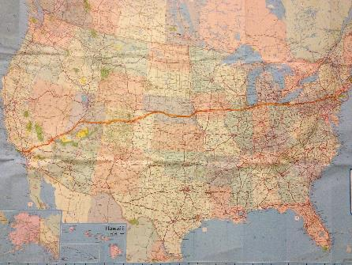
Plot
The sequence of events in a story and their relation to one another as they develop and usually resolve a conflict
The interaction of character and circumstance
Usually in a coherent time frame
Answers what happens
Answers why did it happen

Slide 3
Character
The people who make something happen or produce an effect
They perform the action of the plot
Created by details about
Appearance
Actions
Responses

Slide 4
Character
Round
Complex, real, capable of alternatives, believable responses to situations
Flat
Lacking depth, undeveloped
Dynamic
Character changes in the course of the story
Static
Character remains the same throughout

Slide 5
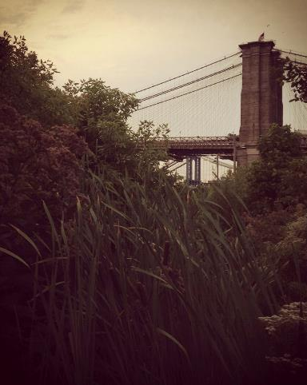
Setting
The place and time of the story
The illusion of a solid world in which the story takes place
A sense of place is necessary for readers to engage in the characters’ situations
Has dramatic use
Affects the characters or plot

Slide 6
Point of view
First-person narration
“I”
Narrator, participant
Third-person narration
“he,” “she,” “they”
Narrator, nonparticipant
A major character
A minor character
Limited authority
Not always trustworthy
Omniscient (sees into the minds of all characters)
Limited omniscient (sees into one or two of the characters’ minds)
Objective (sees into none of the characters’ minds, detached)

Slide 7
Style and Voice
Style
The characteristic way an author uses language
Rhetorical patterns (sentence length/complexity, word choice, placement, punctuation)
Voice
The total effect of the author’s rhetorical or stylistic choices

Slide 8
Tone
Conveys the author’s unstated attitudes toward the story
Symbol
Anything in a story’s setting, plot or characterization that suggests an abstract meaning to the reader in addition to its literal significance
Allegory
When all of the characters, places, things, and events represent symbolic qualities, and their interactions are meant to reveal a moral truth

Slide 9
Theme: A generalization about the meaning of a story
First…
Then…
“Boil down” the meaning of a story to one sentence
Check to see if this statement is true to any and all of the specific details in the narrative

Slide 10
So just read it!
“Finding a summary of the plot or a statement of the theme does not mean that you understand a story and so can skip reading it, however. The theme or meaning of any good story is inseparable from the language of the complete narrative. In fact, the way the writer fleshes out a dramatic structure to embody the theme is, in the final sense, the most important achievement of the story, infinitely more significant than the bare theme standing alone in its unconvincing nakedness on a sheet of notebook paper.”

