Slide 1
Checking in
Who’s working on an annotated bibliography, also known as the RAB?
What questions do you have?
What’s confusing you?

Slide 2
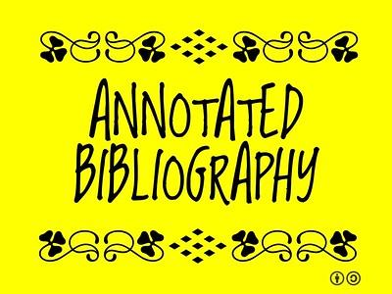
What does RAB stand for?
Reflective: Looking at something closely to see what it is and how it works… including things we’ve done!
Annotated: Annotate means “to mark.” We annotate – mark up something – so we can think more carefully about it. So we can explain it.
Bibliography: Comes from Latin “biblio” meaning books, and “graphia” meaning writing. So it’s writing down about books. It has come to mean a list of books and other materials.
Why do we use annotated bibliographies? To save us a whole lot of time and aggravation!
In other words, it’s a list of sources that we make notes about and then think about what those notes mean to us.

Slide 3
Annotated Bibliographies…
Metri, Angela Elizabeth. “The Importance of Design.” Medium, Medium, 9 July 2019, https://medium.com/@aemetri/the-importance-of-design-187c3ce45961
The article contains basic information to introduce people to design. It gives information about how design has evolved throughout the years with different companies attempting to master their brand design for the industry. For example, designers developed infographics to make it simple and easy to understand what they want to convey. These came from basic sketches and drawings used to create a new language without using words. The article also says that one way to know how to understand what design is by learning the technical side behind it. The easier it is to use a design, the better the design. If the design is bad then that means we wouldn't be able to use it as easily. That's the very basis of how the eye can distinguish a good and bad design.
This article was published in 2018 which isn't that long ago and still is relevant since it talks mostly about the general history and what design is on paper. Medium.com is a known platform where people are allowed to post essays or blogs about whatever topic they want. Some are written by professionals and others are written by normal people wanting to express their opinions. The author of the article is a writer but although they aren't a designer themselves, they stated the sources used to speak about what design is in their essay.
I would use this info to simply state the basics about design and to introduce the audience to what I will be speaking about.

Slide 4
So what IS an RAB?
It is a reflective analytical annotated bibliography.
A list of books and other sources/genres that we summarize…
…then examine more closely in terms of audience and author and purpose so that we can really understand how each source works to create its message...
…and finally say what our opinion is of what the sources say… what we’ve learned and/or need to learn more about and/or why this is important and/or who else needs to know about this and why.
In other words, it’s a list of sources we make notes about and then say what we think about the sources.

Slide 5
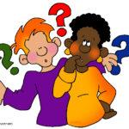
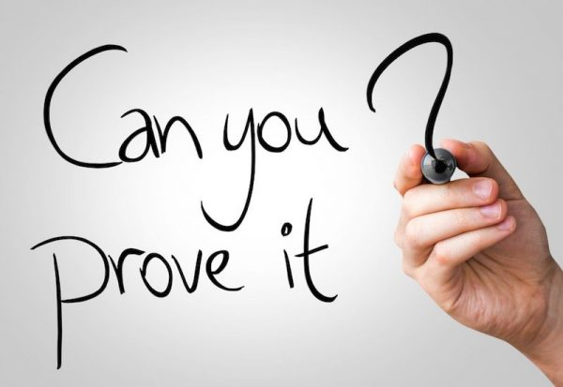
What the RAB isn’t
It is not a persuasive paper where you take a position and proving it. An RAB starts with questions instead of answers - it’s about curiosity!
It is not a high school academic research report. An RAB is information gathered for a larger purpose (curiosity!)
It is not library only research. An RAB asks you to look everywhere!
Peer-reviewed journal articles in the library
Credible websites and news organizations
Credible videos and podcasts
Interviews and field work that you do

Slide 6
The RAB Assignment (briefly)
Introduction
Source Analysis of three sources in different genres, each with:
Bibliographic information
Summary including 2-3 key quotes
Rhetorical analysis
Conclusion/Reflection

Slide 7
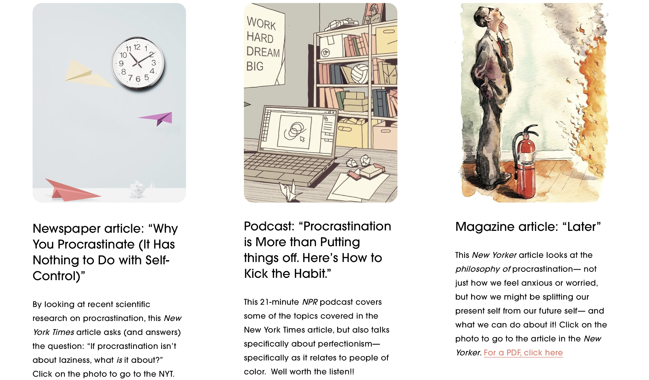
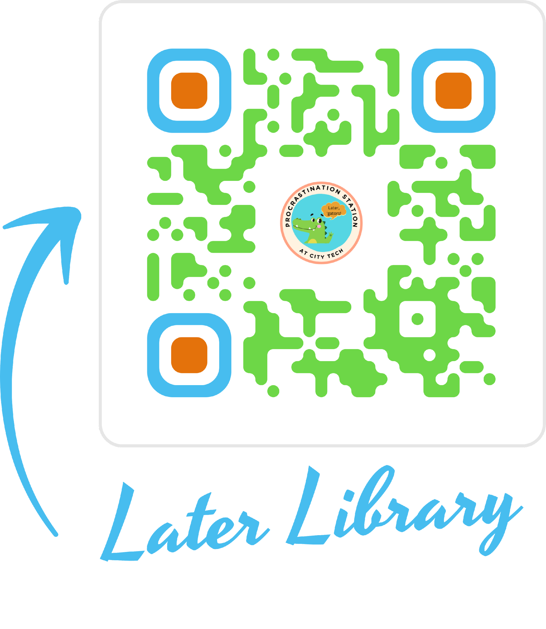
An Example to Share in Class
The Later Library on the Procrastination Station

Slide 8
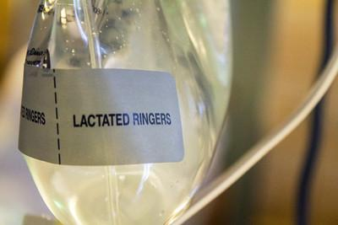
First stop – find a question and do research!!
All research starts with an idea… a question, something you’re REALLY curious about. Why is the Great Barrier Reef dying?
Ask questions about it: who, what, when, where, why, how [KWL+ activity]
Go do a little research (yes, you can start with Wikipedia [and Google] as long as you don’t quote the Wiki page – the references and links can give you great places to find more information.)
Don’t overlook field work – interviews that you do yourself. If the topic is current, and it affects people, then their opinions can be combined with more “expert” information to make for a great bibliography (and you annotate it the same way).

Slide 9
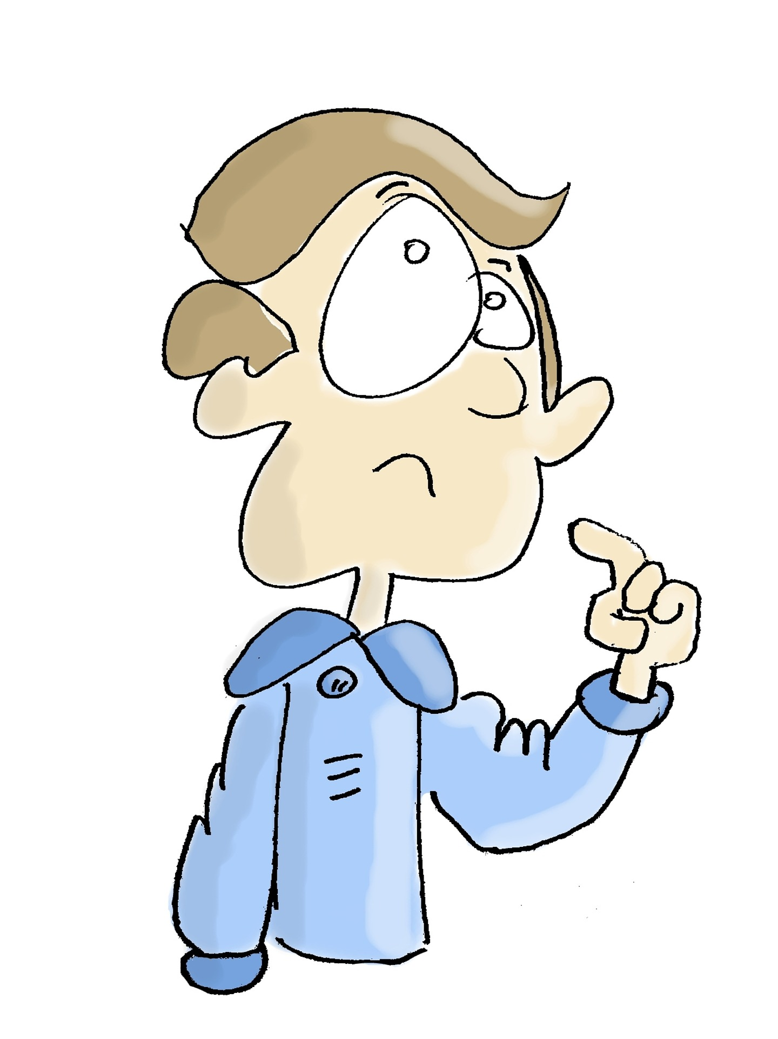
Introduction
Introduce your question/topic.
Explain why it interests you.
Tell us what you wish to find out more about. Get curious!
This part is personal so you can use “I” – it’s your topic! (you can even think of the introduction as your proposal… or your proposal as your introduction…)
Example from an ENG 1101 class a student did on veganism. Introduction

Slide 10
Source Analysis
Bibliographic information
One-paragraph summary with Integrated quotes
One-paragraph rhetorical analysis
(author, credibility, context, use of language, use of visuals)
The word “I” does not appear anywhere in a source analysis unless you’re adding your own personal reflection about each source.

Slide 11
Source Analysis (from the assignment sheet)
THREE source analyses in alphabetical order (at least 400 words each). Mix up the genres. That is, you can’t have three magazine articles or three YouTube videos. Do NOT include your personal opinion anywhere in any of this section – save that for the Reflection/Conclusion.
Bibliographic entry. Use something like easybib.com or the Purdue OWL (go to Research & Citation –> MLA) to help you get the formatting correct. This is NOT just the URL.
1-paragraph Summary of the source’s content including 2-3 Key Quotes.
1-3 paragraph Rhetorical Analysis:The author/publication: credentials, credibility, timeliness of both the author and the publication/website.
The audience: who are they, and how do you know?
The context: this is NOT the purpose of the piece but the larger context it’s been created in (climate change is the context, NOT teaching people about sea animals which is the purpose of the piece)
The purpose – why did the author write this? Information, persuasion, entertainment, a combination?
Discussion of form and language – tone (funny, satirical, serious, combination), appeals (logos, ethos, pathos), the genre, how visuals and text work together.
If there are visuals, how they are used either alone or together with text?
Example from an ENG 1101 class a student did on veganism. Source Analysis

Slide 12
Conclusion/Reflection
Briefly summarize what you learned from doing this research. What surprised you? How did your thinking on the question/topic deepen or change? What happened to your initial question?
What do you think about these ideas (time to use “I” and give your own ideas!) Do you think the authors supported their ideas well and made their point, or not, and why (Avoid simply agreeing or disagreeing with the author; explain your full reaction. Quote particular sentences to which you are responding.)? What questions do you have about what the author said? What don’t you understand? What other information do you need to (or did) look up to better understand this source? If you could say something to the author(s), what would you say? Which genres worked best to answer your questions? Why?
Why you think this is important, who you think should hear about it.
Example from an ENG 1101 class a student did on veganism. Conclusion

Slide 13
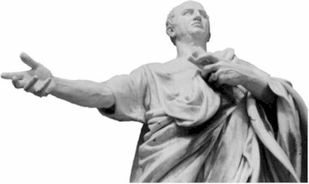
Rhetoric and rhetorical analysis
Don’t panic!!!
Ancient Greece – no text messages, no Instagram, no books! You had to talk to get your message across.
Rhetor = speaker
Rhetoric = rhetor (speaker) + ic (pertaining to) = how a message is put together to make an audience react a certain way.
And that’s something we can analyse!

Slide 14
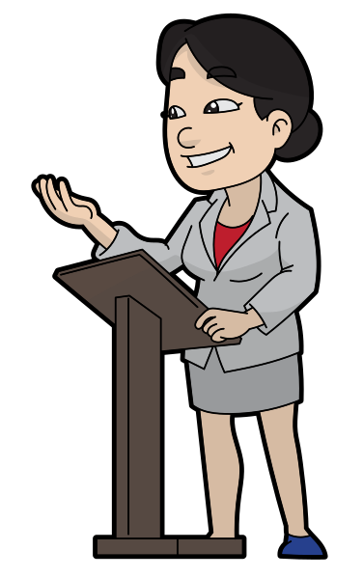
Rhetorical Situation
Any communication act is rhetorical – somebody is putting together a message to get somebody else to pay attention
To inform
To persuade
To entertain
To all three!!!
And we can look at how that happens using…

Slide 15
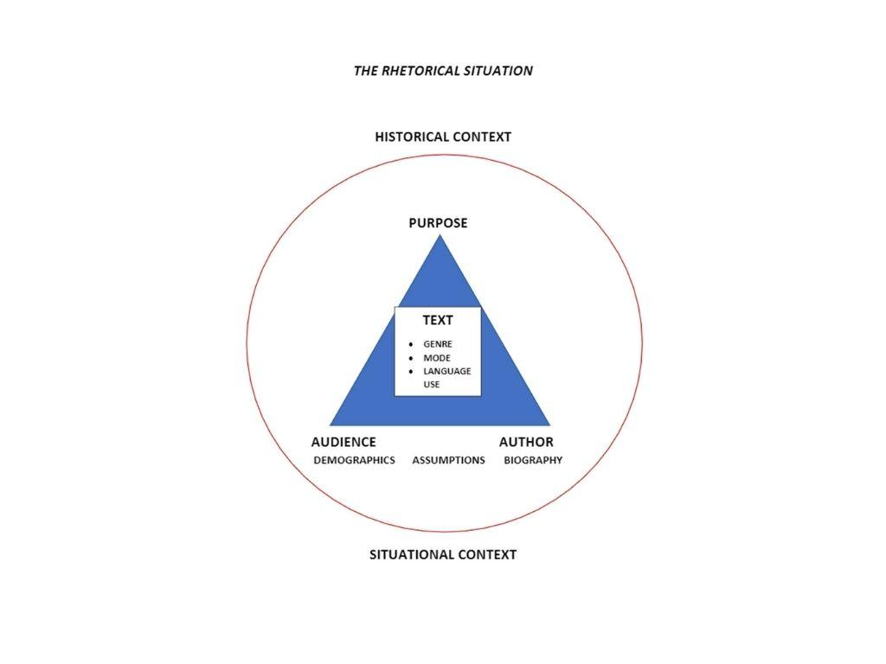

Slide 16
Let’s try it!
Think back to the last argument you had…
Who started it?
Who was on the other side of it?
Where were you (location)?
Was it in person? Text message?
What was the first person trying to do?
What was the purpose of the argument?
What does this have to do with the RAB?

Slide 17
Creating the RAB Source Analysis section
Metri, Angela Elizabeth. “The Importance of Design.” Medium, Medium, 9 July 2019, https://medium.com/@aemetri/the-importance-of-design-187c3ce45961
Bibliographic entry… easy
Summary… One paragraph saying what’s in the source: the main idea and the evidence that supports that idea. NO OPINION FROM YOU!!! Include quotes that you found in your source.
Rhetorical Analysis… One paragraph that talks about the rhetorical situation (there’s that term again!). There are tools to help, starting with…

Slide 18
Tools to analyze each source
The rhetorical situation triangle will help you remember that you’re looking at each point on the triangle as well as the big circle that indicates context.
A rhetorical analysis worksheet will help you gather information on author, audience, purpose, text, and CRAAP (currency, relevance, authority, accuracy, purpose).

Slide 19
Let’s try a couple…
James Baldwin “A Talk to Teachers” 1963
Here’s a worksheet we did in my ENG 1101 class.
Vox article “The surprising link between Covid-19 deaths and… internet access” 16 Mar 2022
Here’s a worksheet we began in class.

Slide 20
A completed RAB/Source Analysis example
This was from an ENG 1101 class. The student’s research question was “what has led to the large rise of veganism, who is responsible for its growth and influence and why has becoming vegan changed the lifestyle of many?”
In her introduction, she talked about how she got interested in this and why she wanted to dig into it.
Here’s one of her source analyses.
In her conclusion, she talked about what surprised her and what she learned.

Slide 21
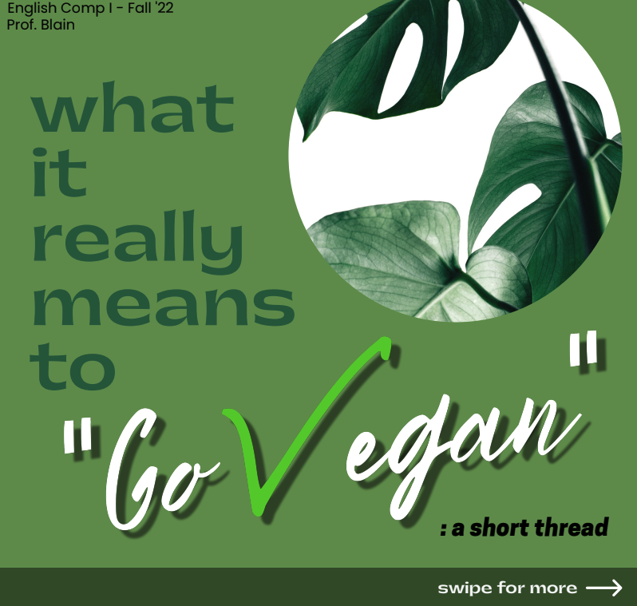
Just for fun…
Here’s the Unit 3 Project that my student created after her RAB on veganism.
It’s an Instagram carousel.

Slide 22
Quick RAB recap
The Introduction:
Gives the research question(s).
Uses “I” because it’s about how you got interested in the topic.
Says what you think you might find in your research.
The Source Analyses:
Three sources from a variety of genres.
Includes bibliographic information, a summary, a rhetorical analysis (author, audience, purpose, language), key quotes.
Does not use “I” because it’s objective and not your opinion
The Conclusion:
Gives your opinion about what the sources say.
Talks about what you learned, what surprised you, what you still want to know.
Uses “I” because it’s your opinion.

Slide 23
What’s the point of all of this?
We’ve looked at how..
An RAB is about questions, not answers, not persuasion. It’s about following your curiosity.
Research isn’t limited to the library.
The rhetorical situation triangle can help us understand any text or communication act.
A rhetorical analysis worksheet can help gather all of that information.
Now take a moment to write down how you think any of this might be useful to you, either in class or in real life.

